Slide 1
Calculus and Analytical
Geometry
MTH 104
Lecture # 13

Slide 2
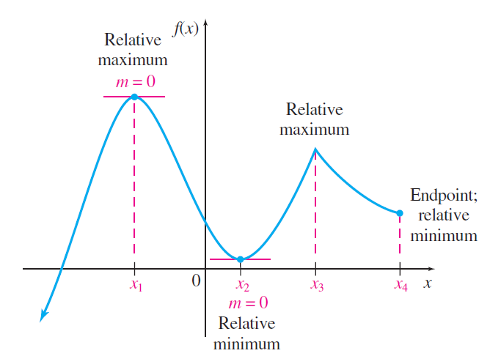
RELATIVE MAXIMA AND MINIMA

Slide 3
RELATIVE MAXIMA AND MINIMA
A function f is said to have a relative maximum at if there is an open interval containing on which is the largest value, that is, for all x in the interval.
A function f is said to have a relative minimum at if there is an open interval containing on which is the smallest value, that is, for all x in the interval
If f has either a relative maximum or a relative minimum
at , then f is said to have a relative extremum at

Slide 4




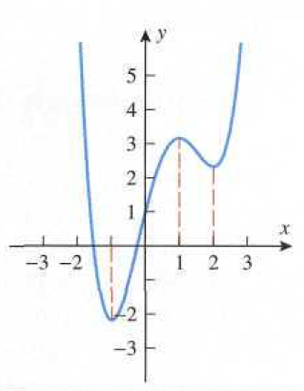
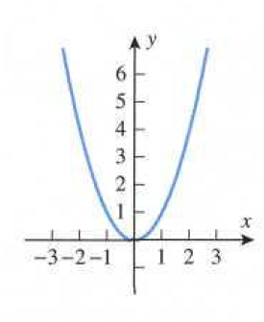
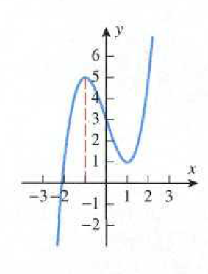
Example

Slide 5
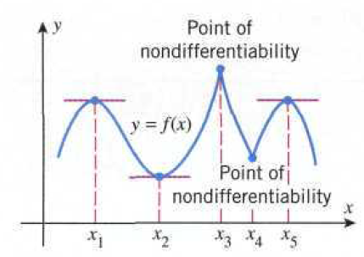
Critical Points
A critical point for a function f to be a point in the domain of f at
which either the graph of f has a horizontal tangent line or f is
not differentiable.
A critical point is called stationary point of
if

Slide 6
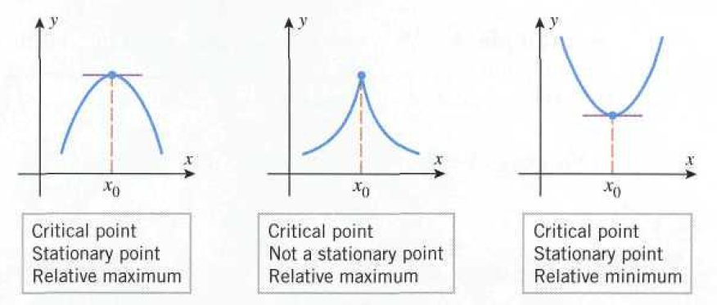
Relative extrema and critical points
Suppose that
is a function defined on an open interval
containing the point
If
has a relative extremum at
then
is a critical point of
; that is, either
is not differentiable at

Slide 7
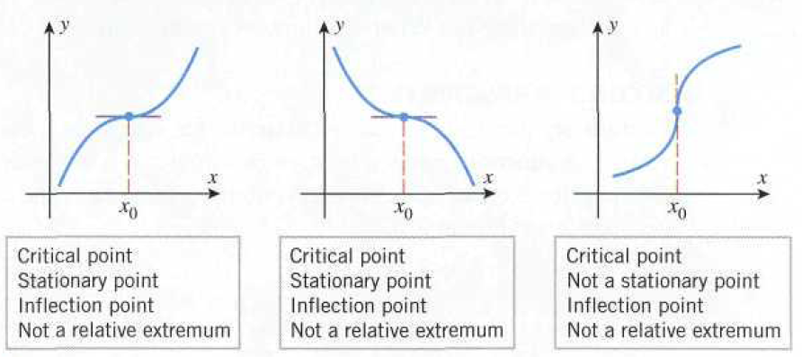
Example
Find all critical points of
Solution
Differentiating w.r.t x

Slide 8
To find critical point setting
Example
Find all critical points of
Solution
Differentiating w.r.t x

Slide 9

and at
does not exist
At
Thus
and
critical points.

Slide 10
Example
Locate the critical points and identify which critical points are
stationary points.
Differentiating w.r.t

Slide 12
setting
Thus x=1 and x=-3 are stationary points.
Stationary points:

Slide 13
First Derivative Test
Suppose that
is continuous at a critical point
1. If
on an open interval extending left from
and
on an open interval extending right from
then
has a relative maximum at
2. If
on an open interval extending left from
and
on an open interval extending right from
then
has a relative minimum at
3. If
has same sign on an open interval extending left
from
as it does on an open interval extending right from
then
does not have a relative extrema

Slide 14
Example
Use the first derivative test to show that
has a relative minimum at x=1
Solution
f has relative minima at x=1
x=1 is a critical point as
Interval
Test Value
Sing of | - | +
Conclusion | is decreasing on | is decreasing on

Slide 15
Second Derivative Test
Suppose that f is twice differentiable at the
(a) If
and
then
has relative minimum at
(b) If
and
then
has relative maximum at
(c) If
and
then the test is inconclusive;
that is, f may have a relative maximum, a relative minimum,
or neither at
Example
Find the relative extrema of
Solution

Slide 16

Critical Points
Setting
are critical points

Slide 17
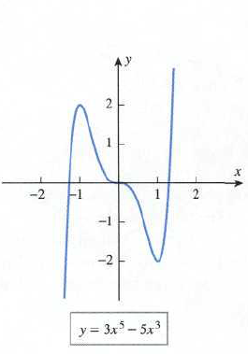
Stationary Point |  |  | Second Derivative Test
 | -30 | - | has a relative maximum
 | 0 | 0 | Inconclusive
 | 30 | + | has a relative minimum

Slide 18
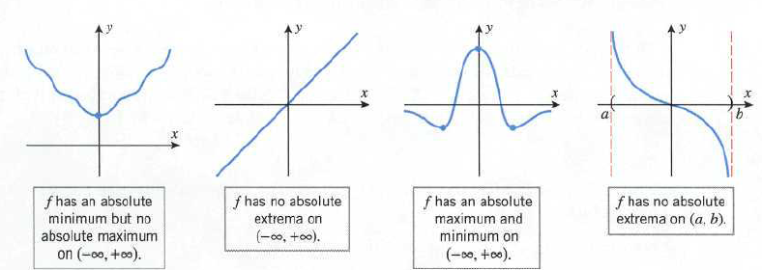
Absolute Extrema
Let I be an interval in the domain of a function f. We say that f
has an absolute maximum at a point in I if
for all x in I, and we say that f has an absolute minimum at
if for all x in I.

Slide 19
Extreme value Theorem
If a function f is continuous on a finite closed interval [a, b] then f has both an absolute maximum and an absolute minimum on [a, b].
Procedure for finding the absolute extrema of a continuous function f on a finite closed interval [a, b]
Step 1. Find the critical points of f in (a, b).
Step 2. Evaluate f at all the critical points and at the end points
a and b.
Step 3. The largest of the value in step 2 is the absolute maximum value of f on [a, b] and the smallest value is the absolute minimum

Slide 20
Example
Find the absolute maximum and minimum values of the function
on the interval [1, 5], and determine where these values occur.
solution
at x=2 and x=3
So x=2 and x=3 are stationary points
Evaluating f at the end points, at x=2 and at x=3 and at the ends
points of the interval.

Slide 21
Absolute minimum is 23 at x=1
Absolute minimum is 55 at x=5

