Slide 1
MTH 104
Calculus and Analytical Geometry
Lecture No. 2

Slide 2
Functions
If a variable depends on a variable x in such a way that each value of determines exactly one value of , then we say that is a function of . For example ,
x | y
-1 | -2
0 | -1
1 | 0
2 | 1

Slide 3
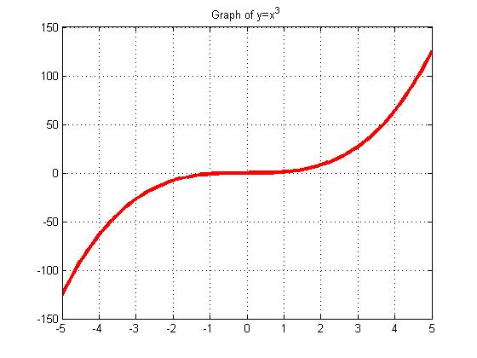
Functions
Functions can be represented in four ways.
Numerically by tables
Geometrically by graphs
Algebraically by formulas
Verbally

Slide 4
Functions
A function is a rule that associates a unique output with each input. If the input is denoted by , then the output is denoted by . Sometimes we will want to denote the output by a single letter, say , and write

Slide 5
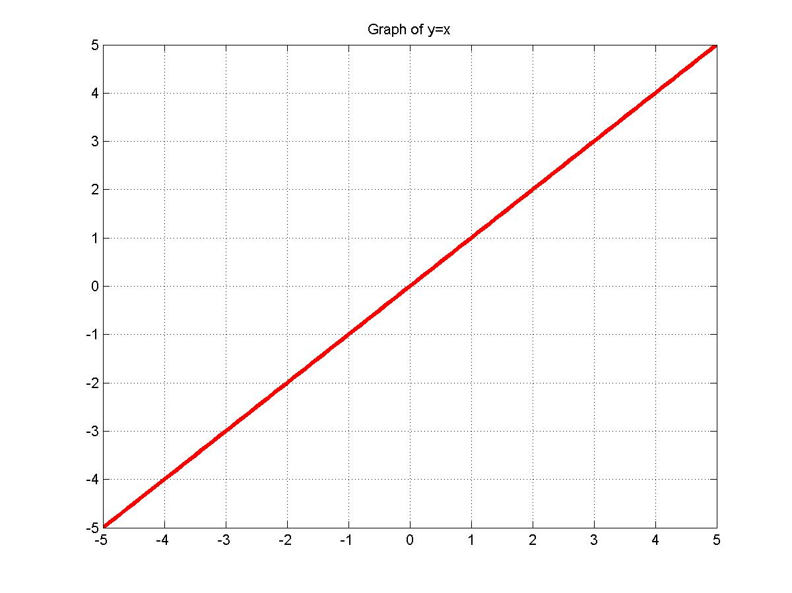
Graphs of functions

Slide 6
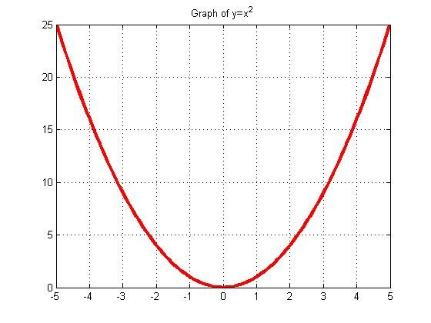
Graphs of functions

Slide 7
Graphs of functions

Slide 8
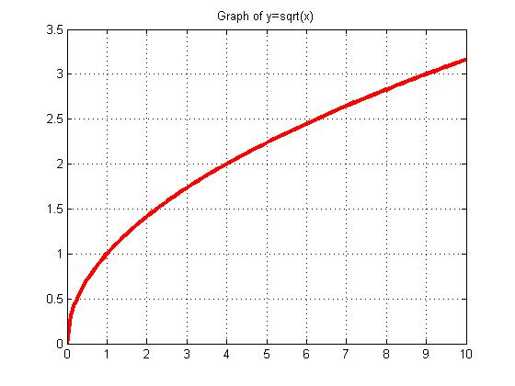
Graphs of functions

Slide 9
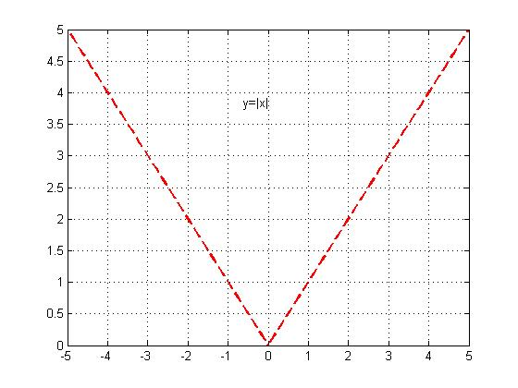
Graphs of functions

Slide 10
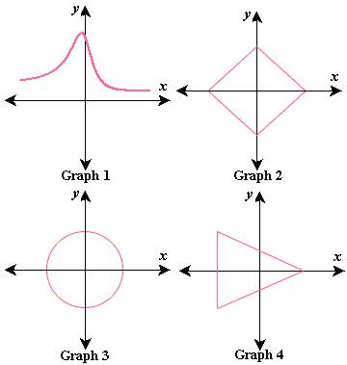
Functions: Vertical line test
The vertical line test. A curve in the xy-plane is the graph of some function if and only if no vertical line intersects the curve more than once.
Consider the following four graphs:

Slide 11
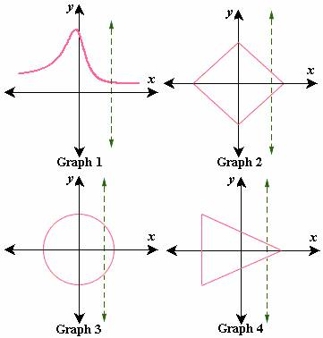
Functions: Vertical line test

Slide 12
The absolute value function
The absolute value or magnitude of a real number is defined by
Illustration:

Slide 13
Properties of absolute values
If a and b are real numbers, then
(i)
(ii)
(iii)
(iv)
Functions defined piecewise. The absolute value function is defined piecewise

Slide 14
Functions: Domain and Range
If and are related by the equation , then the set of all allowable inputs is called the domain of , and the set of outputs that results when varies over the domain is called the range of .
Natural domain:
If a real-valued function of a real variable is defined by a formula, and if no domain is stated explicitly, then it is to be understood the domain consists of all real numbers for which the formula yields a real value. This is called the natural domain of the function

Slide 15
Functions: Domain and Range
Example. Find the natural domain of

Slide 18
Arithmetic operations on functions
Given functions and , we define
For the functions and we define the domain to be the intersection of the domains of and , and for the function we define the domain to be the intersection of the domains of and but with the points where excluded ( to avoid division by zero).

Slide 19
Arithmetic operations on functions
Example 1: Let and . Find the domains and formulas for the functions
Example 2: Show that if , and , then the domain of is not the same as the natural domain of .
Example 3: Let . Find
(a) (b) (c)

Slide 24
Composition of functions
Given functions and , the composition of with , denoted by , is defined by
The domain of is defined to consist of all in the domain of for which is in the domain of
Example Let and . Find
(a) (b) and state the domains of the compositions.

Slide 27
Composition of functions
Composition can be defined for three or more functions: for example is computed as
Example Find if

Slide 28
Expressing a function as a composition
Consider
Let then in terms of can be written as
Example Express as a composition of two functions.

