Slide 1
Regulatory Administrative Institutions
MPA 517
Lecture-9

Slide 2
Recap
Regulatory Intuitions
  Ministry of Commerce
    Mission Statement
    Charter
    Objectives of trade policy
    Functions of Ministry
    Organogram
  Commerce Division

Slide 3
Today’s Lecture
Ministry of Economic Affairs & Statistics
  Economic Affairs Division
  Statistics Division
  Privatization Division

Slide 4
Economic Affairs Division
Economic Affairs Division is responsible for assessment of requirements, programming and negotiations of external economic assistance related to the Government of Pakistan and its constituent units from foreign Governments and multilateral agencies.
The issues regarding external debt management and matters relating to technical assistance to foreign countries, credit to friendly countries on lending / re-lending of foreign loans and monitoring of aid utilization are being handled by this division.

Slide 5
Functions
The functions and responsibilities of the Economic Affairs Division as listed in Schedule II of Rules of Business 1973 are:
Assessment of requirements, programming and negotiations for external economic assistance from foreign governments and organizations.
Matters relating to IBRD (International Bank for Reconstruction and Development), IDA (International Development Association), IFC, ADB and IFAD

Slide 6
  IBRD (The International Bank for Reconstruction and Development (IBRD) aims to reduce poverty in middle-income countries and creditworthy poorer countries by promoting sustainable development through loans, guarantees, risk management products, and analytical and advisory services
  IDA (International Development Association is supporting Pakistan’s efforts to empower the poor with increased incomes and access to services to achieve sustainable livelihoods)
  IFC (International Finance Corporation Investment Services provides a broad suite of financial products-including loans, equity, trade finance, structured finance, and syndications-designed to promote worthy enterprises and encourage entrepreneurship)
  ADB (Asian Development Bank assistance has strengthen Pakistan’s social and environmental safeguards by providing technical guidance, and by improving monitoring and resettlement practices.
  IFAD (International Fund for Agriculture Development)

Slide 7
Functions
Matters relating to technical assistance to foreign countries.
External debt management, including authorization of remittances for all external debt service, compilation, accounting and analysis of economic assistance from foreign governments and organizations.
Review and appraisal of international and regional economic trends and their impact on the national economy. Proposals concerning change in international economic order.
Matters relating to transfer of technology under UNDP assistance.
Matters relating to Islamic Development Bank.

Slide 8
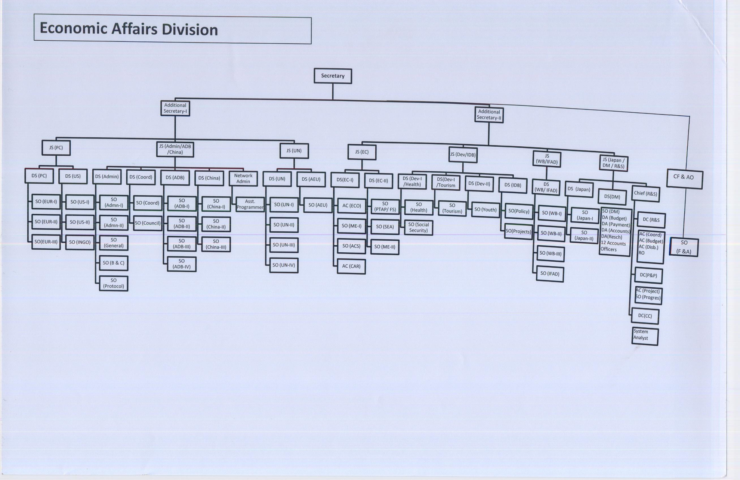

Slide 9
Pakistan Bureau of Statistics- Divisions
Federal Bureau of Statistics, headquartered in Islamabad
Population Census Organization, headquartered in Islamabad
Agricultural Census Organization, headquartered in Lahore

Slide 10
Pakistan Bureau of Statistics
The Pakistan Bureau of Statistics, also known as PBS is a Government of Pakistan's major and executive and federal department charged with the national statistical services and to provide solid and comprehensive statistical research.
The PBS is one of the departments of the Statistics Division of the Ministry of Economic Affairs and Statistics of Pakistan.
The department assists and encourages informed decision-making, research and discussion within governments and the community, by providing a high quality, objective and responsive national statistical service.
PBS compiles statistics from many sources and produces global updates, including the Statistical Yearbook, Pakistan Statistics Handbook and yearbooks in specialized fields of statistics.
It creates statistics on the economy, the government, trade and other fields. It also operates the census for the country

Slide 11
Pakistan Bureau of Statistics- Mission
Pakistan Bureau of Statistics is committed to provide accurate, reliable, timely, comprehensive and user-friendly information to public, private, national and international organizations.
PBS will undertake research, up-to-date its technical knowledge and adopt improved methodologies and new technologies for meeting the future demand of potential users.

Slide 12
Privatization Division
Privatisation is an important policy tool for generating growth and addressing structural imbalances by removing artificial barriers and opening up the economy to competition. Privatisation program is part of the economic reforms agenda of the Government. The Government of Pakistan, therefore, systematically come confining its role to:
Making policy and providing good governance
Providing a sound and effective regulatory framework
Ensuring social equity and economic justice
Providing enabling environment, including physical and technical infrastructure and social services

Slide 13
Objectives of Privatization
The main objectives of privatization are as follows:
To improve the operational efficiency and overall performance of entities proposed to be privatized and to promote competition.
·To reduce the financial burden imposed upon the Government by public enterprises and to release resources for utilization on alternate urgent requirements such as those of the social sectors and the development of physical and technological infrastructure, thereby accelerating the pace of industrialization.
To promote and strengthen the capital market by broadening and deepening its base through enlarging the number of share-holders and listing new enterprises.

Slide 14
Advantages of Privatization
Increase in efficiency and Profitability
Most Govt. industries and services are inefficient and running in losses, when these will be transferred to private sector, their administration will improve and non-development expenditures will be reduced, their efficiency will increase and will be converted into profitable ventures.
2. Increase in Foreign Investment and Export Earnings
Privatization will increase foreign investment when foreigners will purchase them. Their production will increase which will more foreign exchange for Pakistan and if these enterprises are set up by foreign loans, these loans will be repaid out of the sale proceeds, which will reduce the burden of foreign loans.
3. Broaden the Base of Share Capital and Stock Market
Sale of enterprises through stock exchanges will broaden the base of share capital hence stock market will develop, because general public will be in position to purchase their shares and investment opportunities for general public will increase.

Slide 15
Advantages of Privatization
4. Decrease in Political Pressure
There are always political pressures on Govt. owned industries, banks and other institutions for employment of political workers and loan facilities from banks. When these enterprises will go in the hands of private owners then these illegal pressures will be reduced to a great extent.
5. Use of Latest Technology and Know-How
Private domestic investors and foreign investors will adopt latest technology and know-how for the increase in output and their profits. This will result in the increase in national product, thus national income of the country will grow.
6. Decrease in Deficit Budgeting and Increase in Infrastructure
Govt. enterprises usually run into losses and to keep them going. Govt. provides funds every year. After privation, Govt. need not to resort to deficit financing and the funds provided to these enterprises will be utilized for construction of social infrastructure of the economy.

Slide 16
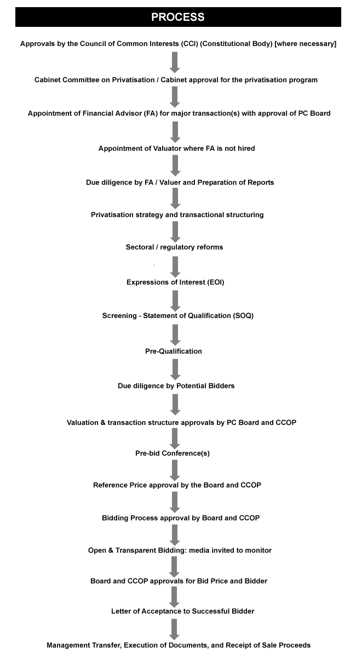

Slide 17
Summary
Ministry of Economic Affairs & Statistics
  Economic Affairs Division
  Statistics Division
  Privatization Division

Slide 18
Next Lecture
Disadvantages of Privatization
Ministry of Privatization

