Slide 1
Regulatory Administrative Institutions
MPA 517
Lecture-8

Slide 2
Recap
Regulatory policy as part of good public governance
  The value of free markets
  Guiding Principles for Regulatory Quality and Performance

Slide 3
Country principles for better regulation
An early example is the set of principles established by the United Kingdom’s Better Regulation Task Force in 1998, an independent advisory body to the government at the time:
  Transparency
  Accountability.
  Targeting.
  Consistency.
  Proportionality

Slide 4
Today’s Lecture
Regulatory Intuitions
  Ministry of Commerce
    Mission Statement
    Charter
    Objectives of trade policy
    Functions of Ministry
    Organogram
  Commerce Division

Slide 5
Ministry of Commerce
MISSION STATEMENT
Contributing to the national economy through trade liberalization and facilitation, improving export competiveness and reducing cost of doing business.
Aim to achieve higher market access for Pakistani products in existing markets as well as new markets with ultimate aim of improving quality of life of the people of Pakistan.

Slide 6
CHARTER OF THE MINISTRY
Under the Rules of Business 1973, Commerce Division is assigned the following functions:
Imports and exports across custom frontiers
Export promotion
Commercial intelligence and statistics
Tariff policy and its implementation
Anti-dumping duties, countervailing duties and safeguard laws

Slide 7
CHARTER OF THE MINISTRY
Inter-Provincial trade
Domestic Commerce
Organization and control of Chambers and trade associations
Law of Insurance and regulation and control of Insurance companies
Administrative Control of Attached Departments/Organizations
Selection of Trade Officers for posting in Pakistan’s Missions abroad

Slide 8
OBJECTIVES OF TRADE POLICY
People centric : Poverty alleviation and employment generation through export led growth
Supply side:
Value addition and Higher Unit Value (e.g.Yarn-Fabric-Textile Chain)
Coordination for Improvement of Infrastructure
Improving competitiveness through reduction in cost of doing business
Facilitating investment in manufacturing sector
Marketing:
Focus on Export Marketing
Better Commercial Intelligence
Trade diplomacy/market access
Diversification of export products and markets

Slide 9
FUNCTIONS
ADMINISTRATION
Administrative, financial and budgetary affairs of main Ministry and affiliated organizations, trade offices abroad and administration of Commerce and Trade Group. PAC/DAC meetings, Insurance & related matters for all the organizations of the Ministry.
Administration of three Governments owned insurance companies i.e. State Life Insurance Corporation of Pakistan, National Insurance Company Limited, Pakistan Reinsurance Company Limited and dispensation of policy as well as legislative/ legal direction.

Slide 10
FUNCTIONS
FOREIGN TRADE
Trade diplomacy and market access initiatives
WTO
Multilateral trade negotiations and compatibility of domestic laws with WTO laws.

Slide 11
WTO
The WTO is a body designed to promote free trade through organizing trade negotiations and act as an independent arbiter in settling trade disputes. To some extent the WTO has been successful in promoting greater free trade.
  Advantages
  Lower prices for consumers. Removing tariffs enables us to buy cheaper imports
  Free trade encourages greater competitiveness. Firms face a higher incentive to cut costs. For example, a domestic monopoly may now face competition from foreign firms

Slide 12
WTO- Advantages
Law of comparative advantage states that free trade will enable an increase in economic welfare. This is because countries can specialize in producing goods where they have a lower opportunity cost.
Economies of scale. By encouraging free trade, firms can specialize and produce a higher quantity. This enables more economies of scale, this is important for industries with high fixed costs, such as car and aero plane manufacture.
Free trade can help increase global economic growth

Slide 13
WTO- Disadvantages
It is argued the benefits of free trade accrue mostly to the developed world.
Free trade may prevent developing economies develop their infant industries.
  For example, if a developing economy was trying to diversify their economy to develop a new manufacturing industry, they may be unable to do it without some tariff protection.

Slide 14
FUNCTIONS
IMPORTS WING
Formulation of Trade Policy in conjunction with other wings. Implementation of import policy initiatives.
EXPORTS WING
Formulation and Implementation of annual Trade Policy, jointly with the Imports Wing. Implementation of Export policy initiatives

Slide 15
FUNCTIONS
ITO WING
Formulating, processing and monitoring of development projects of Ministry and affiliated organizations. Tabulations of Trade Statistics and Analysis based thereon.
TRADE ORGANIZATIONS WING
Registration, Monitoring and Supervision of all Trade Bodies in the country under the Trade Organization Law of 2007. Local trade fairs and exhibitions

Slide 16
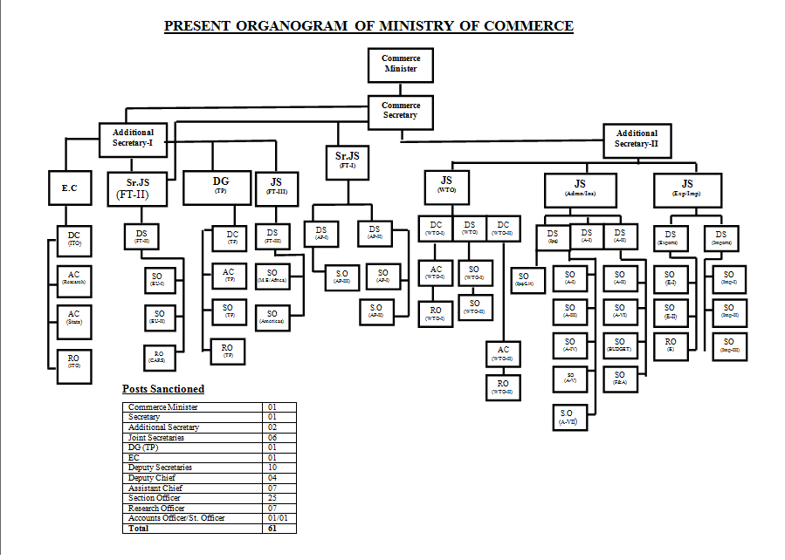
Organogram

Slide 17
Strategic Trade Policy Framework (2012-15)
The major elements of STPF 2012-2015 are:
i. Focus on regional trade
ii. Strengthening of the institutional framework for promotion of exports
iii. Creation of regulatory efficiencies
iv. Export development initiatives
v. Increase exports from less developed regions of Pakistan
vi. Promotion of domestic commerce
vii. Strengthen the monitoring and evaluation mechanism

Slide 18
RATIONALIZING TARIFF PROTECTION POLICY (TPP)
High tariff protection maintained over a period of time tends to erode competitiveness and affects consumer welfare. Ministry of Commerce will adopt following guiding principles to create a competitive environment:-
i. Promote competitive markets in Pakistan
ii. Ensure conformity to international agreements and practices.
iii. Promote domestic and foreign investment.
iv. Create level playing field for Pakistani firms in international as well as domestic markets.
v. Due consideration to consumer welfare.
vi. Cater to the changing needs of Pakistan’s economy.
vii. Create an enabling environment to pursue the legitimate goal of industrialization in Pakistan.

Slide 19
Ministry of Commerce
Commerce Division
Textile Industry Division

Slide 20
Summary
Regulatory Intuitions
  Ministry of Commerce
    Mission Statement
    Charter
    Objectives of trade policy
    Functions of Ministry
    Organogram
  Commerce Division

Slide 21
Next Lecture
Ministry of Economic Affairs & Statistics
  Economic Affairs Division
  Statistics Division

