Slide 1
Regulatory Administrative Institutions
MPA 517
Lecture-29

Slide 2
Recap
Pakistan has remarkable and laudable human resource which is characterized by hard work, dedication and distinction. Our human resource is classified into the categories of professional, non-professional, skilled, semi skilled and un-skilled.
Due to rapid increase in population and developing economy, it is not possible to provide jobs to all. The Ministry, therefore, focuses on availing all the overseas opportunities

Slide 3
Vision
Formulation of progressive manpower policy
Promotion of welfare of Industrial and commercial workers.
Strengthening of labor management relations.
Coordination with the provincial Government, International.
Labour organizations and other International Agencies.

Slide 4
Overseas Employment Corporation
Overseas Employment Corporation is a company limited by shares incorporated under the Companies Act 1913 as a private limited concern.
Its equity is owed entirely by the Government of Pakistan. Policy guidelines are provided by a Board of Directors, which are executed by the Managing Director as Chief Executive of the Corporation.
In the discharge of his functions and duties, the Managing Director is assisted by a team of professionals.
The Head Office of the Corporation is located at PMI Auditorium Building, Zero Point Islamabad.
Its regional offices are located at Karachi & Lahore, Peshawar and Quetta. Administrative and financial control is exercised by the Ministry of Human Resource Development, Government of Pakistan.

Slide 5
Today’s Lecture
Ministry of States and Frontier Regions
Ministry of Religious Affairs
Ministry of planning development and Reforms

Slide 6
Ministry of States and Frontier Regions
The Quaid-i-Azam has instructed for the creation of a new Ministry of states and frontier regions.
The Quaid-i-Azam has decided that the new Ministry will be called “The Ministry of States and Frontier Regions”.
The Quaid-i-Azam has further directed that unless there is any serious legal or other objection, it must be stated in the Press Note that the new Ministry will function under the direct control, guidance and direction of Quaid-i-Azam and Governor-General of Pakistan and this portfolio will be his special care.

Slide 7
CHIEF COMMISSIONERATE FOR AFGHAN
Background
In view of the influx of Afghan Refugees into Pakistan in early 1980, under the direction of the President of Pakistan, an Office of Chief Commissioner for Afghan Refugees was established at Federal level declaring it as an attached department of Ministry of SAFRON. The main functions of that office were as under:
a) Receipt/storage, dispatch and bulk distribution to the Provinces of NWFP and Balochistan of the relief assistance received for the Afghan Refugees.
b) Close Liaison with National and International Aid Giving Agencies of relief goods.
c) Maintenance of Statistics

Slide 8
d) Coordination of relief work between the Federal Government and Provincial Governments.
e) Streamlining and standardization of procedures and methods of distribution of aid for Afghan Refugees down to the lowest level.
f) Accounting/Documentation of the relief assistance.
g) Appropriate publicity of relief assistance for Afghan Refugees at the Federal level.

Slide 9
MAIN OBJECTIVES AND FUNCTIONS
I. Monitoring and evaluation of programmes being carried out of the Commissionerate Afghan Refugees Lahore, Peshawar, Quetta, International Organizations and the NGOs etc through periodical visits/inspections by the Chief Commissioner Afghan Refugees and other officers in the Chief Commissionerate for Afghan Refugees.
II. Issuance of NOCs for vehicles imported by UN Agencies, NGOs and Afghan Tanzeemats for disposal etc.
III. Issuance of exemption certificates for relief goods meant for Afghan Refugees.
IV. Maintenance of warehouse funded by the United Nations High Commission for Refugees (UNHCR).
V. Preparation of Reconciliation Statement of wheat supply to Afghan Refugees with Provincial Food Department.
VI. Coordination for repatriation of Afghan Refugees.

Slide 10
RAZMAK CADET COLLEGE
Cadet College, Razmak, North Waziristan Agency is an autonomous body of Ministry of SAFRON and is located in the heart of FATA. The College is providing quality education to the poor tribal candidates up to Intermediate. The College was established under Presidential Regulation-II of 1977.
FATA Secretariat, Peshawar sponsors the financial liabilities of the college. The Finance Division allocates funds in the regular budget of FATA Secretariat, Peshawar as “ grant in-aid”.
The funds are released to the college on the monthly basis. The Board of Governors manages the affairs of the College.
The College started functioning in 1978 with strength of 100 students which has now been increased to 500 students. The College is providing educational facilities from 7th to 12th classes.

Slide 11
Ministry of Religious Affairs
The Ministry of Religious Affairs is responsible for the pilgrimage beyond Pakistan, Muslims pilgrims visits to India for Ziarat and Saudi Arabia for Umra & Hajj.
It is also responsible for the welfare and safety of pilgrims and zairines.
The main activities also include research based Islamic studies, holding of conferences, seminars ,training education of Ulemas and Khateebs , exchange of visits of scholars of Islamic learning with the liaison amongst foreign and international institutions.

Slide 12
This Division also performs the activities like management of Ruit-e-Hilal, Dawah , council of Islamic Ideology, infants and minor adoption laws. There are six subordinate offices working as Directorates of Hajj of this Ministry and two Autonomous bodies i.e. Council of Islamic Ideology and Pakistan Madrassah Education Board.
Ministry of Religious Affairs consists of one division, Religious Affairs Division. Please visit the web site of the Religious Affairs Division for a more comprehensive and detailed information about its Policies, Publications, Information and Services, Forms, Tenders, Jobs, News & Press Releases, and Related Links.

Slide 13
The Council Of Islamic Ideology
The Council of Islamic Ideology is a constitutional body that advises the legislature whether or not a certain law is repugnant to Islam, namely to the Qur'an and Sunna.
The Council of Islamic Ideology was established as Advisory Council of Islamic Ideology on August 1, 1962 under Article 199 of the Constitution of the Islamic Republic of Pakistan 1962, which provided for the constitution of the Council (Articles 199 - 203), its functions (Article 204), rules of procedure (Article 205), and the establishment of Islamic Research Institute (Article 207).

Slide 14
Advisory Council of Islamic Ideology was re-designated as Council of Islamic Ideology in Article 228 of the 1973 Constitution with provisions for its composition (Article 228), Procedure for reference to the Council (Article 229), its functions (Article 230), and Rules of Procedure (Article 231).

Slide 15
Functions
To make recommendations to Majlis-e-Shoora (Parliament) and the Provincial Assemblies as to the ways and means of enabling and encouraging the Muslims of Pakistan to order their lives individually and collectively in all respects in accordance with the principles and concepts of Islam as enunciated in the Holy Qur’an and Sunnah;
To advise a House, a Provincial Assembly, the President or a Governor on any question referred to the Council as to whether a proposed law is or is not repugnant to the Injunctions of Islam;
To make recommendations as to the measures for bringing existing laws into conformity with the Injunctions of Islam and the stages by which such measures should be brought into effect; and
To compile in a suitable form, for the guidance of Majlis-e-Shoora (Parliament) and the Provincial Assemblies, such Injunctions of Islam as can be given legislative effect

Slide 16
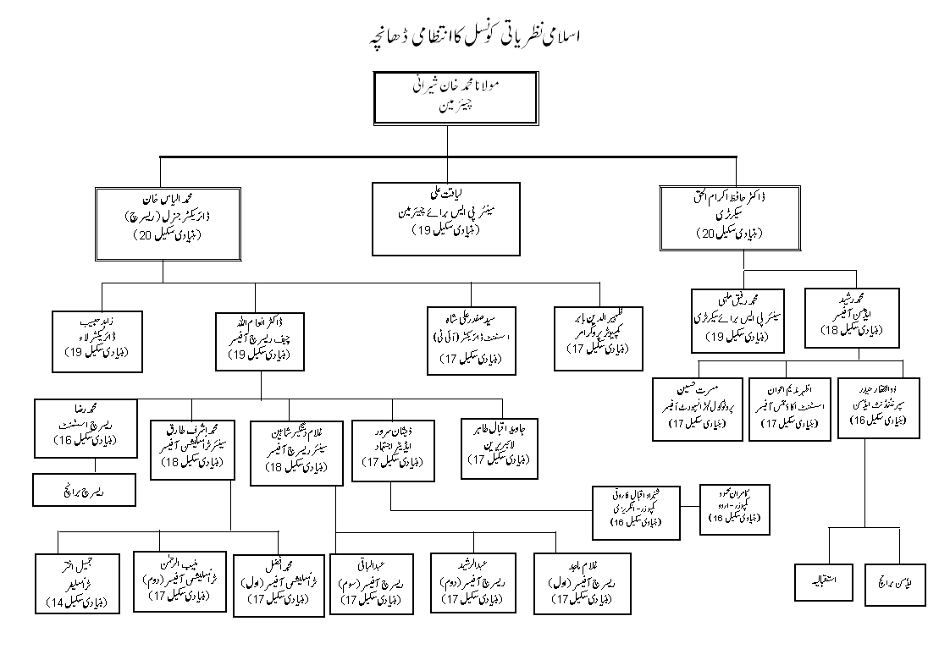
Organogram

Slide 17
Major Achievements
Important Laws enacted on the recommendations of Council of Islamic Ideology.
The Offences against Property (Enforcement of Hudood) Ordinance, 1979.The Offence of Zina( Enforcement of Hudood) Ordinance, 1979.The Offence at Qazf (Enforcement at Hadd) Ordinance, 1979.
The Prohibition (Enforcement) of Hadd) Order, 1979.The Qanun-e-Shahadat Order, 1984.
The Zakat and Ushr, Ordinance, 1980.The Criminal Law (Amendment) Act, 1997(Qanun-e-Qisas and Diyat).The Ehtram-e- Ramzan Ordinance, 1984.
The Enforcement of Shariat Act, 1991(adopted with certain modifications).Transplantation of Human organs.
(Under consideration of the Parliament).Marriage with the Qur'an (Prohibition)(Under consideration of the Parliament).

Slide 18
Some of the departments established on the recommendations of the Council of Islamic Ideology.
Ministry at Religious Affairs and Minorities Affairs
Law Commission
Judicial service/Shariah Academy
Shariah Benches and Federal Shriat Court
Promotion of Arabic Language.

Slide 19
Ministry of planning development and Reforms
  Functions of Planning Commission
Preparing the National Plan and review and evaluating its implementation;
Formulating annual plan and ADP;
Monitoring and evaluating implementation of major development projects and programmes;
Stimulating preparation of sound projects in regions and sectors lacking adequate portfolio;
Continuously evaluating the economic situation and coordinate economic policies
Organizing research and analytical studies for economic decision making.
The Planning Commission also discharges the following functions:
i. Assisting in defining the national vision, and undertaking strategic planning
ii. Assessing the material, capital and human resources of the country and formulating proposals for augmenting such resources
iii. Facilitating capacity building of agencies involved in development
iv. Any other functions assigned by the Prime Minister

Slide 20
Vision 2025
The Vision 2025 is the country’s long–term development blueprint which aims to create a globally competitive and prosperous country providing a high quality of life for all its citizens.
It aspires to transform Pakistan into an industrialized and knowledge based middle income country by 2025.
Themes/ Priority Areas
Integrated Energy
Modernization of Infrastructure
Indigenous Resource Mobilization
Institutional Reforms and Governance
Value-addition in Commodity Producing Sectors
Export promotion and Private Sector Led Growth
Social Capital

Slide 21
Young Development Fellows Program 2013
This program aims to take top minds of Pakistan in variety of fields and use their talents for better long term planning for Pakistan and also train these young brains to become the future development leaders of Pakistan.

Slide 22
Young Development Fellows
The Young Development Fellows (YDF) programme will bring together 220 emerging leaders during period of five years (up to 40 each year) from around Pakistan.
YDF will be a one-year programme with built in “stretch/learning assignment” where they will gain valuable on job experience.
They will be a member of team where they are expected to make significant contribution towards the unit’s work programme while gaining a broad overview of Planning Commission’s policies and functions.
The YDF will provide an opportunity to the Pakistan’s young leaders to learn from the experience of the Planning Commission and other economic ministries/divisions involved in policy formulation.

Slide 23
Upto 40 Fellows from around Pakistan in each year up to five years of Young Pakistani Fellows work and learn from experienced of the policy makers working in Planning Commission minds, carefully selected for their academic background, passion and leadership potential. These fellows will include economists, social scientists, engineers, etc.
YDF scholar will learn from some of the national and international most reputed policy makers and knows for their outstanding contribution in policymaking
YDFs will be coached on life skills and will have a chance to develop their “Whole person” through a portfolio of engaging practical experiences. They will have a chance to perform numerical analysis, exercise critical thinking, problem solving, and will be trained in business and entrepreneurship.
YDFs will receive a monthly stipend of Rs. 60,000 all-inclusive for period of one year.

Slide 24
Annual Plan 2013-2014
Growth Framework
  Growth and Investment
  Balance of Payments
  Fiscal and Monetary Developments
  Public Sector Development Programme
Enhancing Productivity
  Higher Education
  Science and Technology
  Skill Development and Employment
Physical Infrastructure and Environment
  Energy Security and Affordability
  Water Resources Development
  Urban Development
  Environment
Poverty Reduction and Human Resource Development
  Poverty Alleviation and Millennium Development Goals
  Youth Empowerment, Sports, Culture and Tourism
  School and College Education
  Health, Nutrition and Population
  Women Development and Empowerment
  Area Development

Slide 25
Summary
Ministry of States and Frontier Regions
Ministry of Religious Affairs
Ministry of planning development and Reforms

Slide 26
Next Lecture
Drug Regulatory Authority of Pakistan
Ministry of Defence

