Slide 1
Regulatory Administrative Institutions
MPA 517
Lecture-26

Slide 2
Recap
Administration Wing consists of a Joint Secretary, two Deputy Secretaries and six Section Officers along with the supporting staff. Administration Wing is responsible for the following functions:
All matters pertaining to personnel management and general administration of the Ministry ( Secretariat ).
All matters relating to personnel management and general/financial management affairs of the Policy Wing of the Ministry, Oil, Gas and Mineral sector companies, Geological Survey of Pakistan (GSP) and Hydrocarbon Development Institute of Pakistan ( HDIP ), under Ministry of Petroleum & Natural Resources.
Corporate affairs of oil and gas companies.

Slide 3
Mineral Wing
As evident from the geological environment and present state of exploration and mineral discoveries made, so far, Pakistan has vast potential for varieties of minerals. These includes:
1) Huge resources of Thar Coal Sindh,
2) Well-known copper and precious metal potential of district Chagai Baluchistan, Waziristan and Gilgit-Baltistan
3) Marble and granite deposits of Khyber Pakhtunkhwa (K.P.)
4) Rare earth elements in carbonatites in K.P.
5) World famous gemstones of K.P, AJ&K and Gilgit-Baltistan, and
6) Huge potential of industrial rocks and minerals (rock salt and coal) in Punjab

Slide 4
Current Development
For development of these mineral resources through private national / international investment an investment friendly National Mineral Policy (NMP) has been formulated with the consensus of all the provinces and stake holders.
The NMP offers various incentives for investment in the mineral sector and all the provinces have formulated investment friendly mineral concession rules to enhance its shares in the GDP and make it competitive in the international market.

Slide 5
Today’s Lecture
Ministry of Ports & Shipping

Slide 6
Ministry of Ports and Shipping
Ministry of Ports and Shipping in Islamabad is the central administrative authority of the Government of Pakistan primarily assigned to facilitate the ports and shipping industry of Pakistan by providing policy guideline to encourage port development and growth in shipping while maintaining safety standards.
The Ministry is headed by the Federal Minister for Ports and Shipping assisted by the Secretary, Pors and Shipping. In Karachi Director General ( Ports and Shipping ) represents Ministry.

Slide 7
Vision:
"To be the leading contributing sector to the national economy known for its competence and professionalism“
Ministry Mission:
"Sustainable development of maritime capabilities and competitive shipping to improve the socioeconomic condition of the country and to ensure maritime safety and protection of marine environment"

Slide 8
Goals & Objectives
The primary goals are to ensure efficiency, enhance productivity and inculcate advanced practices and technology.
Enhance good governance
Rationalize port charges
Formulate plans and policies to promote shipping sector
Induce ship owning under the flag of Pakistan
Maintain safety and security standards as per International Maritime Organization(IMO) Convention
Ensure and maintain quality of Pakistani seafarers in the line with international best practices
Maintain technical control and to regulate functioning of subordinate organizations

Slide 9
Functions Of the Ministry
National Planning, research and international aspects of: Inland water transport: and Coastal shipping within the same Province.
Diverted cargo belonging to the Federal Government.
Navigation and shipping including coastal shipping but no including shipping confined to one Province; safety of ports and regulation of matter relating to dangerous cargo.
Navigation and Shipping on inland water-ways as regards mechanically propelled vessels and the rule of the road on such water-ways; carriage of passengers and goods on inland water-ways.

Slide 10
Functions Of the Ministry
Light-houses, including lightships, beacons and other provisions for safety of shipping.
Admiralty jurisdiction; offences committed on the high seas;
Declaration and delimitation of major ports and the constitution and power of authorities in following ports: a) Karachi Port Trust b) Port Bin Qasim c) Gwadar Port
Mercantile Marine; Planning for development and rehabilitation of Pakistan Merchant Navy; international shipping and maritime conferences and ratification of their conventions; training of seamen; pool for national shipping.

Slide 11
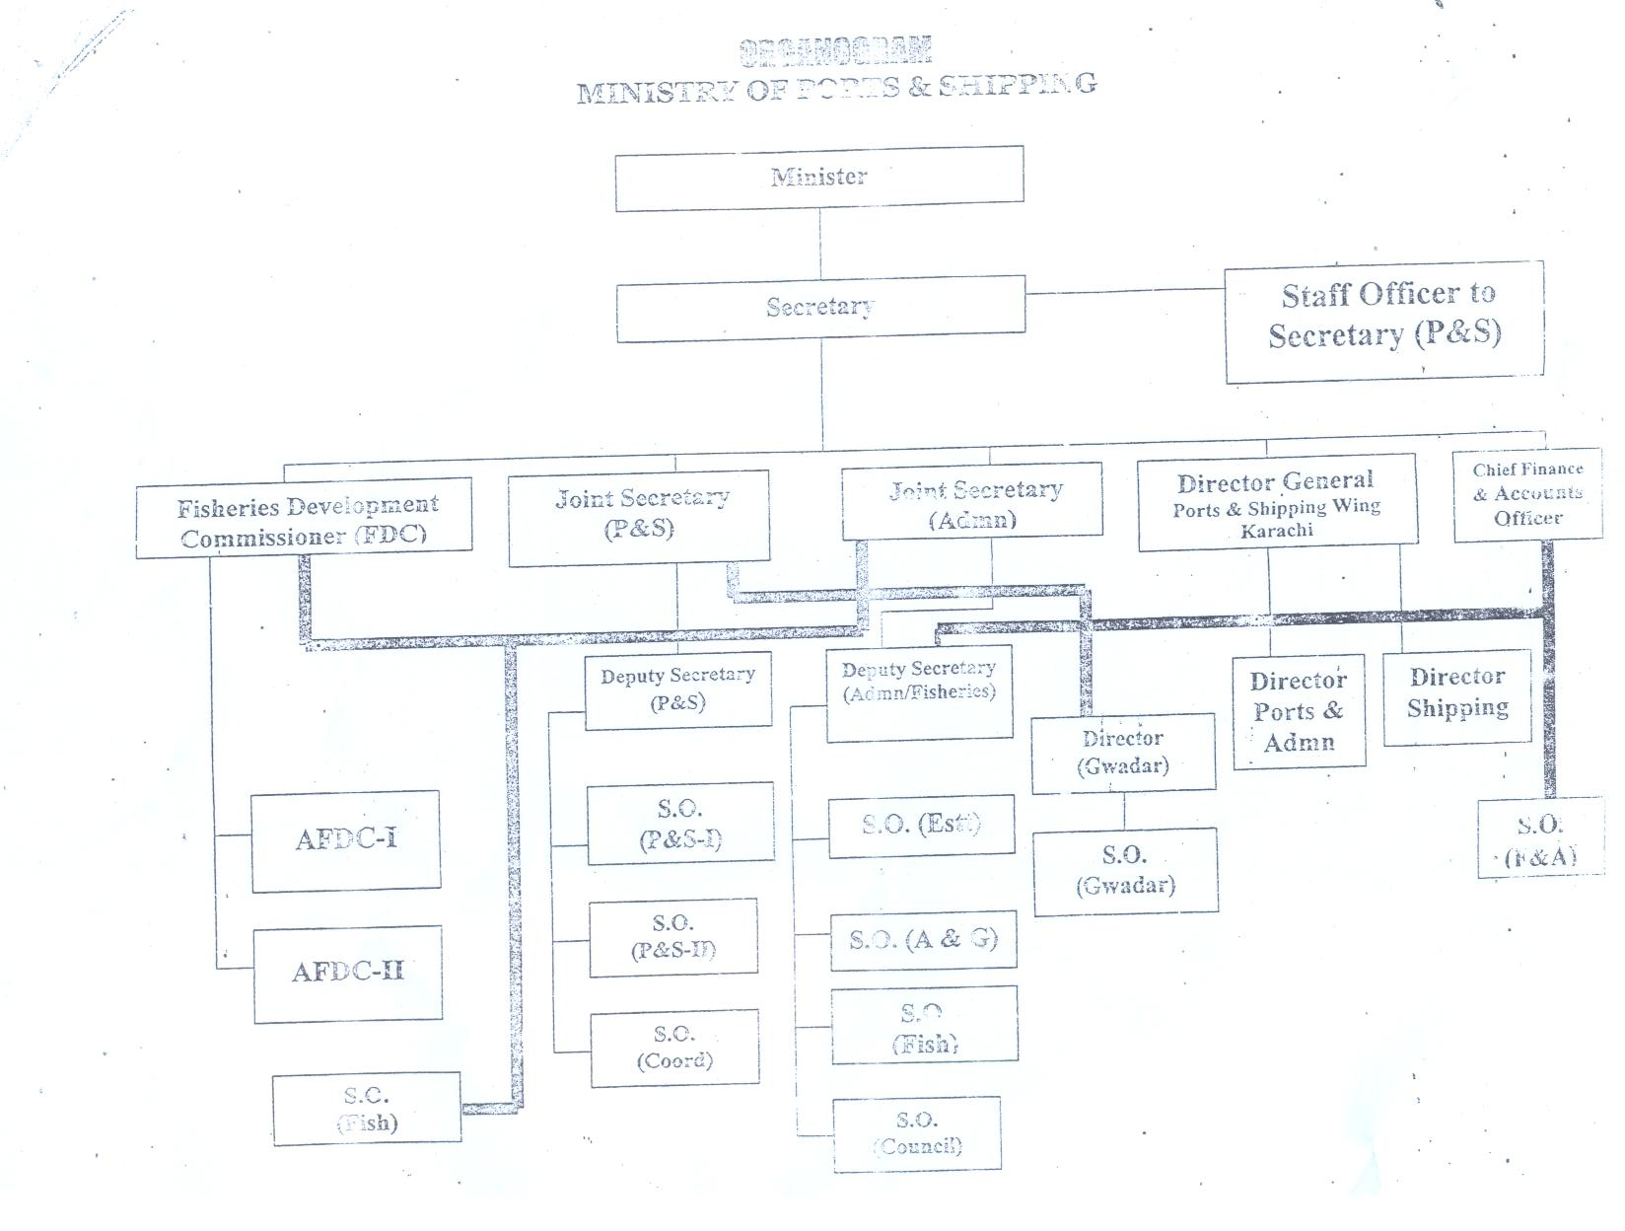

Slide 12
Administration Wing
Administration Wing consists of a Joint Secretary, one Deputy Secretaries and four Section Officers along with the supporting staff. Administration Wing is responsible for the following functions:
All matters pertaining to personnel management and general administration of the Ministry.
All matters relating to personnel management and general/financial management affairs.
All matters relating to technical assistance, tours and training in Pakistan and abroad.
Coordination work of the Ministry, its attached departments, organizations with other Federal Ministries/Divisions/Departments etc.

Slide 13
Development Wing
Development Wing consists of a Joint Secretary, one Deputy Secretaries and one Section Officers along with the supporting staff.
Environment Wing
Environment Wing consists of a Joint Secretary, Two Deputy Secretaries, Co-Project Manager, Director (PEPC), three Section Officers, TO (Chemical), UP, RP, TO (Legal) and two DDs along with the supporting staff.
International Cooperation Wing (IC Wing)
This wing comprises of one Joint Secretary, one Deputy Secretaries and three Section Officers along with complementary staff.

Slide 14
GWADAR PORT
Currently, Pakistan has two main operating international deep-sea ports: Karachi Port and Port Qasim. During the coming years, their capacity expansion programs are unlikely to keep pace with the expected growth in demand, resulting in a need for a third port to fill the gap.
In particular, Karachi Port has significant physical limitations and will not be able to grow at the same speed as the national growth in demand over the coming decades. These limitations result mainly from its location, which is within the city of Karachi itself, which has seen very rapid growth over the past years.

Slide 15
In the case of Port Qasim, although having a large physical space for expansion, its possible speed of development is hampered by its up-stream location, which is more than 40 km from the open sea, resulting in long turnaround times for visiting ships. This is not a problem for cargoes that are linked to industries located near the port, but it carries cost-disadvantages for cargoes that have origins and destinations elsewhere.
Against this background, it was deemed timely to construct and inaugurate a third deep-sea port for Pakistan so as to ensure that national development is not hampered by a lack of national port capacity in the future. Given the expected rapid growth in demand for port capacity, it is likewise important to continue expanding the capacity of Gwadar port over the coming decades

Slide 16
Vision
“The vision of GPA for Gwadar Port is to be a national gateway port for Pakistan and the region and a world-class maritime hub. Gwadar Port is to complement Karachi Port and Port Qasim in order to satisfy the country’s trading and shipping needs and to stimulate economic growth in the western and northern parts of Pakistan, utilizing the available resources of the country and also providing an outlet for land locked Central Asian Countries and Afghanistan through transit trade and offering transshipment facilities.

Slide 17
Mission
To cater for all ships and all types of cargo ships
To facilitate trade and industrial and economic development, nationally, locally and regionally
To operate in a manner that is efficient, effective, competitive, transparent and fair to all
To remain aligned with expectations of local and international customers and stakeholders
In doing so, the development of both Gwadar City and Gwadar Port will provide important contributions to the socio-economic development of the district of Gwadar and the province of Balochistan.

Slide 18
Gwadar Port Civic Center
The Ministry of Ports and Shipping and Gwadar Port Authority initiated the Project of building a modern Civic Centre Building in the heart of the Gwadar City to set a model for the upcoming buildings in the future and to develop the underprivileged area of Gwadar in particular and Balochistan in general.
The Civic Center is offering comfortable and state of the art office accommodations, shops as well as residential flats to cater for administrative and residential needs of various organizations & Private persons.

Slide 19
Summary
Ministry of Ports & Shipping
  Gwadar Port

Slide 20
Next Lecture
Oil and Gas Development Company

