Slide 1
Regulatory Administrative Institutions
MPA 517
Lecture-24

Slide 2
Recap
The Pakistan Water and Power Development Authority (WAPDA) was established through an act of parliament in February 1958 for integrated and rapid development and maintenance of water and power resources of the Country.
This includes controlling soil salinity and water logging to rehabilitate the affected land in order to strengthen the predominantly agricultural economy of the Country

Slide 3
WAPDA Water vision 2025
WAPDA has formulated a comprehensive $25–33 billion National Water Resource and Hydropower Development Programme, entitled Water Vision 2025.
The Water Vision 2025 projects are expected to generate 16,000 MW of hydroelectricity. Other goals are to prevent water shortages, limit drought and increase water storage for a growing population.
Five massive hydropower projects have been announced by the President of Pakistan; these are to be completed by 2016, with a generation capacity of 9,500 MW.
Two of the projects are ready for construction, while three are in the stages of feasibility studies and preparation of tender documents

Slide 4
Public Procurement Regulatory Authority
The Public Procurement Regulatory Authority is an autonomous body endowed with the responsibility of prescribing regulations and procedures for public procurements by Federal Government owned public sector organizations
Main aim is to improve governance, management, transparency, accountability and quality of
public procurement of goods, works and services.
It is also endowed with the responsibility of monitoring procurement by public sector agencies/organizations and has been delegated necessary powers under the Public Procurement Regulatory Authority Ordinance 2002.

Slide 5
Today’s Lecture
Oil and Gas Regulatory Authority (OGRA)
Ministry of Petroleum & Natural Resources

Slide 6
INTRODUCTION
Oil and Gas Regulatory Authority (OGRA) has been set up under the Oil and Gas Regulatory Authority Ordinance dated 28th March 2002 to foster competition, increase private investment and ownership in the midstream and downstream petroleum industry, protect the public interest while respecting individual rights and provide effective and efficient regulations.
As laid down in the Ordinance, the Authority comprises one Chairman and three members. To create a working environment where the interests of all stakeholders namely the Consumer, Investor & the Government is protected through Independent & Fair Regulatory practices.

Slide 7
Upon the establishment of OGRA on 28th March, 2002 the Natural Gas Regulatory Authority (NGRA) was subsumed by the OGRA.
All properties and works done by the NGRA were transferred to and protected under the OGRA Ordinance.
OGRA was, therefore, in a position to start its functions in respect to natural gas immediately upon its establishment.

Slide 8
The Federal Government has now w.e.f. March 15, 2003 assigned functions for the regulation of activities relating to LPG (Liquefied Petroleum Gas) and CNG (Compressed Natural Gas) sectors in the country to the Oil and Gas Regulatory Authority and has designated the OGRA as an Authority in place of the Director General (Gas) of the Ministry of Petroleum and Natural Resources.

Slide 9
Inspection of POL Depots
Oil & Gas Regulatory Authority (OGRA) in order to monitor the movements of Petroleum products to the special freight areas i.e Gilgit Baltistan and AJK conducts one month inspections of POL Depots.
During these inspections, the movements of tank lorrys along with petroleum supplies to the said areas were physically monitored.
The discrepancies noted during the inspections were discussed with the Oil Marketing Companies in the sesssion meeting and further course of action is being taken in accordance with the Rules and the prevailing Law.

Slide 10
Ministry of Petroleum & Natural Resources
Petroleum & Natural Resources Division was created in April 1977.
Prior to that Petroleum and Natural Resources was part of the Ministry of Fuel, Power and Natural Resources

Slide 11
Mission Statement
To ensure availability and security of sustainable supply of oil and gas for economic development and strategic requirements of Pakistan and to coordinate development of natural resources of energy and minerals.

Slide 12
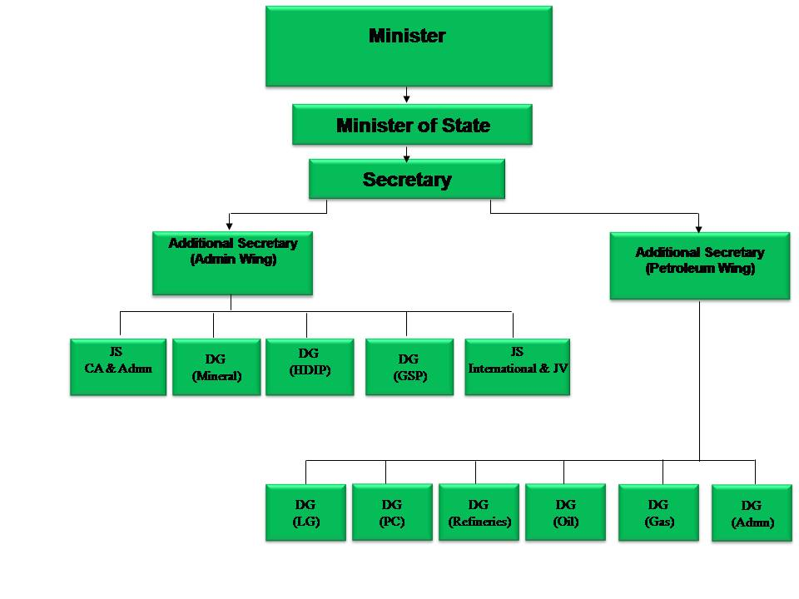

Slide 13
Wings
Directorate General of Gas
Directorate General of LNG & LPG
Directorate General of Oil
Directorate General of Petroleum Concession
Directorate General of Refineries
Human Resource and Administration Wing
International Joint Venture Wing
Mineral Wing
Policy Wing

Slide 14
Directorate General of Gas-FUNCTIONS
Formulation of the Government Policies regarding Natural Gas, Liquefied Petroleum Gas (LPG), Liquefied Natural Gas (LNG), Compressed Natural Gas (CNG)
Assessment and management of gas demand & supply
Allocation of gas from new finds to gas utility companies
Allocation of Natural Gas from different supply sources to various sectors
Review and execution of gas price agreements with producers and gas sales agreements between the producers and the Government nominated buyer;

Slide 15
Directorate General of Gas-FUNCTIONS
Assessment of consumers’ gas prices based on the prescribed prices, determined by OGRA and making recommendations to the Government for their fixation
Budgeting and monitoring of receipts of Gas Development Surcharge
Implementation of the President/PM directives including Gas supply schemes of the Parliamentarians
Coordination with Ministry of Interior and Civil Armed Forces etc on issues relating to safety/security of gas pipeline in the country
Processing as well as implementation of Cabinet/ECC decisions
Parliamentary Business, i.e. Senate/National Assembly Questions, Standing Committees meeting and ensure implementation of their recommendation.

Slide 16
Directorate General of Oil
The Consumption of petroleum products in the country during 2007-2008 was 19.0 million tons.
The demand is expected to increase around 1.9 million tones per annum by the year 2010-11. Thereafter, it is expected to further increase to around 26 million tones by the year 2017-18.
The production of refined products by the local refineries during the year 2007-08 was 11.0 million tons.
The deficit product imports were 9 million tons in 2007-08 while it will remain around 6-8 million tons per annum up to year 2010-11. Thereafter, it is expected to increase to a level of around 14 million tons per annum by the year 2017-18.

Slide 17
Petroleum products demand/supply scenario
 | 2007-08 | 2011-12 | 2016-17
Demand of Petroleum Products | 19 | 22.4 | 28.4
Production from local Refineries | 11 | 12.4 | 13.2
Surplus Naptha / Motor Gasoline available from Exports | 1.3 | 1.3 | 1.5
Deficit of HSD and FO | 9 | 11.3 | 16.6

Slide 18
Directorate General of Petroleum Concession
Directorate General of Petroleum Concessions is one of the Directorates of the Ministry of Petroleum & Natural Resources functioning as the Regulatory authority for all Upstream Exploration & Production activities in Pakistan.

Slide 19
FUNCTIONS OF DGPC
Grant of petroleum rights i.e. inspection permits, Exploration licenses, development and production leases;
Facilitation of Exploration & Production and Services Companies/activities
Oil and Gas fiscal regimes analysis and recommend by adequate policies keeping in view of international practices;
Promotion of petroleum exploration, negotiations with foreign and local petroleum exploration companies including petroleum concessions/production sharing agreements under the Petroleum Policy and the Pakistan Petroleum (Exploration and Production) Rules, 2001 & 2003

Slide 20
FUNCTIONS OF DGPC
Management of Petroleum exploration, development and production operations in accordance with the good international oil field practices, applicable rules and Petroleum Concession.
Ensuring realization of the Government receipts (dividend, royalty, rents, application fees etc.) and compilation of investment data and Management and scale of technical data.

Slide 21
Summary
Oil and Gas Regulatory Authority (OGRA)
Ministry of Petroleum & Natural Resources

Slide 22
Next Lecture
Human Resource and Administration Wing
International Joint Venture Wing
Mineral Wing
Policy Wing

