Slide 1
Regulatory Administrative Institutions
MPA 517
Lecture-23

Slide 2
Recap
Ministry of Industries and Production is the Focal Ministry for the Execution of Prime Minister’s Youth Business Loan Scheme… MoIP, through its member organizations, has taken a number of initiatives to facilitate the loan beneficiaries.

Slide 3
Objectives of WTO Cell
The proposal perceives to strengthen the capacity within MOIP with additional technical positions and short term expert services as well as supporting facilities to evolve in the long term perspective a viable and efficient setup which can meet the requirements of Pakistan’s trade in non agricultural goods.
This project would go a long way in creating specialists to deal with the new issues emerging from the WTO.

Slide 4
Objectives
To create capacity within MOIP to backstop and respond to need for actions at all levels, and coordinate all WTO related activities in the country effecting non-agriculture sector.
To meet the informational and analytical needs associated with the WTO negotiations on non-agriculture and in the process to improve the capacity for participation in the ongoing WTO negotiations.
To enhance capabilities and capacities of the manufacturing/ industrial sector in the country with the objective to facilitate this sector to meet the challenges of WTO, thus enabling Pakistan; Industry to be competitive in the international Market.
To promote Non-Agricultural goods as vehicles for National Economic growth and reduction of National poverty levels.
To increase productivity and profitability of industrial goods.
The project also created employment opportunities in this Ministry as following staff has been appointed in the project.

Slide 5
Today’s Lecture
PAKISTAN WATER AND POWER DEVELOPMENT AUTHORITY
Public Procurement Regulatory Authority

Slide 6
WAPDA
The Pakistan Water and Power Development Authority (WAPDA) was established through an act of parliament in February 1958 for integrated and rapid development and maintenance of water and power resources of the Country.
This includes controlling soil salinity and water logging to rehabilitate the affected land in order to strengthen the predominantly agricultural economy of the Country

Slide 7
As per the charter, amended in March 1959 to transfer the existing electricity departments from the federating units to it, WAPDA has been assigned the duties of investigation, planning and execution of projects and schemes for :
Generation, Transmission and distribution of Power,
Irrigation, water supply and drainage,
Prevention of water logging and reclamation of saline land,
Flood control and
Inland navigation

Slide 8
WAPDA Water vision 2025
WAPDA has formulated a comprehensive $25–33 billion National Water Resource and Hydropower Development Programme, entitled Water Vision 2025.
The Water Vision 2025 projects are expected to generate 16,000 MW of hydroelectricity. Other goals are to prevent water shortages, limit drought and increase water storage for a growing population.
Five massive hydropower projects have been announced by the President of Pakistan; these are to be completed by 2016, with a generation capacity of 9,500 MW.
Two of the projects are ready for construction, while three are in the stages of feasibility studies and preparation of tender documents

Slide 9
PAKISTAN ELECTRIC POWER COMPANY
The Pakistan Electric Power Company (Private) Limited (PEPCO) has been entrusted the task of managing the transition of WAPDA from a bureaucratic structure to a corporate, commercially viable and productive entity.
It is a mammoth task and progress in the initial months was rather slow, but one should keep in mind that responsibility is enormous and transition is a long drawn process.
Before going into further details of the restructuring programme, it is necessary to understand the shift in the GoP policy.
The GoP, in line with its Strategic Plan of 1992 approved by the cabinet committee, had decided to restructure the entire power sector in the country
De-regulation of power sector
Promotion of IPPs
Restructuring of WAPDA
Privatization of select corporate entities

Slide 10
VISION
To make Pakistan Power Sector customer friendly, efficient, able and responsive in meeting tee electric energy requirements of industry, business and domestic customers, and move to an energy sufficient model from the current energy deficient scenario, on commercially viable and sustainable basis, in order to support the high growth economy and to meet the government's objective of "Power for All".

Slide 11
MISSION
To fully enable the reform and restructuring of the Pakistan Power Sector and to transform the fourteen (14) Corporate entities (CE's) into autonomous and commercially viable enterprises, thru induction of effective corporate management, best business and utility practices, and well engineered systems, and bridge the ever growing supply-demand gap, so as to meet customers electric energy requirement on a sustainable and environmentally friendly basis, thru best utilization of resources, in an efficient, ethical and customer friendly manner, with responsibility to the community and the Nation.

Slide 12
OBJECTIVES
Pakistan Electric Power Company (PEPCO) unveiled new face of Pakistan's power sector with the crisis management objectives to improve the efficiency of the power sector and to meet customers' electric energy requirements on a sustainable and environment friendly basis

Slide 13
Objectives of PEPCO
. The specific objectives of PEPCO are:
  Stop load shedding,
  Constructing new grid stations,
  Reducing line losses; minimizing tripping and theft control,
  Revamping of generation units and to improve customer services and
  Development of an integrated automated power planning system for generation, transmission and distribution to ensure system stability, fault isolation and upgrade relying, metering and tripping system at NTDC as well as Discos level.

Slide 14
Public Procurement Regulatory Authority
The Public Procurement Regulatory Authority is an autonomous body endowed with the responsibility of prescribing regulations and procedures for public procurements by Federal Government owned public sector organizations
Main aim is to improve governance, management, transparency, accountability and quality of
public procurement of goods, works and services.
It is also endowed with the responsibility of monitoring procurement by public sector agencies/organizations and has been delegated necessary powers under the Public Procurement Regulatory Authority Ordinance 2002.

Slide 15
Laws and Acts
Anti Money Laundering Ordinance, 2009
Anti Terrorism Act (ATA), 1997
Anti Terrorism Ordinance, Amended (2009)
Central Depositaries Act 1997
Copyright Ordinance 1962
Pakistan Companies Act 1974
Consumer Laws
Copyright Rules

Slide 16
Laws and Acts
Pakistan Customs Act 1969
Customs Rules 2001
Designs Ordinance 2000
Integrated Circuits Ordinance 2000
Sales, Finance Ordinance 2009.
Income Tax Rules 2008
Income Tax Ordinance 2001 (updates 28-10-2009)
Insurance Ordinance 2000

Slide 17
Laws and Acts
Intellectual Property Ordinance
Labor laws Pakistan-
child labor laws
Patent Ordinance 2000
Law and Justice Commission Ordinance
Listed Companies Ordinance 2002
Patent Rules 2003
Sales Tax Act 1990

Slide 18
Child Labor Law
International Labour Organisation (ILO) suggests poverty is the greatest single cause behind child labour. Pakistan has a per-capita income of approximately $1900.
A middle class person in Pakistan earns around $5 a day on average.The average Pakistani has to feed nine or ten people with their daily wage. Further to that there is also the high inflation rate to contend with
As of 2008, 17.2% of the total population lives below the poverty line, which is the lowest figure in the history of Pakistan.
Poverty levels in Pakistan appear to necessitate that children work in order to allow families to reach their target take‐home pay.
On the side of the firms, the low cost of child labour gave manufacturers a significant advantage in the Western marketplace, where they undersell their competitors from countries prohibiting child labour, often by improbable amounts

Slide 19
Child Labor Law
A number of laws contain provisions prohibiting child labour or regulating the working conditions of child and adolescent workers. The most important laws are:
The Factories Act 1934. The West Pakistan Shops and Establishments Ordinance 1969.
The Employment of Children Act 1991 The Bonded Labour System Abolition Act 1992.
The Punjab Compulsory Education Act 1994
Child labour remains one of the major problems afflicting Pakistan and its children. Pakistan has passed laws in an attempt to limit child labour and indentured servitude—but those laws are universally ignored, and some 11 million children, aged four to fourteen, keep that country's factories operating, often working in brutal and squalid conditions

Slide 20
National Institute of Procurement
PPRA with its new institutional setup, called National Institute of Procurement (NIP) is playing a pivotal role in capacity building of procurement professionals of public and private sector in Pakistan.
Training is a distinctive function of Human Resource Management helping employees to acquire new skills in line with the overall objectives of an organization.
Absence of this phenomenon is detriment to organizations failing to keep pace with the latest developments pertaining to the modern world of procurement.
The procurement officials need to keep abreast with the latest international best practices in the public procurements and be informed about the current training opportunities available world wide.

Slide 21
International organizations
Crown Agents
RIPA International
International Law Institute
International Training Center
Siemens Pakistan
Dublin City University
International Institute of Learning
Kable Direct.
The Charted Institute of Purchasing and Supply.
Procurement and Sourcing Institute of Asia (PASIA).

Slide 22
Punjab Public Procurement Management
Public procurement management in Punjab like in most developing countries needs a lot improvement.
Laws, Rules and Regulations are non-existent, inadequately implemented or enforced.
Capacity and morale of the work force is low whereas accountability and transparency on need basis.
Public procurement practitioners face challenges from both external and internal environment. The former include legal, political, economic and business and socio-cultural environments.
The later is related to three factors: People who make procurements decisions, procedure which provide a guidance to the practitioners; and controls which ensures probity, transparency and accountability.
In order to deal effectively with the challenges an adequate and independent audit mechanism should be formed that manages to balance between the financial and performance audit.

Slide 23
Functions
Section 5 of the PPRA Act 2009 stipulates the following mandate and responsibilities of the Authority:-
The Authority may take measures and exercise powers as may be necessary for improving governance, management, transparency, accountability and quality of public procurement;
Monitor application of the laws, rules, regulations, policies and procedures in respect of, or relating to the public procurement;
Prepare standard documents to be used in connection with public procurement;
Establish performance indicators for procurement performance of the Procuring Agencies and monitor compliance with these indicators through independent third party evaluation and make recommendations for improvement of procurement performance of the Procuring Agencies;

Slide 24
Functions
Present an annual report to the Government regarding the overall functioning of the public procurement system, including recommendations on measures to be taken by the Government to enhance the quality of procurement work;
Call a functionary of a Procuring Agency to provide assistance in its functions and call for information from a Procuring Agency pursuance of its objectives and functions;
Develop, promote and support training and professional development policy of officials and other persons engaged in public procurement;
Perform other function as may be assigned to it by the Government.

Slide 25
Services
PPRA provide several services / facilities to procuring agencies. Most of the services are web based. These services include...Uploading of tender via decentralized system
Public tenders view
Annual procurement plan availability
Evaluation Reports uploading
Capacity building
Tendering Advices
Prompt guidance regarding procurement [Telephonic/ Email]

Slide 26
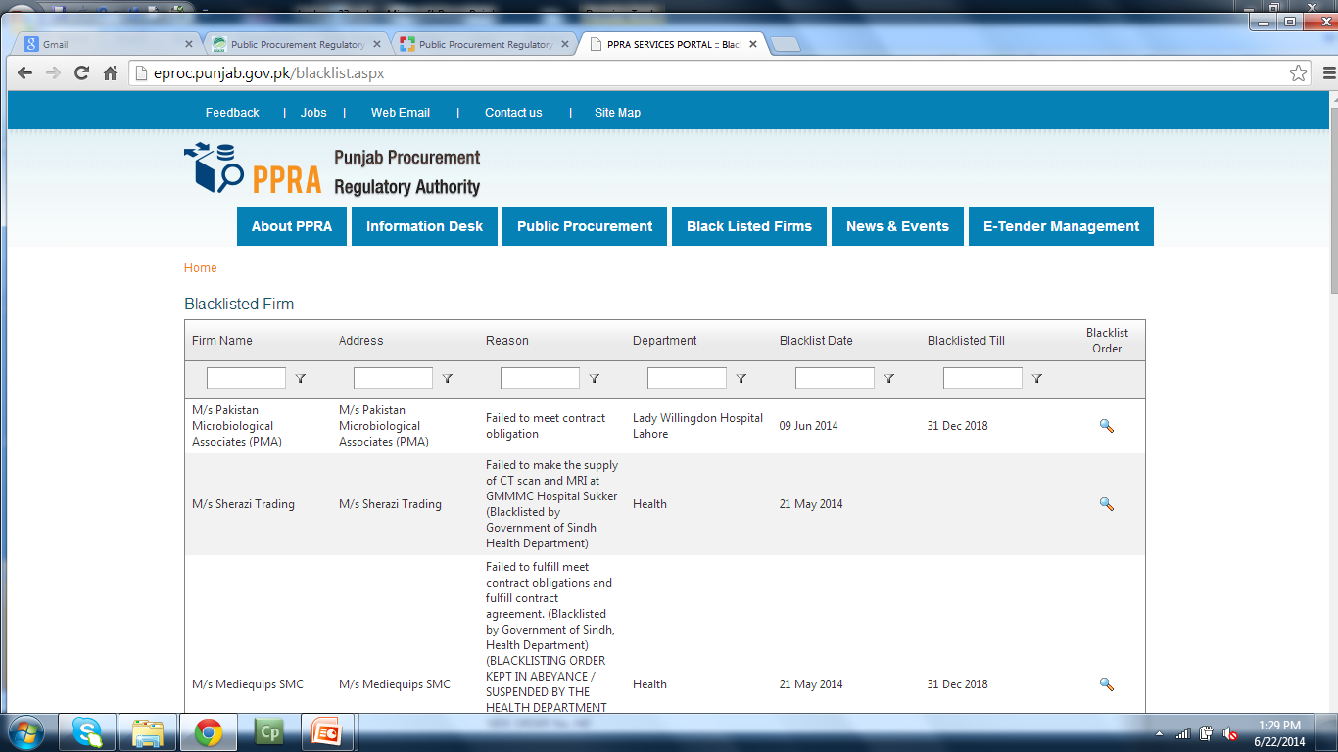
Blacklisted Firm

Slide 27
Trainings
Training, Workshops and Video Conferences have been organized with the cooperation of International Agencies like World Bank, USAID and ADB to provide an insight into the latest trends and development in Tender Management and Procurement Rules.
Since major number of Departments and Govt. Institutions serve at Divisional/District level, hence capacity building program has been launched for public functionaries serving at Divisional/District level to train them about new Procurement Laws / Rules.
The training includes orientation of the Procurement Laws, familiarization with policies, techniques for supervising and handling procedures.
For General Public awareness specially for private sector people, an awareness programme on PPRA Laws/Rules has been arranged in collaboration with NAB on FM 101.
PPRA Laws / Rules have also been made part of the training syllabus of fresh intake of Provincial Officers and financial management courses being conducted by different training institutions like MPDD.

Slide 28
Summary
PAKISTAN WATER AND POWER DEVELOPMENT AUTHORITY
Public Procurement Regulatory Authority
  Punjab Procurement Regulatory Authority

Slide 29
Next Lecture
Oil and Gas Regulatory Authority (OGRA)

