Slide 1
Regulatory Administrative Institutions
MPA 517
Lecture-20

Slide 2
Recap
Pakistan Medical and Dental Council (abbreviated as PMDC), established in 1962, is a regulatory authority for practitioners and students of medicine and dentistry in Pakistan.
The Council is a supreme body and takes all policy decisions, it meets at least once in a year or as and when there are sufficient items for the agenda, which needs policy decisions.
It acts through various Committees and Secretariat. The meetings of the Council are presided over by the President and in his absence by the Vice President.

Slide 3
Pakistan Engineering Council
Pakistan Engineering Council (PEC), is a professional and statutory federal institution for accreditation and regulation of the chartered and professional engineers and technicians.
The PEC is dedicated for promoting its education programs in applied science, computing, engineering, and engineering technology.
Established in 1976 by the PEC 1976 Act of the Constitution of Pakistan, it is the elite representative engineering community in the country, assisting the government and the provisional governments of the four provinces

Slide 4
Functions
Its main statutory functions include registration of engineers, consulting engineers, constructors/operators and accreditation of engineering programmes run by universities/institutions, ensuring and managing of continuing professional development, assisting the Federal Government as think tank, establishing standards for engineering products and services besides safeguarding the interest of its members.
The council shall encourage, facilitate and regulate working of professional engineering bodies for creativity and as custodians of engineering under the umbrella of the Council.

Slide 5
Continuing Professional Development
Continuing Professional Development (CPD) or Continuing Professional Education (CPE) is the means by which members of professional bodies maintain, improve and broaden their knowledge and skills for developing personal qualities required in their professional lives.
Pakistan Engineering Council under its Act has mandate for introducing and ensuring continued professional development activities amongst its growing community of engineers and has devised a comprehensive framework titled Professional Development of Engineers (Bye Laws – 2008) approved by the Government of Pakistan.
The main objective is to develop competence and ability of engineers for the application of theoretical knowledge to practical situations and to evolve innovative solutions to real life problems while adhering to professional ethics and acquisition of a broader understating of their obligations to society.

Slide 6
Today’s Lecture
Ministry of Science and Technology
  Pakistan Council for Science and Technology

Slide 7
Ministry of Science and Technology
The Ministry of Science and Technology (MoST) is a Cabinet-level ministry of the Government of Pakistan concerned with science and technology in Pakistan and in general, Pakistan's science policy, planning, coordination and directing of efforts to initiate and launch scientific and technological programs as well as projects aimed at economic development.
The ministry is coordinated by the Federal Minister for Science and Technology, and is headquartered in Islamabad.

Slide 8
Mission
The Ministry of science and Technology is the national focal Ministry and enabling arm of the Government of Pakistan for planning, coordination and directing efforts to initiate and launch scientific and technological programs and projects aimed at economic development of the country.
The Ministry is working on the national agenda to have a sound and sustainable Science and technological research base which would lead to the socio-economic development of the country and to achieve the vision for a better Pakistan.

Slide 9
National Research Institutes and Departments
The Ministry of Science and Technology National Research Institutes and Technological departments is an administrative and systematic division that oversees, coordinates, and supervises the system of facilities and laboratories for the purpose of developing and promoting advancement of science and technology to benefits the country's economy and foreign policy.
Majority of these institutes are federally funded but are controlled autonomously by their appointed and designated director-generals who are under contract to Ministry of Science.
These national research institutes and laboratories are staffed by private corporations and academic universities, and conduct their research on behalf of the government on national and defense initiatives.

Slide 10
National Research Laboratories
The Kahuta Research Laboratories, previously known at various times as Project-706, and Engineering Research Laboratories, is a Pakistan Government's multi-program national research institute, managed and operated under the scrutiny of Pakistan Armed Forces, located in Kahuta, Punjab Province.
The laboratories are one of the largest science and technology institutions in Pakistan, and conducts multidisciplinary research and development in fields such as national security, space exploration, and supercomputing

Slide 11
Abdus Salam Research Laboratories
The Abdus Salam Chair in Physics, also known as Salam Chair in Physics, is an academic physics research institute of the Government College University at Lahore, Punjab province of Pakistan.
Named after Pakistan's only Nobel Laureate, Abdus Salam, the institute is partnered with Pakistan Atomic Energy Commission (PAEC) and International Center for Theoretical Physics (ICTP).
While it is a physics research institute, the institute is dedicated to the field of Theoretical and Mathematical physics.
The institute was established in 1999, after it was suggested by Ishfaq Ahmad, by the Government of Pakistan led by the Prime minister Nawaz Sharif.
Its first director who is designated as Salam Professor, was Dr. Ghulam Murtaza who was appointed in 1999. The institute is partnered with PAEC and International Center for Theoretical Physics, and also participated with the projects led by the Khan Research Laboratories (KRL) and the Ministry of Science and Technology (MOST).

Slide 12
Marine Systems Laboratories
Marine Systems Limited (MSL) is a Pakistani maritime engineering and marketing organisation. MSL develops real time embedded systems, design services and analysis of acoustic or radar signatures of surface and sub-surface vessels.
  Products
  Advanced Towed Array Sonar (ATAS) - a towed array sonar developed by MSL and Maritime Technologies Complex (MTC) to replace old systems in service with the Pakistan Navy (PN) and for export.
  Action Speed Tactical Trainer (ASTT) - programmable simulator for tactical training of operations room teams. Based on High Level Architecture.

Slide 13
Hamdard Research Laboratories
Hamdard Laboratories (Waqf) Pakistan, is a private non-profit research laboratory famous for its Unani and ayurvedic medicine. Hamdard Dawakhana originated in undivided India in 1906.
After the independence in 1947, a branch was established in Karachi, Pakistan by Hakim Mohammed Saeed, named Hamdard Laboratories.
In 1953, Hamdard Laboratories was converted into a Waqf (Islamic irrevocable trust) and renamed Hamdard Laboratories (Waqf) Pakistan.
Profits of Hamdard Laboratories (Waqf) Pakistan were made over to the trust, for use in the development of health, education and other nation-building and philanthropic activities. Hamdard Foundation Pakistan was created to manage these funds

Slide 14
Pakistan Council for Science and Technology
Pakistan Council for Science and Technology (PCST) is mandated to advise the Government on the development of Science and Technology at the national level.
The Council is involved in S&T Policy making, planning, implementation and in carrying out policy studies.
PCST is also the secretariat of National Commission of Science and Technology (NCST), headed by the Prime Minister (which takes the major decisions for the development of S&T)

Slide 15
Objectives
Advising the Government on S&T policy and plans.
Regular evaluation of scientific research through bibliometric and peer review techniques.
Strategic planning of R&D through expert committees/think tanks.
Scientometric and futuristic studies.
Promotion of R&D and encouragement of consultancy services for scientists and technologists.

Slide 16
Functions
To discuss all policy matters, proposals and issues on the overall development of science and technology in the country and provide recommendations and advice to the National Commission for Science and Technology for facilitating their decision-making;
To identify priority areas of research and development keeping in view the futuristic developments of science and technology especially those of the disciplines falling the high technolgy fields;

Slide 17
Functions
To act as an independent forum of senior and eminent scientists and technologists of the country and to act as a "Think Tank" to the Federal Government on policies and problems of national importance in respect of science and technology;
To collect science and technology statistics and maintain a data bank of the research and development institutions of the country;

Slide 18
Functions
To provide a forum for co-ordination of S&T activities with national and international agencies
To enter into contracts, agreements with national agencies for undertaking development projects in fields relevant to the functions of the Council

Slide 19
To organize study groups and task forces for dealing witth issues such as:
  Scientometric studies and analysis of science and technology data;
  Assessement and innovation of impact of science and technology policies and programmes on the overall development of the country;
  Preparation of state of art reports on certain important scientific and technological issues;
  Identification of priority subjects with reference to their bearing on socio-economic development and national security; and
  Encouragement of consultancy services for scientists and technologists in various important fields

Slide 20
Productive Scientists of Pakistan
Regular qualitative and quantitative evaluation of publicly funded scientific endeavor is desirable throughout the world in order to gauge the efficacy of exploitation of the public funds.
Pakistan Council for Science and Technology conducts regular studies which provide information about the productive scientists of Pakistan based on eight research related parameters including authorship of books, M.Phil/PhD level research papers, comulative impact factor, international citation of publications, national / international patents registered and winning of competitive national / international grants

Slide 21
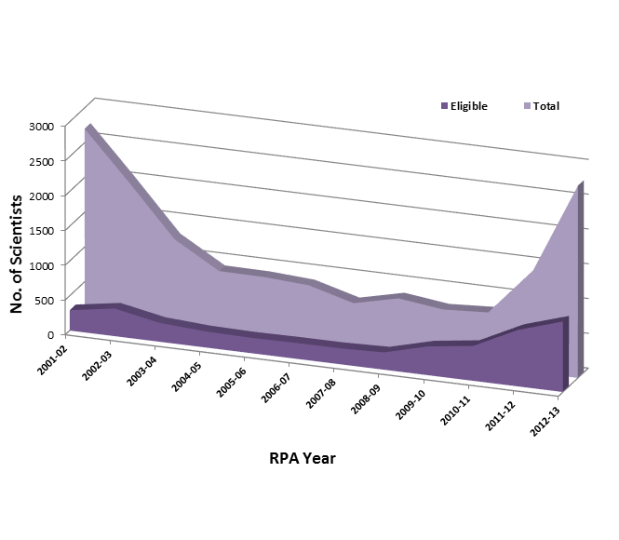
Research Productivity Award

Slide 22
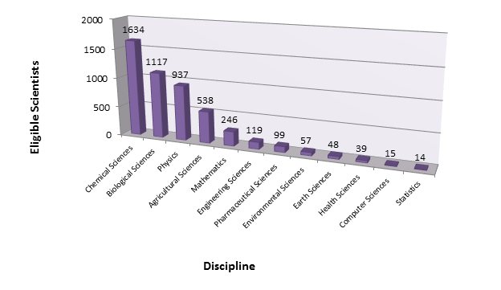

Slide 23
Summary
Ministry of Science and Technology
  Pakistan Council for Science and Technology

Slide 24
Next Lecture
Pakistan Nuclear Regulatory Authority

