Slide 1
Regulatory Administrative Institutions
MPA 517
Lecture-17

Slide 2
Recap
The Ministry of Foreign Affairs is a Pakistan Government's federal and executive level ministry responsible for international and Foreign Affairs of Pakistan.
The ministry was created in 1947, and was one of the first ministries to be established. The executive and political figure heading the Foreign Ministry is the Foreign Minister.
The Foreign Ministry is currently headed by Prime Minister of Pakistan

Slide 3
Foreign Policy Objectives
In light of the guiding principles laid down by the founding fathers and the constitution as also aspirations of the people of Pakistan, the objectives of foreign policy can be summarized as under:
Promotion Pakistan as a dynamic, progressive, moderate, and democratic Islamic country.
Developing friendly relations with all countries of the world, especially major powers and immediate neighbours.
Safeguarding national security and geo-strategic interests, including Kashmir.
Consolidating our commercial and economic cooperation with international community.
Safeguarding the interests of Pakistani Diaspora abroad.
Ensuring optimal utilization of national resources for regional and international cooperation.

Slide 4
Attached Departments
DEPARTMENT OF ARCHAEOLOGY AND MUSEUMS
CENTRAL BOARD OF FILM CENSORS
  Other Linked Departments
    PAKISTAN NATIONAL COUNCIL OF THE ARTS (PNCA)
    NATIONAL INSTITUTE OF FOLK & TRADITIONAL HERITAGE (LOK VIRSA)
    IQBAL ACADEMY
    QUAID-I-AZAM ACADEMY

Slide 5
Today’s Lecture
  Higher Education Commission
  Ministry of Environment
    Pakistan Environmental Protection Agency

Slide 6
Education in Pakistan
In Pakistan, gender discrimination in education occurs amongst the poorest households but is non-existent amongst rich households.
Only 18% of Pakistani women have received 10 years or more of schooling.
Among other criticisms the Pakistani education system faces is the gender disparity in enrollment levels. However, in recent years some progress has been made in trying to fix this problem. In 1990-91, the female to male ratio (F/M ratio) of enrollment was 0.47 for primary level of education.
It reached to 0.74 in 1999-2000, showing the F/M ratio has improved by 57.44% within the decade.
For the middle level of education it was 0.42 in the start of decade and increased to 0.68 by the end of decade, so it has improved almost 62%. In both cases the gender disparity is decreased but relatively more rapidly at middle level

Slide 7
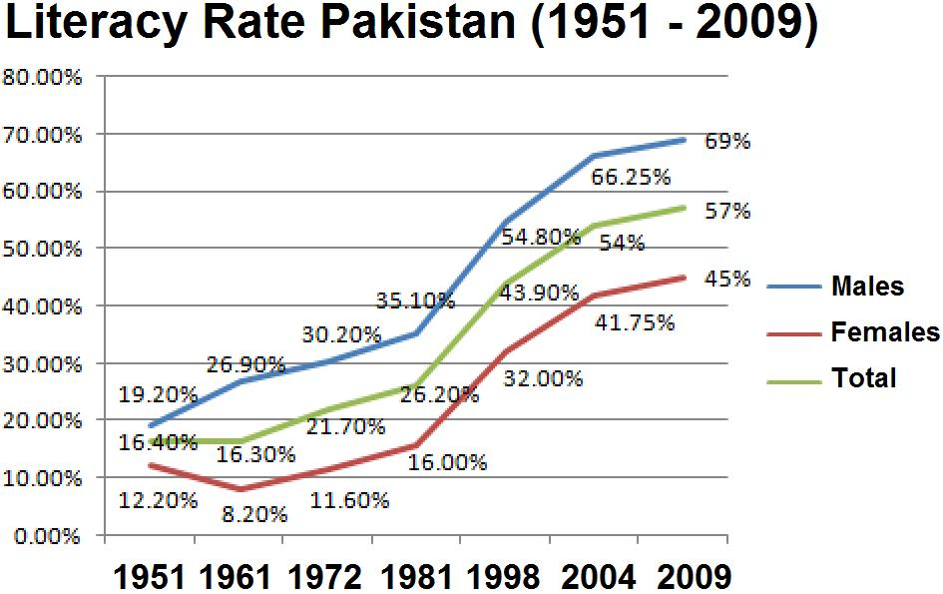

Slide 8
  Higher Education Commission
The Higher Education Commission of Pakistan is an independent, autonomous, and constitutionally established institution of primary funding, overseeing, regulating, and accrediting the higher education efforts in Pakistan.

Slide 9
University Grants Commission
Preceded by the University Grants Commission (UGC) in 2002 by a constitutional amendment, the universities were formerly accredited by the UGC established in 1947; the institution was revised 1974 and came its modern form in 2002 with additional executive reforms granted by the constitution.
Under a new and revised reforms, the HEC is made responsible for formulating higher education policy and quality assurance to meet the international standards as well as providing accrediting academic degrees, development of new institutions, and uplift of existing institutions in Pakistan.

Slide 10
HEC
The HEC also facilitated the development of higher educational system in the country with main purpose of upgrading the universities and colleges in the country to be focal point of the high learning of education, research, and development.
Over the several years, the HEC plays an important and leading role towards building a knowledge based economy in Pakistan by giving out hundreds of doctoral scholarships for education abroad every year

Slide 11
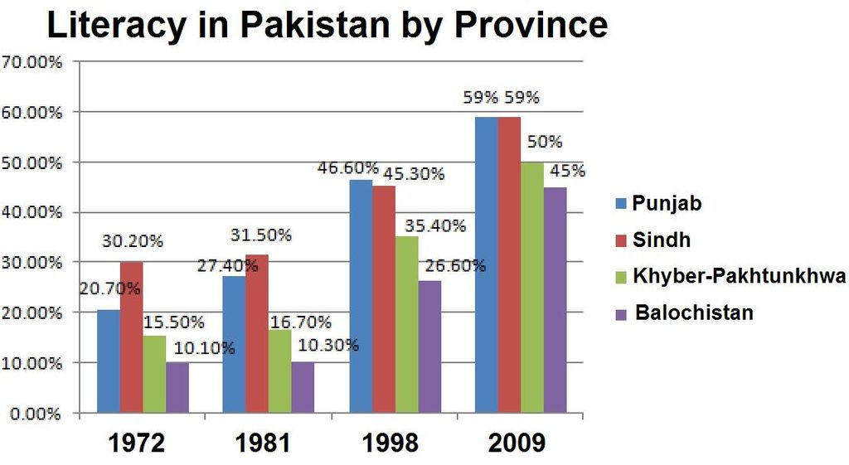

Slide 12
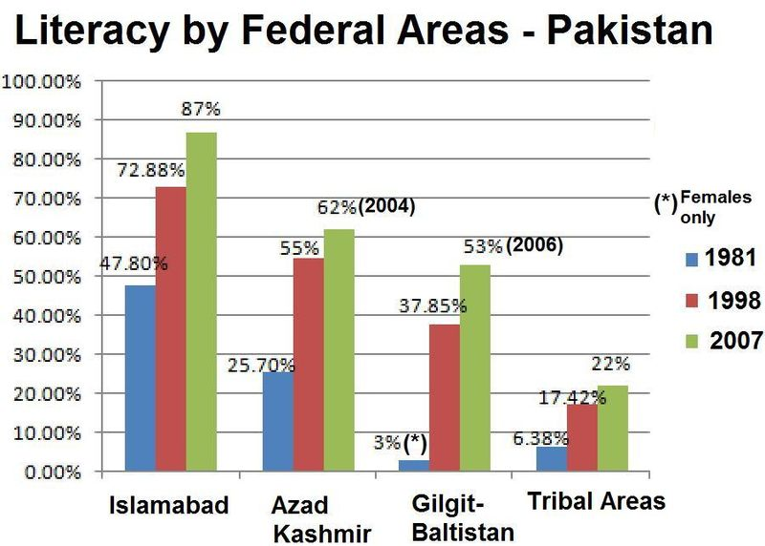

Slide 13
Governance in HEC
The HEC is governed and chaired by the appointed chairman who is assisted by the secretaries of education, science and technology, telecommunications, and information technology.
The Chairman and secretaries are assisted by the additional members who are appointed from the four provinces as well as university vice-chancellors. Other members are included from state and private-sector and executive director of the HEC.
The Chairman of HEC is appointed by the Prime Minister of Pakistan for four tenured term based upon the requests and recommendations send by the Ministry of Education (MoEd).
According to HEC Ordinance altered in Constitution, the Prime Minister is the controlling authority of the HEC and the shortlisted names are to be forwarded to Him for the final say

Slide 14
Impact of Higher Education Reforms in Pakistan
Since the HEC's reforms have been carried out in 2002, HEC has received praise from the international higher education observers. Prof. Atta-ur_Rahman, founding Chairman of HEC, has received number of prestigious international awards for the remarkable transformation of the higher education sector under his leadership.
German academic, Dr. Wolfgang Voelter of Tübingen University in Germany over viewed the performance of HEC under the leadership of Prof. Atta-ur-Rahman and described the reforms in HEC as "A miracle happened.“
After teaching and visiting in 15 universities of Pakistan, Voelter wrote that the "scenario of education, science and technology in Pakistan has changed dramatically, as never before in the history of the country.
The chairperson of the Senate Standing Committee on Education recently announced the first 6 yearsof HEC under Prof. Atta-ur-Rahman as "Pakistan's golden period in higher education"

Slide 15
Impact of Higher Education Reforms in Pakistan
American academic Prof. Fred M. Hayward has also praised the reform process undertaken by Pakistan, admitting that "since 2002, a number of extraordinary changes have taken place.“
Hayward pointed our that "over the last six years almost 4,000 scholars have participated in PhD programs in Pakistan in which more than 600 students have studied in foreign PhD programs.“
The HEC instituted major upgrades for scientific laboratories, rehabilitating existing educational facilities, expanding the research support, and overseeing the development of one of the best digital libraries in the region.
Seeking to meeting the international standard, a quality assurance and accreditation process was also established, of which, ~95% of students sent sent abroad for training returned, an unusually high result for a developing country in response to improved salaries and working conditions at universities as well as bonding and strict follow-up by the commission, Fulbright, and others.

Slide 16
Achievements
The creation of HEC has had a positive impact on higher education in Pakistan.
Established the finest Digital Library in Pakistan: Every student in every public sector university today has access to 45,000 textbooks research monographs from 220 international publishers as well as to 25,000 international research journals - regarded as one of the best digital libraries anywhere in the world.
Tripled University enrollment from 135,000 in the year 2003 to 400,000 in 2008.
Promoted research, resulting in huge expansion of international research publications from Pakistan from only 600 research papers/yr in 2003 to 4300 research papers in 2008.
During the 56 year period (1947–2003) not a single Pakistani university could be ranked among the top 600 universities in the world. Today 2 Pakistani universities ranked among top 200 World’s Technology Universities.

Slide 17
Achievements
About 5000 Ph.D. level scholarships awarded for study in technologically advanced countries (largest program in developing world) and some 3,000 indigenous Ph.D. scholarships have been awarded. The world’s largest Fulbright Scholarship program (US $ 150 million) launched with joint funding (HEC/USAID)

Slide 18
Ministry of Environment
The Ministry of Environment (or MoE), is a Cabinet-level ministry of Government of Pakistan, tasked and primary responsible for planning, coordinating, promoting, protecting and overseeing the policy implementation of government sanctioned environmental and forestry programmes in the country.
Its government activities includes conservation, survey of fauna, flora, forestry, wildlife (including Wildflowers); protection and prevention of pollution control. The MoE is also responsible for administrating and establishing the National Parks of Pakistan.

Slide 19
Ministry of Environment
The MoE has also contained the separate and autonomous government department— Pakistan Environmental Protection Agency (Pakistan EPA).
The EPA is a leading department of the MoE, usually tasked to handle the air pollution, radioactive waste management, promotion of civilian usage of environmental isotopes, while it also has the responsible to implementing and enforcing the Pakistan Environmental Protection Act in the country

Slide 20
Environmental Protection Agency
The Pakistan Environmental Protection Agency, sometimes known as Pak-EPA, is an executive agency Government of Pakistan managed by the Ministry of Climate Change (formly Ministry of Environment) .
The agency is charged with protecting human health and the environment by writing and enforcing regulation based on laws passed byParliament. The Pakistan Environmental Protection Act was passed in 1997 by the Parliament repealing the Pakistan Environmental Protection Ordinance 1983.
The agency was established under the 1983 Ordinance and saved in the 1997 Act.
The agency is led by an appointed director-general, who is appointed by the Prime Minister on the advice of the Minister for Environment

Slide 21
Summary
  Higher Education Commission
  Ministry of Environment
    Pakistan Environmental Protection Agency

Slide 22
Next Lecture
QUALITY ASSURANCE SYSTEM OF HEC

