Slide 1
Regulatory Administrative Institutions
MPA 517
Lecture-16

Slide 2
Recap
The Federal Board of Revenue (more commonly known by its initials as FBR) is the semi-autonomous, supreme federal agency of Pakistan that is responsible for auditing, enforcing and collecting revenue for the government of Pakistan

Slide 3
Central Excise duties
Central Excise duties are leviable on a limited number of goods produced or manufactured, and services provided or rendered in Pakistan.
On most of the items Central Excise duty is charged on the basis of value or retail price.
Some items are, however, chargeable to duty on the basis of weight or quantity.
Classification of goods is done in accordance with the Harmonized Commodity Description and Coding system which is being used all over the world.
All exports are exempted from Central Excise Duty.

Slide 4
Sales Tax
Sales Tax is levied at various stages of economic activity at the rate of 15 per cent on:
  All goods imported into Pakistan, payable by the importers;
  All supplies made in Pakistan by a registered person in the course of furtherance of any business carried on by him;
  There is an in-built system of input tax adjustment and a registered person can make adjustment of tax paid at earlier stages against the tax payable by him on his supplies.
  Thus the tax paid at any stage does not exceed 15% of the total sales price of the supplies.

Slide 5
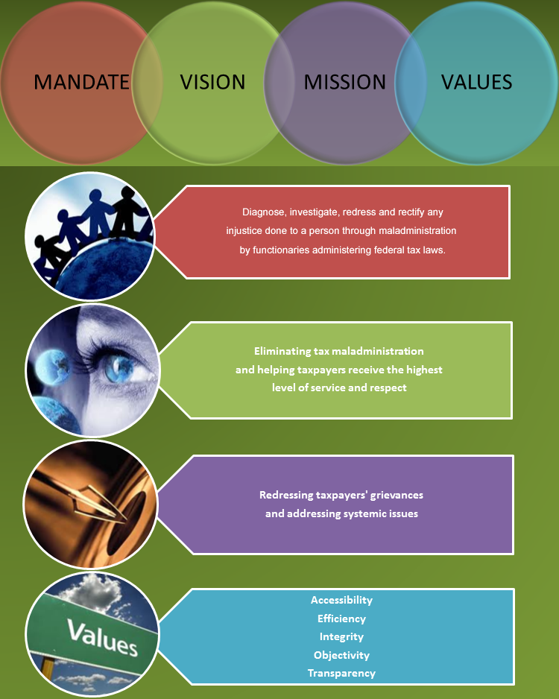

Slide 6
Today’s Lecture
Ministry of Foreign Affairs
Ministry of Culture and Sports

Slide 7
Ministry of Foreign Affairs
The Ministry of Foreign Affairs is a Pakistan Government's federal and executive level ministry responsible for international and Foreign Affairs of Pakistan.
The ministry was created in 1947, and was one of the first ministries to be established. The executive and political figure heading the Foreign Ministry is the Foreign Minister.
The Foreign Ministry is currently headed by Prime Minister of Pakistan

Slide 8
Function of the Ministry
In Government cabinet secretariat and public service spectrum, the position of Foreign Minister is a one of the high-profile portfolios in Cabinet Secretariat, and usually has a Deputy Minister.
The Deputy Minister who is known as Minister of State for Foreign Affairs is a chief assistant to the Foreign Minister or is second to take a charge of the ministry in case the Foreign Minister dies or resigns.
The Minister also contained an administrative bureaucratic infrastructure that is tasked with the management of foreign affairs records, government identifications, foreign portfolios, and is responsible for coordinating and implementing foreign missions and objectives to Pakistan' diplomatic missions abroad.
Foreign Secretary is the bureaucratic head of the Ministry.

Slide 9
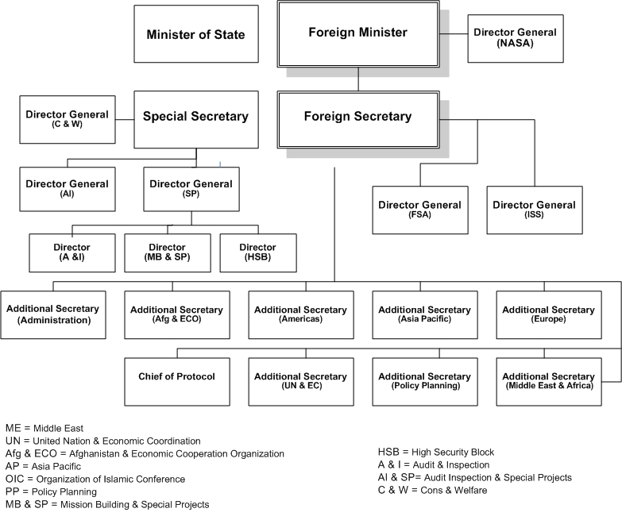

Slide 10
STRATEGIC EXPORT CONTROL DIVISION
In pursuance of its commitment to non-proliferation, Pakistan has instituted a comprehensive legislative, regulatory and implementation system involving transfer of sensitive goods and technologies and ensuring their safety and security at various stages.
Export Control Act on Goods, Technologies, Materials and Equipment related to Nuclear and Biological Weapons and their Delivery Systems Act– 2004 was passed by the National Assembly on 14 September 2004 and by the Senate on 18 September 2004.

Slide 11
Foreign Policy Objectives
In light of the guiding principles laid down by the founding fathers and the constitution as also aspirations of the people of Pakistan, the objectives of foreign policy can be summarized as under:
Promotion Pakistan as a dynamic, progressive, moderate, and democratic Islamic country.
Developing friendly relations with all countries of the world, especially major powers and immediate neighbours.
Safeguarding national security and geo-strategic interests, including Kashmir.
Consolidating our commercial and economic cooperation with international community.
Safeguarding the interests of Pakistani Diaspora abroad.
Ensuring optimal utilization of national resources for regional and international cooperation.

Slide 12
Consular Affairs
Ensures the genuineness of the document
They only countersigns the attestation made by other authorities like the educational certificates which have to be attested by IBCC and Higher Education Commission etc
The Ministry, thus, verifies the signatures of concerned attesting authorities.
These documents include:
  Documents issued by various authorities of central, provincial and local government which are intended to be used abroad or submitted in Foreign Missions in Pakistan;
  Documents verified/attested by our Foreign Missions which are intended to be presented in Pakistan

Slide 13
Public Diplomacy
The Ministry of Foreign affairs Pakistan has established a Public Diplomacy division in order to increase interaction with a wide range of governmental and non-governmental actors to:
Project state policy
Promote national interest
Build positive image
Create a better understanding of its foreign policy decisions within Pakistan and abroad.

Slide 14
Objectives of Public Diplomacy
Promote rich, diverse, open and tolerant culture of Pakistan
Project Pakistan’s economy as a source of enterprise & innovation
Project Pakistan’s image as a democracy and a pillar of peace and stability
Build relationships with decision-makers & opinion-leader
Use credible messaging in support of national policy on key issues
Utilize modern technology and communication networks to reach out

Slide 15
In some nations, such as India, the foreign minister is referred to as the Minister for External Affairs or, as in the case of Brazil and of the former Soviet Union, as the Minister of External Relations.
In the United States the equivalent to the foreign ministry is called the Department of State, and the equivalent position is known as the Secretary of State. Other common titles may include minister of foreign relations.
In many Spanish-speaking countries in Latin America, the foreign minister is colloquially called canciller

Slide 16
A foreign minister's powers can vary from government to government. In a classic parliamentary system, a foreign minister can potentially exert significant influence in forming foreign policy but when the government is dominated by a strong prime minister the foreign minister may be limited to playing a more marginal or subsidiary role in determining policy.
Similarly, the political powers invested in the foreign minister are often more limited in presidential governments with a strong executive.
Since the end of World War II, it has been common for both the foreign minister and defense minister to be part of an inner cabinet (commonly known as a national security council) in order to coordinate defence and diplomatic policy.
Although the nineteenth and early twentieth centuries saw many heads of government assume the foreign ministry, this practice has since become uncommon in most developed nations

Slide 17
Foreign Service Academy
The Foreign Service Academy of Pakistan was established in September 1981. It has organized 62 courses for the officers of Foreign Service and other departments of Pakistan and 56 courses for foreign diplomats.
The aim of such courses is to prepare families for the discharge of representational duties abroad. The Academy has also been arranging short duration courses and seminars on diplomacy and financial management for defence and community welfare attaches.

Slide 18
The number of our international alumni, many of them serving in responsible positions in their respective countries, stands at 1143 from 83 countries. In addition, almost the entire Foreign Service of Pakistan of today has passed out through the gates of this Academy. The strength of Pakistani alumni stands at 514.

Slide 19
Ministry of Culture
VISION
The Ministry of Culture promotes the documentation, preservation, conservation and development of Pakistan’s diverse cultural heritage. Its dynamic cultural policy is committed to manifesting the beauty and the message of peace and harmony intrinsic in Pakistani culture.
OBJECTIVES
The Ministry's primary responsibilities are the promotion of culture and the arts through its attached departments and subordinate organizations.

Slide 20
Its activities include the organization of events relating to the visual and performing arts, both locally and internationally; the encouragement of artists and establishment of art/cultural organizations; the maintenance and preservation of archaeological sites and National Monuments; support and regulation of the Film Industry.
It is also engaged in Cultural Exchange Programs and Agreements with foreign countries.

Slide 21
Attached Departments
DEPARTMENT OF ARCHAEOLOGY AND MUSEUMS
CENTRAL BOARD OF FILM CENSORS
  Other Linked Departments
    PAKISTAN NATIONAL COUNCIL OF THE ARTS (PNCA)
    NATIONAL INSTITUTE OF FOLK & TRADITIONAL HERITAGE (LOK VIRSA)
    IQBAL ACADEMY
    QUAID-I-AZAM ACADEMY

Slide 22
Pakistan Sports Board
Pakistan Sports Board was established under the Ministry of Education through the Sports (Development and Control) Ordinance, 1962 as a corporate body for the purposes of promoting and developing uniform standards of competition in sports in Pakistan comparable to the standards prevailing internationally, and regulating and controlling sports in Pakistan on a national basis.

Slide 23
Subsequently, in July, 1977 with the creation of Ministry of Culture, Sports and Tourism, the administrative control of the Pakistan Sports Board was transferred to it
After the devolution of the Ministry of Sports in June, 2011, the administrative control of the Pakistan Sports Board has transferred to Ministry of Inter Provincial Coordination.

Slide 24
Pakistan Sports Board
Pakistan Sports Board being the supreme body of sports monitors the activities/affairs of National Sports Federations affiliated to it and ensure proper utilization of annual and special grants given by the Board.
The annual grants are released to the National Federations to meet their day to day expenses whereas special grants are meant for participation and holding of international sports events.

Slide 25
These grants are allocated/approved by the Executive Committee of Pakistan Sports Board keeping in view the popularity of games, achievements of international level and activities of the Federations.
At present, 42 National Sports Federations are affiliated with the Board. Each Federation is responsible for promotion and development of its respective game/sports

Slide 26
Summary
Ministry of Foreign Affairs
Ministry of Culture and Sports

Slide 27
Next Lecture
  Higher Education Commission
  Ministry of Environment
    Pakistan Environmental Protection Agency

