Slide 1
Regulatory Administrative Institutions
MPA 517
Lecture-15

Slide 2
Recap
Prepare the annual fiscal budget and issue adequate regulations for its execution.
Manage government financial assets.
Propose bills related to the management of government employees, particularly bills related to staffing, salaries, benefits and pensions.
Amortize debt and coordinate financial activities carried out within the scope of its power, for the different ministries and their related entities.
Be aware of and report on any initiative of a financial nature involving public expenditure and indebtedness before it is debated by Assembly.
Participate in the negotiation of international free trade and financial agreements.
Exercise all powers and rights as granted on it in the State Banks Law.

Slide 3
MTBF
The annual budget of the Federal Government is based on a medium term budgetary framework (MTBF).
The MTBF is an approach to budgeting that integrates policy-making, planning and budgeting within a medium-term framework.
The MTBF has provided the framework for budget preparation in all Ministries/Division and Departments of the Federal Government since 2009.

Slide 4
Poverty Reduction Strategy Paper
The Poverty Reduction Strategy Paper (PRSP) Secretariat housed in the Ministry of Finance was established in 2000 to prepare a holistic anti-poverty strategy for Pakistan.
It provides secretarial support to the National PRSP Implementation Committee.
The Committee, headed by the Secretary Finance, comprises secretaries of Federal and Provincial PRSP partner government agencies to oversee the implementation of Pakistan’s PRSPs

Slide 5
Today’s Lecture
Federal Board of Revenue
  Federal Tax Ombudsman Pakistan

Slide 6
Federal Board of Revenue
The Federal Board of Revenue (more commonly known by its initials as FBR) is the semi-autonomous, supreme federal agency of Pakistan that is responsible for auditing, enforcing and collecting revenue for the government of Pakistan

Slide 7
Responsibilities
FBR has the responsibility for:
formulation and administration of fiscal policies,
levy and collection of federal taxes and
quasi-judicial function of hearing of appeals.
  A quasi-judicial body is an entity such as an arbitrator or tribunal board, generally of a public administrative agency, which has powers and procedures resembling those of a court of law or judge, and which is obligated to objectively determine facts and draw conclusions from them so as to provide the basis of an official action.
  Such actions are able to remedy a situation or impose legal penalties, and may affect the legal rights, duties or privileges of specific parties)

Slide 8
Fiscal policy
In economics and political science, fiscal policy is the use of government revenue collection (taxation) and expenditure (spending) to influence the economy, or else it involves the government changing the levels of taxation and government spending in order to influence aggregate demand and the level of economic activity.
The two main instruments of fiscal policy are changes in the level and composition of taxation and government spending in various sectors

Slide 9
Introduction
The Central Board of Revenue (CBR) was created on April 01, 1924 through enactment of the Central Board of Revenue Act, 1924.
In 1944, a full-fledged Revenue Division was created under the Ministry of Finance.
After independence, this arrangement continued up to 31st August 1960 when on the recommendations of the Administrative Re-organization Committee, FBR was made an attached department of the Ministry of Finance.
In 1974, further changes were made to streamline the organization and its functions. Consequently, the post of Chairman FBR was created with the status of ex-officio Additional Secretary and Secretary Finance was relieved of his duties as ex-officio Chairman of the FBR.
By the enactment of FBR Act 2007 in July 2007 the Central Board of Revenue has now become Federal Board of Revenue.

Slide 10
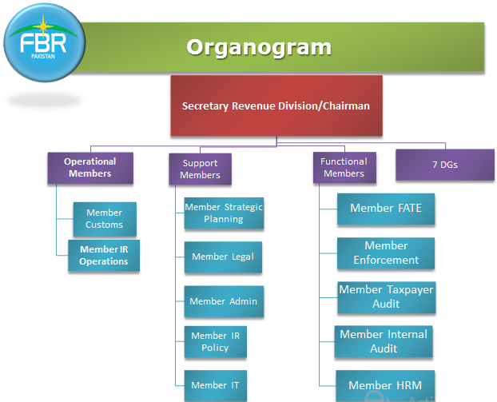

Slide 11
Monitoring
Income Tax
Federal Exercise Duty
Sales Tax
Imports
Exports

Slide 12
Central Excise
Central Excise duties are leviable on a limited number of goods produced or manufactured, and services provided or rendered in Pakistan.
On most of the items Central Excise duty is charged on the basis of value or retail price.
Some items are, however, chargeable to duty on the basis of weight or quantity.
Classification of goods is done in accordance with the Harmonized Commodity Description and Coding system which is being used all over the world.
All exports are exempted from Central Excise Duty.

Slide 13
Sales Tax
Sales Tax is levied at various stages of economic activity at the rate of 15 per cent on:
  All goods imported into Pakistan, payable by the importers;
  All supplies made in Pakistan by a registered person in the course of furtherance of any business carried on by him;
  There is an in-built system of input tax adjustment and a registered person can make adjustment of tax paid at earlier stages against the tax payable by him on his supplies.
  Thus the tax paid at any stage does not exceed 15% of the total sales price of the supplies.

Slide 14
Customs
Goods imported and exported from Pakistan are liable to rates of Customs duties as prescribed in Pakistan Customs Tariff.
  Customs duties in the form of import duties and export duties constitute about 37% of the total tax receipts.
  The rate structure of customs duty is determined by a large number of socio-economic factors.
  However, the general scheme envisages higher rates on luxury items as well as on less essential goods.
  The import tariff has been given an industrial bias by keeping the duties on industrial plants and machinery and raw material lower than those on consumer goods.

Slide 15
History of Income Tax
Income Tax Act of 1922: prevalent in the British Raj and was adopted by the Government of Pakistan as its Income Tax Law.
Income Tax Ordinance, 1979 was the first law on Income Tax which was promulgated in Pakistan from 1 July 1979 by Government of Pakistan.
To update the tax laws and bring country's law in accordance with international standards, Income Tax Ordinance 2001 was promulgated on 13 September 2001, which became effective from 1 July 2002.
IT rules 2002 were promulgated by FBR on 1 July 2002 in exercise of powers granted under section 237 of the Ordinance

Slide 16
BBC report
The BBC report said Pakistan had a lower-than-average tax take, with only 0.57% of Pakistanis - 768,000 individuals - paying income tax last year. In comparable countries, the level is about 15%.
http://www.bbc.com/news/uk-politics-22017091

Slide 17
Federal Tax Ombudsman Pakistan
Federal Tax Ombudsman Pakistan is a critical component of our strategy to strengthen complaint filing and decision support system for the aggrieved taxpayers.
The Government of Pakistan, established the Federal Ombudsman in 1983 in accordance with the requirements of the Constitution of the country.
The Provinces followed suit and established Provincial Ombudsmen. Thus Pakistan joined the international club of countries having the office of Ombudsmanship as a critical component of welfare states with adequate focus on service delivery at national and sub-national levels.

Slide 18


Slide 19
Services
We do:
  We resolve complaints and provide relief to the public by carrying out independent investigations into complaints about Tax Maladministration.
  We work to put things right and share lessons learned and help improve public services as a result. Our independent complaints handling service is free and open to everyone.
  We don’t:
  Matters that are sub-judice
  External Affairs
  Defence matters
  Service matters

Slide 20
Interaction with Civil Society
Advisory Committee
Standing Committee
Website
Annual Report
News Letter
Print Media / Electronic Media
Collaboration with Transparency International
Frequent meetings with Tax Bars, Chambers of Commerce & Industry, Trade Bodies
Outreach Meetings with Civil Society Organization

Slide 21
Summary
Federal Board of Revenue
  Federal Tax Ombudsman Pakistan

Slide 22
Next Lecture
Ministry of Foreign Affairs
Ministry of Culture and Sports

