Slide 1
Lecture 32
NATURAL RESOURCE PLANNING AND MANAGEMENT
Dr. Aneel SALMAN
Department of Management Sciences
COMSATS Institute of Information Technology, Islamabad

Slide 2
Why Environment Matter?

Slide 3
Environment and Development

Slide 4
Sustainability

Slide 5
Environmental Degradation
“Resource scarcity and inequitable distribution of resources emerge as key factor of insecurity and violent conflicts”

Slide 6
Dependence on Natural Resources
Transportation, Housing, Agriculture, Culture, Intergovernmental Cooperation, Land use, Economic Development

Slide 7
Limiting Factors
Time Frame
Scarcity of Information
Lack of proper Funding

Slide 8
Basic Definitions
Natural resources: Natural resources are the resources available in a nature like air, water, sunlight, soil, minerals, forests, wild life etc.
Natural resources occur naturally within environments that exist relatively undisturbed by humanity, in a natural form. A natural resource is often characterized by amounts of biodiversity and geodiversity existent in various ecosystems.

Slide 9
Natural resources are of two main types. They are renewable and non-renewable natural resources.
Renewable natural resources: Those resources which can be replenished in a short period of time like air, water, sunlight, forests etc.

Slide 10
Non-renewable natural resources: Those resources which cannot be replenished in a short period of time like minerals (coal, petroleum, natural gas, metals etc.) because they take millions of years to be formed.
Human activities produce a lot of waste materials which are thrown away into the environment. These wastes cause pollution of natural resources like air, water and soil.

Slide 11
Need for Management of Natural Resources
All the things we use and consume are obtained from natural resources.
Due to increase in population, industrialization and urbanization the demand for natural resources is increasing and their availability is limited . So there is a need for proper management of natural resources. The proper management of natural resources consists of :-
  Judicious use of natural resources and avoiding wastage of natural resources.
  Long term planning for the use of natural resources so that it last not only for the present but also for future generations.
  The exploitation of natural resources should not be for the benefit of a few people but should be distributed equally for all.
  While extracting and using natural resources we should also plan for the safe disposal of wastes so that no damage is caused to the environment.

Slide 12
Definition of planning
"Planning is usually interpreted as a process to develop a strategy to achieve desired objectives, to solve problems, and to facilitate action" (Mitchell 2002, 6).
The role of the planner is thus to identify a desirable future and to prepare a course of action to achieve this goal (Mitchell 2002). He records this in a plan.
Natural resource planning thus is - with regard to resources - "the identification of possible desirable future end states, and development of courses of action to reach such end states" (Mitchell 2002, 6).

Slide 13
Definition of management
Management refers to the controlling and planning of details.
By judicious use of available means the actual decisions are made and actions are carried out to achieve the objectives.
Management thus requires both plans and objectives.

Slide 14
How to achieve sustainable development?
To achieve a sustainable development at least two requirements should be considered:
  to address also intragenerational equity issues. People who don't have enough food today will be less concerned about the needs of future generations

Slide 15
How to achieve sustainable development?
to develop environmental knowledge and skills to allow for an economically sustainable utilization of resources.
For instance, a ban on the use of forests should not be imposed: instead, a sustainable forest management concept should be elaborated in cooperation with the population.
A multitude of forest products (such as herbs and honey) can be used sustainably by the population for the satisfaction of their needs and for income generation .
The UN proclaimed ‘Education for a sustainable development’ as a UN decade from 2005-2015.

Slide 16
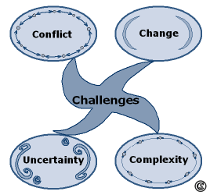
Challenges for planners and managers
Natural resource planners and managers as well as rural development planners are faced with varied and frequently interconnected challenges

Slide 17
Planning Models
Planning models describe how planning may proceed.
Several models have been developed over the past decades.
Each reflects different values and assumptions about the nature of the world for which planning is done and about the role of the planner.

Slide 18
Planning Models
Two important ones for natural resource management and development are:
  Comprehensive rational planning
  Transactive planning
Note how they differ concerning the involvement of the local population in the planning process.
It is increasingly recognised that participative ways of planning are essential for natural resource management and rural development.

Slide 19
Challenges
All states will face significant challenges over the next two decades as natural resources become increasingly scarce. However, managed intelligently, these problems are not insuperable.
Forecasting the future shape of the world has become an increasingly important part of the policy planning of states, non-governmental organizations and international organizations.

Slide 20
Aims
Introduction to the changing approaches to Natural Resource Management
Focus on three major approaches:
    Regionalisation
    Market approaches
    Co-regulation (Environmental Management Systems)

Slide 21
Why/How NRM has changed
The concepts and tools by which NRM is undertaken have been quietly (but dramatically) changed
The ‘rational’ or science-based model implemented by government action or regulation has been widely criticised
Why?
    Declining confidence in government’s ability
    Need local solutions to local problems
    Failed to improve environmental outcomes and reduce conflict over policy and management approaches

Slide 22
‘New Technologies of Governance’
Government-directed action – encounters alternate nodes of power; suffers from a lack of legitimacy
Government policy & action now mediated through other actors
‘Top down’ replaced with ‘horizontal’ approaches
The new toolkit: partnerships, collaboration, community-based policy and action, co-regulation, market instruments

Slide 23
Resource Security
Capacity to meet fundamental energy and material demands for the socio-economic development of a nation and the daily living conditions of its people.
The objective is to ensure sufficient amounts, feasible prices, and stable and sustainable supplies.
Three chains (resource supply, resource value and resource benefit), and
Three abilities (to control resources, to safeguard security, and to encourage core innovation).

Slide 24
Problem Solving and Decision Making
Problem
  A situation that exists when objectives are not being met.
Problem Solving
  The process of taking corrective action to meet objectives.
Decision Making
  The process of selecting an alternative course of action that will solve a problem.
    Managers need to make proficient decisions while performing the functions of management.

Slide 25
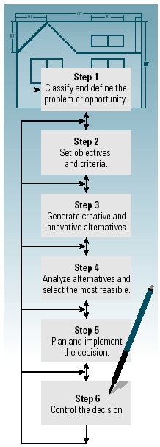
The Decision-Making Model
A six-step model that when properly utilized increases chances of success in decision making and problem solving.
Model 4–1

Slide 26
Decision-Making Styles
Reflexive Style
  Makes quick decisions without taking the time to get all the information that may be needed and without considering all the alternatives.
Reflective Style
  Takes plenty of time to make decision, gathering considerable information and analyzing several alternatives.
Consistent
  Tends to make decisions without rushing or wasting time.

Slide 27
Sustainable Rural Livelihoods (SRL) framework
Understanding of what policies and institutions are required for effective, equitable, and sustainable management of renewable natural resources.
The Sustainable Rural Livelihoods (SRL) framework is the most recent development of an approach to the analysis of links between livelihoods and natural resource use.
Sustainability of livelihood strategies of individuals or households depends on access, use, and development of different types of assets.

Slide 28
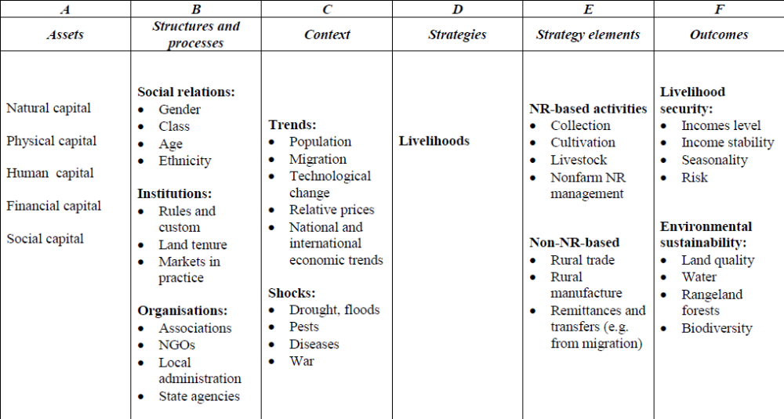
Elements of a Sustainable Rural Livelihoods framework

Slide 29
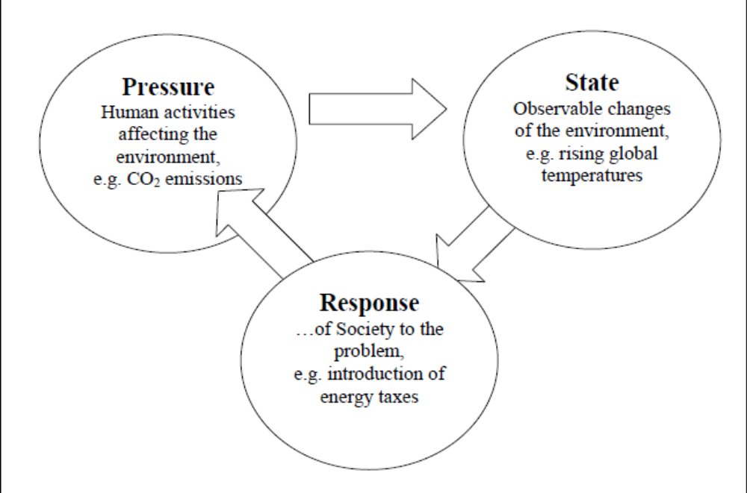
PSR Framework

Slide 30
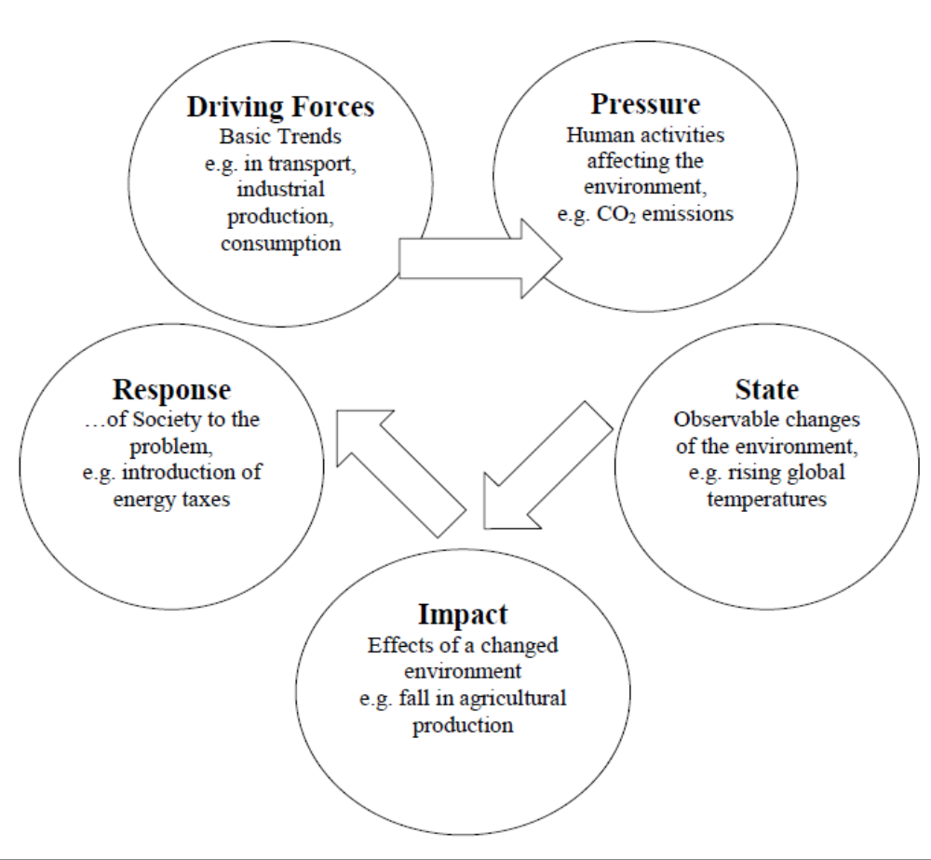
The DPSIR Framework

Slide 31
Community Based Natural Resource Management (CBNRM)
CBNRM is mostly about ways in which the state can share rights and responsibilities regarding natural resources with local communities.
Co-Management (CM) of natural resources is used to describe a partnership by which two or more relevant social actors collectively negotiate, agree upon, guarantee and implement a fair share of management functions, benefits and responsibilities for a particular territory, area or set of natural resources (Borrini-Feyerabend et al.2004)
This definition covers different ways in which the planning and implementing authority over natural resources can be shared among various types of social actors, thus refraining from any a priori indication of which model is the most appropriate.

Slide 32
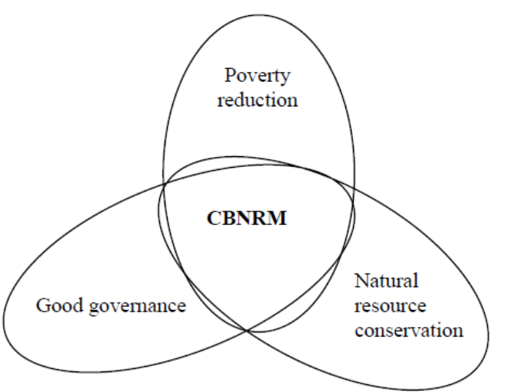
CBNRM for poverty reduction, resource conservation, and good governance
CBNRM can be considered a management strategy aiming to reduce poverty, conserve natural resources and promote good governance and decentralisation, in a single process.

Slide 33
Coupled Human and Natural Systems (CHANS)
Coupled Human and Natural Systems (CHANS) are systems in which human and natural components interact.
The science of CHANS builds on but moves beyond previous work (e.g., human ecology, ecological anthropology, environmental geography)

Slide 34
Value of Nature
In the late 1990s, a group of ecologists and economists collaborated on an effort to assign value to nature's services. In sum, they estimated that nature's services were worth approximately $33 trillion per year. (Costanza, R, D’Arge, R, De Groot, R, et. al)
Since the number was almost twice that of the global gross national product at the time ($18 trillion in 1997), the finding generated a global buzz and a generous dose of controversy.
The term “ecosystem services” came into widespread use in the ensuing dialogue and, formalizing the term in a 1997 publication, the Ecological Society of America explained that the term ecosystem services "refers to a wide range of conditions and processes through which natural ecosystems, and the species that are part of them, help sustain and fulfill human life." (Dally et al)

Slide 35

Drivers of Today’s Challenges
Lack of conceptual frameworks/ data
Lack of clarity on property rights
Lack of investment incentives
Perceptions of public sector responsibility for maintenance
Promotion of activities that undercut environmental services
‘Invisibility’ of effects, as impacts are dispersed across time and geographies
Notes:
more than 60% of the world’s ecosystems are being used in ways that cannot be sustained
many of these ecosystem services are either undervalued or have no financial value at all
as the global population swells by approximately 146 people every minute, the human strain on terrestrial, marine and freshwater ecosystems is causing some of nature's life support services to falter
There is a growing global awareness of the services that natural ecosystems provide. Still, the value of these ecosystem services and the long term costs of their loss are rarely taken into account in decisions about how natural resources are used, or into calculating their ‘cost’. Because these day-to-day management decisions often focus only on short-term financial returns, the ecosystems that provide these services are often degraded, sometimes in ways that irreparably reduce ecosystem service production.

Slide 36

Payments for Ecosystem Services
A payment for environmental services scheme is:
a voluntary transaction in which
a well-defined environmental service (ES), or a form of land use likely to secure that service
is bought by at least one ES buyer
from a minimum of one ES provider
if and only if the provider continues to supply that service (conditionality).
Notes:
Payments for Ecosystem Services (PES) are a way to incentivize land users to properly manage and conserve their natural environment – thus ensuring the flow of ecosystem services
These schemes compensate those who provide ecosystem services through direct payments, selling credits for carbon, biodiversity or water on international or national markets, or through other similar mechanisms.
Payments for Ecosystem Services (PES) deals are emerging wherever businesses, public-sector agencies, and nonprofit organizations have taken an active interest in addressing particular environmental issues. These schemes provide a new source of income for land management, restoration, conservation, and sustainable use activities, and thus have significant potential to promote sustainable ecosystem management.
Extended Notes:
PES include both monetary and non-monetary transactions. Some PES transactions provide other forms of compensation for ecosystem services, such as strengthened property rights or temporary permission to actively manage the ecosystem involved.
The key characteristic of these PES deals is that the focus is on maintaining a flow of a specified service — such as clean water, biodiversity habitat, or carbon sequestration capabilities — in exchange for something of economic value.
The critical, defining factor of what constitutes a PES transaction, however, is not just that money changes hands and an environmental service is either delivered or maintained. Rather, the key is that the payment causes the benefit to occur where it would not have otherwise. That is, the service is “additional” to the business as usual scenario, or at the very least, the service can be quantified and tied to the payment.

Slide 37
Why ‘Payments’ for Ecosystem Services?
Nature provides services free of charge
Consumption of ecosystem goods (such as timber or oil) is favored over the conservation of ecosystem services
Market forces must be realigned to invest in the production of both ecosystem goods and services
If market forces reward investments in ecosystem services, a positive feedback loop will start in which increased investments in ecosystem services leads to increased production of ecosystem goods.
This will fuel sustainable economic growth and ecological restoration

Slide 38
Land Use Planning
The purpose of land use planning is to regulate land use in an efficient and ethical way, thus preventing land-use conflicts.
Land use planning is land-use regulations, or zoning.
Zoning regulates the activities on a given piece of land, the amount of space devoted to those activities and the ways that buildings may be placed and shaped

Slide 39
Climate Change Background
Climate change is happening and it is a reality
Most victims are poor, they loss more but recover less
CC, significant barriers/challenge to meet MDGs
CC enhances existing risks and vulnerabilities
Flood, droughts, storm/cyclone, salinity intrusion etc destroys annual harvests of Asia and the Pacific
Vulnerability is highest in LDCs in the tropics and subtropical areas

Slide 40
Climate Change: Some Definitions
Weather: The state of the atmosphere at a given time and place, with respect to the variables such as temperature, moisture, pressure etc.
Climate: Average weather. Statistical description of mean weather conditions over a period of several years, typically 2-3 decades.
Climate Change: Climate Change in excess of natural variability, attributable to human activity.

Slide 41


CLIMATE CHANGE
Global Warming
Increased Precipitation & its Uneven Distribution
Melting of Glaciers & Snow
Sea level Rise
Increase in Frequency & Intensity of Extreme Weather Events
IMPACTS
Uncertainty in Water Availability
Decrease in Crop
Yields
Newer perspective for sources of energy
Loss of Biodiversity
Increased
Health Risks
Natural Climate
Variability
Climate Change
Natural + Anthropogenic
Anthropogenic Influences since the Industrial revolution
Spiraling Population
High pace of Industrialization
Increasing use of Fossil Fuels in Industry & Transport
Deforestation for Agriculture and Urbanization
Notes:
41

Slide 42
Policy Evaluation
Final step in policy making
Process to know impact of any public policy
It is about learning the consequences of public policy – Thomas Dye
The impact of any policy whether direct or indirect, immediate or futuristic, symbolic or tangible is ascertained and measured through the process of evaluation.

Slide 43
Criteria for Policy Evaluation
Effectiveness: Has a valued outcome been achieved?
Efficiency: How much effort required to achieve outcomes?
Adequacy: Does outcome resolve the problem?
Equity: Are costs & benefits distributed equitably?
Responsiveness: Do outcomes satisfy needs of target groups?
Appropriateness: Are the outcomes/objectives worthy?

Slide 44
National Climate Change Policy-Pakistan Analysis
Framework Analysis (FA)
Cost-Benefit Analysis (CBA)
Policy Process Analysis (PPA)
Discourse Analysis (DA)
Linguistic approach (Fløttum and Dahl 2012)
Keeley and Scoones Framework (2003)

Slide 45
Analysis of National Climate Change Policy of Pakistan of the study
Unrealistic policy options
Redundant policy measures
Implementation issues
Hurdles after 18th amendment
Capacity building & institutional strengthening issues
Coordination issues among the relevant departments
Lacks consultation with Pakistan’s national security
Lacks Consultation with relevant stakeholders
Does not base on Empirical evidences

Slide 46
Ecofeminism and Movements from North to South

Slide 47
Ecofeminism and Movements from North to South

Slide 48
WHY ARE WOMEN MORE VULNERABLE
Biological, social and economical differences
Women have less access to resources
Women are victims of the gendered division of labour
Women are primarily responsible for domestic duties, are caregivers
Early warning systems are orientated towards males
After a natural disaster, women are more likely to become victims of domestic and sexual violence
Migration due to climate change will leave women behind

Slide 49
FOREST MANAGEMENT IN PAKISTAN
After independence- Forest Act 1927
Forestry Policy Resolution of 1955
1962 Policy Directive on Forestry, Watershed Management, Range Management and Soil Conservation
1975 Decision of the Council of Common Interest
1980 Relevant Provision of National Agricultural Policy
1988 Recommendations of the National Commission on Agriculture
Forestry Sector Master Plan (1992)
National Conservation Strategy (1992)
1993 Policy Banning the Commercial Felling of Trees
National Forest Policy (2002)

Slide 50
Case Studies
Energy
Water
Agriculture

Slide 51
Outcomes
  Students will understand natural resource planning as a process with recognizable phases.
  Students will effectively consider the multiple dimensions (physical, biological, social, and institutional) of natural resources management.
  Students will learn to analyze a resource management problem, suggest explicit alternative management approaches, and identify potential consequences of those approaches.
  Students will become familiar with current issues in natural resources management.
  Students will develop their written and oral communications skills.
  Students will develop their abilities to analyze natural resource management policies

