Slide 1
Lecture 31
NATURAL RESOURCE PLANNING AND MANAGEMENT
Dr. Aneel SALMAN
Department of Management Sciences
COMSATS Institute of Information Technology, Islamabad

Slide 2
Recap Lecture 30
Agriculture in Pakistan

Slide 3
Water Resource Management
Water Resources Management is the integrating concept for a number of water sub-sectors
  hydropower
  water supply and sanitation
  irrigation and drainage
  environment.
An integrated water resources perspective ensures that social, economic, environmental and technical dimensions are taken into account in the management and development of water resources.

Slide 4
Overview
Pakistan is one of the world’s most arid countries, with an average rainfall of under 240 mm a year.
The population and the economy are heavily dependent on an annual influx into the Indus river system (including the Indus, Jhelum, Chenab Ravi, Beas and Sutlej rivers) of about 180 billion cubic meters of water, that emanates from the neighboring countries and is mostly derived from snow-melt in the Himalayas

Slide 5
The balance between population and available water already makes Pakistan one of the most water stressed countries of the world
with rapid population growth it will soon enter a condition of absolute water scarcity

Slide 6
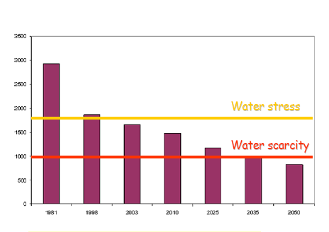
Declining Per Capita Availability Of Water In Pakistan
(Cubic Meters Per Capita Per Year)

Slide 7
Water Resources Of Pakistan
Rain fall
Glacier
Ground water

Slide 8
Rainfall
Pakistan lies in an arid and semi arid climate zone
Sources of rainfall
  Monsoon
  Western disturbances
Mean Annual rainfall
  Lower Indus Plain < 100 mm
  Upper Indus Plain > 750 mm
Average seasonal rainfall
  Kharif = 212 mm
  Rabi = 53 mm

Slide 9
Glacier
Catchment area of Indus basin contains some of the largest glacier in the world outside the polar region.
Glacier area of upper Indus catchment is abut 2250 Km² and accounts about 80% of summer runoff in river.
Kabul River originates from southern Hindukush and starts rising approximately a month earlier than Indus and fulfill the irrigation requirement of late Rabi and early Kharif crops.
Snow melt account for more than 50% of the flow in Jhelum River.

Slide 10
Surface Water Account
MAF
Average annual volume of water from rainfall and snow melt | 154.00
From Western Rivers | 144.91
From Eastern Rivers | 9.14
Diversion for irrigation | 104.73
Flow to see | 39.40
System losses | 9.90

Slide 11
Development Of Irrigation System In Pakistan
Description | Average annual withdrawals (MAF)
Under Colonial Rule (1850 – 1947) | 67
Post independence development (1947-60) | 85
Indus Water Treaty 1960 | 108~105

Slide 12
Indus Water Treaty 1960

Slide 13
Salient Features
All waters of eastern rivers namely Ravi, Beas and Sutlej allocated to India.
All waters of western rivers namely Indus, Jhelum and Chenab allocated to Pakistan except some specified uses in occupied Kashmir.
Pakistan to meet the requirements of its eastern river canals from the western rivers by constructing suitable replacement works.
Safeguards incorporated in the treaty to ensure unrestricted flow of waters in the western rivers.

Slide 14
Salient Features
Either party constructing a work affecting the other party to inform the other party at least six months in advance and supply necessary details to enable the other party to satisfy itself that the proposed work does not adversely affect the other party.
Permanent Indus commission constituted to watch implementation of the treaty and resolve by negotiations any problem arising thereof.
Procedure for settlement of differences and disputes outlined.

Slide 15
Indus Basin Projects
DAMS
i) Terbela on River Indus.
ii) Mangla on River Jhehlum
NEW BARRAGES
i) Chashma Barrage on River Indus
ii) New Rasul Barrage on River Jhehlum
iii) New Marala Barrage on River Chenab
iv) Qadirabab Barrage on River Chenab
v) New Sidhnai Barrage on River Ravi
vi) Mailsi Syphon on River Sutlej

Slide 16
NEW LINK CANALS
  i) Chashma Jhelum Link (C-J Link)
  ii) Taunsa Panjnad Link (T-P Link)
  iii) Rasul Qadirabad Link (R-Q Link)
  iv) Qadirabad Balloki Lin (Q-B Link)
  v) Balloki Sulemanki Link II (B-S Link II)
  vi) Trimmu Sidhnai Link (T-S Link)
  vii) Sidhnai – Milsi – Bahawal Link (S-M-B Link)
OLD BARRAGES REMODELLED.
  i) Trimmu Barrage
  ii) Balloki Barrage

Slide 17
Water Accord 1991

Slide 18
Salient Features
Existing uses of provinces remain untouched and protected.
N.W.F.P / Baluchistan projects which are under execution are provided their authorized quota of water as existing uses.
Need for additional storages on the Indus and other rivers admitted and recognized for planned future agricultural development.
Need for minimum escapages to sea below Kotri to check sea intrusion recognized. Further studies desired to establish minimal escapage needs below Kotri.

Slide 19
Salient Features
No restrictions on Baluchistan to develop water resources of Indus tributaries flowing through its area.
Need for establishing Indus river authority for implementation of the accord recognized and accepted.
IRSA to have headquarters at Lahore and to have representation from the four provinces.
Sharing procedure laid down in Para 14(b) of the accord
Provinces are free to under take new projects within their agreed shares.
Within their allocations provinces may modify uses both system wise and period wise.

Slide 20
Indus River System Authority
Comprises Five Members. One from each Province and one from Federal Government.
First Chairman Member Balochistan followed by KPK, Punjab, Sindh and Federal.
Term of Office
  Chairman One Year
  Member Three Years

Slide 21
Decision Making Process In IRSA
Decisions taken by majority votes.
In case of equality of votes, chairman exercises casting vote.
Aggrieved party to approach Council of Common Interest for redressal.

Slide 22
Water Management Procedure
IRSA prepares the forecast of water availability for Kharif and Rabi crops.
Based on water availability Forecast IRSA determines Provincial shares according to Water Accord Provisions.
Punjab prepares Canal Operation / Distribution Program based on its share in consultation with Punjab Agriculture Department.
If Punjab share is short of requirements Rotational Program of operation of channels is prepared and implemented by the field formations.

Slide 23
Pakistan Water Strategy And Wapda’s Vision 2025
The Pakistan Water Strategy and WAPDA’s Vision 2025 have reviewed likely future demands and the implied requirements for storage.
If no new storage is built, canal diversions will remain stagnant at about 104 MAF and the shortfall will increase by about 12% over the next decade.
The Pakistan Water Strategy calculates that Pakistan needs to raise storage capacity by 18 MAF (6 MAF for replacement of storage lost to siltation and 12 MAF of new storage) by 2025 in order to meet the projected requirements of 134 MAF.

Slide 24
Agriculture: Backbone of economy
Agriculture is the main player of the economy of Pakistan with 21% contribution to GDP and more than 45% contribution in labour force
Pakistan’s agriculture rely heavily on irrigation.
Pakistan has the world’s largest contiguous irrigation system
Pakistan ranks 4th in the world as for as irrigated area ( About 7%) is concerned. About 36 MA( About 75% of the cultivated area) in Pakistan is irrigated land.
Pakistan has invested heavily in the irrigation sector. Allocated about $ 8 billion in this sector upto the year 2011-12
Irrigation: Life blood of agriculture

Slide 25
Consumption Pattern of Water

Slide 26
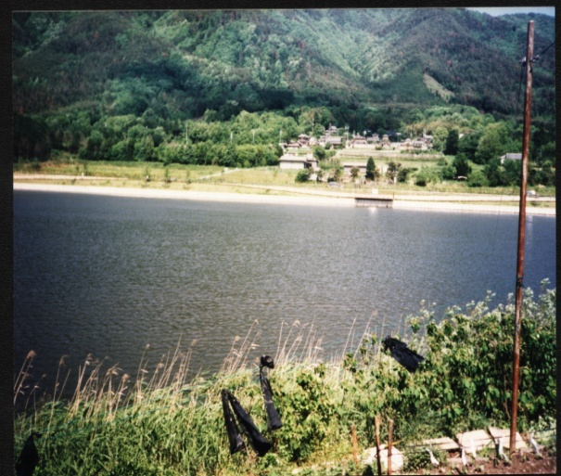
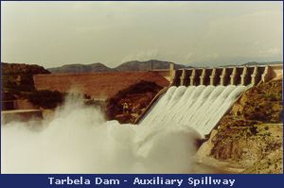
Water Resources of Pakistan
Rainfall
Annual rainfall (125mm in South-East to 750mm North-West)
Total water generated by rainfall is around
32 BCM
Contribution to crops is 10-20%
Groundwater
Exploitation of Groundwater is 59 BCM
Over 9,00,000 private tubewells
40% of total supply at farm-gate
Surface Water Resources
Total Inflow is 171 BCM
Tarbela (10.38 BCM - 485 ft),
Mangla (5.90 BCM - 380 ft)
48 Canals (61000 km), 19 Barrages
1,70,000 Watercourses (1.6 Million km)

Slide 27
Existing Situation
Water is becoming scarce with each passing day. Per capita availability of fresh water in Pakistan has decreased by about 800% since 1950.
Efficient and judicious use of the irrigation water is the only sustainable option left with us.
Surface water is still the largest source of irrigation in Pakistan (31% as a single source)
Irrigation system is over burdened and loosing its efficiency due to increasing gap in actual and required O&M expenditures (Actual O&M expenses made only about 20-30% of required expenses)
Govt. has to subsidize major portion of the O&M expenditures (about 70% according to an estimate)

Slide 28
Freshwater availability scenario (Per person)
Global
  1950 – 16,800 cubic meters per annum
  2000 – 6,800 cubic meters per annum
  Reduction: 60 % in 50 years
Pakistan
  1950 – 5,300 cubic meters per annum
  2000 – 1,200 cubic meters per annum !!!!
  Reduction: 77 % in 50 years
Critical limit 1,000 cubic meters per person per annum

Slide 29
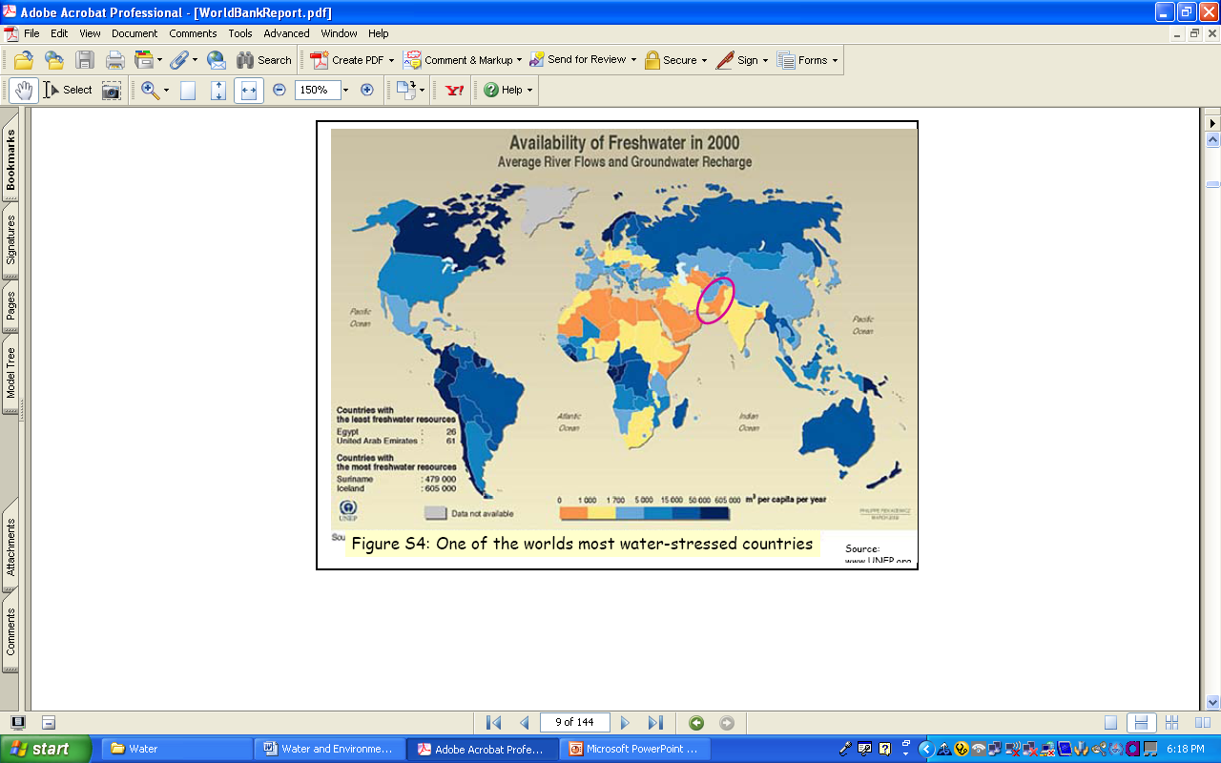
Future Water Scenario
Year Population Water availability
(Million) per capita (m³)
1951 34 5300
1961 46 3950
1971 65 2700
1981 84 2100
1991 115 1600
2000 148 1200
2010 168 1066
2020 196 915
2025 209 850

Slide 30
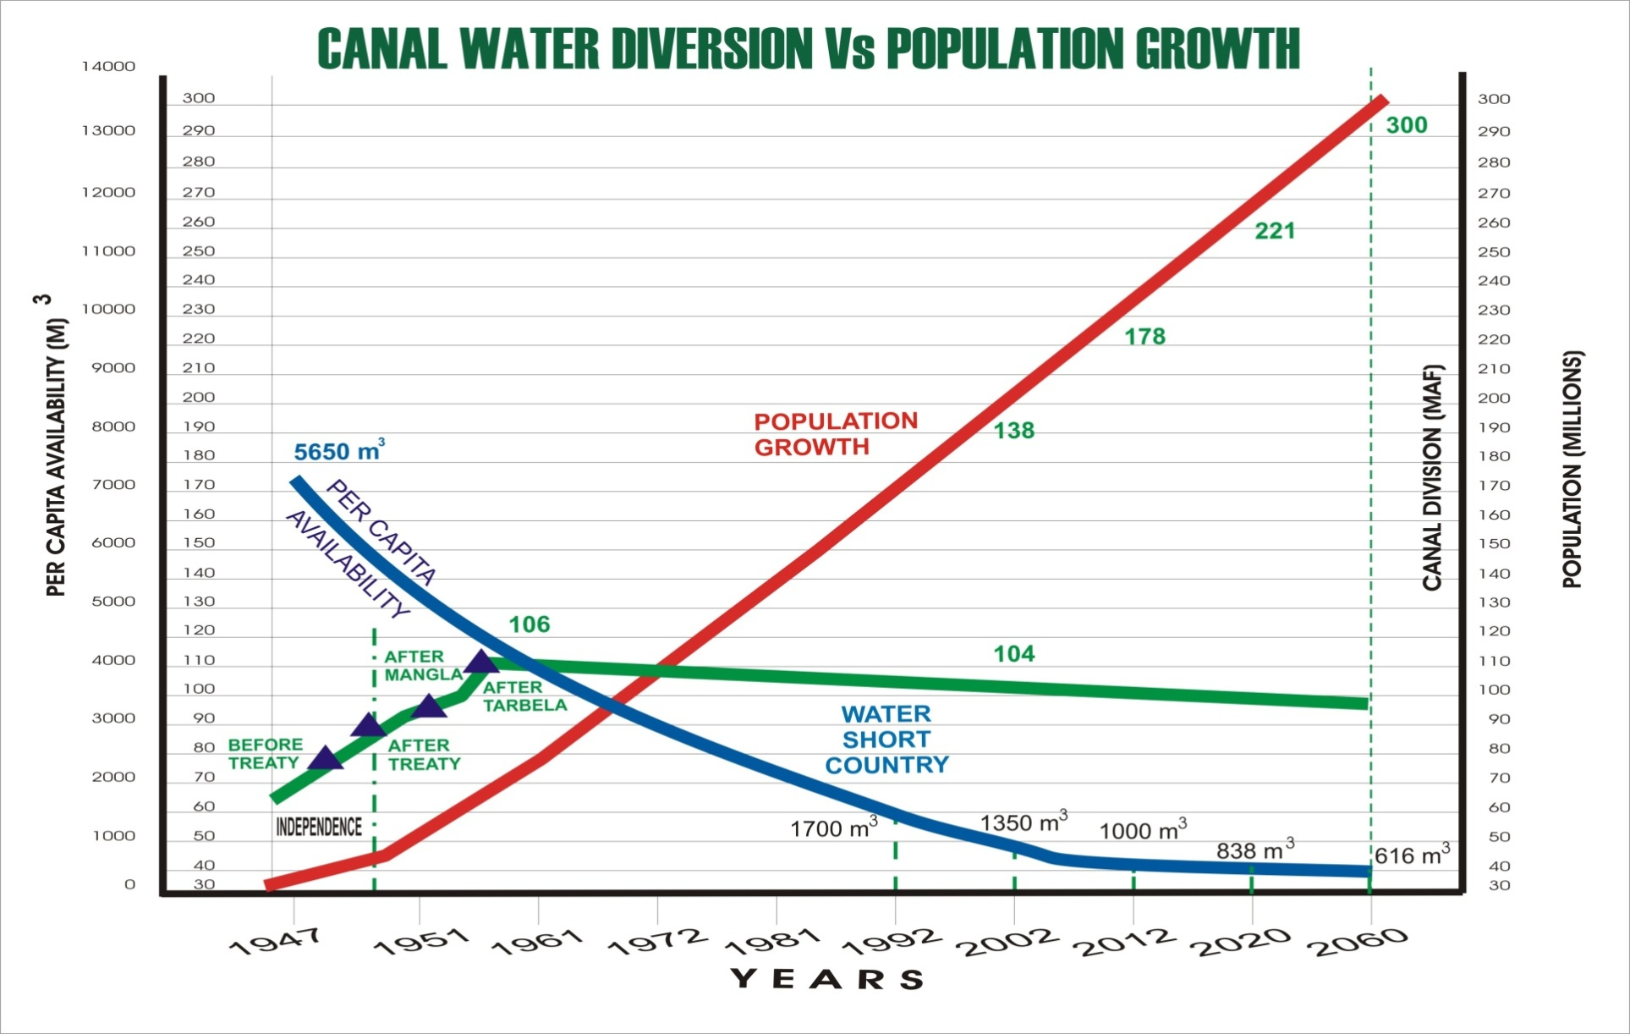
Rising Water Demand But Stagnant Water Availability

Slide 31
Current Irrigated Area
Irrigated Area | 36 million acres (14.56 million hectares)
Length of Canals | 56,073km
Length of Water Courses | 1.6 million km

Slide 32
Losses at different levels
Location | Delivery at Head (MAF) | Loss
 |  | % age | MAF
Main and Branch Canals | 106 | 15 | 16
Disty. And Minors | 90 | 8 | 7
Watercourses | 83 | 30 | 25
Fields | 58 | 30 | 17
Crop Use | 41
Total |  | 62 | 65
30%
The additional irrigation water requirement at farm gate has been estimated at 12.61 MAF, which is 31.93 MAF at canal head (PWSS 2002). Which we can save even if we save water at water course level

Slide 33
Major Concerns/Problems
A : Problems from management perspective
Overall water scarcity, low water availability during winter and at the beginning and end of summer with limited reservoir capacity.
Physical and technical limitations of the system.
Low efficiency in delivery and use.
Inequitable water distribution.
Inadequate operation and maintenance of the system
Excess seepage and wastage in the system.
Insufficient cost recovery ( O&M expenditures are more than recovery of Aabiana).
Administrative and financial constraints.

Slide 34
Contd…
B- Problems from Farmer’s Perspective
Unreliable and inequitable distribution of irrigation water.
Deterioration of the canal system and frequent breaches due to weak bands.
Increased cases of water theft and failure of management to check them.
Increase in water disputes and delay in actions and justice.
Political interference in system management.
Increasing cost of groundwater extraction

Slide 35
Contd…
C- Problems From Society’s Perspective
      Overall poor performance of Government agency managed irrigation system.
      Wastage of water and low water use efficiency.
      The failure of government to finance, recovery from farmers and high cost of management.
      Financial mis-management and poor accountability.
      Lack of farmers participation in decision making.
      Political influence in management of irrigation water delivery system.
    Overexploitation of future water resources especially the groundwater

Slide 36
Irrigation Issues
Supply driven rather than demand led distribution of water without consideration of cropping pattern
Inequity of irrigation water both inter and intra provincial level and watercourse level
Deferred operation and maintenance of centuries old irrigation system
System losses as high as 55%
Slow and lackluster approach for watercourse improvement and lining
Lack of water conservation and application techniques at the farm level

Slide 37
Options for Improving Irrigation Water Productivity-Technical
Land leveling to apply water more uniformly
Efficient sprinklers to apply water more uniformly
Furrow and bed cultivation to save water
Drip irrigation to conserve water

Slide 38
Options for Improving Irrigation Water Productivity Managerial
Better irrigation scheduling
Improving canal operations for timely deliveries
Applying water when most crucial to a crops yield
Water-conserving tillage and field operation methods
Better maintenance of canal, watercourses and equipment
Recycling drainage water

Slide 39
Options for Improving Irrigation Water Productivity-Institutional
Establishing water users organizations for better management of water
Fostering rural infrastructure for private sector dissemination of efficient technologies
Better training and extension efforts

Slide 40
Options for Improving Irrigation Water Productivity- Agronomic
Selecting crop varieties with high yields per cubic meter of transpired water
Inter-cropping to maximize use of soil moisture
Better matching crops to climate conditions and the quality of water available
Crop rotations to maximize output under condition of soil and water salinity
Selecting drought-tolerant crops where water is scarce or unreliable
Breeding water-efficient crop varieties

Slide 41
Options For Future Water Development- I
Surface Water
  Additional storage to replace lost capacity of existing dams - 6 MAF
  Additional storages to add new supplies to the Indus basin canal diversions - 14 MAF
  Saving of conveyance losses in canals and watercourses - 20 MAF
  Development of Spate Irrigation System in Rod-Kohi, Sailaba and Riverain areas covering 3.25 million hectares
  Small dams and earthen ponds to store runoff in mountainous and Barani areas of KPK, Punjab and Balochistan - 2 MAF

Slide 42
Options For Future Water Development- II
Groundwater
  Sustained pumping upto 55 MAF
  Energy and water efficient pumping systems
  Amending and managing poor quality groundwater
  Skimming wells for southern Pakistan

Slide 43
Irrigation Strategies
Crash Program for cleaning of watercourses, minors and distributaries.
Remodeling of moghas for uniform distribution of water.
Crop independent Abiana on gross farm area.
Minimize element of rent seeking by irrigation personnel.
Investment in surface supplies to improve remaining watercourses.
Management” put on hold for want of funding.
Consensus on new dams sites is imperative to ensure water supplies
Increase cropping intensity within Riverine area by better water management at system level.

