Slide 1
Lecture 03
NATURAL RESOURCE PLANNING AND MANAGEMENT
Dr. Aneel SALMAN
Department of Management Sciences
COMSATS Institute of Information Technology, Islamabad

Slide 2
Recap Lecture 02
Basic Concepts
Classification by use
Classification by development
Three Rs
Need for Management of Natural Resources
Forests
Wild Life

Slide 3
Water

Slide 4
Uses of water
Water is a basic necessity for all living things.
We use water for our daily needs, for agriculture, transportation, construction of buildings, roads, dams etc.
Water is a natural habitat for aquatic organisms.
Human activities are affecting the availability of water and causing pollution of water bodies.

Slide 5
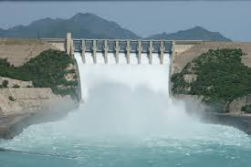
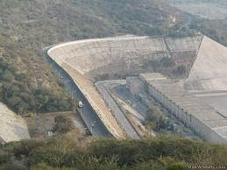
Dams

Slide 6
Advantages of dams
Irrigation of crops.
Producing electricity.
Supplying water to towns and cities.
To control floods.

Slide 7
Disadvantages of dams
Social problems :- It displaces a large number of people who have to be rehabilitated.
Economic problems :- It is expensive and uses a huge amount of public money.
Environmental problems :- It causes deforestation and loss of biodiversity.

Slide 8
Water harvesting (Rain water harvesting)
Water harvesting is collecting and storing rain water for future use.
The common methods of water harvesting are :-
  Digging pits, ponds, lakes etc.
  Building small earthen dams or concrete check dams.
  Construction of dykes.
  Construction of reservoirs.
  Construction of rooftop collecting units in houses.

Slide 9
Advantages of underground water
It does not evaporate easily.
It spreads out and recharges wells.
It provides moisture for irrigation of crops.
It does not get polluted easily.
It does not provide breeding ground for mosquitoes and houseflies.

Slide 10
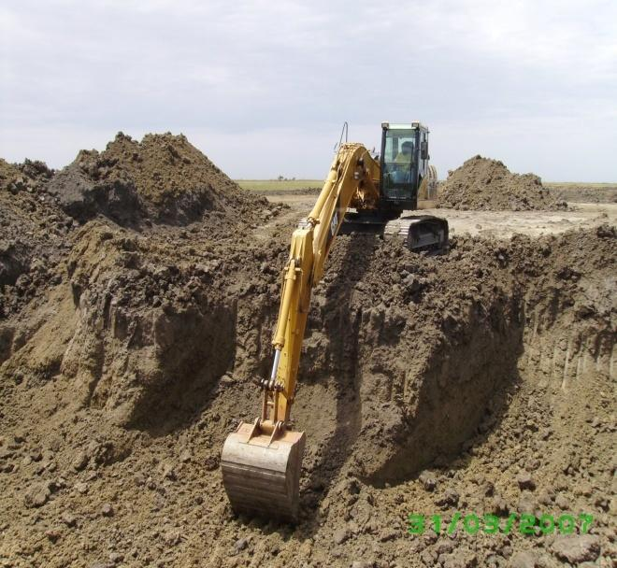
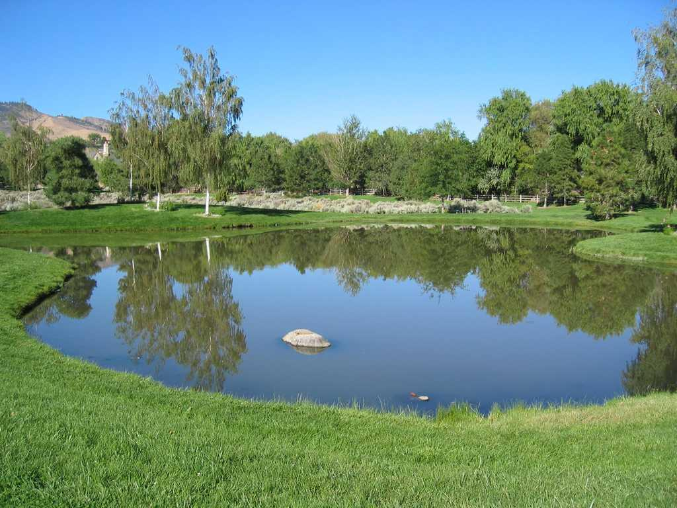
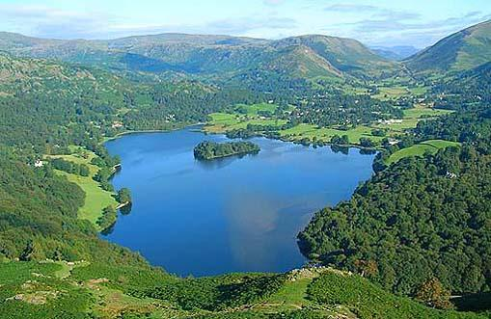
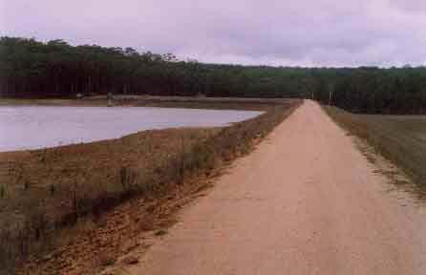
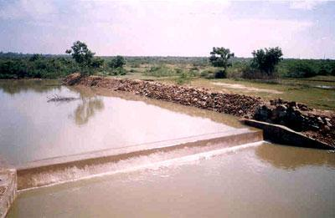
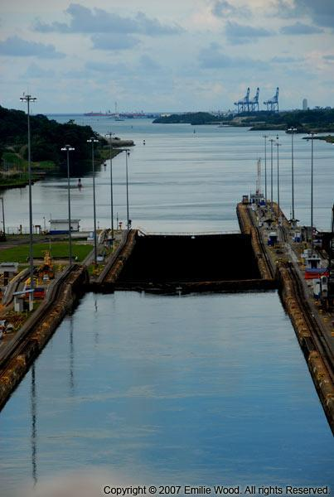
Different methods of water harvesting

Slide 11
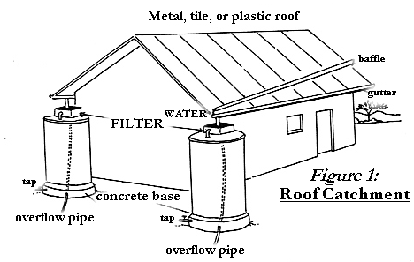
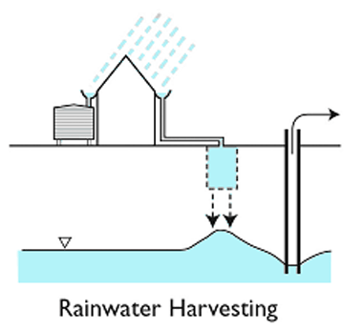
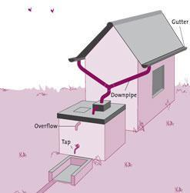
RAINWATER HARVESTING

Slide 12
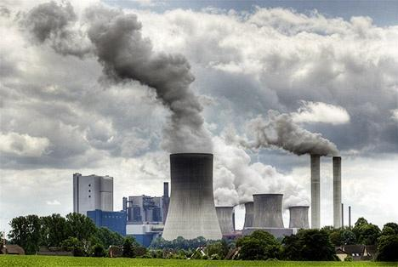
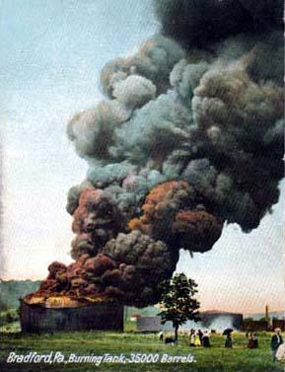
Coal and petroleum

Slide 13
Coal and petroleum
Coal and petroleum are fossil fuels formed by the decomposition of dead plants and animals inside the earth after several millions of years. They are non-renewable sources of energy.
Petroleum reserves may last for about 40 years and coal reserves may last for about 200 years.
Coal and petroleum contain carbon, hydrogen, nitrogen and sulphur. When they are burnt, they release carbon dioxide and oxides of nitrogen and sulphur.
Carbon dioxide is a green house gas which causes global warming.
Oxides of nitrogen and sulphur combines with moisture in the air and produces acid rain.

Slide 14
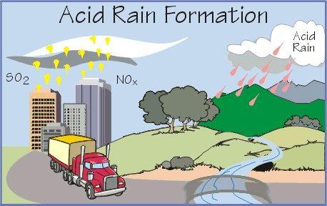
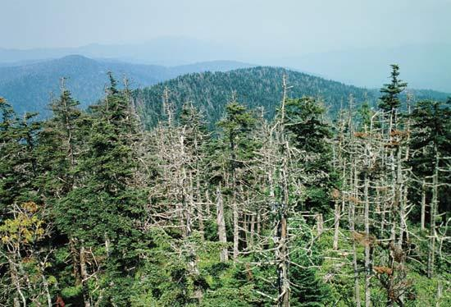
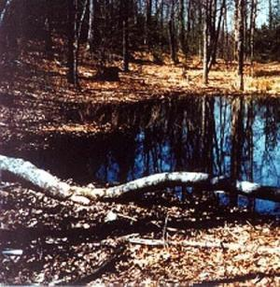
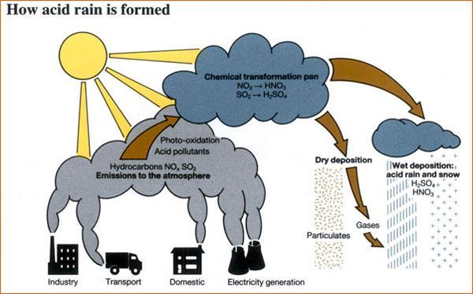
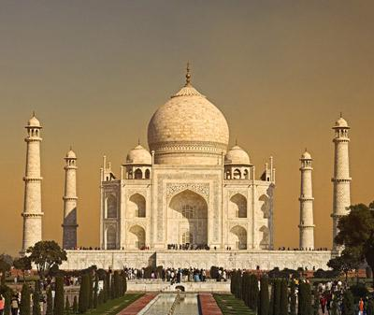

Slide 15
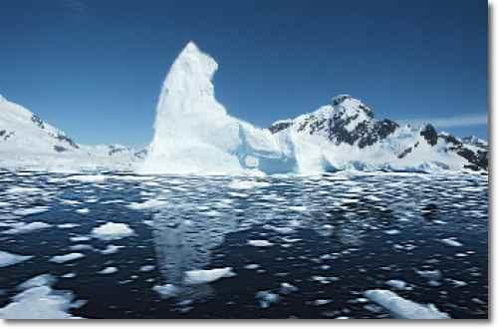
MELTING OF POLAR ICE

Slide 16

RISE IN SEA LEVELS

Slide 17
Natural Resource Management and Planning
In the past few decades, management of natural resources has become an important topic in practically all societies.
Natural resources are materials created in nature that are used and usable by humans.
They include natural substances (such as soil) and energy supplies (such as coal) that serve to satisfy human needs.
Materials occurring in the environment thus only become a resource if people attach great importance to them.
As Zimmermann stated: „Resources are not, they become“ (Zimmermann 1951, citied in Barsch and Bürger 1996).

Slide 18
Why Natural Resource Management is necessary
Natural resources are the basis of human life (Simmons 1993).
We use these varied natural resources in different ways to satisfy our needs and wants – eating and drinking, growing food, making clothes, building houses and transport, for example.
However, natural resources are not infinitely available for human use. Not only non-renewable but also (theoretically) renewable resources are limited. So communities should be economical with their natural resources in a sustainable manner.

Slide 19
In many regions of the world, this general shortage problem is aggravated by the degradation and destruction of natural resources (e.g., soil erosion).
This is mainly due to overuse or a non-adapted use of these resources
The resistance and regenerative power of many landscape systems are thereby exceeded.
Water balance problems threaten the living conditions of communities and limit the use of resources (e.g., destructive flooding, droughts). These problems are indicators of a non-sustainable management of natural resources.

Slide 20
As a result, some possible uses of resources are increasingly restricted.
Food production and rural livelihood may be threatened as well as resource use conflicts may occur
Finally, the development chances of the specific region are increasingly impaired.

Slide 21
Sustainable management of natural resources is needed
to avoid further degradation and destruction,
to solve the water balance problems and
to improve the conditions of the resources.
This requires careful and competent planning. For this, skilled planners and managers are required

Slide 22
Definition of planning
"Planning is usually interpreted as a process to develop a strategy to achieve desired objectives, to solve problems, and to facilitate action" (Mitchell 2002, 6).
The role of the planner is thus to identify a desirable future and to prepare a course of action to achieve this goal (Mitchell 2002). He records this in a plan.
Natural resource planning thus is - with regard to resources - "the identification of possible desirable future end states, and development of courses of action to reach such end states" (Mitchell 2002, 6).

Slide 23
Definition of management
Management refers to the controlling and planning of details.
By judicious use of available means the actual decisions are made and actions are carried out to achieve the objectives.
Management thus requires both plans and objectives.

Slide 24
The manager has therefore to control, handle and direct the decision-making and the course of action. He has the responsibility and the authority to allocate the capital, technology and human resources to achieve the desired end.
Natural resource management thus comprises actual decisions and actions concerning policy and practice regarding how resources are appraised, protected, allocated, developed, utilized, processed, rehabilitated, remediated and restored, monitored and evaluated.

Slide 25
This management process includes the broad economic, social, environmental and technical considerations that influence natural resource management decision-making.
Management is complex and requires substantial advance planning.
Planning the development and management of natural resources should involve the broader development goals of the community aiming to improve the living conditions of the local population (such as marketing opportunities for the cultivated crops).
In this context, natural resource management means less the outright protection of natural resources (e.g., game reserves to which local people are denied access); rather it means a sustainable and environmentally appropriate management

Slide 26
Requirements of management and planning
In view of the human dependence on natural resources and their exhaustibility a natural resource management and a societal development are required which are sustainable and environmentally appropriate.

Slide 27
Sustainability and environmental appropriateness
Resources have to be managed in such a way that the demand of the present generation can be satisfied without exhausting, degrading or destroying them in the long term in order to preserve them as a basis of survival for future generations (intergenerational equity). Such a management for the benefit of the people and in harmony with the environment implies that
  resources are only to be used if they are renewable
  resources are used at rates that correspond to the replenishment rates or at an intensity which does not exceed the carrying capacity of the system.
Unfortunately, most management practices of today are not sustainable.

Slide 28
The overall societal development has to be sustainable as well.
Sustainability in all its dimensions can only be attained if the goals are defined according to the environmental, socio-economic, political and institutional framework.
For example, winter sport tourism cannot be economically and ecologically sustainable in a region only receiving snow five days per year on average. Here, the pistes has to be prepared by snowguns consuming valuable water and energy resources.

