Slide 1
Lecture 29
NATURAL RESOURCE PLANNING AND MANAGEMENT
Dr. Aneel SALMAN
Department of Management Sciences
COMSATS Institute of Information Technology, Islamabad

Slide 2
Recap Lecture 28
Shigar Valley Case Study

Slide 3
Energy Situation in Pakistan
Pakistan’s primary energy supply heavily depends upon the imported crude oil & petroleum products because of low production capacity of crude oil and natural gas.
During calendar year 2012, net primary energy supply remained 64, 727 thousand TOEs compared to 64,522 thousand TOEs last year thus posting growth of 0.32 percent, however, on average the growth rate of net primary energy supply remained 1.8 percent for last six years.
Energy outages hampered economic growth of Pakistan for last few years.

Slide 4
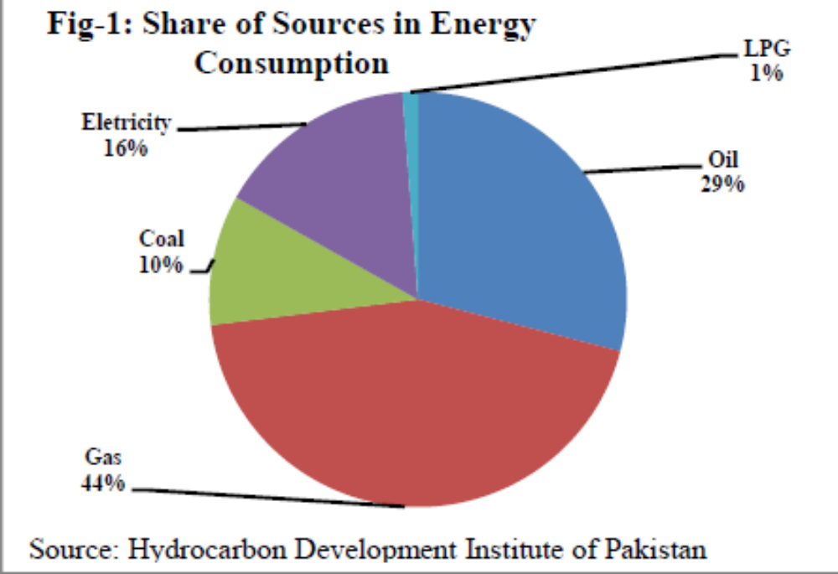

Slide 5
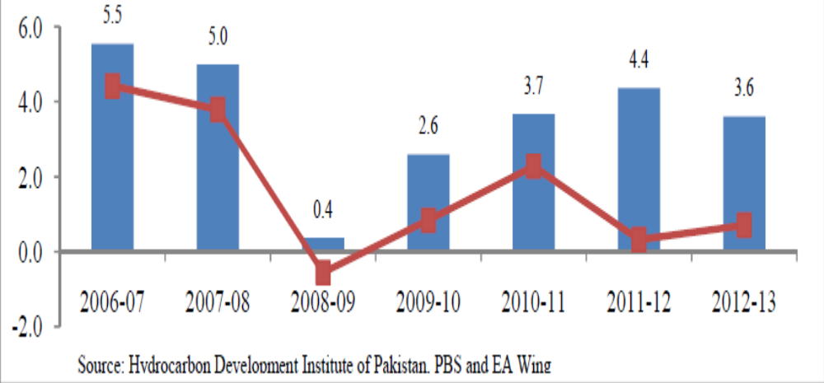
Relation between growth rate of GDP and energy consumption

Slide 6
Energy policy of Pakistan
The energy policy of Pakistan is formulated and determined by the federal, provisional, and local institutional entities in Pakistan, which address the issues of energy production, distribution, and consumption of energy, such as gas mileage and petroleum standards.
Energy policy requires the proper legislation, international treaties, subsidies and incentives to investment, guidelines for energy conservation, taxation and other public policy techniques.

Slide 7
Several mandates and proposals have been called over the years to overlook the energy conservation, such as Neon signs were banned and the official weekend was extended from one to two days in an attempt to conserve electricity (Gillani, 2010)
Reducing the electricity load used by industrial units by 25% during peak hours (Aziz, 2007) but no comprehensive long-term energy strategies were implemented.
Since 1999, many legislative provisions were adopted for energy conservation including the seeking energy from various renewable energy sources.
There is also an intense criticism about the unequal distribution of energy, the irresponsible usage of energy sources, and the country's new plan which is aimed to raise country's dependence on imported oil for power generation to 50% by 2030.
After much public criticism, the long-term energy security policy was announced in 2013 through the introduction of equal cutting edge energy transmission network, minimizing financial losses across the energy system and aligning the ministries involved in the energy sector as well as improving the governance of energy sources.

Slide 8
Studies and policy implementation recommended by AEDB, Water ministry (as policy enforcer), the NEPRA regulates the energy sources network as well as determining the financial prices of the usage of energy.
Government-specific energy-efficiency incentive programs also play a significant role in the overall energy policy of Pakistan. As of 2013 Prime Minister Nawaz Sharif has announced a determined and aggressive energy policy to meet the energy challenges and energy management.

Slide 9
Energy authorities and institutions
Government of Pakistan
  Ministry of Water and Power
  Alternative Energy Development Board
Industrial energy sector
  Electricity sector in Pakistan
  Electricity in Pakistan
Energy and power regulatory authorities
  Water and Power Development Authority
  National Electric Power Regulatory Authority
Energy corporations
  Electricity and energy corporations in Pakistan
  Karachi Electric Supply Company

Slide 10
Background
1960s: Large civilian energy input and infrastructure was built by the Pakistan military, with the financial funds provided by various countries and international monetary sources.
1960s: Much of the energy was produced by the hydroelectric dams and thermal power stations.
1970s: Pakistan's energy consumption expanded to nuclear power sources with the establishment and commissioning of first nuclear power station in Karachi.
1980s: Dependence on nuclear sources further grew and the military continued engineering and building the nuclear power infrastructure.

Slide 11
1994: Prime Minister Benazir Bhutto of Pakistan Peoples Party (PPP) launched the country's first ever and largest energy conservation program to produce 13,000MW and issues 70 Memorandum of Understandings (MOUs) and Letters of Intent (LOIs) to Independent Power Producers (IPPs).
1994: Energy policy brought a decisive shift in Pakistan's diverse energy sources.
In 1994, out of the total installed capacity of 11000MW, ~60% of energy was produced from the hydroelectric power sources while nearly ~40% was produced from the thermal and nuclear sources.
This mix was reversed from 60:40 to 30:70 in favor of thermal capacity based on imported fuel (Sartaj Aziz).
Every year, this ratio went down further to 20:80 in winter months as hydropower generation was reduced due to lower water flows in the rivers.

Slide 12
Controversially, the energy policy depended less on renewable energy sources and dependence on imported oil increased that created a permanent fault in country's energy conservation system.
1995: Only 27 IPPs were able to generate ~6,335MW of electricity.
1998: Ratio was stabilized by the policies enforced by Prime Minister Nawaz Sharif.
2001: Military government led by President Pervez Musharraf and Prime Minister Shaukat Aziz, while contributing to the growth of domestic demand for electricity through large scale provision of bank loans for the purchase of air-conditioners and home appliances (share of domestic energy consumption had jumped to 46% of the total by 2008), did not add any new capacity to the energy system.

Slide 13
Alternative Sources of Energy
The government of Pakistan (GoP) has been taking all possible measures to ensure energy security and sustainable development in the country.
The government in its bid to diversify its energy mix, has been giving due attention towards fast track development of Alternative / Renewable Energy (ARE) resources in the country.
Alternative Energy Development Board (AEDB), under the Ordinance was mandated to implement policies, programs and projects through private sector in ARE sector; assist and facilitate development and generation of ARE to achieve sustainable economic growth; encourage transfer of technology and develop indigenous manufacturing base for ARE Technology; and promote provision of energy services that are based on ARE resources.

Slide 14
In May, 2010, AEDB was given the mandate to implement ARE commercial projects on its own or through joint venture or partnership with public or private sector entities in addition to its mandates under the ordinance. AEDB has updated the Renewable Energy (RE) Policy, 2006, in consultation with the provinces and other stakeholders.
The RE Policy, 2006 was focused only on Solar, Wind and Hydro; whereas, ARE Policy, 2012 includes all ARE technologies including Wind, Solar, Hydro, Bagasse, Cogeneration, Waste-to- Energy, Geothermal, providing extremely attractive financial and fiscal incentives to both local and foreign investors while offering them a level playing field.

Slide 15
The ARE Policy invites investment from private sector for
  Independent Power Projects (IPPs) for sale of power to the grid only.
  Grid spillover power projects for self-use and sale to utility.
  Captive power projects for self or dedicated use.
  Isolated Grid Power Projects.

Slide 16
Supportive Measures
New wind corridors in areas outside Sindh have also been identified. Resource assessment of these corridors underway and a number of wind measuring masts are being installed in all four provinces.
National Grid Code for wind power projects has been amended. Grid Integration Plan 2010 -2015 for wind power projects is developed by AEDB to support NTDC.
Regional Environmental Study has been conducted by AEDB to support wind power projects. Guidelines for environmental assessment have also been developed.

Slide 17
Trainings & capacity building of partner departments like NTDC, NEPRA, PMD, DISCOs, Provincial Government Departments, etc. have been arranged by AEDB.
MoU between General Electric (GE)& Government of Pakistan has been signed that includes execution of wind power projects and setting up of manufacturing facility with in the country.
Local manufacturing of micro wind turbine has been started. Manufacturing for large wind turbines is also being initiated. The turbine towers for the first project are being manufactured in Pakistan. World leading WTG manufacturers are also in talks with local investors and agencies to start full scale manufacturing facilities.

Slide 18
Issues related to financing of projects have been resolved and now leading financing agencies like IFC, ADB, OPIC, ECO Trade Bank etc. are offering financing to wind power projects in Pakistan.
There existed a shyness in adopting ARE technologies applications amongst the people, as these are new in the country. AEDB initiated mass campaign to create awareness of these technologies with support of media and stakeholders. A number of international and national level exhibitions were organized, road shows arranged, talk shows / seminars / conferences were arranged to attract entrepreneurs for investments and consumers to buy the ARE equipment.

Slide 19
As a result of the government’s will to develop ARE sector and the AEDB’s extensive and untiring efforts, the country has made significant progress in the development of a considerable base of ARE technologies in the country, especially Wind, Solar, Biomass, Waste to Energy, Small / Mini / Miro Hydro, Biodiesel.

Slide 20
Policy overview
Energy policy: 2008–10
2005: Prime Minister Shaukat Aziz announced the long-term energy security program which was aimed to the development of the power infrastructure from all energy sources.
This policy relied on privatizing the energy sector by international mega energy corporations.
Controversially, this program was aimed to raise dependence on imported oil from the Arab countries for power generation to be increased by 50.1% by 2013.
2006: Prime Minister Aziz held conversation with the officials of the Saudi Ministry of Petroleum and invited Ali Al-Naimi to invest in country's energy sector.
2007: Prime Minister Aziz allocated ₨. 12.5 billion for power production-related projects which remained unutilised. In his last policy statement, Prime Minister Aziz further called for banning the Neon lights, Neon signs, and to close the market places by 9PM; such policy enforcement was harshly resisted by the left-wing parties, such as Pakistan Peoples Party, Communist Party and the labour unions

Slide 21
Energy Policy: 2010–13
After the general elections held in 2008, the mismanagement and weak policies led to an intense repetitive cycle of loadshedding in the country.
Responding to a massive demonstration against the loadshedding and the growing power shortages in the country, Prime Minister, Yousaf Gilani announced the "energy policy" on 22 April 2010.
The policy was announced after the Prime Minister, Gilani had held a three-day national energy conference in Islamabad with energy experts that discussed the causes of the power crisis in Pakistan and possible steps to relieve it.
On an immediate effects, the gaseous Neon lights and the signs were banned and the official weekend was extended from one to two days in an attempt to conserve electricity.

Slide 22
Energy Policy: 2010–13
Under this policy, several attempts were made by Gilani government to privatized the energy sector.
Devised by the Finance Minister Abdul Hafeez Shaikh, the programme failed to resolve electricity shortage, which private energy companies failed to maintain and upgrade despite being part of their contract.
After much criticism and public demonstration in 2012, the PPP government decided to nationalized the energy sector and issued clear directives to regulate the energy corporations to produce the power generations

Slide 23
Energy Policy: 2013–Present
Musadik Malik has been entrusted to develop Energy Policy for Pakistan. He was appointed Federal Minister, Water and Power of the Pakistan Government in 2013.
2014: The National Energy Policy 2013-18 aims at achieving the goals of social development and prosperity for the country, highlighted earlier as ‘Roshan Pakistan’ in Pakistan Muslim Leage-Nawaz’s (PML-N) manifesto.

Slide 24
National Energy Policy 2013-18
Salient Features
Power sector subsidy would be phased out till it is put to an end. (Unstoppable flood of inflationary pressure would create havoc in the lives of the common people in the country)
End to load shedding would be made possible till 2017 and surplus electricity in 2018. (Without proper utilization of all available natural resources, mix of alternative energy resources and above all creation of strategic balance in the power generation chain, it would not be possible).
Privatization of government owned power plants and little power distributing companies (Discos), bringing the double digit cost of power generation to a single digit. (Levels of productivity and efficiency of the private sector of the country is not so encouraging to meet the demands).

Slide 25
Salient Features
Restructuring of water and power ministry, National Electric Power Regulatory Authority (Nepra) (It may pay dividends, provided all the key appointment will be made on merit and without any political compromise).
Oil and Gas Regulatory Authority (Ogra) adjustment of outstanding dues owned by the government and privately owned bodies through federal adjusters (Financial discipline would hold the key of success).
Formation of regional transmission and power trading system would be made. (Role of provincial governments would be crucial in the days to come).

Slide 26
It focuses the government’s efforts on reducing the weighted average cost of producing electricity by shifting to cheaper fuels and cracking down more forcefully on theft.
It proposes charging higher rates from industrial and upper-middle class household consumers, who have heavy electricity use and for whom the higher tariff, coupled with a guarantee of uninterrupted supply, would still be cheaper than running back-up generators.
It proposes privatisation of state-owned energy companies to reduce the influence of corrupt labour unions.

Slide 27
Philosophical inputs
Philosophical inputs are always good for reading but hard to implement especially where there is a chain of corruption.
It has some philosophical inputs too. It speaks about the importance of honesty, transparency, financial discipline and accountability which are parts of parcels of a bygone story in our parts of the world.
It has long term goals aiming to build a power generation capacity that can meet country’s energy requirements in a sustainable manner.
It also aims to create a new culture of achievement, rights and responsibility and to form new culture of energy conservation and responsibility, ensure the generation of inexpensive and affordable electricity for domestic, commercial and industrial use, minimize pilferage and adulteration in fuel supply and promote world-class efficiency in power generation.
Moreover, it envisages creating a cutting edge transmission network, minimizing financial losses across the system and aligning the ministries involved in the energy sector and improves governance.

Slide 28
Result-Oriented Policy
It is envisioned to build energy cities and corridors and sponsor public-private partnership for coal and run of river projects.
The government will also redesign and strengthen the national grid transmission network and build a regional transmission and power trading system.
The government would like to limit its role to policy making and unless necessary, service delivery will be promoted through a fiercely competitive and transparent private sector.

Slide 29
Elements of Supply & Demand | Details
Efficiency | It would be based on merit order, transparency/automation, and accountability.
Competition | It would be institutionalized through the help of upfront tariff and competitive bidding, and key client management
Infrastructure | It will be developed and incentives would be provided to attract greater private sector investments.
Tariff | It will be by a world-class regulatory authority. Up-front tariffs will be set for low cost fuel and competitive bidding will be used to decrease the costs further.

Slide 30
The new national policy of energy 2013-18 tells the roadmap for attracting domestic and foreign investments in the power sector.
It explains different means to increase the power generation capacity in the days to come. It introduces new system of price determination for the household and commercial utilization.
It gradually shifts Pakistan’s energy mix towards low cost sources such as hydel, gas, coal, nuclear and biomass. Local and foreign investment will aggressively be sought for small and medium size run of river hydel projects.
Selected hydel projects under development will be positioned for privatization. Multilateral agencies will be invited to partner in large infrastructure hydel projects.

Slide 31
Operational Strategies
Different Strategies | Details
Generational | Establishing plant efficiency through external heat rate testing, building a merit order accordingly, and allocating fuel to the more meritorious plants. Allocations will be made public online to increase the transparency. The strategy calls for the privatization or O&M based leasing of GENCOs.
Transmission | Installation of upgrade SCADA software to optimize transmission and monitor its losses. Dispatch will be based on economic order and internal/audit control will be established on dispatch and payment. Plants will be built closer to load centers; high voltage transmission lines will be expanded; and the 220kv rings around cities will be strengthened.
Distribution | The performance contract will be signed with the heads of distribution companies and their respective boards focused on reducing distribution losses due to technical reason, theft, and lack of recovery/ collection. Smart meters will be installed at the feeder level, profit and loss accounts will to be managed at the feeder level, and the accountability will be appropriated to the executive engineer.

Slide 32
Governance Strategies
According to the national energy policy, the financial efficiency strategy (FCS) will be geared towards punishing private defaulters and proposes severing the electric connection of defaulters after 60 days of non-payment and only reconnecting them to the grid with pre-paid meters (The ongoing federal and provincial government joint strike against electricity and gas thieves are creating history).
External collection agencies may also be sourced to improve cash flows. Overall hauling of NEPRA and OGRA to improve efficiencies is a must for the success of new national energy policy.

Slide 33
Estimations
It is predicated that successful execution of new national energy policy would reduce the supply-demand gap by 2017.
Moreover, there would be power surplus in 2018. The cost of power generation will be reduced to a single digit per unit, and the efficiency improvements in transmission and distribution will decrease the burden of power for the end consumer.

Slide 34
Concluding remarks
Apparently the overarching target of the new national energy policy to increase generation from the current 12,200MW to 26,800MW in the medium term (3-5 years) and reduce average generation cost from Rs14.67 per unit to about Rs10 per unit by bringing in efficiency, merit order and transparency in the entire spectrum of the power sector is possible but merely on papers.
Practically it would be possible until and unless, optimal utilization of hydro-power is geared. Big fishes of electricity and gas theft must be dealt with iron hands.

Slide 35
Concluding remarks
Call for accelerating power imports from neighboring nations like 1,000MW from Central Asian states, 500MW from India and 1,000MW from Iran and restructure and renovate or replace public sector generation plants through public-private investment may work.
Supply of energy from Turkmenistan, Afghanistan, Pakistan and India (TAPI), Iran-Pakistan dream pipeline (IP) and even India would badly suffer from the emerging geo-political and geo-strategic problems.
Durable peace and political stability in Afghanistan would be crucial for importing energy from the CIS. In case of IP, U.S. legislations and diplomatic pressure would not be easy to crack.

