Slide 1
Lecture 28
NATURAL RESOURCE PLANNING AND MANAGEMENT
Dr. Aneel SALMAN
Department of Management Sciences
COMSATS Institute of Information Technology, Islamabad

Slide 2
Recap Lecture 27
REDD
Pakistan and REDD +

Slide 3
Climate Change and Sustainable Well-being in Pakistan
Case Study – Shigar Valley

Slide 4
Outline of the lecture
Climate change and development in Pakistan
My motivation
Research Questions
Field notes from Shigar Valley

Slide 5
Traditional Development Models
“Development was—and continues to be for the most part—a top-down, ethnocentric, and technocratic approach, which treated people and cultures as abstract concepts, statistical figures to be moved up and down in the charts of progress.” Escobar (1994)

Slide 6
Climate Change and Development
The field of economics has yet to adequately address the pace of change and social impacts (Sachs, 2007)
Climate fluctuations, on the other hand, have an adverse affect retarding the pace of development (Freeman and Warner, 2001)
The real challenge of connecting climate change and development is not modeling the long term effects and potential threats but rather formulating a sustainable policy which is crucial for the achievements of the Millennium Development Goals (UN, 2009)

Slide 7
Climate Change and Development
The challenges to climate change adaptation and poverty alleviation are similar (Shaheen Rafi Khan)
Evidence from past climate regimes indicate that even if CO2 emissions were immediately halted, the Earth would warm by 2-3 degree C solely because of past emissions and the inertia of the climate system (Haywood and Williams, 2005, Jiang, D. et al. 2005)

Slide 8
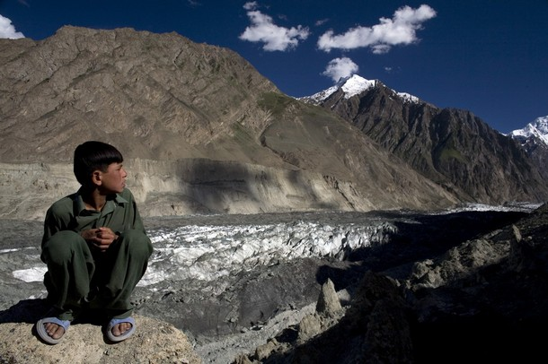
Global warming is real . . .
The chasm
Humans are to blame
The changes will be cataclysmic
Reducing CO2 will stabilize Earth’s climate
Adaptation

Slide 9
Research Question 1
What are the changes in peoples’ lives and livelihoods due to climate change over the past twenty years in the mountainous regions of Pakistan and how have these communities learned to adapt to the changing environment which has impacted their social, economic, cultural and even religious mindset and development?

Slide 10
Research Question 2
What role, if any, has institutional governance (role of state and civil society) played in strengthening and/or weakening the adaptive capacities of these people? How existing institutions can be harnessed to aid climate change adaptation in the future?

Slide 11
Shigar- Pakistan
Location-Right bank of the Indus River in central Karakoram of Pakistan
Sub division of District Skardu
Total area- 170,939 sq feet
Population (60,000-70,000) est 2009
Union Councils- 10
Villages-62
Cultural Hub
Notes:
11

Slide 12
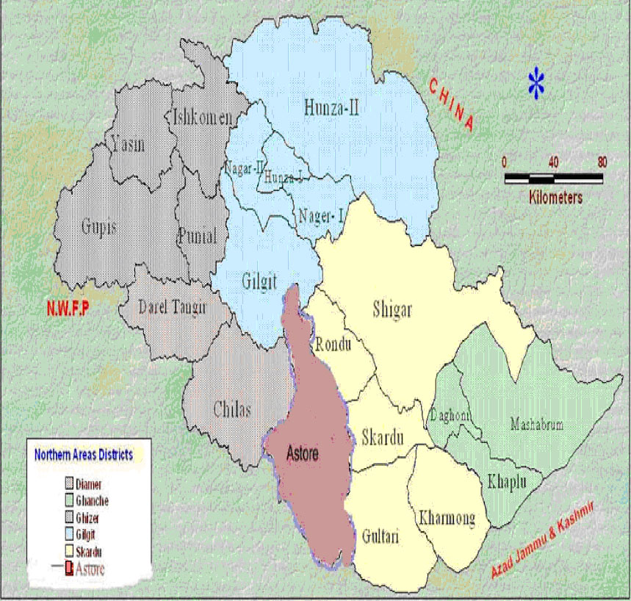

Slide 13
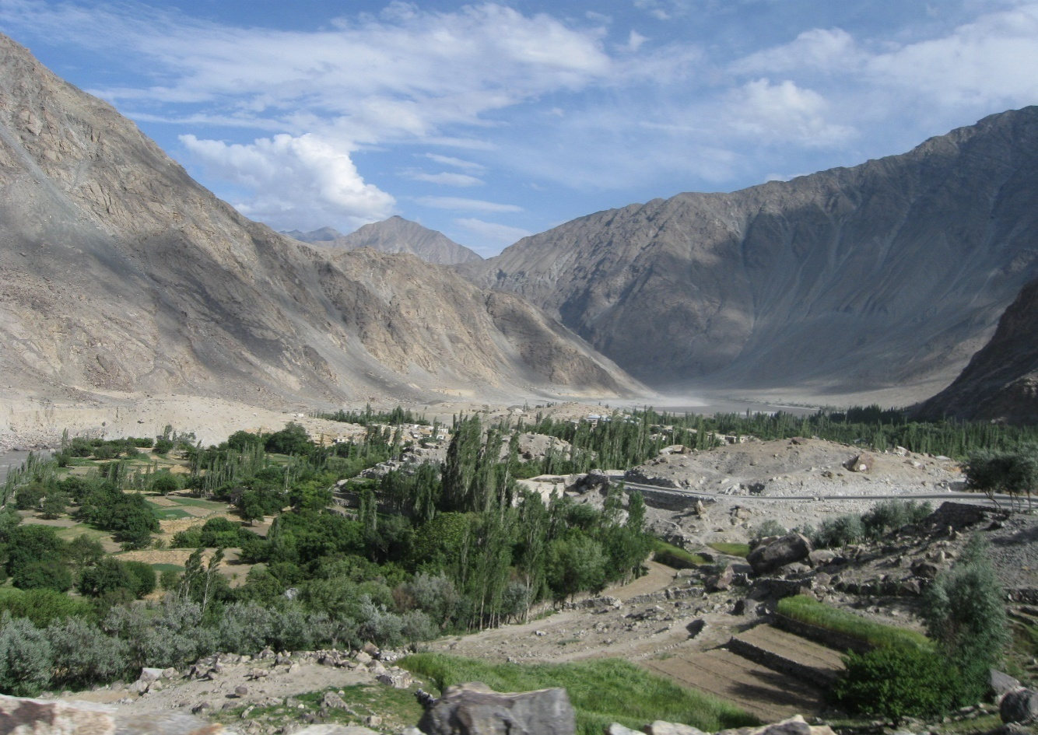

Slide 14
Survey and In-depth Interviews
June 2009: Administered questionnaire to Shigar residents to help understand the perceptions of the community regarding, vulnerability to CC and possible institutional responses to environmental disruption.
Survey results can be generalized to other mountain village communities throughout South Asia.
Notes:
14

Slide 15
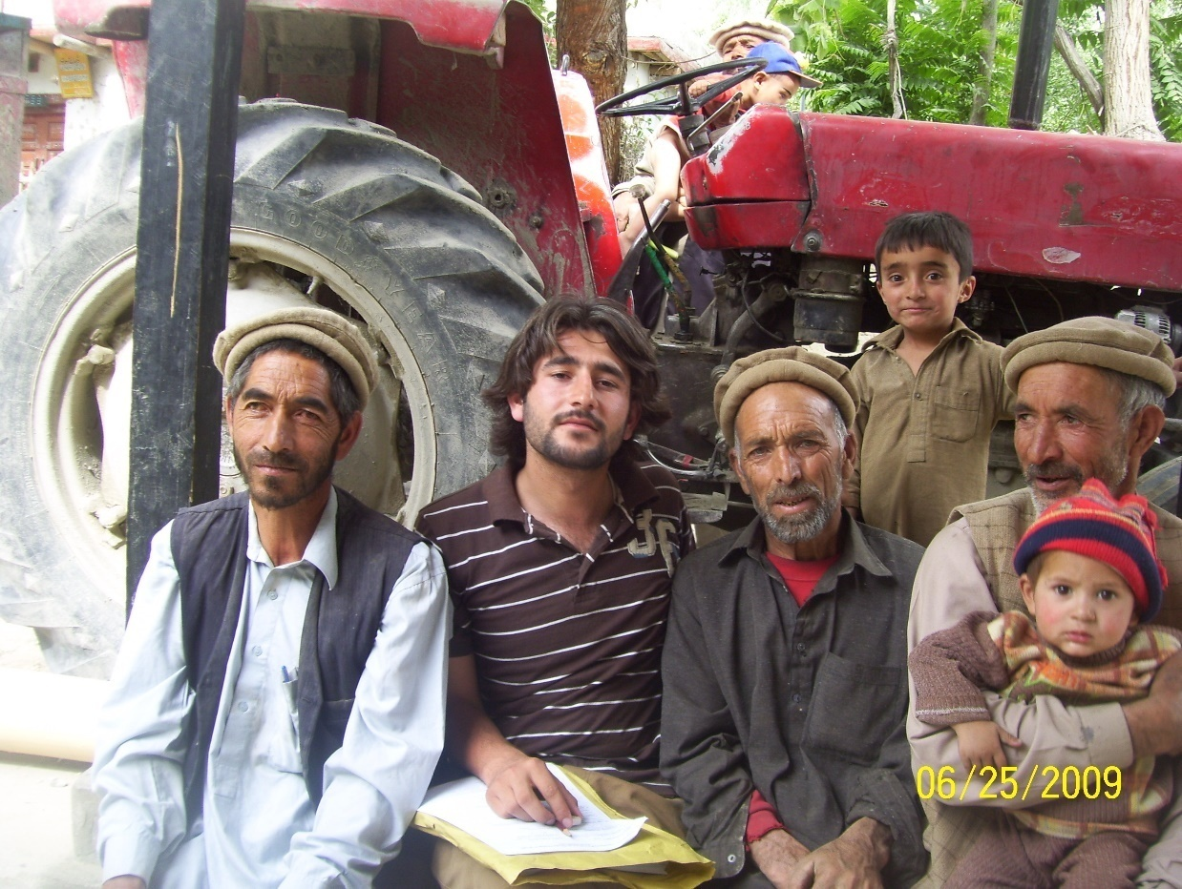
Notes:
15

Slide 16
Research Methodology
Villages- 3 UCs upper part of river—Marapi (687 HH), Markunja (795 HH) and Hshupi (297 HH)
Significance: Socially, economically active, majority literate (M & M); UC Anchor (H)
Stratified Random Sample-Marapi 40 ( 30M, 10 F), Markunja 40 ( 32 M, 8 F) Hshupi 20 (16 M, 4 F)

Slide 17
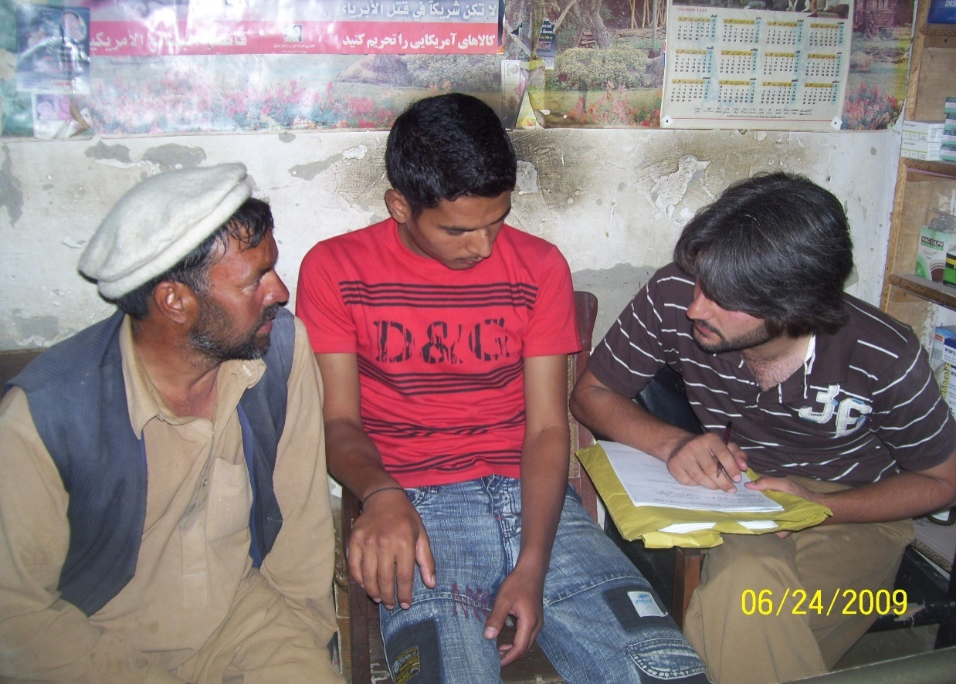

Slide 18
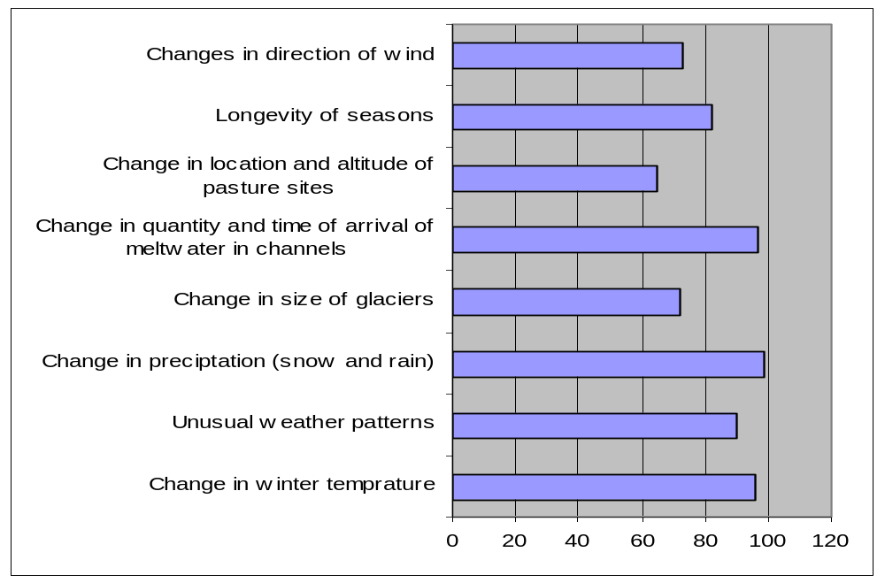
Climate Change Impact

Slide 19
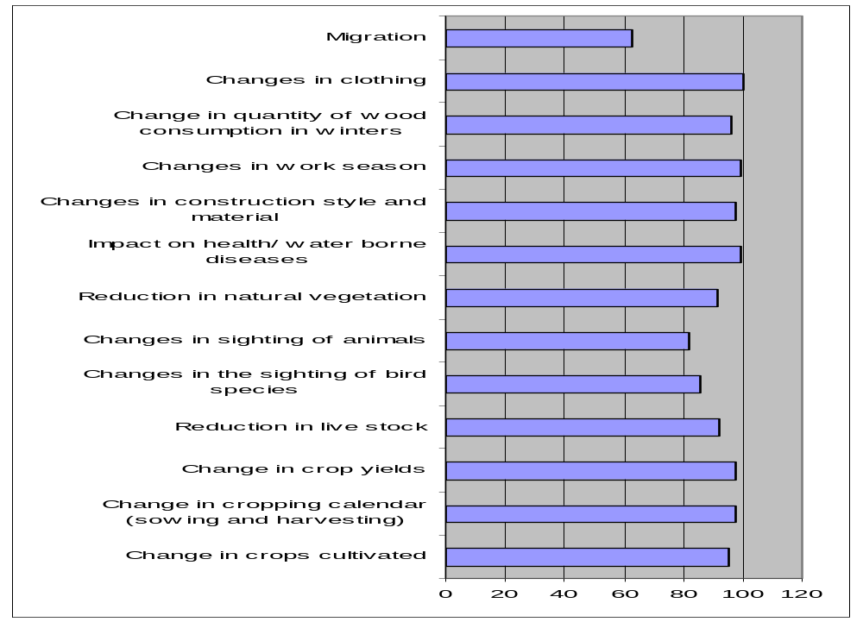
Climate Change Impact: Livelihoods

Slide 20
Climate Change Impact:
Water Resources
Temperature: The mean temperature for Skardu for the period (1980-2006) shows an overall annual increase of 0.17° C per decade (Steinbauer and Zeidler, 2008).
Change in precipitation (Past): 1-6 feet snow till March-April. (Present): No snowfall since 6-7 yrs except Jan. 2009
Rainfall (Past): Throughout year, esp after spring starting in April. Continuous rain (6-9 times). In summers, jari season (rains) would occur once in July-August. (Present): 2-5 times a year. When it does rain, it is heavy and causes floods.
Notes:
20

Slide 21
Climate Change Impact:
Water Resources
Glacial Size: Karakoram Mountains glaciers retreating (Hewitt 2005, Haritashya et al 2007; Steinbauer and Zeidler 2008).
Quantity & Time of Arrival of melt water in channels (Present): Surplus melt water now arrives in water channels by March (15 days earlier). Streams are filled by April-June, till Sept-Nov.

Slide 22
Environmental Change
Village |  |  | Snow fall |  | Size of glaciers |  | Rainfall |  | Quantity of melt water
 |  |  | 2008* | 20 yrs | 2009 | 20 yrs | 2009 | 20 yrs | 2009 | 20 yrs
Marapi | Male | 30 | 2.2 | 4.9 | 3.8 | 5.0 | 2.3 | 4.2 | 2.8 | 5.0
 | Female | 10 | 2.5 | 4.3 | 4.5 | 5.0 | 2.4 | 4.2 | 2.4 | 5.0
Markunja | Male | 32 | 2.4 | 4.7 | 3.9 | 5.0 | 2.4 | 4.9 | 2.8 | 4.9
 | Female | 8 | 2.1 | 4.2 | 4.2 | 5.0 | 2.5 | 4.1 | 2.9 | 5.0
Hshupi | Male | 16 | 2.2 | 4.8 | 3.2 | 5.0 | 2.5 | 4.3 | 2.5 | 5.0
 | Female | 4 | 1.9 | 4.1 | 4.0 | 5.0 | 2.6 | 4.9 | 3.0 | 4.8
 |  | 100

Slide 23
Climate Change Impact:
Agriculture
Change in crops cultivated (Present): Two crops are grown each year, as there is a longer duration of suitable weather for crop cultivation.
Cropping Calendar: Sowing season in Shigar is March-April and harvesting is July- Aug.

Slide 24
Climate Change Impact:
Agriculture
Crop Yield (Present): Annual yield increased in last 10 to 15 years, especially of wheat and potatoes. A general trend is a 30-40% increase in yield. Land quality has decreased over the years, thus increased dependency on fertilizer use.
Wind Direction (Past): Indigenous knowledge (IK) of local farmers and herders used to guide them about timing for various farm practices, including the collection of grass for feeding animals in winters.

Slide 25
Climate Change Impacts: Livestock
Livestock (Present): Substantial change in livestock health, productivity (milk/meat obtained per domestic animal)
Sighting of bird species (Past): Used to be rich in diverse bird species (crows, wild pigeons, chakor, ram chakor, sparrows, partridges, hawks and eagles). Many migratory birds were seen in April. (Present) migratory patterns have changed. Crows extinct; other species rarely seen linked to hunting practices, change in weather conditions and loss of habitat due to deforestation.

Slide 26
Climate Change Impact:
Biodiversity and Deforestation
Sighting Animals (Present): No snow leopards. Pop. of Markhore and Keil also decreased.
Deforestation: Community forestry is practiced. Poplar (used as fuel wood), mulberry, bair, beo, willow and shahtoot are some of the trees grown.
Juniper (cheer) and katal is also still seen in the area, though the quantity has reduced drastically, due to excessive use as fuel wood.
Cold has decreased BUT deforestation in region is primarily the result of fuelwood consumption given increased gas prices. Wood is less expensive.

Slide 27
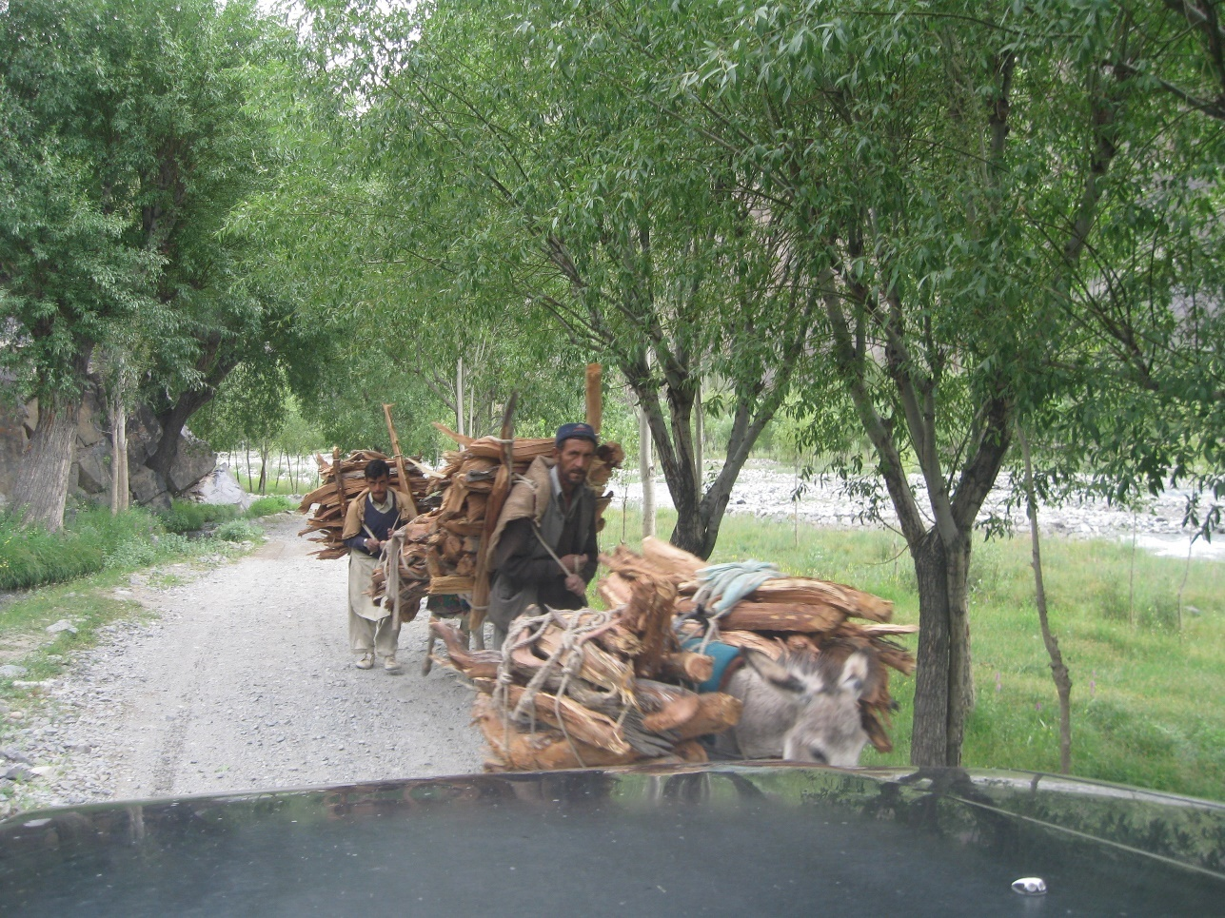

Slide 28
Climate Change Impact:
Lifestyle Patterns
Clothing
Architecture
Construction material
Technology
Working season
Education
Migration

Slide 29
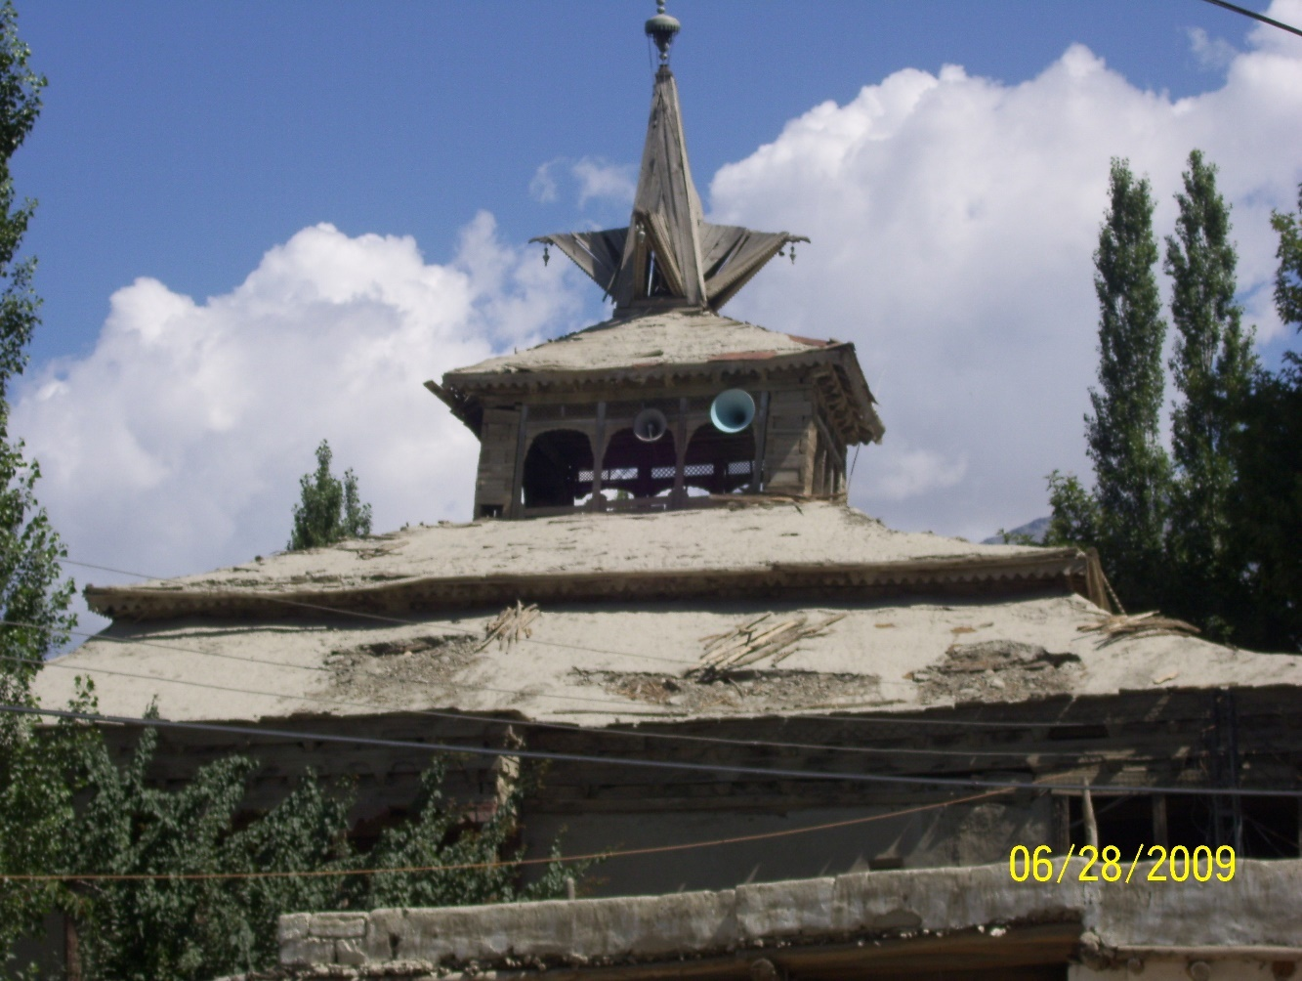

Slide 30
Way Forward
Markets and governments have failed to offer the desired fruit of development.
Elinor Ostrom: third path for development, one that relies on the ability of human institutions to solve basic needs.
Kapoor (2004): understanding the functioning of local cultures and institutions.
Gayatari Spivak: “learning to learn from below”

Slide 31
Role of Institutions
Role of institutions achieving development goals (Agrawal, 2008; World Bank, 2009; Jütting, 2003)
Positive impact of institutions on natural resource management (Becker, 2003; Lanjouw and Levy, 2002; Nemarunde and Kozanayi, 2002; Heltberg, 2001; Ostrom, 1990; Mazzucato and Niemeijer, 2000).

Slide 32
Adaptation
In response to environmental risks the common adaptation responses are mobility, storage, diversification, communal pooling and exchange (Agrawal, 2008).
Effectiveness of these adaptive strategies depends on the nature of institution and environmental threat, culture of the community, geographic location, economic and social factors (Ostrom, 1990; Jütting, 2003; Agrawal, 2008; Rodrik et al, 2002; Sachs, 2003).

Slide 33
Policy Prescriptions for Shigar
Strengthen local institutions through capacity building about climate sensitive assets/NR management
Awareness creation
Creating local climate change committees for disaster risk management
Document and respect indigenous/rural coping strategies and knowledge-they add to local adaptive capacity
Notes:
33

