Slide 1
Lecture 27
NATURAL RESOURCE PLANNING AND MANAGEMENT
Dr. Aneel SALMAN
Department of Management Sciences
COMSATS Institute of Information Technology, Islamabad

Slide 2
Recap Lecture 26
Analysis of forest policies in Pakistan
Recommendations

Slide 3
REDD+

Slide 4
What is ?
Introduction To REDD+
What’s the big deal ?
What’s new about REDD+ ?
How can I find out more ?

Slide 5
Reducing Emissions from Deforestation and Degradation
What is ?
Introduction To REDD+

Slide 6
Causes of deforestation
Direct causes
Agricultural/ bioenergy expansion
Wood extraction/ logging
Infrastructure development
Underlying causes
Macroeconomic factors
Governance factors
Political factors
Technological factors
Cultural factors
Demographic factors

Slide 7
Background
The Kyoto Protocol only addresses afforestation and reforestation (A/R) to enhance the sink of GHG emissions
Avoiding deforestation (AD) was not included because countries have different circumstances in LULUCF(Land Use, Land Use Change and Forestry ) sector, hence equity was an issue
A/R through CDM has not been very promising
In fact, addressing AD would address 20% of the global emissions which is equivalent to 1.6 billion tons of carbon per year (1.6 Gt C/y)
Notes:
Self explaining

Slide 8
History of REDD
Submissions of the Governments of PNG and Costa Rica (FCCC/CP/2005/MISC.1)
COP11 initiated a 2-year process of reducing emissions from deforestation - RED (FCCC/CP/2005/L.2)
SBSTA (Subsidiary Body for Scientific and Technological Advice ) invited submissions from Parties and Observers to stimulate actions
The second ‘’D’’ (forest Degradation) was considered in COP13
SBSTA organized workshops
  Rome, September 2006
  Cairns, March 2007
  Tokyo, May 2008
  Bonn, October 2008
REDD was broadened to REDD+ in early 2009
Notes:
Self explaining

Slide 9
Definitions
Note! No definition has been approved to be used REDD+ in current negotiations. The following definitions are from the Kyoto Protocol or from the IPCC
Forest is defined structurally on the basis of crown cover percentage, minimum height and minimum area of stand:
  Forest area between 0.05 and 1 ha
  Potential to reach a minimum height at maturity in situ of 2 to 5 m
  Tree crown cover (or equivalent stocking level): 10 to 30 %
(Decision 19/CP9) - Kyoto Protocol definition
Deforestation is defined as the direct, human-induced conversion of forested and to non-forested land
(Decision 11/CP.7) - Kyoto Protocol definition
Degradation is defined as a direct, human-induced, long-term loss (persisting for X years or more) or at least Y% of forest carbon stocks [and forest values] since time T and not qualifying as deforestation. The parameters X,Y and T have not been defined (Penman et al., 2003) - IPCC definition
Notes:
For forest definition, countries will have to choose a value within the ranges. Definition of forest degradation, however, is a framework definition suggested by IPCC. It is realized that there are difficulties to operationalize the definition, especially in determining the thresholds.

Slide 10
Reducing Emissions from Deforestation and Degradation

Slide 11
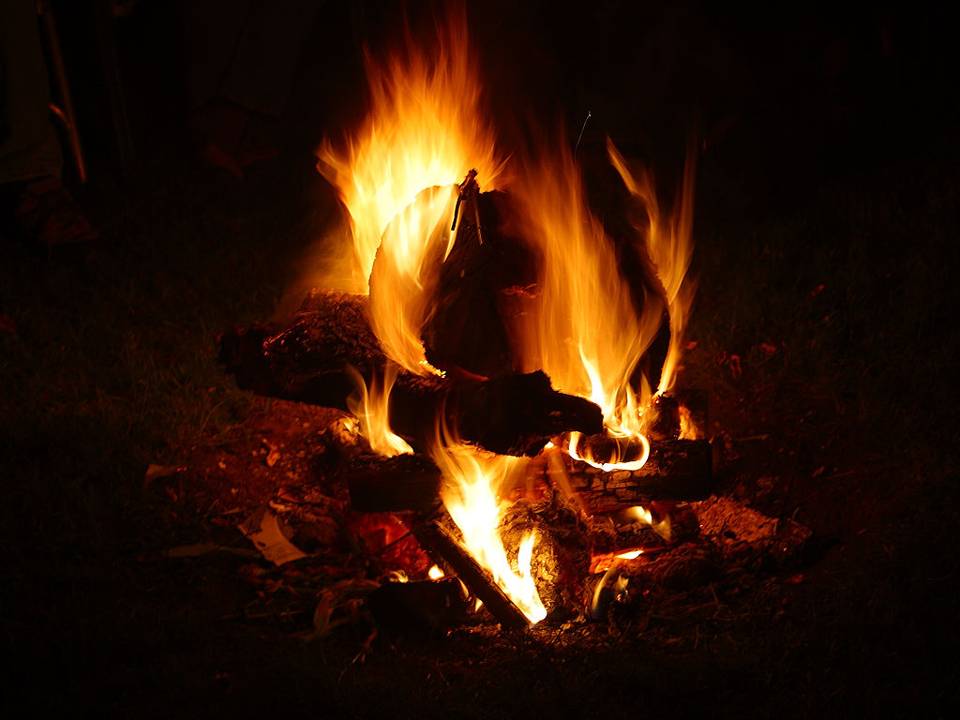
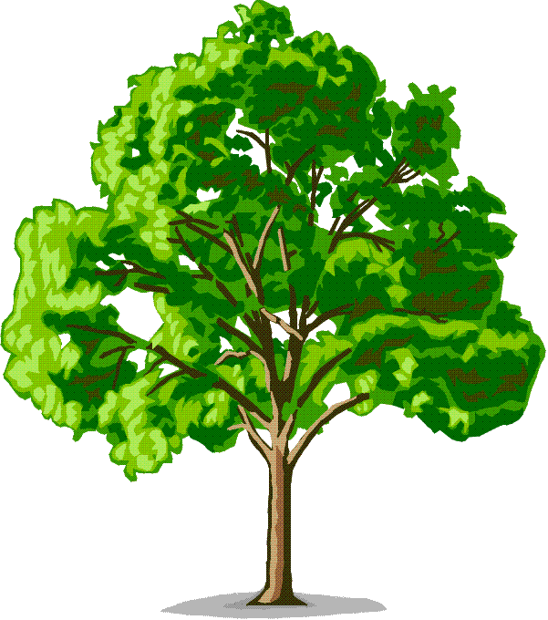
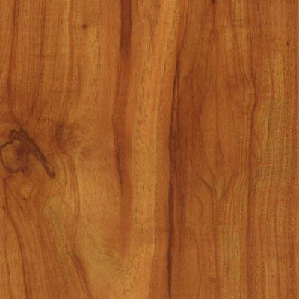
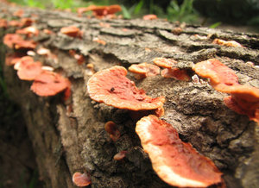
CO₂
Reducing Emissions from Deforestation and Degradation
CO₂
Oxygen
Sugar
C
Wood
Carbon Removals
Carbon Stored
Carbon Emissions

Slide 12

CO₂
Reducing Emissions from Deforestation and Degradation
CO₂
“Drain”
“Tap”
Forest Carbon
Carbon Removals
Carbon Stored
Carbon Emissions

Slide 13
CO₂
Reducing Emissions from Deforestation and Degradation
CO₂
“Drain”
“Tap”
Forest Carbon
Carbon Removals
Carbon Stored
Carbon Emissions

Slide 14
CO₂
Reducing Emissions from Deforestation and Degradation
CO₂
“Drain”
“Tap”
Forest Carbon
Carbon Removals
Carbon Stored
Carbon Emissions

Slide 15
CO₂
Reducing Emissions from Deforestation and Degradation
CO₂
“Drain”
“Tap”
Forest Carbon
Carbon Removals
Carbon Stored
Carbon Emissions

Slide 16
CO₂
Reducing Emissions from Deforestation and Degradation
CO₂
“Drain”
“Tap”
Forest Carbon
Carbon Removals
Carbon Stored
Carbon Emissions

Slide 17
CO₂
Reducing Emissions from Deforestation and Degradation
CO₂
“Drain”
“Tap”
Forest Carbon
Carbon Removals
Carbon Stored
Carbon Emissions

Slide 18
Reducing Emissions from Deforestation and Degradation

Slide 19
Reducing Emissions from Deforestation and Degradation

Slide 20
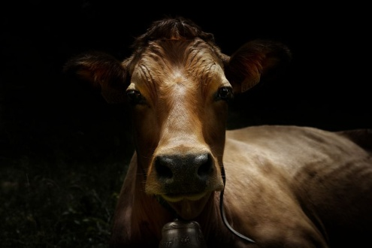
Reducing Emissions from Deforestation and Degradation
What is ?
Forest Land Use
Non-Forest Land Use
Reduction in carbon stocks
Time

Slide 21
Reducing Emissions from Deforestation and Degradation

Slide 22
Reducing Emissions from Deforestation and Degradation
What is ?
Forest Land Use
Forest Land Use
Reduction in carbon stocks
Time

Slide 23
Reducing Emissions from Deforestation and Degradation

Slide 24
Reducing Emissions from Deforestation and Degradation
What is ?
Introduction To REDD+
Enhancing Forest Carbon Stocks
Sustainable Management of Forests
Forest Conservation
New Forests

Slide 25
What is ?
Introduction To REDD+
What’s the big deal ?
What’s new about REDD+ ?
How can I find out more ?

Slide 26
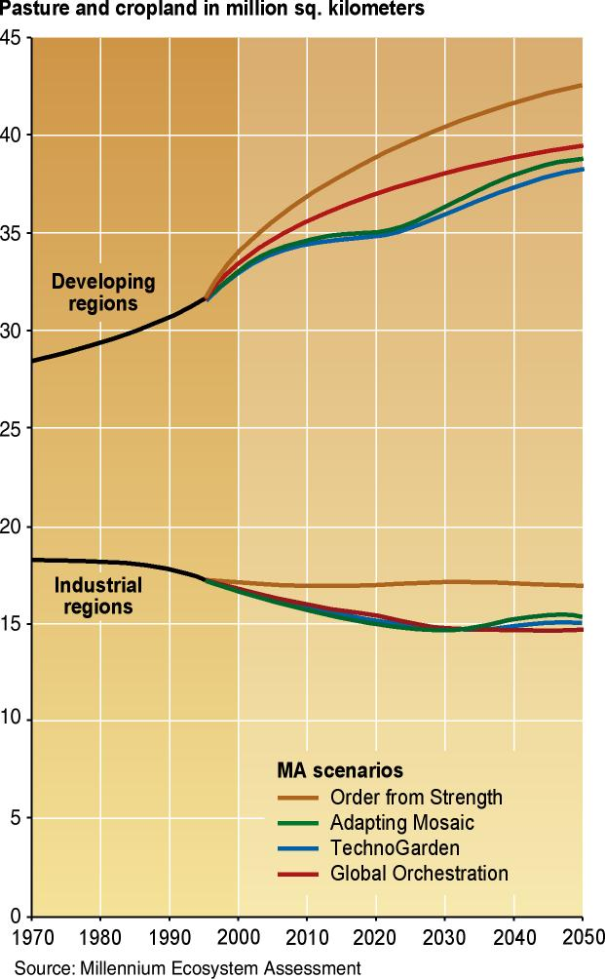
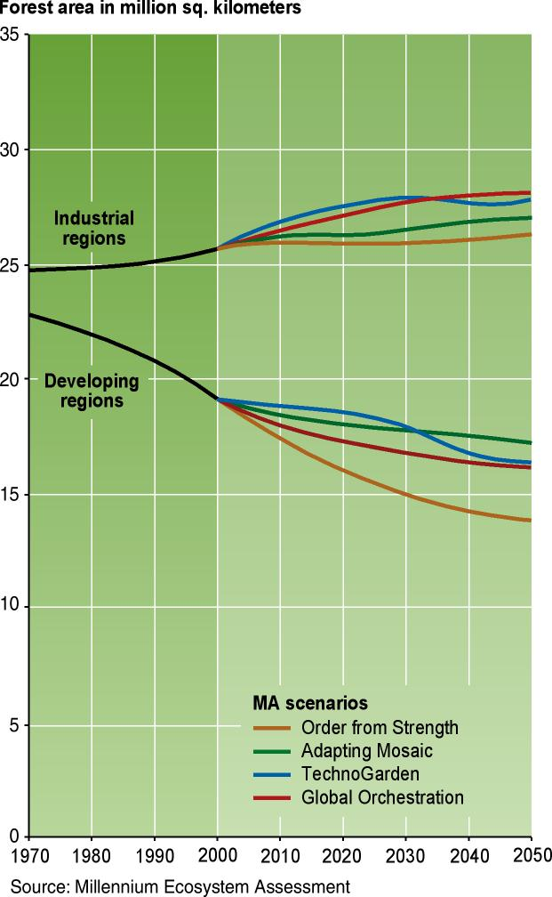
Cropland
Forest
What’s the big deal ?

Slide 27
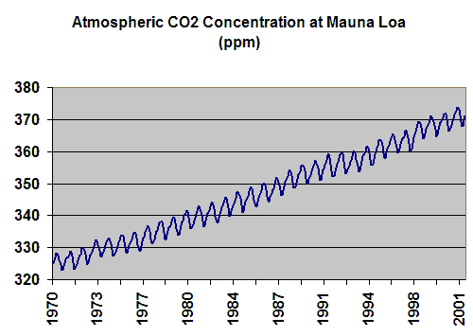

Slide 28
CO₂ concentration at 2100 (lower end projections)
500
Current CO₂ concentration
400
Climate and atmospheric history of past 400,000 years from the Vostok ice core, Antarctica
10
300
5
250
CO₂
ppm
0
200
Temp
-5
150
-10
100
0
50
100
150
200
250
300
350
400
450
Age 100,000 years b.p.

Slide 29
CO₂ concentration at 2100 (lower end projections)
500
Current CO₂ concentration
400
Climate and atmospheric history of past 400,000 years from the Vostok ice core, Antarctica
10
300
5
250
CO₂
ppm
0
200
Temp
-5
150
-10
100
0
50
100
150
200
250
300
350
400
450
Age 100,000 years b.p.

Slide 30
CO₂ concentration at 2100 (lower end projections)
500
Current CO₂ concentration
400
10
300
5
250
CO₂
ppm
0
200
Temp
-5
150
-10
100
0
50
100
150
200
250
300
350
400
450
Age 100,000 years b.p.

Slide 31
700
CO₂ concentration at 2100 (upper end projections)
Global Warming
600
CO₂ concentration at 2100 (lower end projections)
500
350ppm
Current CO₂ concentration
400
Safe level for CO2
10
300
5
250
CO₂
ppm
0
200
Temp
-5
150
-10
100
0
50
100
150
200
250
300
350
400
450
Age 100,000 years b.p.

Slide 32
Sea level rise
Cyclone intensity
Flooding
Drought
Ocean acidification
Biodiversity decline
Global Warming
Impacts
350ppm
Safe level for CO2
International economy
Population growth
World oil prices
Food security
Cross cutting issues:

Slide 33
Global Warming
= Quite Big Problem
Solution?
= Reduce Emissions
Sources?
= Approx 80% Fossil Fuels
Approx 20% Forests
Kyoto Protocol
UNFCCC REDD Agreement (still under negotiation) (and other instruments already available)

Slide 34
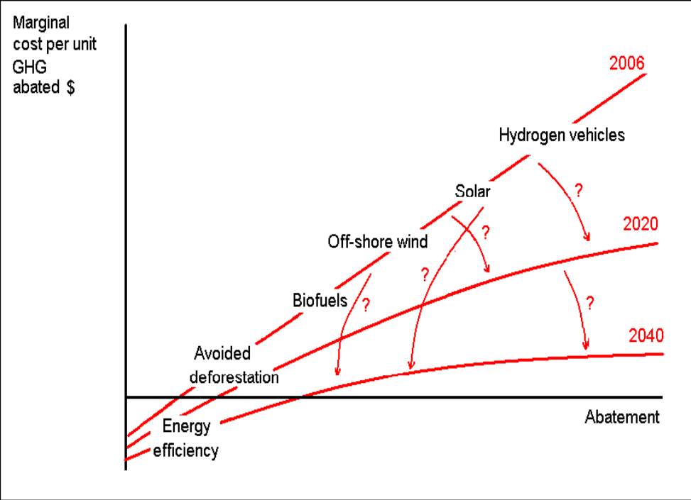
Why include REDD in a global climate regime ?
BIG:
  1/5 of GHG emissions, but
  not included in global climate regime
CHEAP: (Stern report)
  Negative - $5/ton
  50 % red: USD 5-15 billion
  But problems of implementation
  (transaction costs)
QUICK:
  Stroke of pen reforms
  No deep restructuring of economy or new technoloigy
  A wooden bridge to a clean energy future
WIN-WIN:
  Large transfer
  Good governance?

Slide 35
Why include … (cont.)
Initiated by developing countries
Less resistance from environmental groups
Poor countries: an opportunity to receive large transfers (sell carbon credits)
Rich countries: a cheap way to undertake mandatory reductions

Slide 36
What is ?
Introduction To REDD+
What’s the big deal ?
What’s new about REDD+ ?
How can I find out more ?
UNFCCC REDD Agreement (still under negotiation) (and other instruments already available)

Slide 37
What’s new about REDD+ ?

Slide 38

What’s new about REDD+ ?
New form of forest finance
Payment for Ecosystem Services

Slide 39
Performance-based payments for the delivery of forest carbon benefits that are:
Measurable
Verifiable
Additional
Permanent
New form of forest finance
Payment for Ecosystem Services

Slide 40

Measurement Reporting & Verification System (MRV)
Measurable
Verifiable
Additional
Permanent

Slide 41
Measurement Reporting & Verification System (MRV)
Measurable
Verifiable
Additional
Permanent
Additionality Test
(would not have happened without carbon finance)

Slide 42
Measurement Reporting & Verification System (MRV)
Instrument for Delivery of Incentive Payments
Measurable
Verifiable
Additional
Permanent
Additionality Test
(would not have happened without carbon finance)
Legal & Socio-Economic Measures to Fix Causes of Deforestation/Degradation

Slide 43
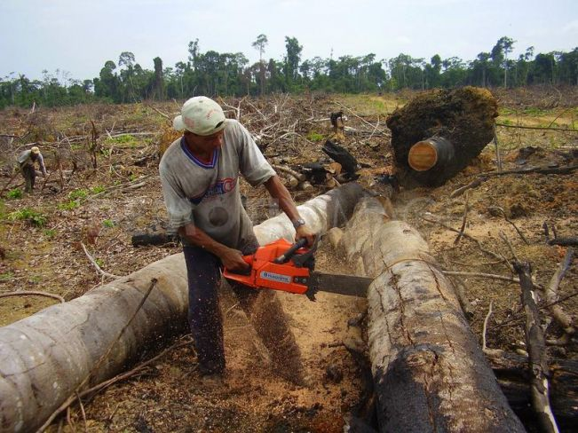

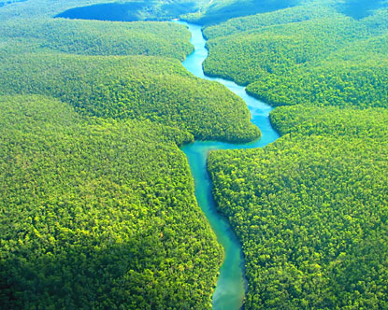
Instrument for Delivery of Incentive Payments
Income From This
Income From This

Slide 44
What does REDD look like ?
Jobs
Economic development
Community well-being
Benefits from living forests
Income From This
Wood/agriculture commodities sold in a market
If income from these activities is similar, then forest protection can compete commercially with deforestation
Carbon credit commodities sold in a market
Income From This
+ grant finance opportunities

Slide 45
What is ?
Introduction To REDD+
What’s the big deal ?
What’s new about REDD+ ?
How can I find out more ?

Slide 46
How can I find out more ?
SPC Website
Department of Forestry Staff
NGOs (CI, Live & Learn, WWF, Greenpeace)
UNFCCC REDD Web Platform
UN REDD Programme
World Bank Forest Carbon Partnership Facility
REDD+ Partnership

Slide 47
How can I find out more ?
SPC Website

Slide 48
REDD+ for Pakistan? A Complex Cycle
Total Registered project with CDM- EB (UNFCCC)= 2399 (as of June 2010)
CDM- AR Registered Projects= 8
REDD/ REDD+ = None
Is Pakistan prepared to take up the challenge??
UN Criteria to support REDD initiatives:
An expressed willingness to work with the UN-REDD Programme
Existing collaboration between the country, the UN partners and other relevant actors in related areas that will help ensure rapid progress
Emission avoidance potential
Degree of REDD readiness potential
Regional, biome and socio-economic representation
Coordination with international REDD initiatives
Potential to provide leadership in sub-regional sharing of experience
Ability to contribute experiences to UNFCCC negotiations and development of REDD mechanisms

Slide 49
Risks associated with Carbon business
Natural/ climatic risks: (disease, growth lower than prediction drought, floods, damaging winds, land slides etc.)
Anthropogenic factors: encroachment, poaching, fire
Political risks: policy changes, unstable governments
Economic risks: exchange rates, interest rates, lower than expected CER prices, changes in opportunity cost of land
Risks associated with CER purchaser (willing to pay upfront?)
Future of Kyoto??
Crediting Period (5 years for forestry)
Investment in forestry (is it viable business??)

Slide 50
Management/ ownership issues (influence of black market/ feudalism)
Baseline data/ methodology development/ monitoring (huge investments)- will it still be viable?
Leakages in carbon budget (if not forests, where shall we cater for needs? Any alternates?)
Long- term involvement of stakes~ easy at it sounds?

Slide 51
Is it Practical for Pakistan?
Though the REDD policy has been finalized~ modalities and procedures yet to be Clearfield
Not eligible for Kyoto first Commitment Period (2012)
REDD mechanism suitable for Pakistan….
  high rate of deforestation- an opportunity! but can it be reduced…? If yes, how and how much??
  How much time we nee to be prepared??
  Is it cost effective??
  Is it socio- politically applicable? If yes, how??
  Administrative and technical capacities?

Slide 52
Concluding
REDD/ REDD-plus will only achieve results if it is able to be adapted to the individual circumstances of countries
AND
if countries have the political will to adapt policies and methods to meet the needs of REDD/ REDD-plus implementation

