Slide 1
Lecture 24
NATURAL RESOURCE PLANNING AND MANAGEMENT
Dr. Aneel SALMAN
Department of Management Sciences
COMSATS Institute of Information Technology, Islamabad

Slide 2
Recap Lecture 23

Slide 3
Ecofeminism and Movements from North to South

Slide 4
Outline
Concept of Ecofeminism and its movement
Women and the Environment: Is there a connection?
Ecology and Feminism: A common Language
Ecological movements and the role of women
Conclusion

Slide 5
Gandhiji was once asked, "When we plan for our country, what should we remember most?" "Think of the last man", he replied.
Experience has taught us, however, that the last man is invariably a woman.

Slide 6
Ecofeminism
Concept
  Francois d’ Eaubonne in 1974,
  twin subordinations
Movement
  Nash, 1989; Warren, 1990; Lahar, 1991; Cuomo, 1992; Salleh, 1992). Diamond and Orenstein in Reweaving the World: The Emergence of Ecofeminism (1990)

Slide 7
Ecology and Feminism: A common Language
All parts of system have equal value
The Earth is a home
Process is primary
There is no free lunch

Slide 8
Ecological Movements and the role of women
Market power
North versus South
Steam Roller effect of technological moderization
Process not a thing
Motion as well as emotion
Phases of Environmental movements

Slide 9
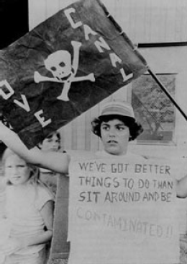


Love Canal –United States

Slide 10
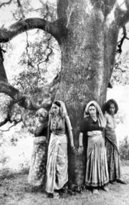
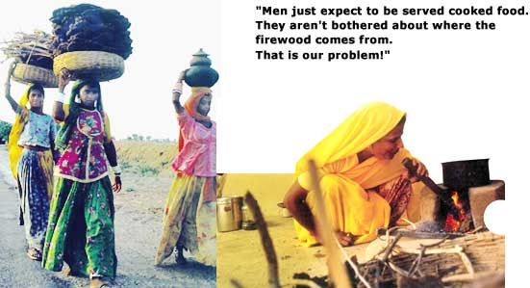
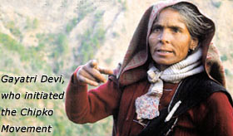
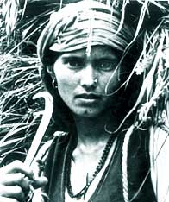
Chipko Movement -India

Slide 11
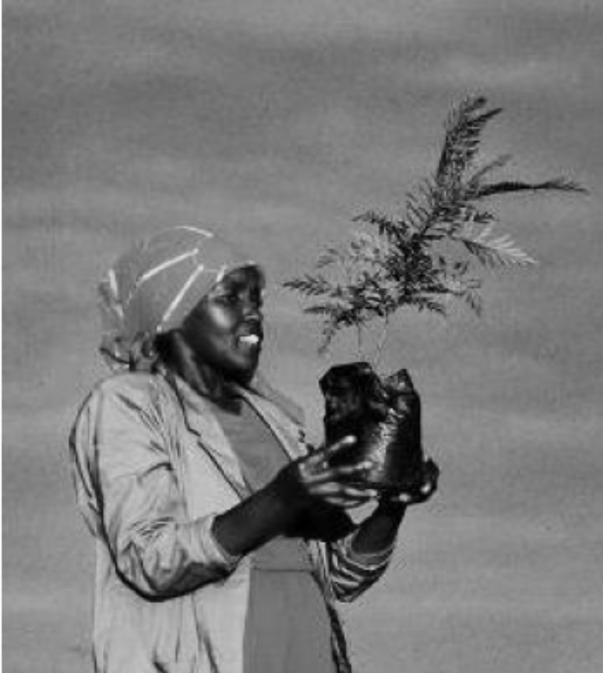
Green Belt Movement- Kenya

Slide 12
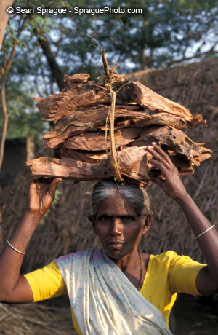

Women and Trees Bangladesh

Slide 13
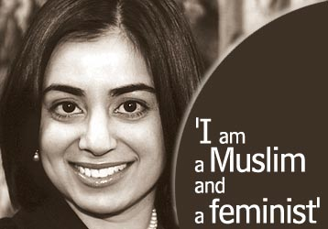
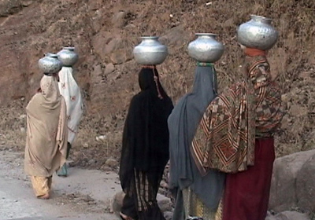
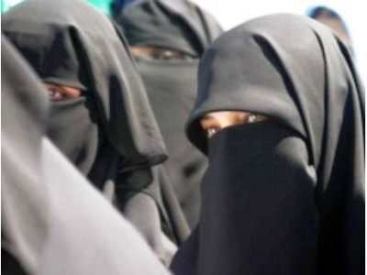
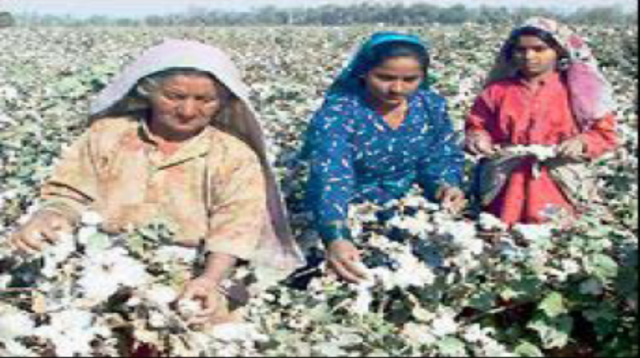
Ecofeminism in Pakistan

Slide 14
Policy Interventions
Property Rights
Institutional arrangements
Participation
Legal system
Representation
Widen the choices
Financial independence

Slide 15
Conclusion
Successful
Domino Effect
Conservation
Gap between philosophy and action

Slide 16
Women and Environment
Women are more vulnerable to natural hazards
Women are key actors in disaster preparedness
Women constitute up to 80% of refugee and displaced populations
In emergency situations women and children make up 70 to 80% of those needing assistance

Slide 17
WHY ARE WOMEN MORE VULNERABLE
Biological, social and economical differences
Women have less access to resources
Women are victims of the gendered division of labour
Women are primarily responsible for domestic duties, are caregivers
Early warning systems are orientated towards males
After a natural disaster, women are more likely to become victims of domestic and sexual violence
Migration due to climate change will leave women behind

Slide 18
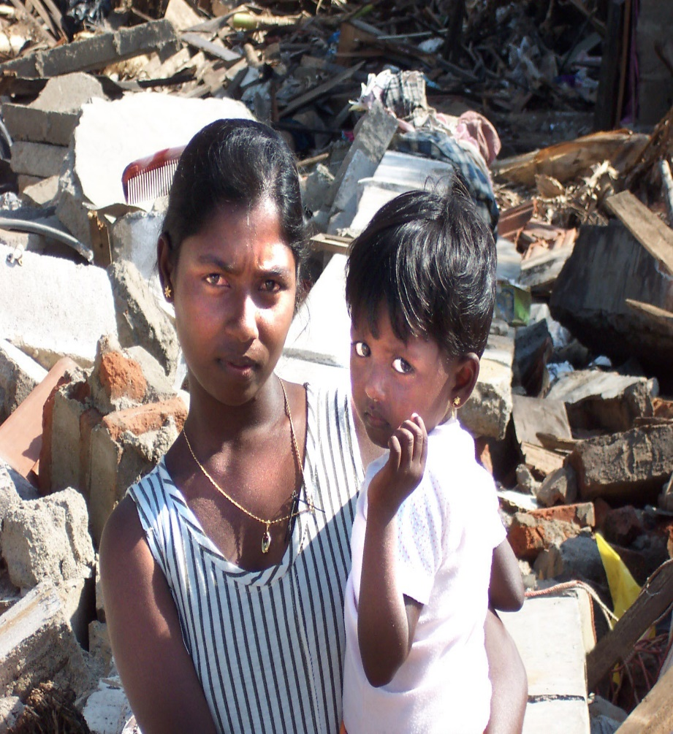
Women’s role in Disaster Risk Management
WOMEN ARE KEY ACTORS IN BUILDING, SHAPING AND SUSTAINING RESILIENT COMMUNITIES
Photo Credit: Joanne Omang

Slide 19
Women’s role in Disaster Risk Management
Women respond to disasters
  Building houses; digging wells and ditches; hauling water and building shelters, considered as “male” tasks.
  Forming groups and networks which is essential in disaster preparedness and mitigation.

Slide 20
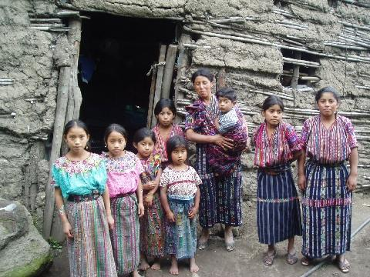
Women’s role in Disaster Risk Management
Women play decision-making roles in disaster issues
Women and young girls play an important role in their families and communities (in health, education and childcare).
Posted by Mayan Families; www.mayanfamilies.org/6a61re2.jpg

Slide 21
The question raises a very important ethical problem because women, the half of humanity, have a greater responsibility and suffer more than men from water scarcity and pollution, particularly in developing countries.
In our changing world, gender issue is a very sensitive question because it is directly related to power and dominance.
The term gender points out the relation between men and women as a social construction through which all human beings organize their work, rights, responsibilities and relationships – in short their culture, and their civilization.

Slide 22
According to UNESCO Programme for Gender Equality,
“Gender equality means; giving women and men, girls and boys, the same opportunities to participate fully in the development of their societies and achieve self-fulfillment.”
Gender equality is an essential component of human rights, and it is a key of “development”

Slide 23
Water and Ethıcs
In developing countries women’s life is particularly concerned with water availability and domestic contexts are very different from those of industrialized ones:
Family work usually covers one third to one half of a woman’s working day.
In both rural and urban areas, it includes tiring tasks such as fetching water for domestic use.
Women are the main users of water: for cooking, washing, family hygiene and sanitation

Slide 24
In some countries, men are traditionally given greater access to technology, training and engineering than women.
Although women’s better understanding of natural variations of water availability, this knowledge is still scorned or simply ignored by policy-makers and engineers who are still usually men

Slide 25
Women traditionally play also a major role in managing and maintaining communal water supply:
In some communities, women are responsible for the regulation and control of the social use and safe maintenance of water resources: e.g., restricting cattle watering to particular sites, and washing to specific downstream sites on the river.
Since their managerial work is performed informally, women are rarely involved in the political and legal processes of making strategic decisions regarding water resources management at a level beyond the local one.

Slide 26
IFAD stresses that a gender perspective is essential in the selection of new projects because the access of women to resources is disproportionately small relative to that of men.
According to the UN Commission on the Status of Women, women are increasingly recognized to be key actors in the conservation and safeguarding of natural resources as managers, producers, users and intermediaries between the natural environment and the society.

Slide 27
The impact of environmental degradation on women’s life
Since the early 1980s considerable attention has been devoted to the relationship between women and environment. The World Conference on Women in Nairobi (1985) recognized that ‘women and development’ cannot be separated from ‘environmental issues’, and that these issues must be incorporated into policy planning (FAO, 2002).
Attention was focused on natural and man-made disasters and the resulting environmental degradation. There was concern that such degradation deprived a growing number of poor women, in rural and urban areas, of their traditional means of livelihood and pushed them into a marginal environment, leaving them in critical circumstances (UN, 2000).

Slide 28
The linkage between environmental degradation and poverty, in particular related to women’s life, was recognized five years later, during the Conference on the Environment and development (UNCED) held in Rio in 1992. The Rio Declaration stated that ‘Women have a vital role to play in environmental management and development. Their full participation is essential to achieving sustainable development’ (UN, 1992).

Slide 29
Women are not only those who give birth, breed and educate infants and children to play a vital role in development. As stated in Agenda 21, ‘Women are the main food producers and the environment’. They play a crucial role in agricultural work and in the sustainable use of the land, however might be underestimated their participation in official economic statistics. Women farmers achieve marvel in improving traditional cropping methods developed over time to protect natural resources and the conservation of soil fertility whenever they are given the possibility (FAO, 2002).

Slide 30
According to the World Health Organisation (WHO), the lack of safe drinking water and poor sanitation contribute to about 80 per cent of communicable diseases, particularly among children and in Africa where the total water supply is the lowest of any region, with only 62% of the population having access to improved water supply.
There is a strong correlation between high levels of coverage of combined water and sanitation and low child mortality. According the WHO, over one in every ten children dies annually in developing countries before the age of five because of health complications. The major cause of death is diarrheal disease (WHO, 1996). Safe water and basic sanitation are major determinants of health and as such, of development.

Slide 31
As stated in the Fourth World Conference on Women held in 1995, ‘Equitable social development that recognizes empowering the poor, particularly women living in poverty, to utilize environmental resources sustainably is a necessary foundation for sustainable development’ (UN, 1995).
Since then, the fundamental role of women as environmental actors has been increasingly recognized: ‘Women have often played a leadership role in promoting environmental ethics, reducing resource use and recycling resources, to minimize waste and excessive consumption.
Women, especially indigenous women, have particular knowledge of ecological linkage and fragile ecosystem management. A sustainable development that doesn’t involve women will not succeed in the long run.’ (UN, 2001). Yet, much still needs to be achieve to involve them in the decision-making process: it means to give women equal access to education.

Slide 32
CONCLUSION
The first statement of the Right to Water was underlined at the International Conference organized in Mar del Plata, in 1977. It affirmed that : ‘All people have the right to have access to drinking water’. Then the Dublin and Rio Conferences in 1992 linked water with a cause and effect process to sustainable development, the conditions of women in developing countries, poverty and human rights. Water as a basic need to life is an ethical issue and thus a priority of development commitments.
The importance of women for water and water for women was formally recognized in the Dublin Conference. One of the four principles of efficient and effective water provision incorporated into the Dublin Declaration claimed for the full involvement of women in the planning and implementation of all scheme and initiatives for drinking water and sanitation (ACC/ISGWR, 1992).

Slide 33
In 1999, a Conference on Culture of Peace organized by UNESCO has launched a Pan-African women’s movement for peace to promote new values: since shared limited resources on their continent can lead to conflict, a particular effort should be made to stress women’s contribution in conflict prevention (UNESCO, 1999).
As stated in the World Conference on Women in Beijing, women historically have developed caring abilities and they have an important role to play in transforming the culture of violence into a culture of peace.
The Final Report of the International Consultation to Advance Women in Ecosystem Management: has stated that: ‘There is a natural convergence of interest between the needs of women and the need to conserve natural resources environments.

Slide 34
Women maintain a rich storehouse of technical environmental knowledge, which can be mobilized in the problem-solving process. In addition to their profound knowledge of fragile ecosystem management and sustainable resource use, women have a remarkable ability to work together, in taking care of children. Women also have a powerful influence over future attitudes towards the environment.’
Women have an important role to play in promoting a new attitude towards the use of water resources, based not only on technical knowledge, but also on cultural and ethical values. This new attitude would contribute to build a more just and peaceful world, provided it includes mutual exchange of gender specific knowledge, skills and sharing of opportunities to improve and manage our future limited freshwater resources.

