Slide 1
Lecture 23
NATURAL RESOURCE PLANNING AND MANAGEMENT
Dr. Aneel SALMAN
Department of Management Sciences
COMSATS Institute of Information Technology, Islamabad

Slide 2
Recap Lecture 22
Climate Change basics
Climate Change science
Impacts of Climate Change
How to mitigate climate change impacts in Pakistan.

Slide 3
Disconnect between Pakistan’s Climate Change Policies and Documents

Slide 4
What is a Framework Convention
A framework convention is a legally-binding international treaty establishing general guidelines and principles for international governance on a particular issue
More detailed legal instruments called protocols can be attached to a framework convention to address specific aspects of an issue.

Slide 5
Framework Convention vs Protocol
A framework Convention establishes
  Objectives
  Principles
  Basic obligations
  Procedures regarding decision-making
A Protocol
  Builds on the parent agreement
  Elaborates additional more specific commitments and institutional arrangements

Slide 6
UNFCCC and Pakistan
Signed the Convention : 13 June 1992
Signed at : The Earth Summit in Rio
Ratified the Convention : 01 June 1994
Became legally binding: 30 August 1994

Slide 7
First Things First
All Parties to develop “Initial National Communications” containing inventories of GHG emissions by source and GHG removals by sinks.

Slide 8
National Communications
According to Articles 4 and 12 of the Convention all parties must submit their national communications on regular basis with the following information :
Projected anthropogenic GHG emissions by sources and sinks with the aim of returning them to 1990 levels, individually or jointly.
Policies and measures to limit GHG emissions and protect/enhance sinks and reservoirs.

Slide 9
Study Objective
Undertake a comparative analysis of discourses on Climate Change found in two policy documents and the draft Climate Change Policy 2011 approved in June 2011 produced by the Ministry of Environment, Government of Pakistan.

Slide 10
Study Methodology
Using key principles from Critical Discourse Analysis, the study is informed by adopting an ‘argumentative turn’ to the study of policy
The comparative analytical framework looks at four gaps in policy analysis: administrative capacity and implementation, finances, and research/policy gaps.

Slide 11
Initial National Communication
(Nov 2003) Background
High-powered Project Steering Committee (PSC) chaired by the Secretary, Ministry of Environment and comprising government and private sector experts in the area of climate change.
Held six meetings and four workshops
3rd Nov 2003

Slide 12
Task Force Report on CC (Feb 2010) Background
PC set up a task force on CC in Oct 2008 to provide guidelines for ensuring security of vital resources of the country
10 TFCC meetings
9 working groups
Seminal document for formulation of national climate change policy

Slide 13
Comparative Analysis
1) Introduction
2003
Land area of Pakistan
Climate type
Water resources
Live stock
Agriculture
Forestry
Energy
Socio economic conditions
2010
Global climate change
Climate change scenario in Pakistan
Impact of climate change on various sectors of Pakistan

Slide 14
2)Objectives
2003: Objectives unspecified
2010
  Sustained economic growth
  Low carbon economy
  Increase forest cover
  New developments in science and technology
  Role of EIA in CCIA
  CDM,etc

Slide 15
3) Status as GHG Emitter
2003 and 2010
Energy
Agriculture
Wastes
Industrial processes
Land use change

Slide 16
4)Past and Future C.Changes
Year |  | CC Effect
2003 | Past | Unspecified
 | Projected | Temperature
 |  | Precipitation
 |  | CO₂ levels
2010 | Past | Specified
 | Projected | Temperature
 |  | Extreme Events
 |  | Precipitation
 |  | GHG levels

Slide 17
Major climate change related concerns
2003
Water
Agriculture
Food
Forestry
Coastal zones
Live stock
Biodiversity
Important ecosystems
Socio economic impacts
Extreme events
2010
Water security
Food security
Energy security
Coastal areas
Forests
Other ecosystems
Socio economic impacts
Extreme events

Slide 18
Mitigation
2003 and 2010
Energy
Agriculture
Forestry

Slide 19
Adaptation
2003 AND 2010
Water resources
Agriculture
Livestock
Forests
Coastal zones
Biodiversity
Energy and industry
Socio economic adaptation measures
2010
All above variables
Health

Slide 20
8)Organizational Structure to Address Climate Change
2003 2010
MOE
PMCCC
MOE
PC
TFCC
Other organizations
NGOS
Ministries etc

Slide 21
9)CDM
2003
Unspecified
2010
(current status and need for further effort)
CDM cell
CDM projects
Measures to strengthen CDM cell
Recommended measures to improve CDM cell

Slide 22
10)Education, Communication and Awareness
2003
GLOBE
GEF website
International symposium on Energy and Environment Conservation
Workshops
Print and electronic media
2010
(present status ,recommended measures)
Major steps taken by MOE with stake holders to formulate sustained communication strategy and facilitate national climate change actions in Pakistan

Slide 23
11)Institutional Capacity for Addressing Climate Change
2003
MOE
2010
MOE
GCICS
PMD
Ministries, govt funded organizations, international organizations, NGOs

Slide 24
12)International Cooperation
2003
Only international treaties
2010
Mitigation efforts
Adaptation efforts
Capacity building
Regional collaboration

Slide 25
13)International Negotiations for Future Climate Related Concerns
2003
Unspecified
2010
Mitigation effort by annex 1 countries
Mitigation effort by Pakistan and other non annex 1 countries
Adaptation by Pakistan and Other Non-Annex 1 Countries
Technical cooperation
Technology transfer and capacity building

Slide 26
Critical Analysis
Introduction:
11 variables were taken into account
2003
General overview of Pakistan’s national circumstances, including climatic conditions, socioeconomic conditions, and environmental issues.
Considered overall variables
Contribution to GDP not to CC was mentioned
Climate scenario of Pakistan was not mentioned well
2010
Analyzed global and Pakistan scenario of CC

Slide 27
Objectives
2003
Lacked objectives
No basic goals
Presents a weak picture of climate change policy guiding principle
According to article 12, non annex parties are required to submit a national inventory of anthropogenic emissions by sources and removals, this report mainly highlights this goal.
2010
Contained detailed basic goals and objectives

Slide 28
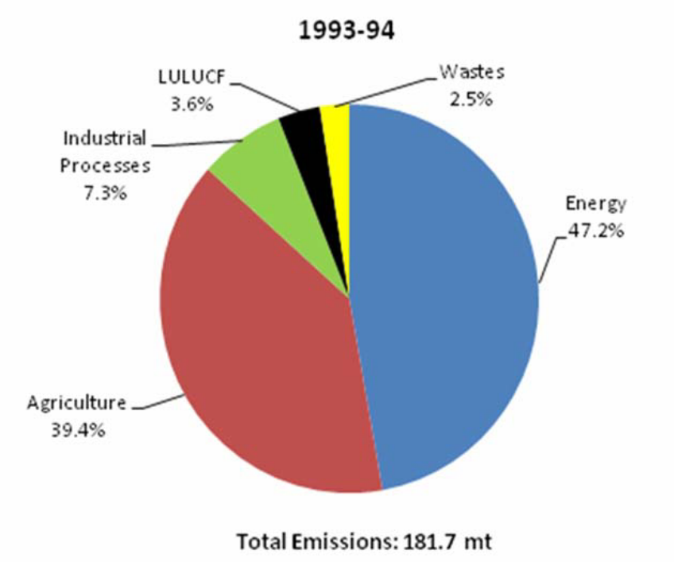
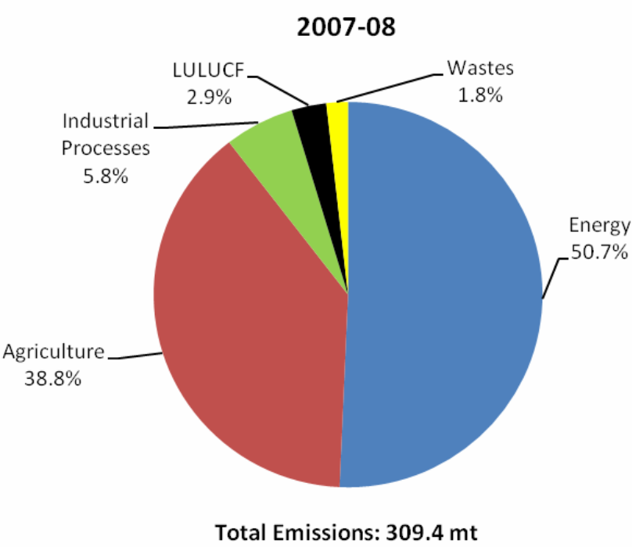
Pakistan status as GHG emitter:
2003
2010

Slide 29
Past and Future C.Changes in Pakistan
Temperature, precipitation, extreme events and carbon dioxide
2003
Past trends: absent
Projected trends: mentioned for temperature, precipitation and carbon dioxide levels based on 1961-1990.
Extreme events are absent
2010
Detailed version of the observed were based on data over the past last century and projected trends of all these variables were based on 1960-1990 values

Slide 30
Major Climate Change related Concerns:
2003
It does not categorize the major sectors of importance to Pakistan in context of CC under which related sub sectors could be categorized rather it provides data on the overall potential threatening sectors
2010
Highlights the three main sectors that are important for Pakistan in terms of climate change and its impacts ,these sectors are water, food and energy security. Other relevant sectors are categorized as sub sectors under these major headings

Slide 31
Mitigation
Variables: Energy, Agriculture, Forestry
2003
Mitigation measures were analyzed in terms of mitigation costs, along with total carbon dioxide abated and Net Present Value.
On going and planned actions were unspecified
2010
General measures were mentioned
Recommended plus On going and planned actions are mentioned well
Analyzation in in terms of mitigation costs, along with total carbon dioxide abated and Net Present Value are absent.

Slide 32
Adaptation
Water, Agriculture, Range land, Coastal Areas, Forests, Health, Extreme events, Socioeconomic conditions and Biodiversity
2003
Overall adaptation measures
Health sector adaptation measures absent
Input from local communities missing
2010
In depth adaptation measures considering the particular requirements for each sector
Recommended measures, on going and planned actions are mentioned
Input from local communities missing

Slide 33
Critical Analysis: Administrative capacity and Implementation
While both reports outline who and which department is responsible for what, there is no overarching monitoring and evaluation mechanism to determine if the responsibilities set in 2003 and subsequently in 2010 were accomplished or not.
Since there are no time bound objectives, temporal comparisons cannot be made either.
Mitigation and adaptation measures are mentioned but without any time line.
Both reports do not set a frame work for implementation.
Most of the adaptation and mitigation measures in both the reports require vast technologies and extensive research for which no specific activities and roles defined in 2010 while 2003 focused on research programs.
Mechanisms for collaboration for knowledge sharing between NGOs, universities and MoE missing.
No mention is made of either dearth nor availability of (real) climate scientists, (actual) ecological/climate economists in the country nor MoE.

Slide 34
Critical Analysis: Policy and Research Gaps
2003 report: Based on data from 1993-94.
2010 report: Based on data from 2007 - 2008
2010 is more like an assessment report, no mention of future research requirements like the 2003 report.
Completely disconnected reports in terms of continuity of projects and policy.
Data is inconsistent in both.
Data sources different in both so there is no way to determine authenticity and cross checking.
Most of the content and observations based on World Bank or UN reports. Very little use of locally done research by orgs like WWF, PIDE and SDPI.
Baseline data and subsequent comparisons missing.

Slide 35
Critical Analysis: Finances
No cost benefit analysis done in either.
No mention of annual budget/s set aside for climate-related activities in particular even though both reports claim that Pakistan is “extremely threatened by and vulnerable to CC”.

Slide 36
What Next ?
Initial National Communication
To
2010 Task Force Report
To

Slide 37
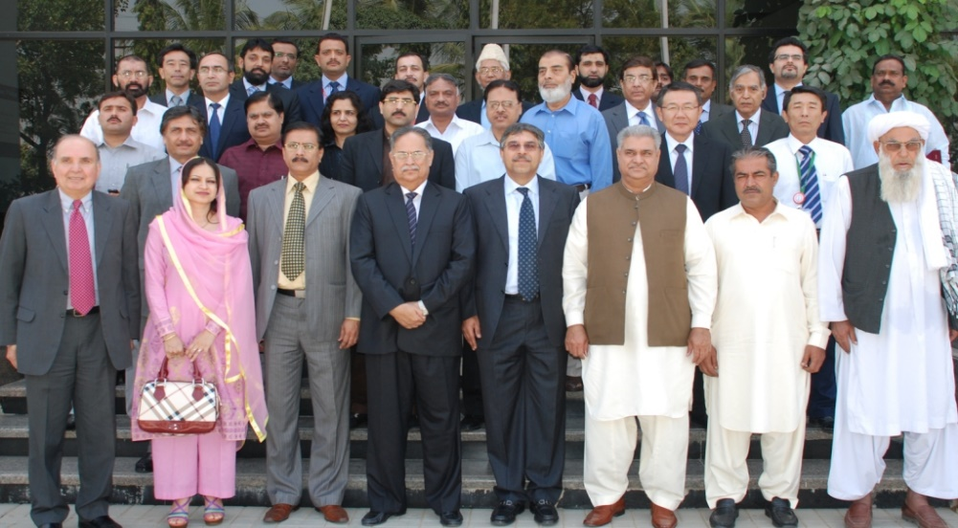
What Next ?
To
Another Standing Committee
Another Report

Slide 38
Pakistan’s First Climate Change Policy
Pakistan is among the few developing countries which has prepared such a comprehensive national policy on a subject which is on top of the global priority agenda may be after war on terror,” said Dr Qamaruzaman Chaudhary, former director general of Meteorological Department of Pakistan and lead author of the policy.

Slide 39
From Aims to Implementation
The main objective of the policy is to sustain economic growth by addressing the challenges of climate change.
“I think what the draft says is correct, but may already have been said in a whole host of other policy documents. The challenge is to turn the general statements into specific targets and timetables,” says Adil Najam

Slide 40
Who will Implement the policy ?
Chaudhary “ An action plan is the next priority and the next step. I hope it will be ready within next few months “.
More Standing Committees for implementation ????

Slide 41
National Climate Change Policy-April 2011
Framework for addressing the issues of CC related to Pakistan
Inputs for this policy document include: Task force of CC, consultation with provinces, federal institutions and civil society. However,
Sets a comprehensive framework for development of action plan for national effort on adaptation and mitigation
Reviewing and updating of policy to reach the emerging concepts and issues of ever evolving science of CC

Slide 42
Strengths
Specified goal along with clear objectives.
Vulnerability of Pakistan to CC.
Specifying adaptation and mitigation policy options
Gender, poverty and disaster preparedness have been brought to front line in tackling climate crises.
Town planning in mitigation as an emerging concept.
Policy implementation mechanism also serves as the main feature.

Slide 43
Weaknesses
Policy options to improve CC scenario is without any time line.
A conceptual frame work to achieve the goal to tackle CC remains unspecified.
How these policy options will reduce and contribute to lowering carbon emissions are not mentioned.
While gender is mentioned, it is more like a cumbersome “add on”.
Adaptation measures are mainly focused on developing resilience of agriculture, water and power sectors in spite of the fact that development and modification of infrastructure and urban development should be given an equal focus.
The policy appears to be a “test tube” development since the 2003 communication and 2010 TFF report are not used as baseline or even strong reference documents.

Slide 44
Weaknesses
Only theoretical promises of “increased investment in research for climate change mitigation and adaptation”.
Costs of achieving the policy options are not calculated. Various “policy measures” are outlined but no directions given on HOW and WHEN they will be achieved and FOR HOW MUCH.
Though the Green Climate Fund, Adaptation Fund, GEF, CDM, World Bank’s Forest Carbon Partnership figure in the policy as mechanisms from which “money” will be obtained, we remain clueless about WHO and WHEN. E.g. Only 11 projects from Pakistan have been registered with UNFCCC since the introduction of CDM and a total amount of $273 million has been invested in these projects, which is just 0.27 percent of the total spending by countries in Asia and Pacific region.

Slide 45
Analysis of NCCPFindings of the study
Unrealistic policy options
Redundant policy measures
Implementation issues
Hurdles after 18th amendment
Capacity building & institutional strengthening issues
Coordination issues among the relevant departments
Lacks consultation with Pakistan’s national security
Lacks Consultation with relevant stakeholders
Does not base on Empirical evidences

Slide 46
Conclusion
Pakistan has a long way to go in even understanding its climate change problems (if any since we still do not know where our vulnerability lies in terms of an index) based on scientific data and its impacts on the lives of local communities and citizenry.
A different way of targeting the Climate Change question should be done based on real time baseline field research and analysis, rather than just number crunching and rehashing statistics based on donor project reports, hearsay and dated government documents.
Pakistan’s stance on international CC platforms needs to be stronger, well-informed and consistent.
Need for a National Commission on CC to:
  coordinate climate change activities
  monitor and assess emissions of greenhouse gases
  monitor and assess impacts of national climate and weather conditions on oceans, snow and glaciers, citizens and Pakistan’s ecosystems and resources.

