Slide 1
Lecture 22
NATURAL RESOURCE PLANNING AND MANAGEMENT
Dr. Aneel SALMAN
Department of Management Sciences
COMSATS Institute of Information Technology, Islamabad

Slide 2
Recap Lecture 21
Policy Analysis
Policy Evaluation
Policy Making process in Pakistan

Slide 3
Background
Climate change is happening and it is a reality
Most victims are poor, they loss more but recover less
CC, significant barriers/challenge to meet MDGs
CC enhances existing risks and vulnerabilities
Flood, droughts, storm/cyclone, salinity intrusion etc destroys annual harvests of Asia and the Pacific
Vulnerability is highest in LDCs in the tropics and subtropical areas

Slide 4
Climate Change: Some Definitions
Weather: The state of the atmosphere at a given time and place, with respect to the variables such as temperature, moisture, pressure etc.
Climate: Average weather. Statistical description of mean weather conditions over a period of several years, typically 2-3 decades.
Climate Change: Climate Change in excess of natural variability, attributable to human activity.

Slide 5
Different Definitions of Climate Change
  IPCC (International Panel on Climate Change): Change in climate over time, whether due to natural variability or as a result of human activity.
  UNFCCC (United Nations Framework Convention on Climate Change):
  Change of climate that is attributed directly or indirectly to human activity that alters the composition of the global atmosphere and that is in addition to natural variability.

Slide 6
Background
IPCC Fourth Assessment Report - 2007
IPCC Third Assessment Report - 2001
IPCC Second Assessment Report - 1995
IPCC First Assessment Report - 1990
Climate
+ Impacts
Climate
+ Impacts
Climate
+ Impacts
Cost-effectiveness
Climate
+ Impacts
Cost-effectiveness
Equity
Cost-effectiveness
(Cost-effectiveness)
Equity
Alternative Development Pathway
(Equity)
(Alternative Development Pathway)
(Sustainable Development)
Najam et al., 2003 and Alam, 2007

Slide 7
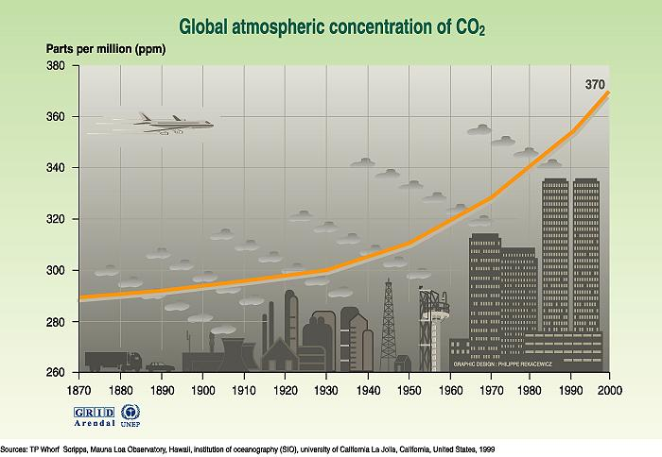

Slide 8
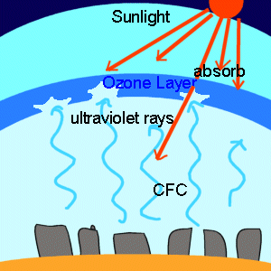
Ozone Layer
A layer in earth’s atmosphere which contains relatively high concentrations of ozone (O₃ ).
Ozone absorbing Solar
UV light is what heats up
the stratosphere.
Without the ozone layer, all solar UV light would get to ground causing cancer and germicide killing of many things from top-to-bottom of food chain.

Slide 9
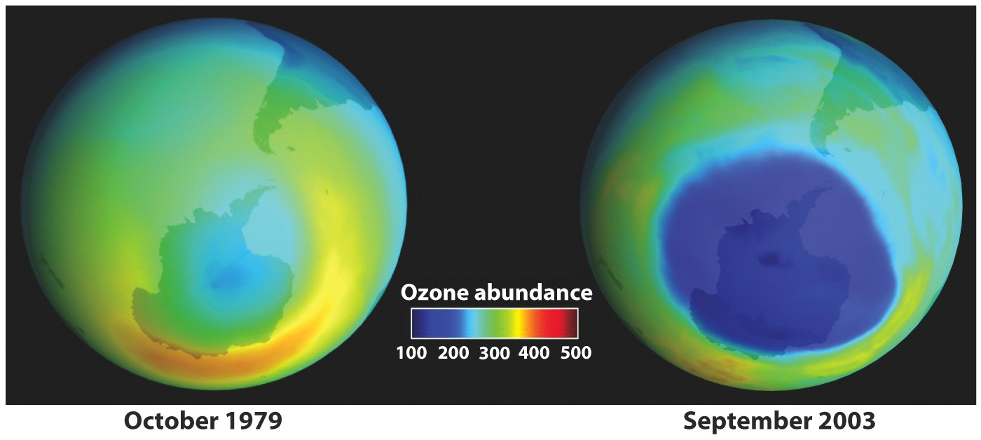
Ozone Hole

Slide 10
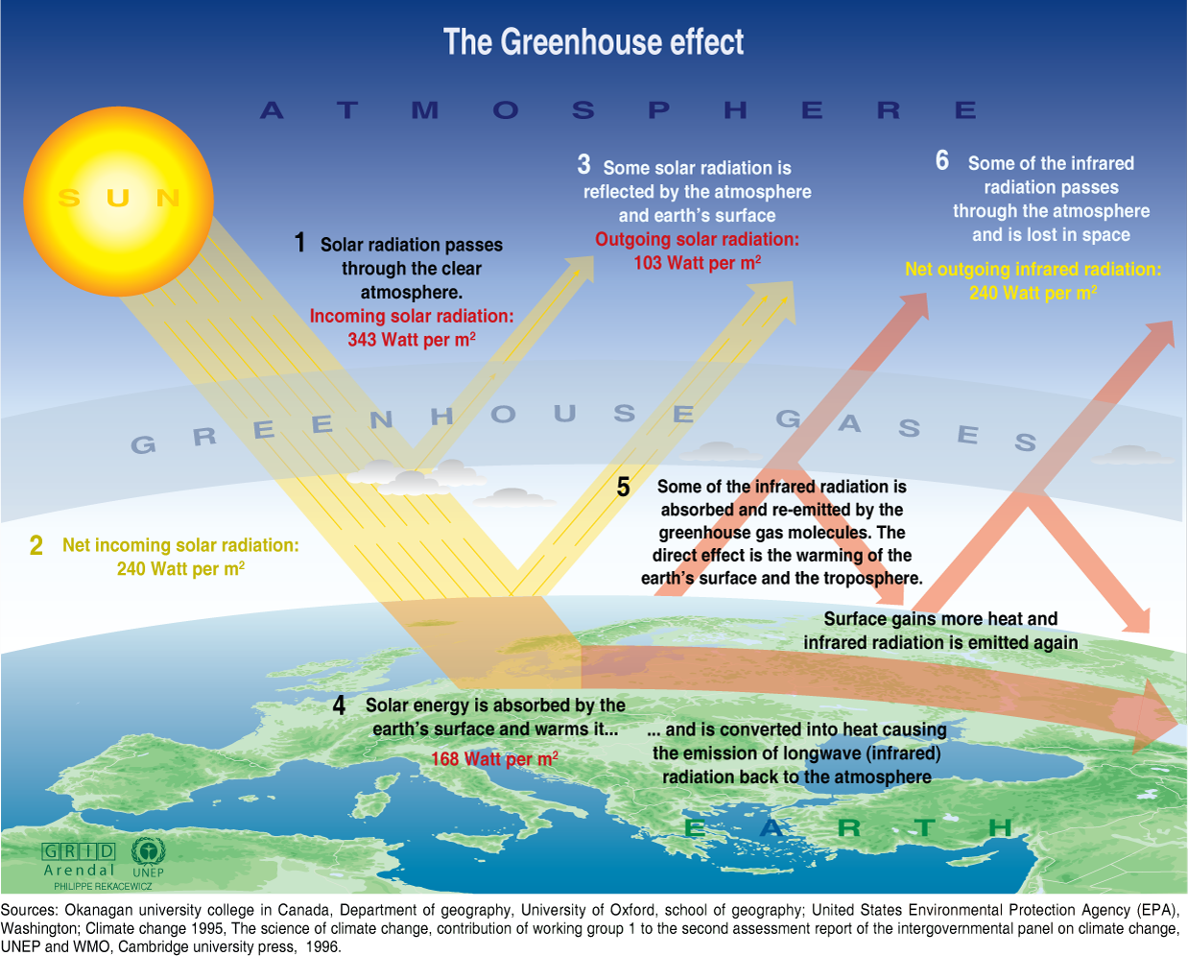

Slide 11
Greenhouse Effect and Global Warming
The “greenhouse effect” & global warming are not the same thing.
  Global warming refers to a rise in the temperature of the surface of the earth.
An increase in the concentration of greenhouse gases leads to an increase in the magnitude of the greenhouse effect. (Called enhanced greenhouse effect).
  This results in global warming.

Slide 12
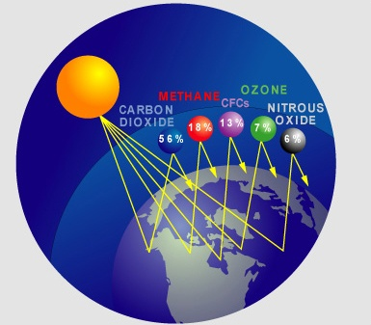
Composition Of Greenhouse Gases
Gases in our atmosphere which absorb IR waves and radiate some of the heat back toward the earth.
  Methane
  Nitrous oxide
  Chlorofluorocarbons
  Carbon dioxide (CO₂)

Slide 13
Attributes Of Key GHGs
CO₂
CH₄
N₂O
CFC-11
HFC-23
CF₄
Pre-Industrial
280
700
270
Zero
Zero
40
Concentration (Y1900)
ppm
ppb
ppb
ppt
ppt
ppt
1998 Conc.
365
1745
314
268
14
40
Annual Rate of Change
1.5
8.4
0.8
-1.4
0.55
1
Global Warming
1
23
296
4600
12000
5700
Potential (100 Yr)
Atmospheric
Lifetime (yrs)
500
12
114
45
260
50,000
Other GHGs include Industrial Gas (e.g.) SF6, Other HFCs
and Indirect Gases (Water Vapour, Nox, etc.)
Notes:
Slide text and notes: CC:train
Atmospheric Concentration of other GHGs: (CFCs and O3 )
Other greenhouse gases, or GHGs, have additional effects on the environment.
Chlorofluorocarbons or aerosols, more popularly referred to as CFCs, also contribute to the depletion of stratospheric ozone.
Tropospheric ozone, or O3 , is another important contributor to local air pollution.

Slide 14
Contributions Of GHGs To Global Warming
The Last 100 Years
6%
13%
Since 1980’s
14%
49%
18%

Slide 15
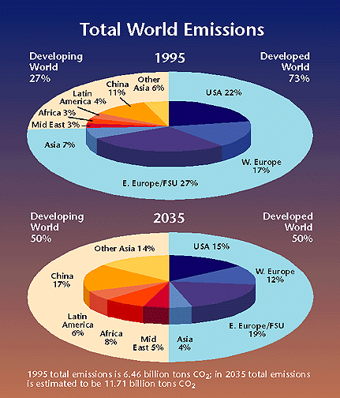
Share Of Global GHGs In Future
1995 total emissions:
6.46 billion tons of carbon
2035 total emission estimate:
11.71 billion tons of carbon
Notes:
OSTP: Office of Science and Technology Policy, Executive Office of the President, United States. Taken from http://www.whitehouse.gov, accessed, July, 2000.

Slide 16
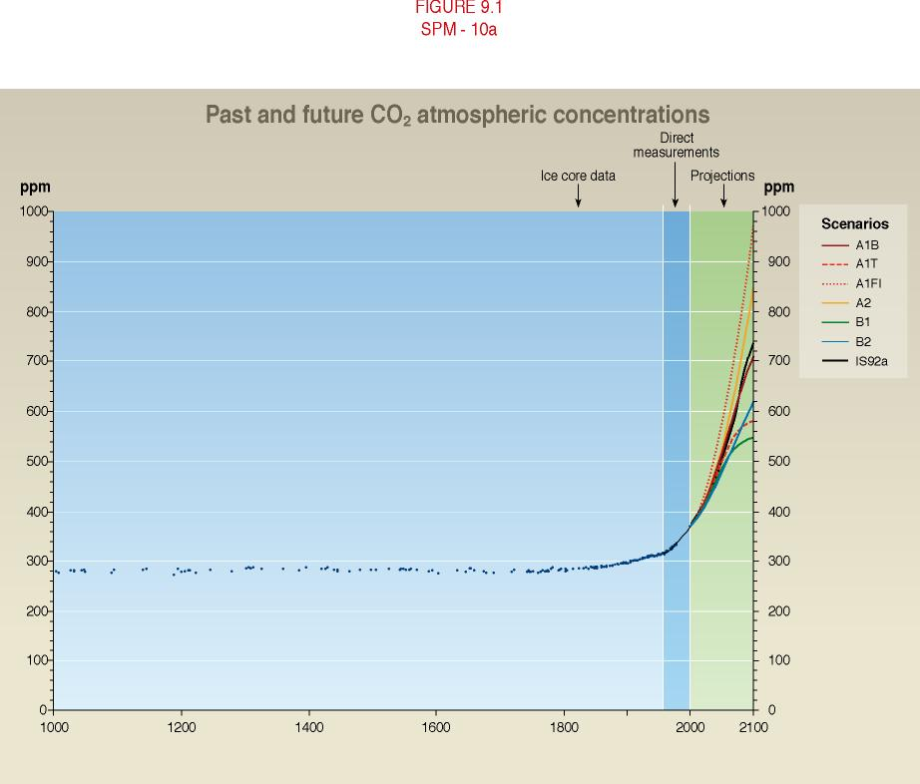
Emissions
CO₂
Pre-industrial level: 280 ppm
Current level:
360 ppm
Level in 2100: ~700 ppm with large uncertainty
Notes:
Most of the increase in global temperature since the late 19th century has occurred in two distinct periods: 1910 to 1945 and since 1976. The rate of increase of temperature for both periods is about 0.15°C/decade. Recent warming has been greater over land compared to oceans; the increase in sea surface temperature over the period 1950 to 1993 is about half that of the mean land-surface air temperature. The high global temperature associated with the 1997 to 1998 El Niño event stands out as an extreme event, even taking into account the recent rate of warming.
In the mid- and high latitudes of the Northern Hemisphere over the latter half of the 20th century, it is likely that there has been a 2 to 4% increase in the frequency of heavy precipitation events. Increases in heavy precipitation events can arise from a number of causes, e.g., changes in atmospheric moisture, thunderstorm activity and large-scale storm activity.

Slide 17
Global Atmosphere Changes Caused By Human Gas Production
 | OZONE DEPLETION | GLOBAL WARMING
Cause | Halogen compounds released into air, diffuse to stratosphere, catalytically destroy ozone layer | CO₂ (and methane) released into air, greenhouse effect heats air, changes climate
Sources | Hair sprays, refrigerants, etc | Fossil fuel burning, deforestation
Latency time | Half a century | Decades
If allowed to go to extreme | Ozone layer goes to half of depth worldwide, Solar-UV light gets to surface, death of food-chain top, bottom, and middle | World heats up by perhaps 10°F, icecaps all melt, majority of world’s population looses homes, frequent high-intensity hurricanes, massive droughts affect half of world, deaths in the billions
Ease of solution | Easy; ban CFCs, manufacture substitutes instead | Hard; too many people in world, all wanting to burn fossil fuels to achieve high living standard. Shift to renewable energy sources.

Slide 18
Global Warming Doctrine
Modern society burns fossil fuels such as gasoline, natural gas, coal.
All of these give off CO₂ as they burn.
The added CO₂ in the atmosphere is increasing the greenhouse effect on the earth.
This is increasing the temperature of the earth beyond its normal range.
This will result in disastrous consequences for life on earth.
The only way to avoid this is to reduce world CO₂ emissions.

Slide 19

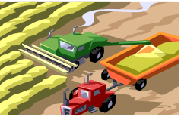
CLIMATE CHANGE
Global Warming
Increased Precipitation & its Uneven Distribution
Melting of Glaciers & Snow
Sea level Rise
Increase in Frequency & Intensity of Extreme Weather Events
IMPACTS
Uncertainty in Water Availability
Decrease in Crop
Yields
Newer perspective for sources of energy
Loss of Biodiversity
Increased
Health Risks
Natural Climate
Variability
Climate Change
Natural + Anthropogenic
Anthropogenic Influences since the Industrial revolution
Spiraling Population
High pace of Industrialization
Increasing use of Fossil Fuels in Industry & Transport
Deforestation for Agriculture and Urbanization
Notes:
19

Slide 20
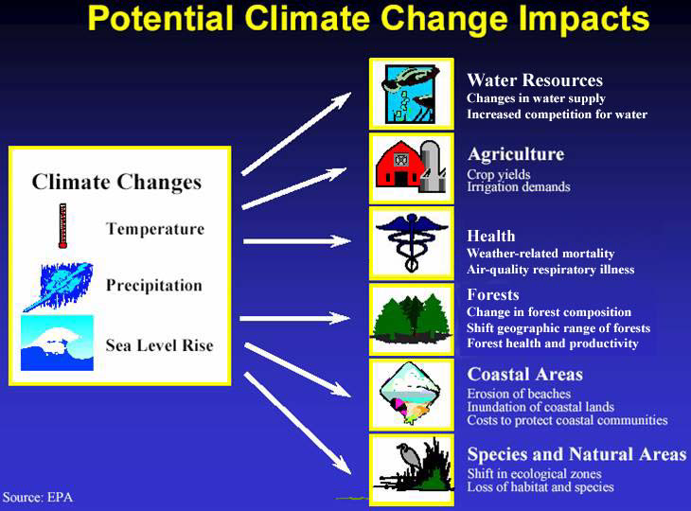
Impacts On Pakistan

Slide 21
Potential impacts some insights
Safe Water supply ↓ at the same time that
water demand ↑ in growing urban areas
Over 25% of the developing world's urban population, including 392 million residents in Asia, lack adequate sanitation.
Storage/treatment capacity would need to expand thus increasing system costs.

Slide 22
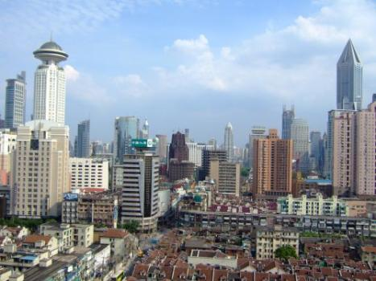
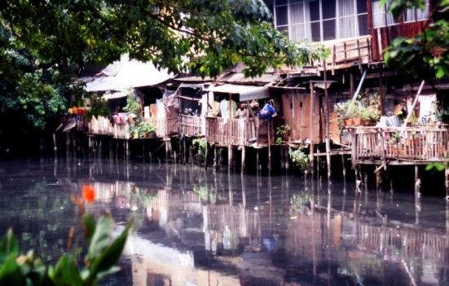
Potential impacts
Housing prices and insurance costs increase in flood zones
Loss of property/land from sea level rise and subsidence

Slide 23
Future Changes in climate
Rainfall
  Increased water availability in moist tropics and high latitudes
  Decreased water availability and drought in mid-latitudes and semi-arid low latitudes
Temperature
  Global temperatures are likely to increase by 1.1 to 6.4°C from 1990 to 2100 (best estimates 1.8 to 5.4)
Sea level rise
  Sea levels are likely to rise in the range of 22-34 cm between 1990 and the 2080s
Extreme events
  Likely that future tropical cyclones, typhoons, and hurricanes will become more intense, with larger peak wind speeds and more heavy precipitation
  Rahman and Alam, 2007

Slide 24
Economic impacts
Developing country economies most affected:
  Climate sensitive economies (agriculture, fishery)
  Low incomes
  vulnerable infrastructure
  threatens poverty eradication
Global GDP:
  1-5% loss (4 degrees warming)
  Up to 10% loss(6 degrees warming)
  Stern: 5-20% loss (per capita consumption;7-9 degrees warming)
  Developing countries higher than average
  Catastrophic events big one-time losses

Slide 25
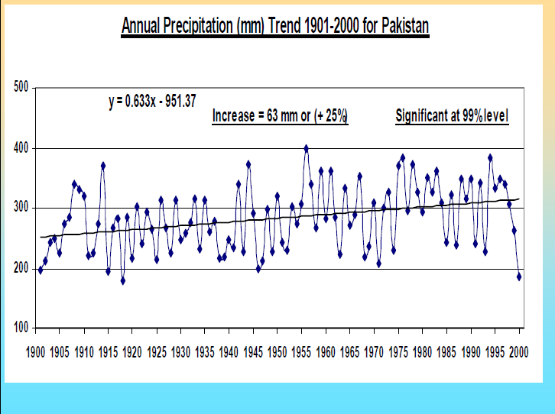
Impacts On Pakistan

Slide 26
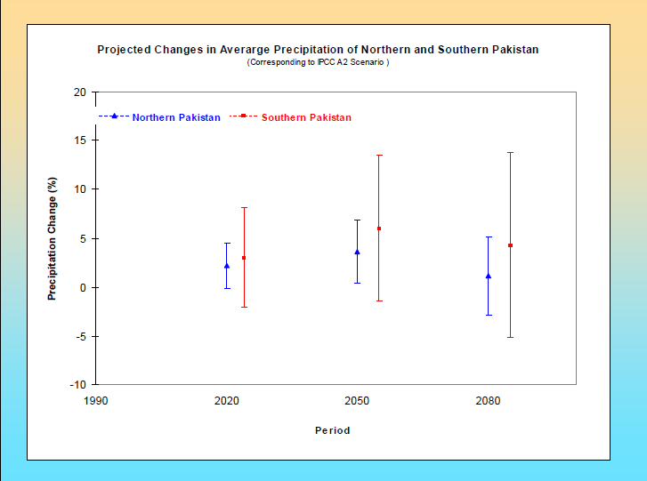
Impacts On Pakistan

Slide 27
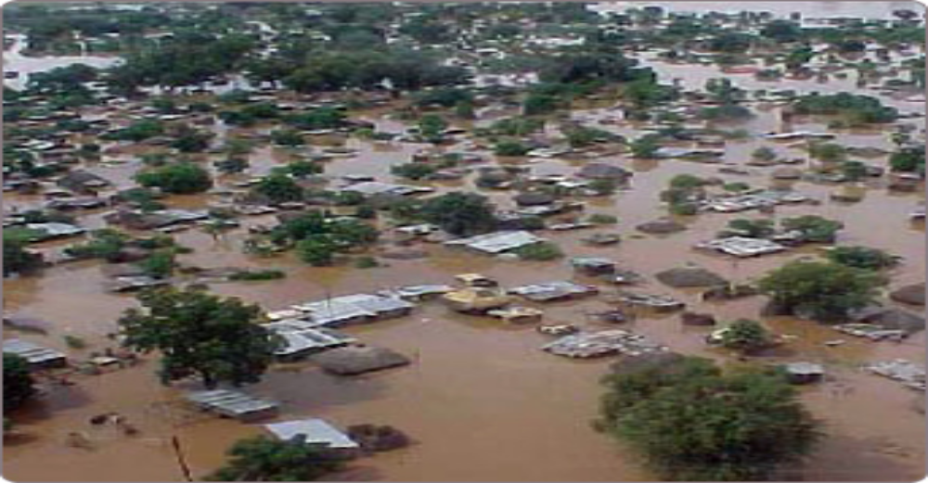
Impacts On Pakistan
Monsoon rains in Pakistan last year, all-time worst ,1400 died in floods, 13,000,000 people displaced.
Shift in rain pattern as well as increase in annual rainfall.

Slide 28
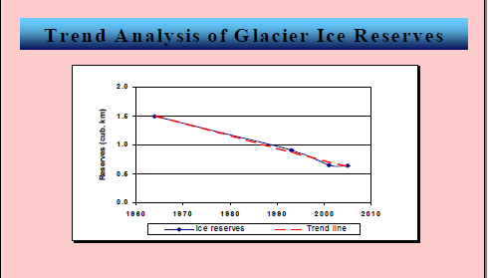
Impacts On Pakistan
Melting of Glaciers in Northern Areas.

Slide 29
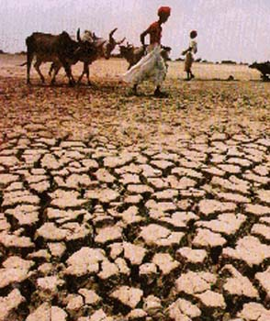
Impacts On Pakistan
Melting of Glaciers predicted in the next 75 years, which will lead to:
Agriculture losses.
Water shortages.
Massive drought.
Food shortages.

Slide 30
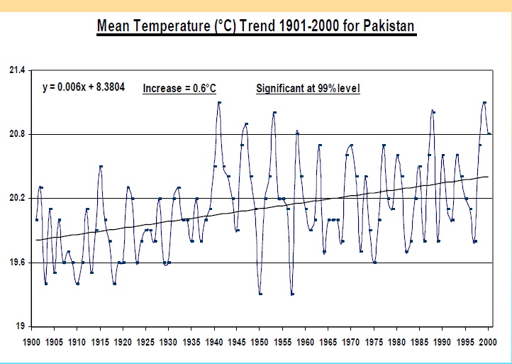
Impacts On Pakistan

Slide 31
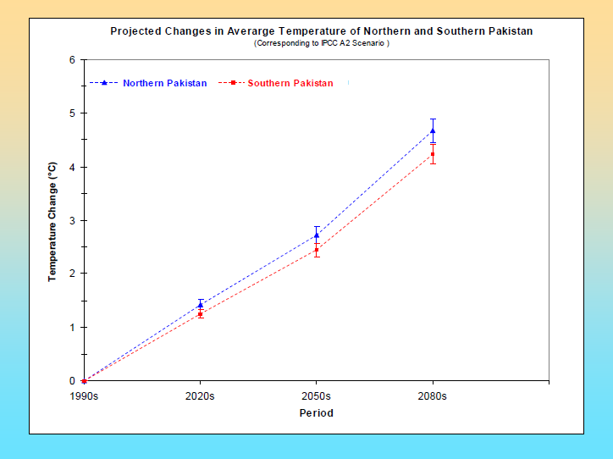
Impacts On Pakistan

Slide 32
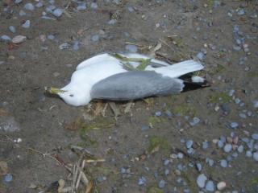
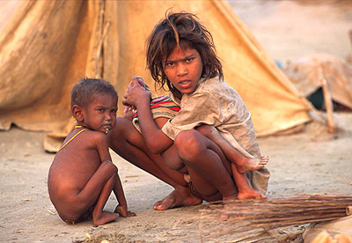
Impacts On Pakistan
Widespread adverse health effects due to extreme weather conditions.
Severe loss of marine life due to reduction in mangrove forests.

Slide 33
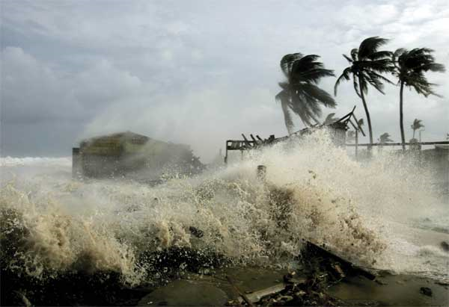
Impacts On Pakistan
Increase in occurrence of Severe storms/ hurricanes.

Slide 34
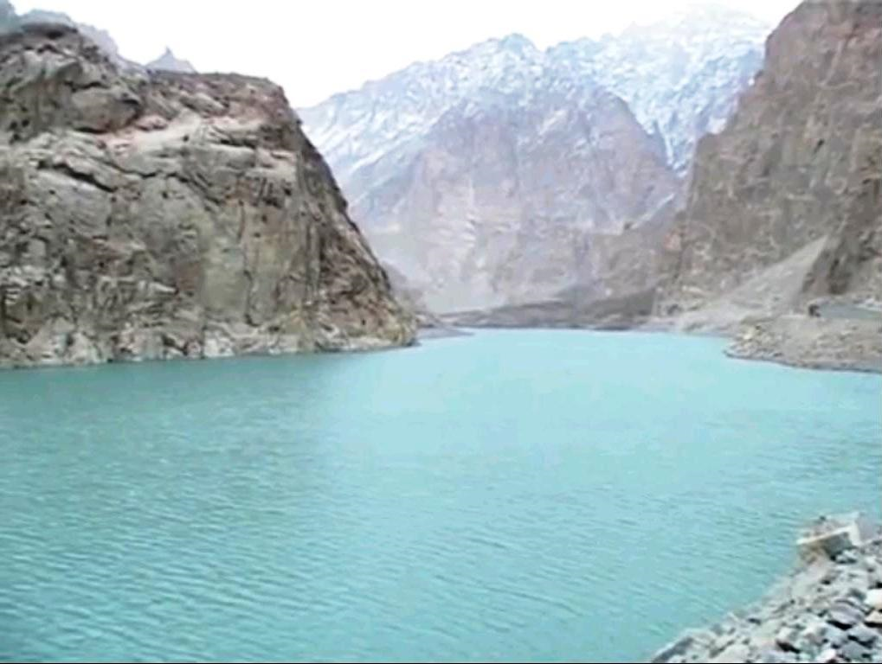
Impacts On Pakistan
Formation of Attabad Lake in Baltistan due to severe land sliding / snowstorm.

Slide 35
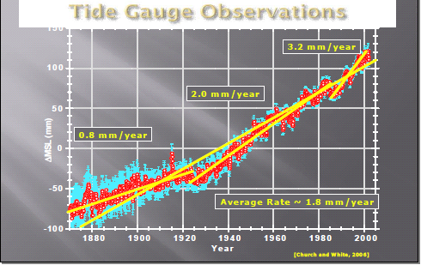
Impacts On Pakistan
Rise in sea level resulting in extinction of coastal areas.

Slide 36
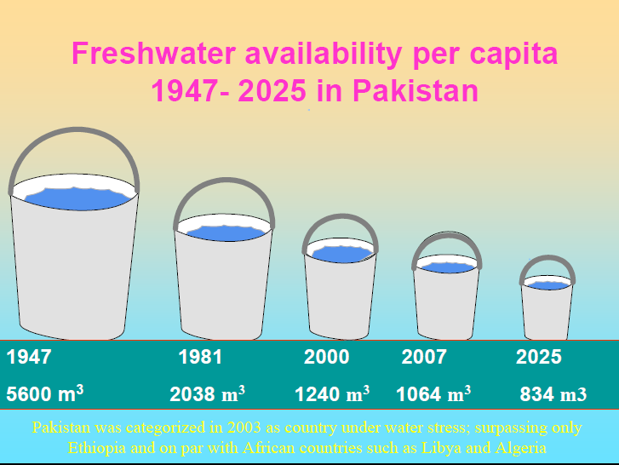
Impacts On Pakistan
Pakistan was categorized in 2003 as country under water stress, surpassed by Ethiopia and at par with African countries such as Libya and Algeria.

Slide 37
Impacts On Pakistan
According to IPCC(Intergovernmental Panel on Climate Change)study for countries most at risk from climate related threats, Pakistan is rated :
7th in flood,
12th in agriculture.

Slide 38
Major CC-related Concerns of Pakistan
Key sectors: Water and Agriculture at greatest risk
Increased risks of floods and landslides, droughts, typhoons and tropical storms, forest fires etc. due to increase in frequency and intensity of extreme events
Severe water-stressed conditions in arid and semi-arid regions due to reduced rainfall, increased temp., and depletion of soil moisture – May lead to expansion of deserts

Slide 39
Major CC-related Concerns of Pakistan
More rapid recession of Hindu Kush (HKH) Glaciers due to increase in temp. and seasonal variability of precipitation may lead to increased summer flows in Indus river system for a few decades, followed by reduction in flows as Glaciers disappear;
Reduction in capacity of natural reservoirs due to rise in snowline on mountains with increase in surface temp. – May increase risk of floods during the wet season;
Agriculture productivity likely to suffer severe losses due to high temp., droughts, flood conditions and soil degradation – Would endanger food security of the country;

Slide 40
Major CC-related Concerns of Pakistan
Large reduction in productivity of both warm water and cold water fish due to oxygen depletion in aquatic systems
As a result of sea level rise, large scale inundation of coastline and recession of flat sandy beaches; upstream incursion of saline water in the Indus delta; and risk to mangroves, coral reefs and breeding grounds of fish
Enhanced risk to life and property in coastal areas due to increased intensity of tropical cyclones, combined with sea level rise; High risk for Karachi and other coastal areas of Sindh-Makran coast

Slide 41
Major CC-related Concerns of Pakistan
Higher incidence of Malaria and other vector-borne, water-borne and heat-related diseases due to warmer and wetter conditions
Risk to fragile ecology of Mountain and Highland systems due to synergetic effects of Climate Change
Increased threat to biodiversity, which is already at risk due to land-use/cover change and population pressure

Slide 42
Conclusion
Temperature increases both past and projected are higher over Pakistan compared to the global changes and as such the country is more vulnerable to climate change. Intensive research is needed to study the adverse impacts of climate change on different socio-economic sectors such as water resources, agriculture production etc.
Pakistan has more glaciers than any other land outside the North and South Poles with sizeable ones in the Karakoram ranges. Glacier melt, in the wake of climate change, is a big threat to the country’s water resources and needs systematic studies to be carried out on the mass balance of glaciers

Slide 43
Conclusion
Capacity Building in the use development and modification of mathematical models for use in climate change related studies, needs to be enhanced
A clear cut climate change policy spelling out the government policy and plan of action needs to be formulated to counter the adverse impacts of climate change
And finally
This new field of climate change, being an emerging component of natural sciences, needs to be taken up as part of the curricula of studies at the college and university level

Slide 44
Global Response
Climate Change is being addressed by several national research programs in all developed countries:
A number of developing countries are also actively pursuing climate change research, e.g.
  In South Asia region, India has some 20 establishments and Bangladesh, Nepal and Sri Lanka are also engaged in CC research
  In Pakistan universities set up academic programs on climate change e-g PIDE. NGOs initiated CC research programs like SDPI, LEAD-Pakistan, IUCN, WWF, OXFAM,
  China has a large number of establishments engaged in CC research.

