Slide 1
Lecture 02
NATURAL RESOURCE PLANNING AND MANAGEMENT
Dr. Aneel SALMAN
Department of Management Sciences
COMSATS Institute of Information Technology, Islamabad

Slide 2
Recap
Emphasizes the comprehensive planning process and human dimensions of resource management.
Students integrate biological, social, and institutional dimensions of management through lectures and readings
  Outcome 1: Students will understand natural resource planning as a process with recognizable phases.
  Outcome 2: Students will effectively consider the multiple dimensions (physical, biological, social, and institutional) of natural resources management.
  Outcome 3: Students will learn to analyze a resource management problem, suggest explicit alternative management approaches, and identify potential consequences of those approaches.
  Outcome 4: Students will become familiar with current issues in natural resources management.
  Outcome 5: Students will develop their written and oral communications skills.
  Outcome 6: Students will develop their abilities to analyze natural resource management policies

Slide 3
Basic Definitions
Natural resources: Natural resources are the resources available in a nature like air, water, sunlight, soil, minerals, forests, wild life etc.
Natural resources occur naturally within environments that exist relatively undisturbed by humanity, in a natural form. A natural resource is often characterized by amounts of biodiversity and geodiversity existent in various ecosystems.

Slide 4
Natural resources are of two main types. They are renewable and non-renewable natural resources.
Renewable natural resources: Those resources which can be replenished in a short period of time like air, water, sunlight, forests etc.

Slide 5
Non-renewable natural resources: Those resources which cannot be replenished in a short period of time like minerals (coal, petroleum, natural gas, metals etc.) because they take millions of years to be formed.
Human activities produce a lot of waste materials which are thrown away into the environment. These wastes cause pollution of natural resources like air, water and soil.

Slide 6
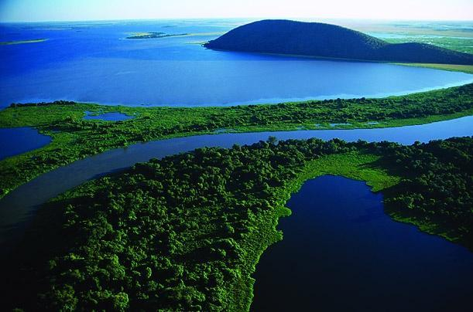
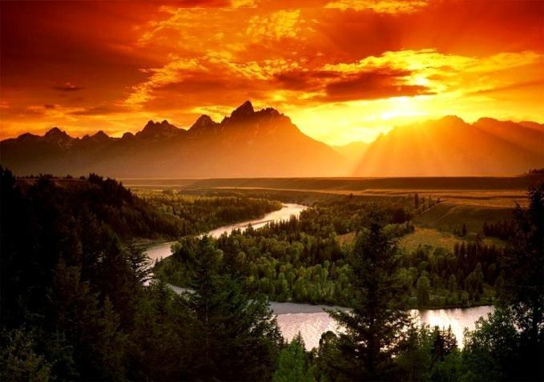

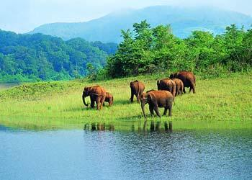
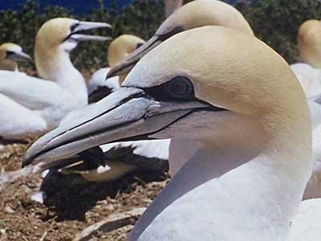
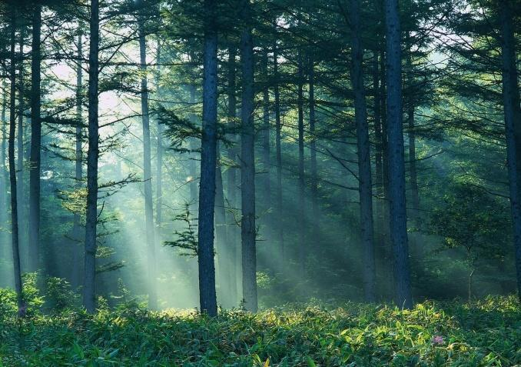
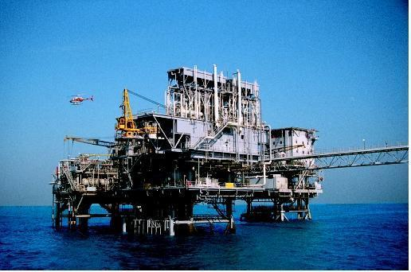
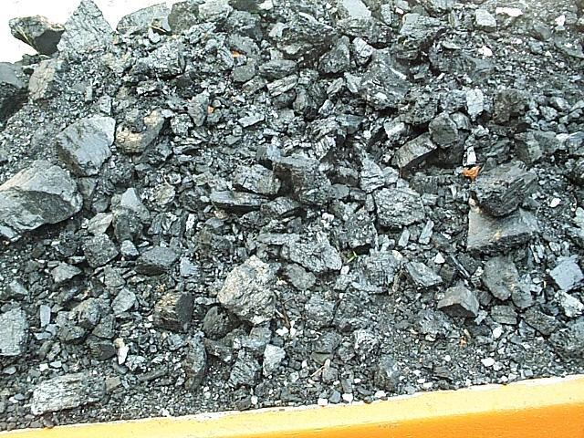
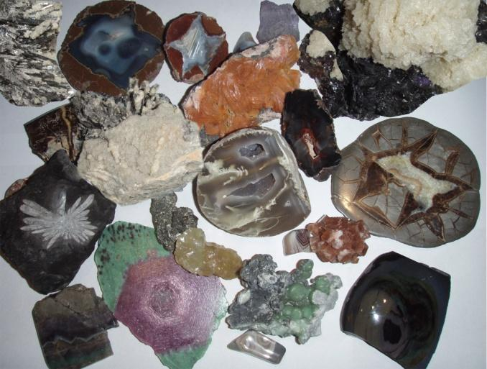
NATURAL RESOURCES

Slide 7
Classification by development
Considering their stage of development, natural resources may be referred to in the following ways:
Potential resources – Potential resources are those that exist in a region and may be used in the future. For example petroleum occurs with sedimentary rocks in various regions, but until the time it is actually drilled out and put into use, it remains a potential resource.
Actual resources – Actual resources are those that have been surveyed, their quantity and quality determined and are being used in present times. The development of an actual resource, such as wood processing depends upon the technology available and the cost involved.

Slide 8
Reserve resources – The part of an actual resource which can be developed profitably in the future is called a reserve resource.
Stock resources – Stock resources are those that have been surveyed but cannot be used by organisms due to lack of technology. For example: hydrogen.

Slide 9
The Three R’s to save the environment
The three R’s to save the environment are Reduce, Recycle and Reuse.
Reduce :- means using less of natural resources and avoiding wastage of natural resources.
Recycle :- means the materials like paper, plastic, glass, metals etc used for making things can again be used for making new things instead of synthesizing or extracting new paper, plastic, glass or metals.
Reuse :- means using things again and again like the plastic bottles in which we buy jams, pickles etc can be again used for storing things in the kitchen.

Slide 10
Need for Management of Natural Resources
All the things we use and consume are obtained from natural resources.
Due to increase in population, industrialization and urbanization the demand for natural resources is increasing and their availability is limited . So there is a need for proper management of natural resources. The proper management of natural resources consists of :-
  Judicious use of natural resources and avoiding wastage of natural resources.
  Long term planning for the use of natural resources so that it last not only for the present but also for future generations.
  The exploitation of natural resources should not be for the benefit of a few people but should be distributed equally for all.
  While extracting and using natural resources we should also plan for the safe disposal of wastes so that no damage is caused to the environment.

Slide 11
FORESTS

Slide 12
Importance of Forests
  Forests help to preserve biodiversity.
  Forests are natural habitats of plants and animals.
  Forests provide timber, wood, fuel, medicines, fodder, etc.
  Forests help to maintain ecological balance.
  Forests help to control climate and rainfall.
  Forests help to prevent soil erosion and controls floods.
  Forests help to maintain the oxygen–carbon dioxide balance in nature.

Slide 13
Stake holders of forests
People who are associated with forests directly or indirectly are:
  People living in and around forests depend on forests for their livelihood.
  Industrialists who use the raw materials from forests for manufacturing paper, medicines, furniture etc.
  Forest Department of the Government who owns the forests and controls the resources from the forests.
  Nature and wild life organizations who want to conserve and preserve forests.

Slide 14
Conservation of forests
Forests can be conserved by :-
  Afforestation – planting of more trees.
  Preventing or reducing deforestation.
  Preventing over grazing by cattle.
  By setting up wildlife sanctuaries, national parks, biosphere reserves etc.
  Undertaking social forestry programs like Van Mahotsav, Chipko movement for planting and protecting trees on a large scale.

Slide 15
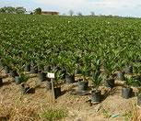
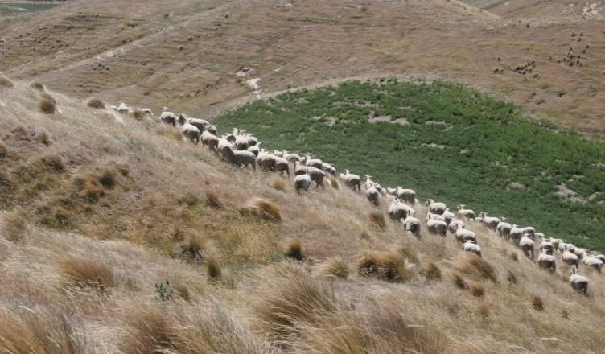
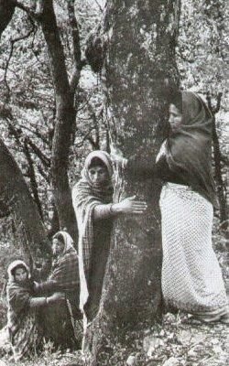
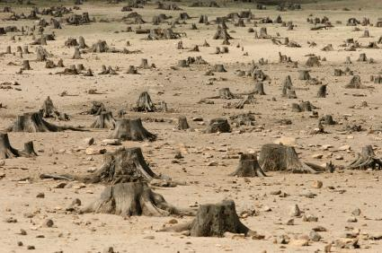
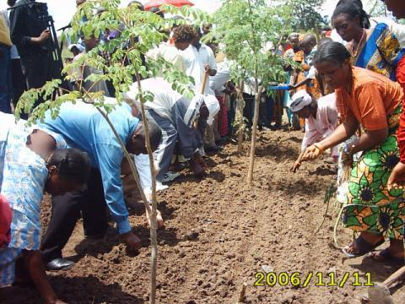
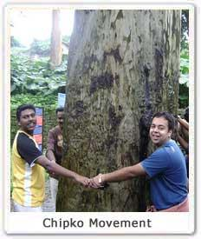

Slide 16
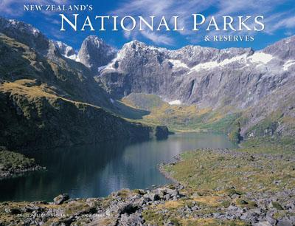
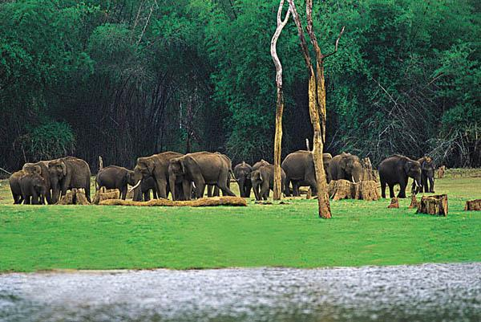
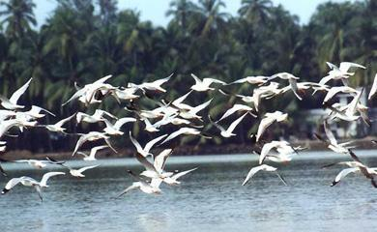
Wild Life

Slide 17
Importance of wildlife
Wildlife helps to preserve biodiversity.
Wildlife helps to maintain food chains and food web.
We get useful products from wildlife like food, medicines, leather, bones, honey, lac etc.

Slide 18
Conservation of wildlife
Preserving the natural habitats of animals.
Banning poaching of animals.
Protecting endangered species of animals.
Setting up of wildlife sanctuaries, national parks, biosphere reserves etc

