Slide 1
Lecture 19
NATURAL RESOURCE PLANNING AND MANAGEMENT
Dr. Aneel SALMAN
Department of Management Sciences
COMSATS Institute of Information Technology, Islamabad

Slide 2
Recap Lecture 18
Value of Nature
Payments for Ecosystems
Why ‘Payments’ for Ecosystem Services?
What makes payments for environmental services attractive?

Slide 3
Payments for environmental services
National initiatives
Colombia | Cauca Valley water user associations
Costa Rica | FONAFIFO/Pagos por servicios ambientales (PSA) Heredia: Environmentally adjusted water tariff
Ecuador | Quito: FONAG
El Salvador | Mesa permanente de servicios ambientales Tacuba, San Francisco de Menéndez, Yamabal
Mexico | Pago por servicios ambientales Hidrológicos (PSAH) Coatepec
Venezuela | CVG-Edelca payments for conservation of Río Caroní
South Africa | Working for Water Program

Slide 4
From theory to practice
1. Understanding
the science…
… and the economics
Hydrological effects
Water services
Welfare of
water users
Land use
Carbon sequestration
Emission reductions
Carbon buyers
Biodiversity
conservation
Ecosystem services
Welfare of
beneficiaries
Payment
2. Charging service users
3. Paying service providers

Slide 5
From theory to practice
Payments for environmental services: Theory
  Example of water services
Identifying and valuing environmental services
Developing PES mechanisms
  Charging service users
  Paying service providers
  Establishing the institutional framework

Slide 6
II.
Identifying and valuing environmental services

Slide 7
Identifying environmental services
Demand:
What specific services?
Who benefits from these services?
How much benefit do they receive?
Supply:
How are these services generated?
How much more or less of these services would we receive if land use changed?
Who generates these services?

Slide 8
Understanding service provision
Hydrological effects
Water services
Welfare of
water users
Land use
Carbon sequestration
Emission reductions
Carbon buyers
Biodiversity
conservation
Ecosystem services
Welfare of
beneficiaries
Bio-physical relationships
Valuation
Begins here!
Need multidisciplinary work

Slide 9
Understanding service provision
Hydrological effects
Water services
Welfare of
water users
Carbon sequestration
Emission reductions
Carbon buyers
Land use
Carbon sequestration
Emission reductions
Carbon buyers
Land use
Biodiversity
conservation
Ecosystem services
Welfare of
beneficiaries
Biodiversity
conservation
Ecosystem services
Welfare of
beneficiaries
Cost of production, profitability
Irrigation
Hydrological effects
Hydropower
producers
Cost of production, profitability
Land use
Domestic water supply
Consumer WTP

Slide 10
Valuing services
Why value?
Value of benefits (maximum payment)
Opportunity cost (minimum payment)
Deforestation and use for pasture
Conservation
Conservation with payment for service
Payment
Benefits to land users
Minimum payment
Costs to downstream populations
Maximum payment

Slide 11
Identifying and quantifying services
Getting the science right is vital
If services aren’t delivered, people won’t pay
Monitoring is critical
  Ensure confidence in system
  Adjust as necessary

Slide 12
III.
Developing payment systems

Slide 13
From theory to practice
Hydrological effects
Water services
Welfare of
water users
Land use
Carbon sequestration
Emission reductions
Carbon buyers
Biodiversity
conservation
Ecosystem services
Welfare of
beneficiaries
Payment
2. Charging service users
3. Paying service providers

Slide 14
IIIA.
Charging service users

Slide 15
Financing requirements
Up-front costs of creating the mechanism
Payments to service providers
Transaction costs of running the mechanism
  Additional costs often imposed on participants

Slide 16
Charging service users
Who benefits from environmental services?
How much do they benefit?
How can part of these benefits be captured to help finance conservation?
How should funds be managed?

Slide 17
Charging service users
Easiest when beneficiaries
Are easy to identify
Are already organized
  Easier to negotiate agreements
  Already have payment mechanisms
Are few
Receive well-defined benefits

Slide 18
Who is going to pay?
Are service users… | Water services | Biodiversity services
Easy to identify?
Already organized?
Few?
Receive well-defined benefits?
√
X
√
X
√
X
√
X

Slide 19
Charging service users
How much should beneficiaries pay?
Maximum: value of the benefit
Deforestation and use for pasture
Conservation
Conservation with payment for service
Payment
Benefits to land users
Costs to downstream populations
Maximum payment

Slide 20
IIIB.
Paying service providers

Slide 21
Paying service providers
Objectives:
Inducing the desired land use change in a sustainable way
Minimum cost

Slide 22
Paying service providers: Principles
Payments should be continuous and open-ended
Payments should be targeted
Avoid perverse incentives

Slide 23
Paying service providers
How much should service providers be paid?
Minimum: their opportunity costs
Deforestation and use for pasture
Conservation
Conservation with payment for service
Payment
Benefits to land users
Minimum payment
Costs to downstream populations
Maximum payment

Slide 24
IIIC.
Establishing the institutional framework

Slide 25
What scale?
National
  Costa Rica’s FONAFIFO
    Economies of scale
    One-size-fits-all
Regional
  Few examples; large river basins
Local
  Colombia: Cauca Valley water user groups
    Flexible, adapted to local circumstances and needs
    Limited local capacity to do science

Slide 26
Institutional framework
Functions which must be accomplished:
Buying services
Selling services
Promotion
Administration
Supervision
Contracting
Investment
Paying participants
Monitoring

Slide 27
Components of a payment system
Supervision mechanism
Technical
Governance
Service
user
Financing
mechanism
Payment
mechanism
$
Service
user
Land users
$
$
$
Service
user
$
Environmental services

Slide 28
Components of a payment system
Supervision mechanism
Technical
Governance
Service
user
Financing
mechanism
$
Functions:
Collects payments
Manages funds
Needs:
MBAs
Accountants
Service
user
Land users
$
Service
user
$
Environmental services

Slide 29
Components of a payment system
Supervision mechanism
Technical
Governance
Payment
mechanism
Functions:
Promotion
Contracting with land users
Monitoring implementation
Needs:
Extension agents
Land users
$
Environmental services

Slide 30
Components of a payment system
Supervision mechanism
Technical
Governance
Technical functions:
Identifying services
Identifying eligible land uses
Monitoring impact on services
Periodically adjusting eligible land uses
Needs:
Analysts (hydrologists, economists, etc)
Payment
mechanism
Land users
$
Environmental services

Slide 31
Components of a payment system
Supervision mechanism
Technical
Governance
Service
user
Financing
mechanism
Governance functions:
Negotiating agreements
Resolving disputes
Needs:
Stakeholder representatives
$
Service
user
$
Service
user
$
Environmental services

Slide 32
Monitoring needs to be done at 3 levels
Implementation
  Do land users undertake the contracted land use?
Impact on services
  Do changes in land use generate the desired services?
Impact on participants
  Is the welfare of participants improved?

Slide 33
Summary

Slide 34
Applying PES to different services
Difficulty of application
Water
services
Carbon sequestration
Biodiversity conservation
Step
1. Understanding
the science
High
Medium/Low
Medium/Low
2. Charging service
users
Medium/Low
High/Medium
Very high
3. Paying providers
Depends primarily on local conditions

Slide 35
Applicability of PES systems
 |  | Upstream opportunity costs
 |  | Low | High
Downstream benefits | High | Yes | Possibly, but difficult to make work
 | Low | Possibly, but not very useful | No

Slide 36
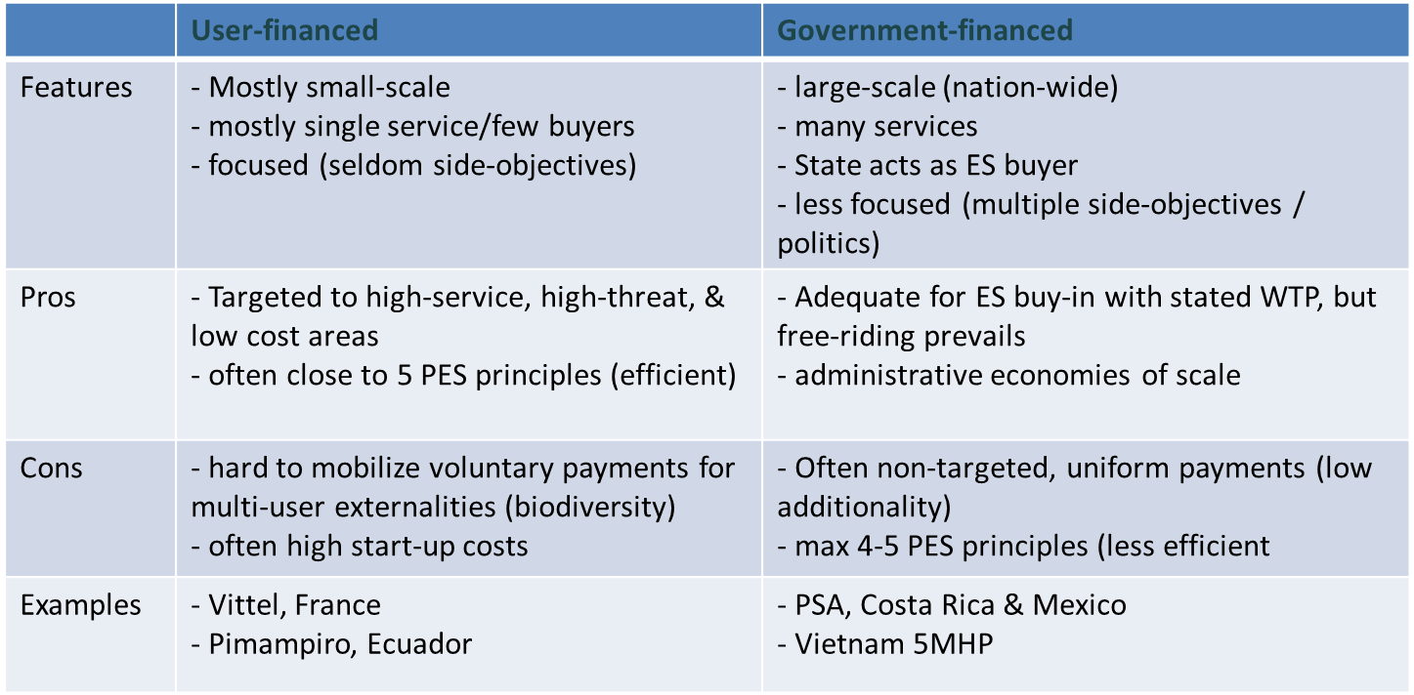
Types of PES schemes
(categories of ES buyers)

Slide 37
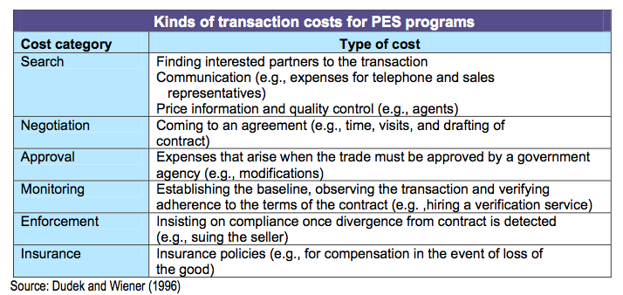
Costs of PES
Opportunity costs (+ land owner’s protection costs)
Transaction costs

Slide 38
Initial lessons
Not a universal solution
One size does not fit all
Identify the services being provided clearly
Understand and document the links between forests and services
Begin from the demand side, not the supply side
Monitor effectiveness
Design flexible mechanisms
Mix and match with other mechanisms
Ensure the poor can participate

Slide 39
Key problems
Getting the science right
Getting the institutions right

Slide 40
a. Can PES be effective?
Promising tool, with regional differences (PES mainly in LA, emerging in SEA and Africa)
But, effectiveness difficult to assess because
  Many schemes still too recent
  Insufficient baseline data (no control area)
  Few analyses based on solid monitoring and evaluation methods
Performance payments (PES) = key for REDD , but upfront conditions needed
To address DD drivers, PES = promising, but not sufficient → need governance investments & extra-sectoral transfers

Slide 41
Preconditions for PES
Preconditions
Economic | - ES = externality AND value of the ES (user’s WTP) > providers opportunity costs (WTA) & transaction costs (TC)
Cultural | PES need social acceptance; where non-economic value systems are important and functioning, resistance to PES is likely (e.g. perception of water access as human right hinders ‘water PES’) most cultural contexts seem to accept PES
Institutional | Need de-facto rights over ES-producing asset in weak governance context, enforcement could be enhanced by contracts with independent provisions in case of non-compliance (e.g. reduced/suspended/stopped payments) rather than only reliance on local juridical system
Informational | Transaction costs of implementing PES schemes (negotiations, baseline setting, system design) need to remain affordable. can be real challenge in small schemes, when buyers and sellers are highly diverse, or when ES is biophysically complex
Source: Wunder 2008, RFF paper

Slide 42
b. Can PES improve livelihoods?
Concerns:
  Weakening of land and resource rights of indigenous and forest dependent communities
  Equity in opportunities to participate as sellers of carbon
  Equity in payment levels and terms – vulnerable communities may be subjective to exploitative contracts
  Local economy impacts which affect non-participants

Slide 43
Can PES improve livelihoods?
Study findings:
  PES schemes have not led to weakening of land tenure, and in some cases have strengthened it
  Direct evidence from our case studies on the impact on livelihoods is limited
  Even if initially access constraints for poor, subsequent corrections occurred (e.g. Costa Rica)
  Despite seemingly low payment levels, PES is popular with farmers (Costa Rica, Mexico)
  Little evidence of local economy impact on prices and employment

Slide 44
PES and poverty
To enhance livelihood/equity outcomes:
“no-harm” approach
  Narrow focus on environmental goal
  Undesired livelihood/equity side-effects are mitigated (e.g. ‘collective contracting’-provision in Costa Rica PSA)
“pro-poor” approach
  Poverty reduction objectives are explicit side-objectives
  (e.g. in areas where rural poverty is pervasive)
  participation of the poor is actively pursued
  (e.g. RUPES – rewarding upland rural poor for ES)

