Slide 1
Lecture 18
NATURAL RESOURCE PLANNING AND MANAGEMENT
Dr. Aneel SALMAN
Department of Management Sciences
COMSATS Institute of Information Technology, Islamabad

Slide 2
Recap Lecture 17
Coupled Human and Natural Systems (CHANS)
Conflict and INRM
Co-management

Slide 3
Defining Ecosystem Services and ‘Payments’
Defining Ecosystem Services and The Concept of ‘Payments’
  Defining Ecosystems and Ecosystem Services
  Ecosystem Services and The Economy
  Drivers of Today’s Challenges
  Evolving Environmental Expectations
  Definition of Payments for Ecosystem Services
  Why ‘Payments’ for Ecosystem Services

Slide 4

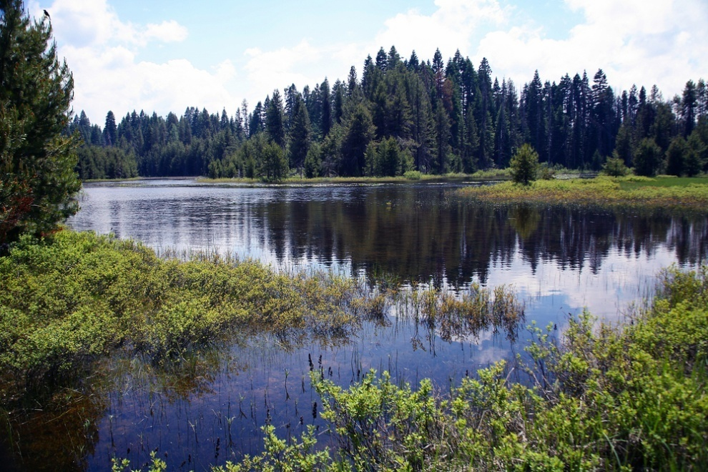
Defining Ecosystems and Ecosystem Services
Ecosystems are the combined interactions of:
Biological / living (plant, animal and micro-organism communities) components of environment
and
Physical / non-living components (air, water, soil and the basic elements and compounds of the environment)
Notes:
Examples:
Coral reefs
Forests
Deserts
Tundra

Slide 5
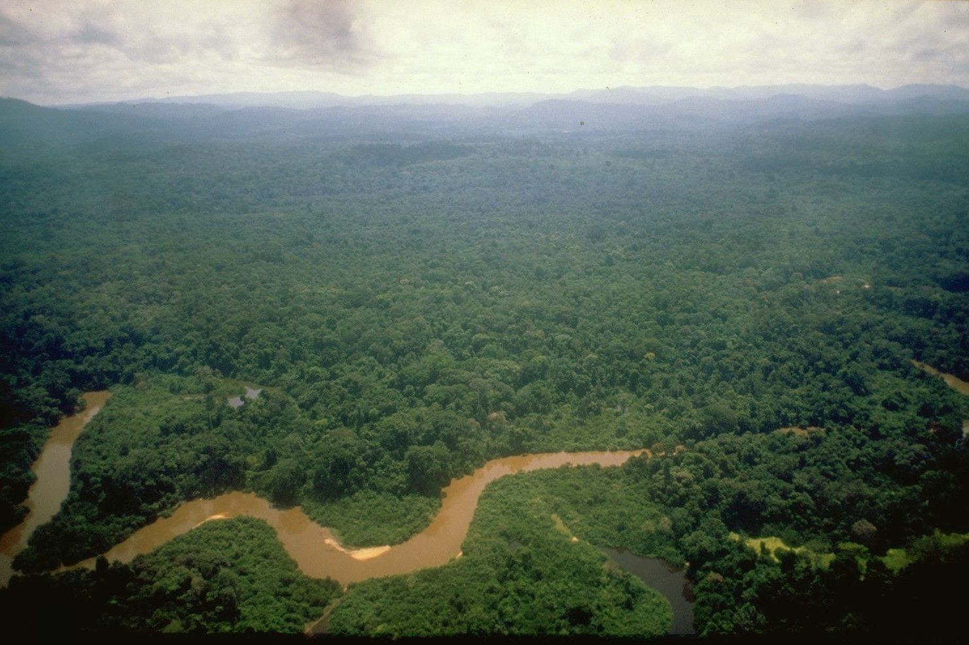
Air quality Pest & disease control
Wild species & habitat protection
_{Carbon sequestration & storage}
_{Soil formation &} _{fertility}
_{Plant pollination}
_{Watershed protection &} _{regulation}
Notes:
In short, they are the benefits that people obtain from ecosystems.
Ecosystem services are the benefits that humans rely upon from functioning ecosystems – such as clean air to breathe, pest and disease control, carbon sequestration and storage, etc.
Well-functioning ecosystems provide reliable and clean flows of water, productive soil, relatively predictable weather, and many other services essential for human well-being. People, companies, and societies rely on these services — for raw material inputs, production processes, and climate stability.
Extended Notes
In the late 1990s, a group of ecologists and economists collaborated on an effort to assign value to nature's services. In sum, they estimated that nature's services were worth approximately $33 trillion per year. (Costanza, R, D’Arge, R, De Groot, R, et. al)
Since the number was almost twice that of the global gross national product at the time ($18 trillion in 1997), the finding generated a global buzz and a generous dose of controversy.
The term “ecosystem services” came into widespread use in the ensuing dialogue and, formalizing the term in a 1997 publication, the Ecological Society of America explained that the term ecosystem services "refers to a wide range of conditions and processes through which natural ecosystems, and the species that are part of them, help sustain and fulfill human life." (Daily et al)

Slide 6
Value of Nature
In the late 1990s, a group of ecologists and economists collaborated on an effort to assign value to nature's services. In sum, they estimated that nature's services were worth approximately $33 trillion per year. (Costanza, R, D’Arge, R, De Groot, R, et. al)
Since the number was almost twice that of the global gross national product at the time ($18 trillion in 1997), the finding generated a global buzz and a generous dose of controversy.
The term “ecosystem services” came into widespread use in the ensuing dialogue and, formalizing the term in a 1997 publication, the Ecological Society of America explained that the term ecosystem services "refers to a wide range of conditions and processes through which natural ecosystems, and the species that are part of them, help sustain and fulfill human life." (Dally et al)

Slide 7





Ecosystem Services & the Economy
Environmental Goods
food, freshwater, fuel, fiber
Regulating Services
climate regulation, flood regulation, water filtration
Supporting Services
nutrient cycling, soil formation
Cultural Services
aesthetic, spiritual, educational, recreational
Product Inputs
Production Process Inputs
Stable Business Operating Context
Healthy worker fundamentals (e.g., clean air, adequate amounts of water, food, etc.)
Contributors to ‘license to operate’
Notes:
Ecosystems provide society with a wide range of services — from reliable flows of clean water to productive soil and carbon sequestration. People, companies, and societies rely on these services — for raw material inputs, production processes, and climate stability.
Ecosystem services fall into 4 categories
The ecosystem services categories include: environmental goods (which we are accustomed to considering), regulating services (upon which we rely for a relatively narrow band of ‘unpredictability’ in weather, water flow, etc.), supporting services (which are key to produce environmental goods), and cultural services (which are enshrined in numerous public agency’s missions and operating procedures).
As a set these ecosystem services provide the items described on the right hand side of the slide.
This figure depicts the strength of linkages between categories of ecosystem services and components of human well-being that are commonly encountered, and includes indications of the extent to which it is possible for socioeconomic factors to mediate the linkage. (For example, if it is possible to purchase a substitute for a degraded ecosystem services, then there is a high potential for mediation.) The strength of the linkages and the potential for mediation differ in different ecosystems and regions.
In addition to the influence of ecosystem services on human well-being depicted here, other factors – including other environmental factors as well as economic, social, technological, and cultural factors – influence human well-being, and ecosystems are in turn affected by changes in human well-being. (Millennium Ecosystem Assessment)
Extended Notes
EXAMPLES OF THE ECOSYSTEM SERVICES
Provisioning: Goods or products produced by ecosystems
Food
Fiber
Genetic Resources
Bio chemicals
Fresh Water
Cultural Services: Non-material benefits obtained from ecosystems
Spiritual and religious values
Aesthetic values
Recreation and ecotourism
Regulating Services: Natural processes regulated by ecosystems
Air quality regulation
Climate regulation
Water regulation
Erosion regulation
Water purification
Waste treament
Disease regulation
Pest regulation
Pollination
Natural hazard regulation
Supporting Services: Functions that maintain all other services

Slide 8

Drivers of Today’s Challenges
Lack of conceptual frameworks/ data
Lack of clarity on property rights
Lack of investment incentives
Perceptions of public sector responsibility for maintenance
Promotion of activities that undercut environmental services
‘Invisibility’ of effects, as impacts are dispersed across time and geographies
Notes:
more than 60% of the world’s ecosystems are being used in ways that cannot be sustained
many of these ecosystem services are either undervalued or have no financial value at all
as the global population swells by approximately 146 people every minute, the human strain on terrestrial, marine and freshwater ecosystems is causing some of nature's life support services to falter
There is a growing global awareness of the services that natural ecosystems provide. Still, the value of these ecosystem services and the long term costs of their loss are rarely taken into account in decisions about how natural resources are used, or into calculating their ‘cost’. Because these day-to-day management decisions often focus only on short-term financial returns, the ecosystems that provide these services are often degraded, sometimes in ways that irreparably reduce ecosystem service production.

Slide 9
Evolving Environmental Expectations
Recognition of environmental protection policy failures
  Declining function of environmental services (60% degraded)
  Increasing demand for access to environmental services
  Growing license to operate challenges
  Human health linkages to environmental quality
Testing of alternatives
    Acid rain-related air pollutants (U.S.)
    Fisheries (Australia and New Zealand)
    Wildlife hunting (Africa)
    Waste quotas (Europe)
Notes:
There are increasing signals that a “game changing” paradigm shift in environmental thinking is underway—with the potential to significantly expand stakeholder expectations.
Environmental thinking is broadening—from discrete issue management to inclusion of how business impacts may be affecting landscape-level ecological dynamics, such as the flows of ecosystem services.
As expectations begin to shift, corporate leaders, landowners, and governments have begun to make commitments related to ecosystem services and develop new practices.
Concurrently, there are emerging government actions, as well as expectations of activists, investors, consumers, and other stakeholders.
Ecosystem services initiatives have been launched in relation to the International Standards Organization (ISO 14,001), the Global Reporting Initiative (GRI) and the Global Compact’s Performance Model (GCPM).
Business for Social Responsibility, 2010: http://www.bsr.org/reports/BSR_Future_Expectations_Corporate_Environmental_Performance.pdf

Slide 10
Evolving Environmental Expectations
Evolution of market-based incentives to environmental protection
Emerging focus on potential for market mechanisms designed to:
    Capture value through capping the use of and trading in markets focused on environmental services
    Discover prices based upon supply and demand
    Establish trading platforms
Notes:
Fortunately, concern over the loss or damage to ecosystem services is driving innovation… A group of scientists, policy makers, landowners, economists have asked: Can we tweak the global economy so that it provides for sustainable resource consumption and the perpetual conservation of ecosystem services?

Slide 11

Payments for Ecosystem Services
A payment for environmental services scheme is:
a voluntary transaction in which
a well-defined environmental service (ES), or a form of land use likely to secure that service
is bought by at least one ES buyer
from a minimum of one ES provider
if and only if the provider continues to supply that service (conditionality).
Notes:
Payments for Ecosystem Services (PES) are a way to incentivize land users to properly manage and conserve their natural environment – thus ensuring the flow of ecosystem services
These schemes compensate those who provide ecosystem services through direct payments, selling credits for carbon, biodiversity or water on international or national markets, or through other similar mechanisms.
Payments for Ecosystem Services (PES) deals are emerging wherever businesses, public-sector agencies, and nonprofit organizations have taken an active interest in addressing particular environmental issues. These schemes provide a new source of income for land management, restoration, conservation, and sustainable use activities, and thus have significant potential to promote sustainable ecosystem management.
Extended Notes:
PES include both monetary and non-monetary transactions. Some PES transactions provide other forms of compensation for ecosystem services, such as strengthened property rights or temporary permission to actively manage the ecosystem involved.
The key characteristic of these PES deals is that the focus is on maintaining a flow of a specified service — such as clean water, biodiversity habitat, or carbon sequestration capabilities — in exchange for something of economic value.
The critical, defining factor of what constitutes a PES transaction, however, is not just that money changes hands and an environmental service is either delivered or maintained. Rather, the key is that the payment causes the benefit to occur where it would not have otherwise. That is, the service is “additional” to the business as usual scenario, or at the very least, the service can be quantified and tied to the payment.

Slide 12
Why ‘Payments’ for Ecosystem Services?
Nature provides services free of charge
Consumption of ecosystem goods (such as timber or oil) is favored over the conservation of ecosystem services
Market forces must be realigned to invest in the production of both ecosystem goods and services
If market forces reward investments in ecosystem services, a positive feedback loop will start in which increased investments in ecosystem services leads to increased production of ecosystem goods.
This will fuel sustainable economic growth and ecological restoration

Slide 13
Introduction to
Payments for
Environmental Services

Slide 14
Payments for Environmental Services
Payments for environmental services: Theory
  Example of water services
From theory to practice
Identifying and valuing environmental services
Developing PES mechanisms
  Charging service users
  Paying service providers
  Establishing the institutional framework

Slide 15
I. Payments for Environmental
Services

Slide 16
Water services
Supply of services:
Upstream land uses affect the Quantity, Quality, and Timing of water flows

Slide 17
Water services
Demand for services:
Possible downstream beneficiaries:
Domestic water use
Irrigated agriculture
Fisheries
Recreation
Downstream ecosystems

Slide 18
The problem
Deforestation and use for pasture
Conservation
Benefits to land users
Costs to downstream populations

Slide 19
Past responses have largely failed
Direct government intervention
‘Demonstration’ approaches
Regulatory approaches
Subsidies (in cash or in kind)
Low adoption rates
Adoption followed by abandonment

Slide 20
The logic of payments for environmental services
Deforestation and use for pasture
Conservation
Conservation with payment for service
Payment
Benefits to land users
Important!
This logic is repeated every year
Costs to downstream populations
» Need annual payments
» Need sustained financing

Slide 21
The principles of PES
Those who provide environmental services get paid for doing so (‘provider gets’)
Those who benefit from environmental services pay for their provision (‘user pays’)

Slide 22
Payments for water services
Payments can go to:
Protected Area
Private landowners
(including buffer zones and biological corridors)
Private lands
PES
Protected Area budgets
Users
PES

Slide 23
What makes payments for environmental services attractive?
Efficient:
  Conserves what is worth conserving
  Does not conserves what is not worth conserving
Potentially very sustainable:
  Not based on whims of donors, NGOs, but self-interest of service users and providers
  Need for water won’t go away, so can generate indefinite payment stream
For this to work, need:
  Base payments to providers on payments by users
  To actually deliver services: getting the science right is critical
  Taylor mechanism to specific local conditions

