Slide 1
Lecture 17
NATURAL RESOURCE PLANNING AND MANAGEMENT
Dr. Aneel SALMAN
Department of Management Sciences
COMSATS Institute of Information Technology, Islamabad

Slide 2
Recap Lecture 16
CBNRM at local Level

Slide 3
DISCUSSION TODAY
Coupled Human and Natural Systems (CHANS)
Conflict and INRM
Co-management

Slide 4
Questions
What kind of relationships are there between Human and Nature?
1) Conquering
2) Succumbing to
3) Reliance
4) Coupling
5) Conflict

Slide 5
1. Coupled Human and Natural Systems (CHANS)
1.1 What is CHANS?
Coupled Human and Natural Systems (CHANS) are systems in which human and natural components interact.
The science of CHANS builds on but moves beyond previous work (e.g., human ecology, ecological anthropology, environmental geography)

Slide 6
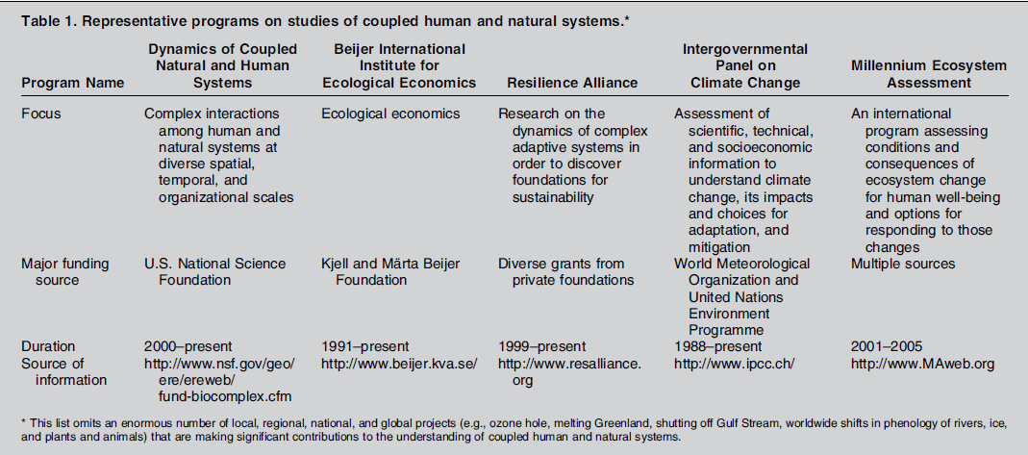

Slide 7
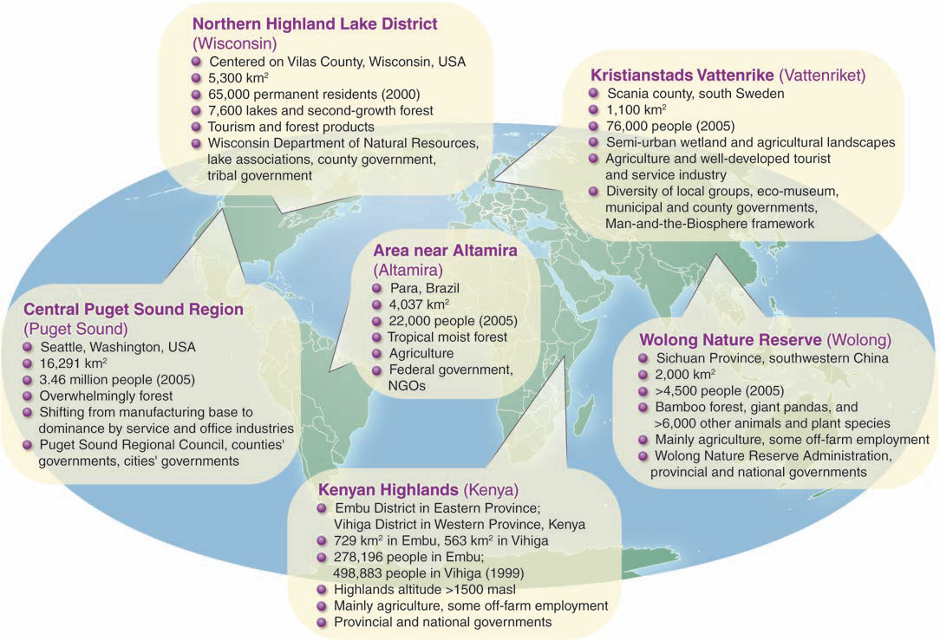

Slide 8
1.2 Major Characteristics of Couplings
Organizational Couplings
-i.e. among organizational levels
Spatial Couplings
    -i.e. across space
Temporal Couplings
  -i.e. over time

Slide 9
1.2.1 Organizational Couplings
Reciprocal effects and feedbacks
Indirect effects
Emergent properties
-e.g. nonlinearity and surprises
Vulnerability
Thresholds and resilience

Slide 10
1.2.2 Spatial Couplings
Couplings across spatial scales
Couplings beyond boundaries
Heterogeneity

Slide 11
1.2.3 Temporal Couplings
Massive increases in human impacts on natural systems
Rising natural impacts on humans
Legacy effects and time lags
Increased scales and pace
Escalating indirect effects

Slide 12
1.3 Challenges and Opportunities
Linking coupled human and natural systems across scales
Integrated tools
Comparative studies and portfolios
Collaborations among all fields relevant to coupled human and natural systems

Slide 13
2. Conflict and International Natural Resource Management
Content:
What are Natural Resource conflicts?
Key Conflict Management Strategies
The Conflict Management Programmes

Slide 14
2.1 What are natural resource conflicts?
Natural resource conflicts are disagreements and disputes over access to, and control and use of, natural resources.

Slide 15
2.2 The Challenge
Multiple stakeholders
Diverse interests
Democratisation and decentralization
Need and opportunity for communities to participate in sustainable resource management

Slide 16
2.3 Sources of Conflict
Exclusion of user groups
Contradictions between local and introduced management systems
Misunderstandings and lack of information about policy and objectives

Slide 17
2.3 Sources of Conflict
Contradictions or lack of clarity in laws and policies
Inequity in resource distribution
Poor policy and programme implementation

Slide 18
2.4 How do conflicts manifest themselves?
The form and intensity of conflicts vary widely by place, and over time within any community.
Conflicts manifest themselves in many ways, ranging from breaking rules to acts of sabotage and violence.

Slide 19
2.5 The Consequences of Conflict
Conflict, if not addressed can:
escalate into violence
cause environmental degradation
disrupt projects
undermine livelihoods

Slide 20
2.6 Conflicts can remain hidden or latent
People may allow problems to continue because of fear, distrust, peer pressure, financial constraints, exclusion from certain conflict resolution procedures, or for strategic reasons.

Slide 21
2.7 Who are the different actors?
Men and Women
Neighbouring communities, villages
Community-based organizations
Businesses
Governments
Development agencies
NGOs

Slide 22
2.8 Key Conflict Management & Resolution Strategies
Avoidance
-Acting in ways to keep conflict from becoming publicly acknowledged.
Coercion
-Threatening or using force to impose one’s will.

Slide 23
2.8 Key Conflict Management & Resolution Strategies
Negotiation
-Following a voluntary process in which parties reach agreement through consensus.
Mediation
-Using a third party to facilitate the negotiation process (a mediator lacks the authority to impose a solution).

Slide 24
2.8 Key Conflict Management & Resolution Strategies
Arbitration
-Submitting a conflict to a mutually agreeable third party, who renders a decision.
Adjudication
-Relying on a judge or administrator to make a binding decision.

Slide 25
2.9 Reasons Why Conflict
May Arise
Policies imposed without participation
Lack of harmony and co-ordination between bodies of law and legal procedures
Poor identification of and inadequate consultation with stakeholders
Uncoordinated planning

Slide 26
2.9 Reasons Why Conflict
May Arise
Inadequate or poor information sharing
Limited institutional capacity
Inadequate monitoring and evaluation programmes
Lack of effective mechanisms for conflict management

Slide 27
2.10 Approaches to NRCMR
Customary Systems
National Legal Systems
Alternative Conflict Management

Slide 28
2.11 What is Needed?
Addressing conflict is a prerequisite for sustainable natural resource management
If not addressed, conflicts can affect community livelihoods and result in resource degradation
Alternative conflict management offers an innovative, multidisciplinary approach to managing conflicts

Slide 29
Remember...
Natural resource management is conflict management

Slide 30
3. Co-Management as a Response to Conflict
What is Co-Management?
Joint decision-making
Local political claims to the right to share resource management power and responsibility with the state
Power-sharing in the exercise of resource management between a government agency and a community or organization of stakeholders

