Slide 1
Lecture 16
NATURAL RESOURCE PLANNING AND MANAGEMENT
Dr. Aneel SALMAN
Department of Management Sciences
COMSATS Institute of Information Technology, Islamabad

Slide 2
Recap Lecture 15
Case Study of Keti Bunder

Slide 3
How to support CBNRM at the local level?
It is the cumulative outcomes at local levels that determine the national-level success or failure of CBNRM.
CBNRM must establish significant economic incentives at the community level for managing and conserving the resource, which is closely related to clearly defined and officially supported tenure systems as well as revenue-sharing mechanisms.
CBNRM should coordinate resource use among numerous individuals to establish an ‘optimal’ rate of production and consumption at the local level as well as for society at large.

Slide 4
The rationale of CBNRM as a development strategy
Means of policy and legal frameworks as well as administrative support, the state may establish attractive and fair economic incentives for communities to manage natural resources, whereby resource conservation, poverty reduction and good governance will be promoted at community level.

Slide 5
Good governance at the local level is seen both as a means to achieve resource conservation and poverty reduction as well as an objective in itself.
it is the elaboration, implementation and experience-based revision of resource management plans at local levels that determine the actual performance of CBNRM on the ground.
Results and experiences of implementing CBNRM at community level should be used to adjust and revise the policy and legal frameworks, including the choice of administrative setup.

Slide 6
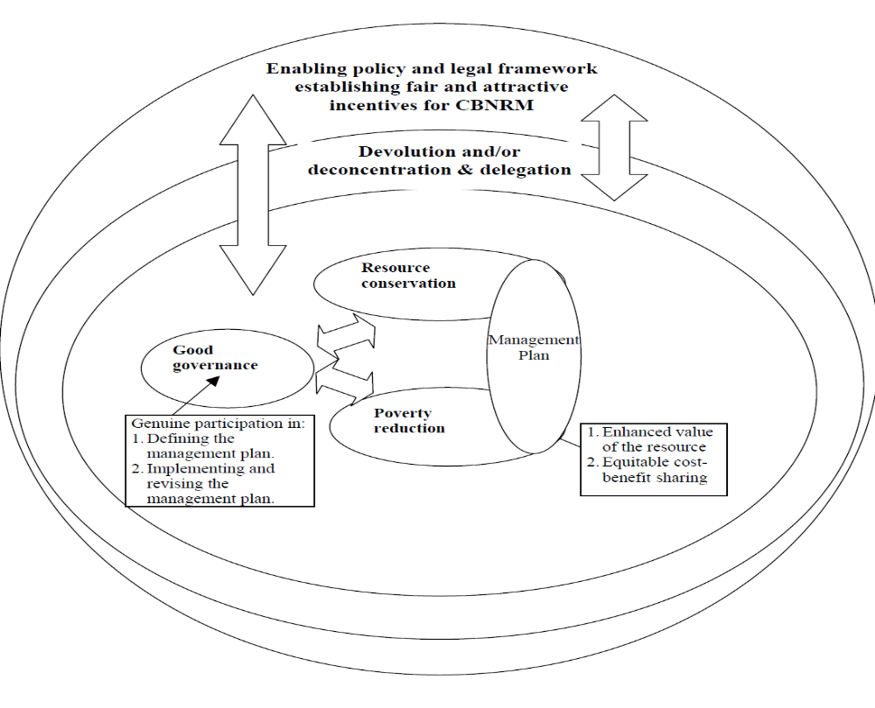
CBNRM embedded in the institutional set-up and national context

Slide 7
Providing economic incentives and ownership at community level
Economic incentives for people to protect and invest in a particular natural resource are closely associated with their enforceable rights, as well as the terms of trade prevailing for resulting product flows.
Owners and proprietors have the strongest incentives to invest in and maintain a resource, because they hold the right of excluding others from capturing the benefits of their investments.

Slide 8
This incentive is even stronger if owners and proprietors can pass on these rights to their heirs.
Claimants hold stronger investment incentives than authorised and unauthorised users, but the propensity of these three categories to invest in the resource is likely to be rather small, because their use of it depends on the goodwill of others (owners or proprietors).

Slide 9
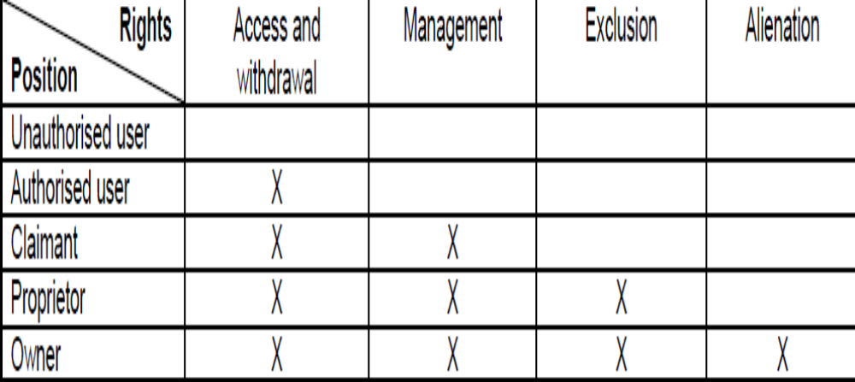
Rights and associated positions

Slide 10
Types of Rights
Access right is the right to enter a defined physical property (a lake, a forest, a spring, etc.).
Withdrawal right is the right to obtain the products of a resource (catch fish, appropriate water, collect forest products, etc.).
Management right is the right to regulate internal use patterns and transform the resource by making improvements, e.g. a group of fishers that collectively devise a zoning plan that limits various types of fishing to distinct areas and time periods.
Exclusion right is the right to determine who have access right and how that right may be transferred, e.g. a forest user group that limits access to ‘their’ forest for firewood collection to female members above a certain age.
Alienation right is the right to sell or lease either or both the rights of management and exclusion, e.g. a fisher who leases out his right to a put up nets on a particular location for the fishing season.

Slide 11
How to promote poverty reduction
The economic rationale behind CBNRM, as an alternative to open access resource use, is that the total resource value can be maintained or enhanced, and that the costs and benefits of management can be distributed equitably, so that all community members, within a reasonable time horizon, experience a net gain, or at least a zero loss.
However, if the point of departure for CBNRM is not a situation of, de facto, open access but rather that a natural resource is controlled by few actors, it may, of course, be impossible to redistribute costs and benefits under CBNRM without some people (e.g. feudal landlords) experiencing a net loss.

Slide 12
it is crucial that governments establish fair and attractive economic conditions for CBNRM.
Natural resource to come under community-based management should preferably not be at such a point of deterioration that organising its use brings few or no net advantages to community members.
However, advantages should not be assessed in financial terms only. Safe seasonal access to land and water can be fundamental for sustaining livelihood practices, for instance in drylands.

Slide 13
If people have few or no realistic alternatives but to continue ecologically non-sustainable utilisation, CBNRM must include external technical and financial help to support resource improvement and local livelihoods.
If, in contrast, a resource is, de facto, utilised far below its productive capacity, local people might not bother to establish CBNRM, because the costs of doing so would outweigh the benefits.

Slide 14
This could, however, change rapidly if, e.g. a bridge is built and powerful external agents suddenly gain access. In such (foreseeable) cases, information campaigns, local capacity building, agitation by civil society organisations and protection by the state are likely to be crucial prerequisites for establishing CBNRM before the resource is raided.

Slide 15
How to support resource conservation?
Resource conservation requires the harvest not to exceed increment over the long term.
This calls for reasonably accurate knowledge about the extent and growth of the resource, as well as reliable recording of harvest volumes.
Since many communities do not command the technical skills to estimate allowable harvest levels of a given resource, guidance and support from external agents (GOs and/or NGOs) may be needed, provided that these do hold the necessary knowledge and skills.

Slide 16
Top-down-defined requirements to resource management planning at community level entails the risk of re-centralising control over the resource, if this makes local communities overly dependent on external agents in fulfilling technical criteria officially justified through environmental concerns.

Slide 17
How to promote good governance including equity
An enabling policy and legislative framework combined with adequate measures to estimate allowable harvest levels do not guarantee success.
CBNRM could still fail at the local level due to:
  Inefficient rule enforcement, allowing free-riders to over-harvest
  Inequitable distribution of costs and benefits, leading to a break-down of management rules and subsequent over-harvesting or permanent marginalisation of certain groups.

Slide 18
Establishment and maintenance of good governance or “appropriate decision-making arrangements” is the only feasible way to prevent the failure (or ensure the success) of CBNRM at the local level.
  The management plan that regulates the use of the resource.
  Rules that establish “conditions of collective choice” within the group most immediately involved in managing the resource. The management plan is, in other words, nested within conditions of collective choice.

Slide 19
Management Plan
The management plan defines which products may be extracted by whom, when, how and in what quantities.
These rules should be guided by the productive capacity of the resource and by equity considerations to establish a fair distribution of costs and benefits among the community members.
Management plans are developed by local management bodies in accordance with certain conditions of collective choice, through which the purpose of management is defined (which products and services should and should not be generated). Moreover, the capacity of the group to make a collective decision binding on all relevant individuals is an important aspect of conditions of collective choice.

Slide 20
Governments can promote “appropriate decision-making arrangements” (good governance) at the local level through nominal resource legislation. This should establish democratic conditions of collective choice, so that all members of a community (including women and other potentially vulnerable groups) get the opportunity to participate in defining:
  the purpose of resource management
  the resulting management, plan including how it is enforced and how products and benefits from the common resource are distributed. Communities must also hold authority to control free-riding by punishing defaulters.

Slide 21
The decision-making arrangements should, as far as possible, prevent elite capture as well as majority rule, and secure that locally elected management committees are made downwards accountable to the community members they represent.
In practice, this may be promoted through legislative requirements of regular management committee elections, frequent general (village) assemblies, frequent oral public reporting of activities, income and expenditures by the committee (allowing illiterate people to digest the information), and unlimited access to accounts and records for all community members.
In addition, it must be possible to depose management committees through democratic processes (votes of no confidence) between regular elections.

Slide 22
Sometimes, men and women; pastoralists and farmers, etc. within a defined community do not give equal priority to all kinds of products that a given resource may deliver, and this can be a source of conflict, including marginalisation of the weakest parties.
Nominal CBNRM legislation may, however, alleviate such problems by providing for the establishment of interest-based resource managing sub-communities, e.g. women’s groups, which hold exclusion rights vis-à-vis the larger community of which they are a part.

Slide 23
How to monitor and sustain CBNRM
Media, including interest organisations’ agitations
Structured collection of information.
Structured data collection on the progress of implementation should provide reliable quantitative information on: (i) the work carried out to implement CBNRM on the ground, (ii) the area under CBNRM, and (iii) the number of communities as well as households officially involved in CBNRM.

Slide 24
More qualitative data on implementation progress should include successes, failures and areas in need of improvement. These systems should be simple and embedded within existing official monitoring systems to ensure sustainability.
Both are important and, ideally, they should be used to adjust the policy, legislative framework and implementation strategies in order to correct failures and sustain and enhance positive effects of CBNRM.

Slide 25
Assessing the degree to which CBNRM is achieving its stated objectives of poverty reduction, resource conservation and governance calls for a different approach, and should probably be carried out by organisations that are not directly engaged in the implementation as such.
These could be independent research centres, NGOs and university departments capable of undertaking such studies.

Slide 26
CBNRM in terms of poverty alleviation
The effects of CBNRM in terms of poverty alleviation and equity can be assessed through interviews with random samples of communities.
The purpose should be to document the overall value flow from a given resource under CBNRM, including how costs and benefits are distributed among households within the resource-managing communities.
The distribution of costs and benefits between communities and the rest of society may be assessed by looking at profit margins in the value chain for CBNRM products.
This will indicate whether officially intended and/or unofficial market interventions as well as market conditions result in producer prices that support or undermine the economic rationale for CBNRM.
Interpretation of the collected data should take demographic and general economic developments into account.

Slide 27
Effects of CBNRM on resource conservation
The effects of CBNRM on resource conservation can be assessed through interviews with random samples of communities as well as simple, participatory technical inventories carried out with certain time intervals.
The former would provide a general picture of how people perceive the development of the resource that they are managing, while the latter would yield a quantitative and qualitative picture of changes in the bio-physical resources and resource use.
In both types of inventories, it is important that the resource development in areas under CBNRM can be clearly distinguished from similar areas that are not under CBNRM.
Preferably, the effect of CBNRM on areas that are not under CBNRM should be included, because the use of resources in these areas might change as well.

Slide 28
Effects of CBNRM on governance
The effects of CBNRM on governance at the local level can be assessed through interviews with households in random samples of communities and analysis of community records, management plan revisions as well as accounts.
The purpose should be to document the development in decision making processes and resulting cost-benefit sharing. This includes a documentation of stakeholders’ positions in order to evaluate whether certain elites have captured most benefits, and whether certain groups are becoming increasingly marginalised, e.g. as a result of de facto majority rule.

Slide 29
District and national level
The effects of CBNRM on governance at the district and national level can be assessed through analysis of policies, laws, directives, administrative procedures, progress reports and accounts.
The objective is to document whether governments (local and national) are:
  Consolidating CBNRM or rather re-centralising resource management through directives or amendments to nominal and functional resource legislation
  Promoting or delaying implementation of CBNRM on the ground
  Actually spending resources on promoting CBNRM.

Slide 30
Effects of CBNRM on governance are indicated by:
the existence, number of members and activities of CBNRM interest organisations
CBNRM-related policy debates in the media
The number of CBNRM-related court cases, particularly those where communities or their interest organisations attempt to hold higher administrative levels accountable.

Slide 31
Summing up
Ideal monitoring of CBNRM would be a formidable and probably prohibitively expensive task.
It would be naïve to assume that, once initiated, CBNRM is a guaranteed selfsustaining success, which needs no monitoring or adjustment.
An informed public debate based on the results of sound monitoring is, in all likelihood, the key to the long-term success of CBNRM at all levels of society.
The short-term effects of CBNRM should, however, not be over-interpreted.
In most countries where CBNRM is implemented nation-wide, this represents a complete paradigm shift within particular sectors, and a number of things are bound to go wrong during the first years.

Slide 32
CBNRM is not a stand-alone solution to secure poverty reduction, resource conservation and good governance, and whether other resource management systems would be better will always be subject to context analysis and political debate.
Accordingly, CBNRM is rather a development process and constant power struggle.

