Slide 1
Lecture 13
NATURAL RESOURCE PLANNING AND MANAGEMENT
Dr. Aneel SALMAN
Department of Management Sciences
COMSATS Institute of Information Technology, Islamabad

Slide 2
Recap Lecture 12
Data- Time Series Vs Cross Section
Indicator Frameworks
Pressure-State-Response Framework
Driving force-State- Response model (DSR) model
Driving force-Pressure-State-Impact-Response model
Dimensions of Sustainability
Process for choosing indicators

Slide 3
What is Community Based Natural Resource Management (CBNRM)?
The poverty-governance-environment link has been further highlighted in recent years through interventions aimed at building capacity for resilience (disaster preparedness) as well as for adapting to climate change.
The concept of CBNRM is related to a variety of terms, including participatory, community, community-based, collaborative, joint and popular natural resource management.
The concept of CBNRM tends to be associated with approaches where the focal unit for joint natural resource management is the local community.
Sometimes, it has also been applied to designate approaches where local communities play a central but not exclusive role in natural resource management

Slide 4
CBNRM is mostly about ways in which the state can share rights and responsibilities regarding natural resources with local communities.
Co-Management (CM) of natural resources is used to describe a partnership by which two or more relevant social actors collectively negotiate, agree upon, guarantee and implement a fair share of management functions, benefits and responsibilities for a particular territory, area or set of natural resources (Borrini-Feyerabend et al.2004)
This definition covers different ways in which the planning and implementing authority over natural resources can be shared among various types of social actors, thus refraining from any a priori indication of which model is the most appropriate.

Slide 5
Communities
Some advocates of CBNRM have assumed communities to be small spatial units, with homogenous social structure and shared norms. In fact, this is rarely found in the real world.
Communities are rather characterized by dynamic relations of:
  Multiple and somewhat conflicting interests
  Different actors attempting to influence decision-making, and
  Internal as well as external institutions shaping decision-making processes
Depending on the actual relations within a particular group of people, their knowledge and the conditions according to which they can make decisions, local communities may sometimes, but not always, be the most ‘appropriate’ unit for natural resource management.

Slide 6
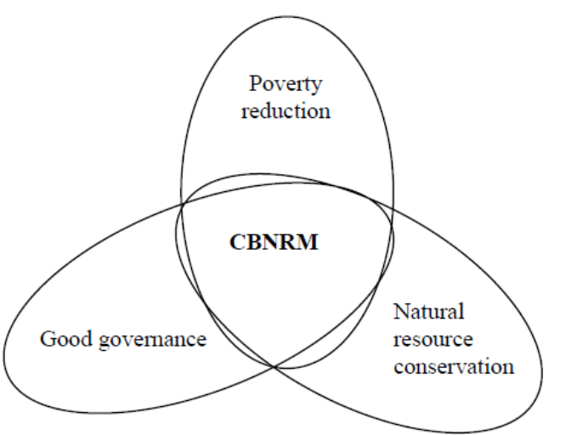
CBNRM for poverty reduction, resource conservation, and good governance
CBNRM can be considered a management strategy aiming to reduce poverty, conserve natural resources and promote good governance and decentralisation, in a single process.

Slide 7
The objective of poverty reduction is closely linked with natural resource conservation, because poor people in developing countries depend on natural resources for their livelihoods. It is therefore important to ensure sustainable management of these resources.
Effective and equitable natural resource management and conservation, on the other hand, require genuine involvement by the social actors who depend on the resource.
Involvement of poor people in natural resource management is often best achieved through decentralisation of authority over the resources, and this cannot be approached in isolation from the need to promote good governance.

Slide 8
Governance means the process of decision-making and the process by which decisions are implemented (or not implemented). In recent years, requirements to the political and administrative system of being democratic, responsive, effective etc. have increasingly been conceptualised as important elements of good governance.
Decentralisation is often seen as an important means to foster and nurture the important elements of good governance in developing countries.

Slide 9
Reasons for decentralised natural resource management
Local people are likely to identify and prioritise their environmental problems more accurately than centralised organisations.
Resource allocation is more efficient and transaction costs lower when decisions are taken locally, so that state expenditure on management can be reduced, while resource conservation is improved.
Local groups are more likely to respect decisions that they have participated in taking.
Monitoring of resource use is improved.
Marginalised groups gain greater influence on local policy.

Slide 10
The three objectives of poverty reduction, natural resource management and good governance are not always mutually supportive, and CBNRM is not always a realistic option.
Depending on how it is pursued, conservation of natural resources can even be contrary to poverty reduction.
A community may, for instance, have to reduce or completely stop their extraction of a particular natural resource in order to gain authority over it and to maintain its productive potential. This will have at least short-term negative impacts on households whose livelihoods rely mostly on products from this resource, unless they are compensated for their (short-term) loss.

Slide 11
Three different levels for CBNRM support
Progress towards the three CBNRM objectives requires significant and durable changes in the allocation of power in society.
A variety of constraints at different levels in society must, therefore, be overcome to make CBNRM work in practice.
There are at least three levels of possible intervention: the national, the intermediate, and the local level.
CBNRM initiatives are likely to be effective only if supported – or at least not impeded – by national decision-makers as well as national legislation and policies.

Slide 12
CBNRM agreements are unlikely to be sustainable, unless they are linked with (decentralised) government structures, and they often rely on local institutions’ room for manoeuvre in the context of democracy.
Communities must also be capable of and interested in managing nearby natural resources.
National laws concerning CBNRM may, for instance, contain provisions on how CBNRM must be linked to decentralised government structures.
Local CBNRM initiatives are always nested within higher levels of decentralised government as well as national policies and legislation.

Slide 13
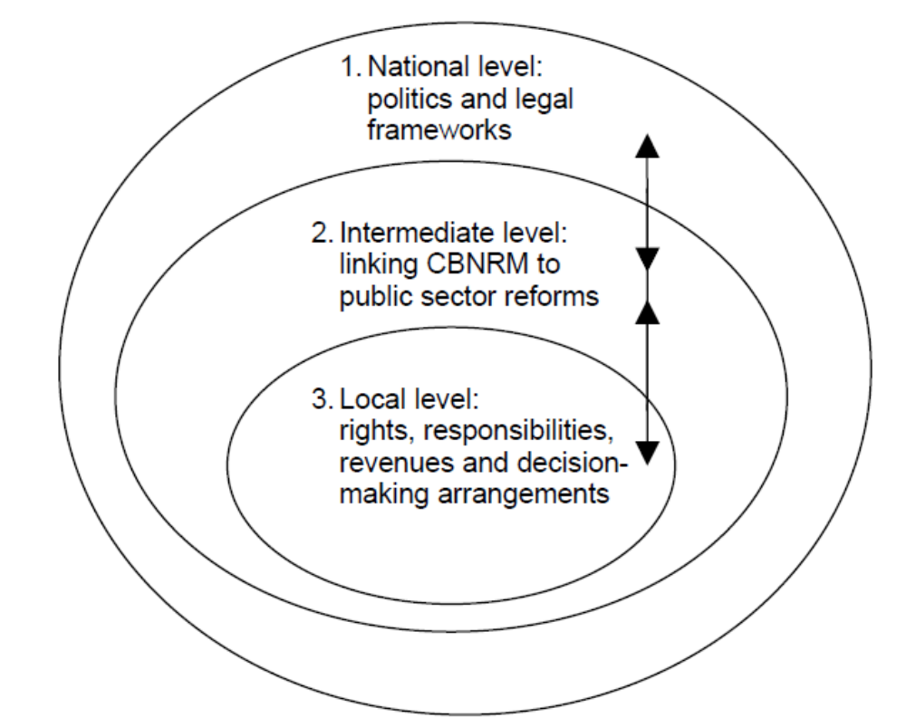
Three levels at which to support CBNRM initiatives

Slide 14
At the national level, the main issue is how to support policy processes and legal frameworks for CBNRM.
At the intermediate level, the key concern is how to institutionalise CBNRM either through local governments under a devolution process or through deconcentration of line agencies, which delegate authority to local communities.
At the local level, the principal question is how to organize the collaboration between social actors and their relationship to the natural resource

Slide 15
The national level

Slide 16
How to support the development of appropriate national CBNRM policies?
It is important to support the development of CBNRM policies within relevant sectors, because they define the political visions according to which legal and administrative frameworks for CBNRM may be developed.
Central governments and line ministries may be hesitant to delegate power to local organisations.
National-level decision-makers might fear losing revenues and, hence, personal and institutional benefits, but resistance may also reflect genuine concerns over lack of capacity and staff to implement institutional changes

Slide 17
Concerns that CBNRM may lead to social tensions or environmental degradation, thus undermining political stability.
No or mere pro-forma decentralisation could be the unfortunate outcome, in which transfers of responsibilities are not complemented by genuine rights of local communities to benefit from managing natural resources.
Decentralisation may also become restricted to resources that are heavily depleted or commercially unimportant.

Slide 18
Before deciding
it is necessary to initiate analyses of the current political and environmental situation in relation to CBNRM, looking at:
  the current political, legislative and administrative environment
  documentation of the current problems in terms of resource degradation
  the potential socio-economic as well as environmental effects of implementing CBNRM (who loses and who gains in the short and long term?).
Strategic environmental assessments may be useful supplementary tools.

Slide 19
The promotion of CBNRM should be related to overall development priorities and strategies expressed in PRSPs and national budgets.
The degree to which CBNRM is included in such overall development plans also indicates how high it really ranks on the national list of priorities.
Assuming that national development plans do consider CBNRM an important vehicle for pursuing overall development objectives, initial support could include national-level, participatory, policy debates on CBNRM.
In this process, donor harmonisation is essential to prevent contradictory demands and to accumulate lessons learnt in an organised manner.

Slide 20
Recommendations
Ensure/encourage donor harmonisation in relation to CBNRM within the framework of PRSP and other key strategies.
Support analyses of: (a) current legislative frameworks, (b) institutional capacity for law enforcement, (c) administrative procedures, and (d) the resulting economic incentives for resource conservation among stakeholders at all levels.
Support technical assessments of resource conditions, if these do not already exist.
Align support with national priorities and/or systems, taking into consideration the conclusions of the above analyses.

Slide 21
Recommendations
Analyse lessons learnt from pilot CBNRM interventions, if any, which have been supported by government (national and local), civil society and the private sector.
Support and encourage civil society organisations, including business associations, to contribute to ongoing CBNRM activities.
Support policy hearings of relevance to CBNRM.
In case there is a need and willingness to further develop policies or adapt existing policies to revised macro frameworks:
  Direct capacity development support towards drafting a CBNRM-related policy or adjustment of existing sector policies, so as to integrate CBNRM.
  Support and encourage public discussion forums among a wide array of stakeholders on policies related to CBNRM.

