Slide 1
Lecture 12
NATURAL RESOURCE PLANNING AND MANAGEMENT
Dr. Aneel SALMAN
Department of Management Sciences
COMSATS Institute of Information Technology, Islamabad

Slide 2
Recap Lecture 11
Sustainable Rural Livelihoods (SRL) framework
Elements of the SRL framework
Indicators and Thresholds
Issues of Scale
Internal and External Indicators
Cross-section or Time-Series Analysis (State or Rate)

Slide 3
Cross-section or Time-Series Analysis (State or Rate)
Whether indicators are to be constructed and monitored between sites at a single point in time, monitored over time, or both.
Ideally indicators of both types will be measured.
A fundamental issue is time. We want to know what has and is changing. What has happened to the biophysical environment, how have people’s perceptions and management and livelihood strategies changed, how have policies and institutions changed and how have these affected each other?
However, monitoring over time is more problematic, as information from external sources is generally required.

Slide 4
Cross-section or Time-Series Analysis (State or Rate)
If trends over time are to be determined then there are two relevant alternative sources of information:
  Historical sources which may include:
    Secondary historical information - past records; studies and surveys.
    Community and individual recollection.
  Biophysical information from sites which were previously of a similar type to other study sites, but have been cultivated or otherwise used in a different manner over a recent, known time-period.

Slide 5
Indicator Frameworks
Several sets of methodological frameworks or guidelines have been identified for the measurement of sustainability indicators at the farm or community to district levels.
Pressure-State-Response Framework
  Pressure refers to “human activities that exert a pressure on the environment and change its quality and the quality and quantity of natural resources (the ‘state’). Society responds to the changes through environmental, general economic and sectoral policies (the ‘response’). The latter forms a feedback loop to pressures.” (Gallopín, 1997:22). These pressures are considered to be negative.

Slide 6
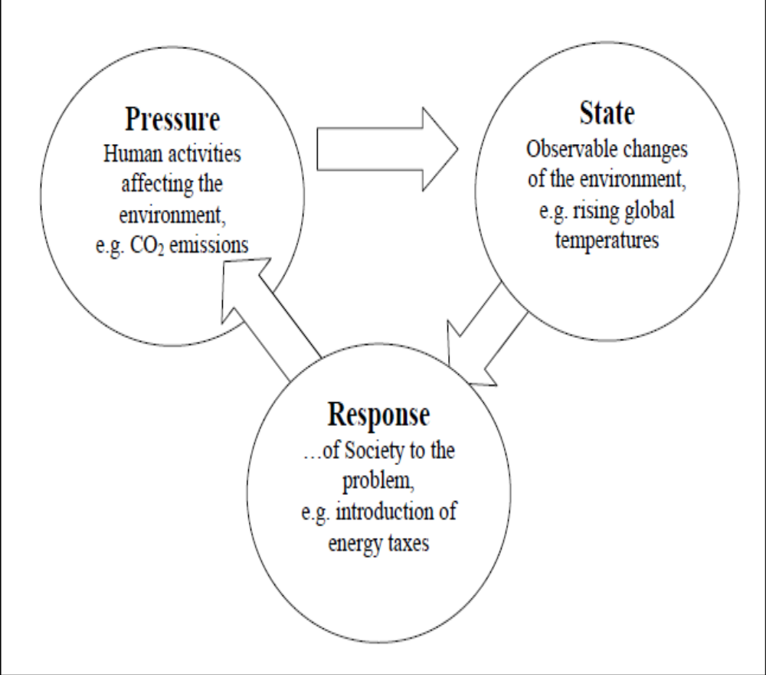
PSR Framework

Slide 7
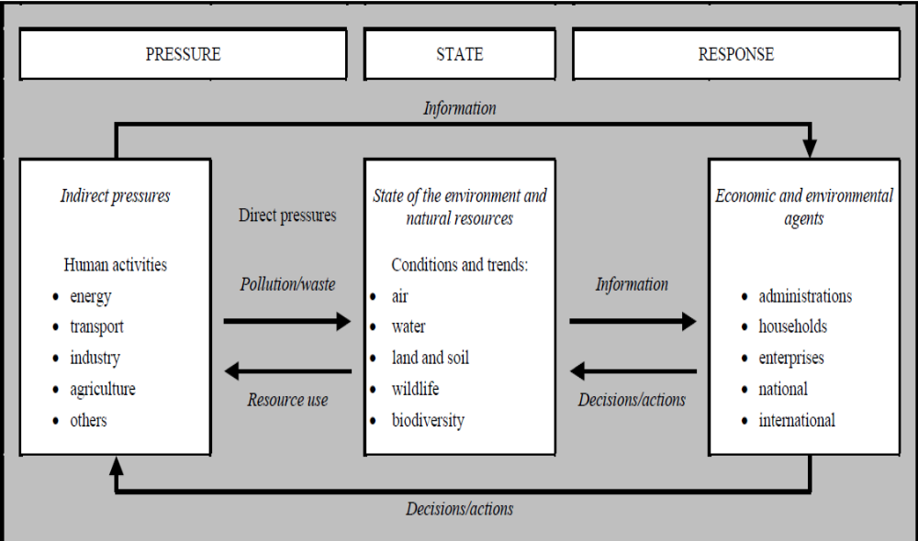
Pressure – State – Response (PSR) Model

Slide 8
Introducing Driving Forces and Impacts into the PSR Framework
Some organizations prefer variants of the PSR model; for example, the UN Commission for Sustainable Development (UNCSD) bases its indicator set on the Driving force-State- Response model (DSR) model, which allows for a better inclusion of non-environmental variables.
Replacement of the term “pressure” in the PSR framework by the term “driving force” was motivated by the desire to include economic, social and institutional aspects of sustainable development.

Slide 9
The extension of the focus to all aspects of sustainable development (social, economic, environmental and institutional) is argued to be “particularly important for developing countries…for whom an equal balance between the developmental and environmental aspects of sustainable development is important in order to ensure future sustainable growth patterns.
Another aspect of the DSR framework which separates it from its predecessor is that there is no assumption of causality between indicators in each of the categories.

Slide 10
“The term ‘driving force’ indicates…an impact on sustainable development. This impact can be both positive and negative, which is not the case for the pressure category used by the OECD”.
“Driving force indicators represent human activities, processes and patterns that have an impact on sustainable development”
For a better description of underlying economic trends, some authors have formulated the Driving force-Pressure-State-Impact-Response model, which includes PSR and DSR as special cases

Slide 11
Driving force-Pressure-State-Impact-Response model
DPSIR framework State and Impact indicators are separated.
State indicators show the current condition of the environment. Examples include the concentration of lead in urban areas; the noise levels near main roads; the global mean temperature.
Impact indicators describe the ultimate effects of changes of state. Examples include the percentage of children suffering from lead-induced health problems; the mortality due to noise-induced heart attacks; the number of people starving due to climate-change induced crop losses.

Slide 12
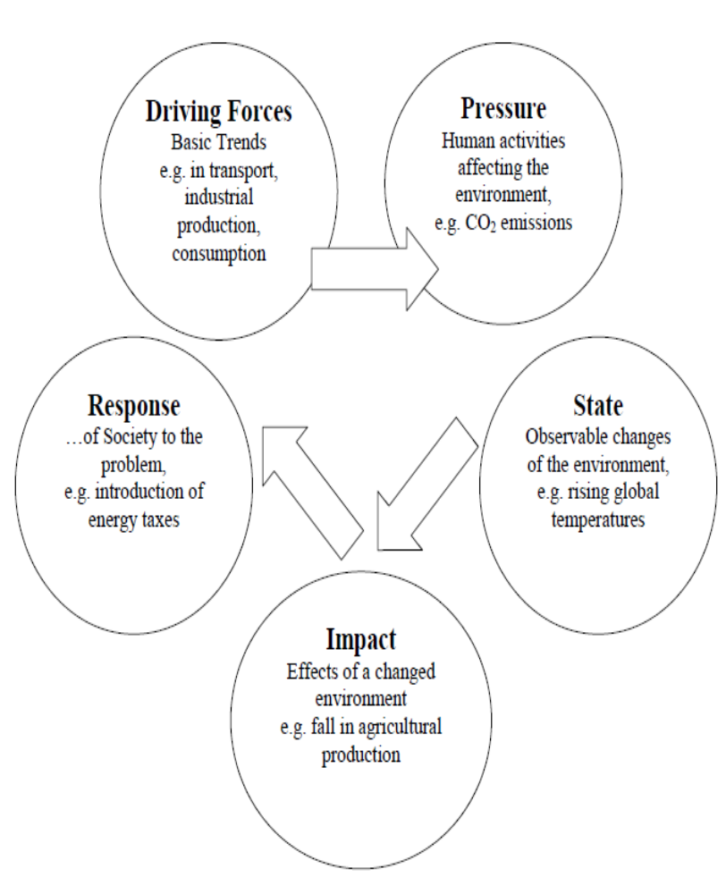
The DPSIR Framework

Slide 13
The Sustainable Livelihoods framework may be envisaged as a DPSIR model:
Driving Force (basic trends in production and consumption): Context
Pressure (human activities directly affecting environment): Livelihood Strategies
State (observable change in the environment): Biophysical outcomes
Impact: Socio-economic outcomes
Response (of society to solve the problem): Policy / structures and
processes

Slide 14
Dimensions of Sustainability
Sustainability, is multi-faceted, and therefore the (un)sustainability of systems must be assessed over several dimensions.
The Framework for the Evaluation of Sustainable Land Management (FESLM), being used in the LQI program of the World Bank, identifies the 5 pillars of sustainable land management as:
  Productivity - maintain or enhance production services.
  Security - reduce the level of production risk
  Protection - protect the potential of natural resources and prevent degradation of soil and water quality
  Viability - be economically viable
  Acceptability - be socially acceptable

Slide 15
Purpose and users of indicators
Much of the measurement of indicators has, at the end of the day, largely resulted just in the measurement of indicators.
The actual operationalization of indicators to influence or change, for instance, policy is still in its infancy.
Views differ as to whether indicators should be identified “externally” by scientists, economists or “internally” by local communities themselves.
One view sees sustainability defined from the “top” with the imperative to maintain and conserve the renewable natural resource base for future generations (e.g. FESLM). A second view focuses on the participatory and empowerment paradigm where local communities need to define what is sustainable to them and to then go on to determine the indicators for this sustainability (e.g. work of IIED and IISD).

Slide 16
Pulling Together an Indicator Framework and Methodology
Identification of an initial set of “external” indicators based on literature review and experience.
Identification of an initial set of “internal” (community) indicators through interviews and participatory methods with key stakeholders.
Development of a combined set of indicators for field testing and monitoring.
Analysis and selection of “final” set of indicators which are practical, meaningful and measurable – the number of these indicators to be kept to a minimum (target<10/15).

Slide 17
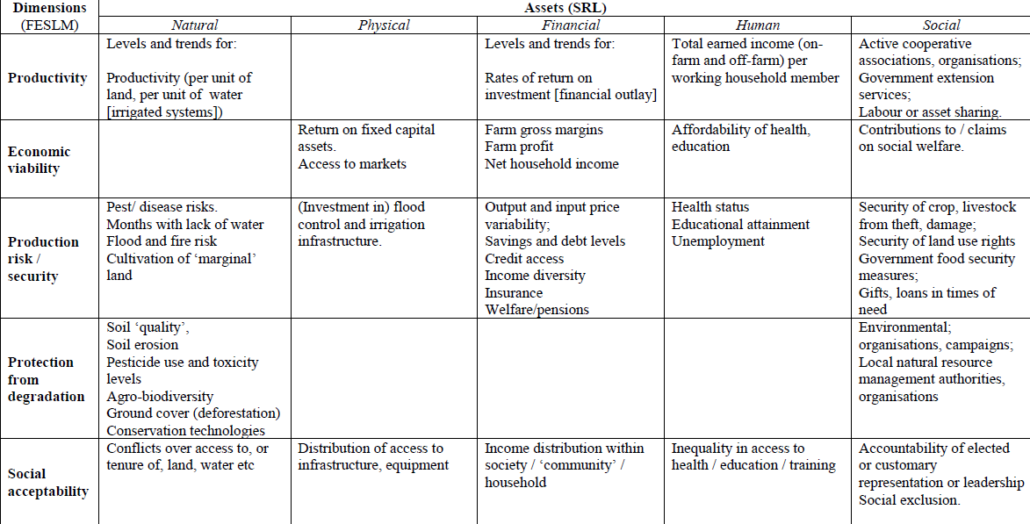
Matrix for sustainability indicators

Slide 18
Choosing and Using Sustainability Indicators
The selection of the issues of concern and the indicators which should measure them is something which should take place as a result of dialogue between the project researchers, local communities and other key stakeholders of the study areas.
Identification of key issues and indicators.
How, when and by whom will the indicators be measured (for example, will an indicator be measured by study area community members or by “external” researchers).
How is the collected information to be analysed, integrated and displayed (this involves issues of aggregation and the identification of threshold values).

Slide 19
Process
A series of steps in this process are:
  Initial Methodology: workshop discussions, and site selection
  Identification of Stakeholders.
  Identification of Core Issues and Indicators.
  Measurement of Indicators
  Analysis, Presentation and Documentation

Slide 20
Types of Indicators
The indicator set will be embedded in a broader context (temporally, spatially and from a hierarchical sense). The indicators will also be of different types:
Generic Indicators – internationally agreed. Example: Soil organic matter level.
Local Indicators – i.e. local or site-specific. Example: Presence of particular species of plant.
Measurement Indicators – often quantitative, precise and replicable. Example: Human height and weight measurements in human health studies
Proxy/Surrogate Indicators – more indirectly related to the issues in question. Example: Consumption of beer bananas as a foodstuff rather than in brewing as an indicator of food shortage.

Slide 21
Summing up
Locally relevant and easily measurable indicators
Indicators which represent the potential diversity of perspectives of different users on success and sustainability– from farmers/local communities (both wealthy and poor), through scientists, to policy makers
Indicators which encompass both agricultural systems and peoples’ livelihoods
Indicators which can be “related” to policy
The smallest number of indicators possible, to make any assessment of success or sustainability of agricultural systems and livelihoods relevant.

