Slide 1
Lecture 11
NATURAL RESOURCE PLANNING AND MANAGEMENT
Dr. Aneel SALMAN
Department of Management Sciences
COMSATS Institute of Information Technology, Islamabad

Slide 2
Recap Lecture 10
Problem Solving
Decision Making

Slide 3
Sustainable Rural Livelihoods (SRL) framework
Understanding of what policies and institutions are required for effective, equitable, and sustainable management of renewable natural resources.
The Sustainable Rural Livelihoods (SRL) framework is the most recent development of an approach to the analysis of links between livelihoods and natural resource use.
Sustainability of livelihood strategies of individuals or households depends on access, use, and development of different types of assets.

Slide 4
The framework further considers that the kinds of strategies which may be available, the choices made, and the outcomes achieved are influenced by two sets of factors which establish a context.
The framework has been developed primarily to address the needs of policies and project interventions to reduce rural and urban poverty.
It explicitly recognises the importance of urban-rural linkages and of the wider economic, institutional, and policy context as part of the analysis of strategies of natural resource management.

Slide 5
Elements of the SRL framework
Assets
  Assets are considered to be stocks of different types of ‘capital’ that can be used directly or indirectly to generate livelihoods.
  They can give rise to a flow of output, possibly becoming depleted as a consequence, or may be accumulated as a surplus to be invested in future productive activities.
  The SRL framework identifies five basic types of capital that comprise assets for livelihoods: natural, physical, financial, human, and social.

Slide 6
Natural capital consists of land, water, and biological resources such as trees, pasture, and wildlife. The productivity of these resources may be degraded or improved by human management.
Physical capital is that created by economic production. It includes infrastructure, such as roads, irrigation works, electricity supply, and reticulated water, and also producer goods such as machinery.
Human capital is constituted by the quantity and quality of labour available. At household level, therefore it is determined by household size, but also by the education, skills, and health of household members.

Slide 7
Financial capital consists of stocks of money or other savings in liquid form. In this sense it not only includes financial assets such as pension rights, but should also include easily-disposed assets such as livestock, which in other senses may be considered as natural capital.
Social capital includes any assets such as rights or claims which are derived from membership of a group. This includes the ability to call on friends or kin for help in times of need, support from trade or professional associations (e.g. farmers’ associations), and political claims on chiefs or politicians to provide assistance. These latter are sometimes discriminated as ‘vertical’ claims on structures of authority, contrasted with ‘horizontal’ claims among group members of similar status.

Slide 8
Context
Range of historical and current socio-economic trends, such as demography, terms of trade, technological change, and income distribution.
Rapid changes in such factors, along with major disruptions such as drought, floods, war, may constitute ‘shocks’ to which livelihood strategies have to adapt quickly.
‘Structures and processes’ in the political realm (i.e. subject to policy). These include institutions, such as those of custom, legislation, property (e.g. land tenure), and market regulation. It also includes organisations of government and civil society through which institutions operate.

Slide 9
Strategies
Livelihoods have been defined as the assets, activities, and access determining the living gained by individuals or households.
Scoones (1998) has identified three broad livelihood strategies: intensification or extensification of existing productive activity; diversification by adopting additional productive activities; migration to develop productive activity elsewhere.
These strategies are not exclusive, and may be combined in practice.
Two important issues in the analysis of the role of particular assets in livelihood strategies are those of sequencing and substitution.

Slide 10
Sequencing
Sequencing refers to the fact that productive use of certain assets may require the prior access to and use of other assets. Financial and physical capital (cash and machinery) may be necessary to achieve productive use of land through cultivation, for example. In certain circumstances financial or social capital may be prior requirements for access to land.

Slide 11
Substitution
Substitution refers to the liquidation or depletion of one asset to accumulate another. Financial capital may be liquidated to invest in physical capital such as equipment, or human capital, such as health or education. Natural capital in the form of trees or livestock may be converted into financial capital. The ability to convert one form of capital asset into another is likely to be an advantage where livelihood strategies must adapt to rapid change in contexts.

Slide 12
Outcomes
Outcomes of livelihood strategies will be of significance not only in terms of livelihoods and natural resources, but will possibly feedback upon the context and hence the further development of livelihood strategies.
In considering what aspects of outcomes will provide useful indicators for such assessment, we can identify an initial list, based on the five types of capital identified by the SRL framework. (NEXT SLIDE)

Slide 13
Natural capital:
  Access to land, water, grazing.
  Ownership of herds, trees
  Productivity (per unit of land, per unit of water, per unit of inputs)
  Soil, water, rangeland, quality
  Biodiversity
Financial capital
  Income levels, variability over time, distribution within society
  Financial savings, access to credit
  Debt levels

Slide 14
Physical capital
  Access to roads, electricity, piped water
  Ownership/access to productive equipment (oxen, tractor , irrigation pump etc)
  Housing quality
Human capital
  Total labour
  Educational level, skills
  Health levels

Slide 15
Social capital
  Membership of organisations
  Support from kin, friends
  Accountability of elected representation

Slide 16
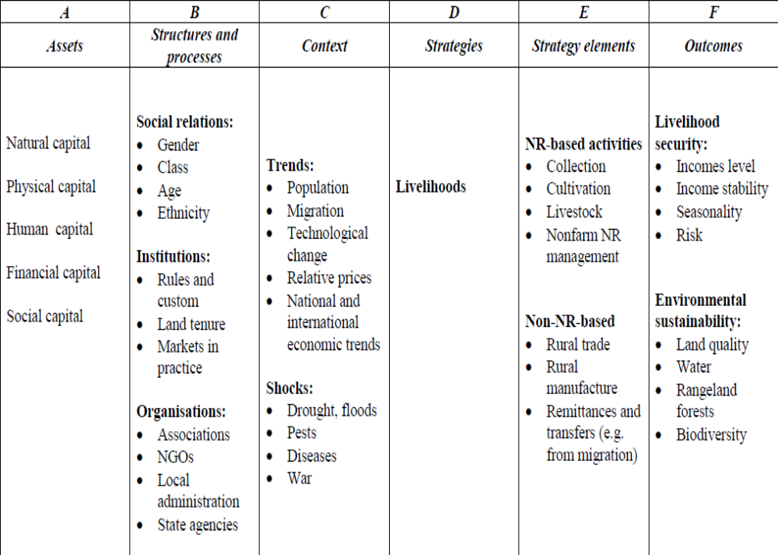
Elements of a Sustainable Rural Livelihoods framework

Slide 17
Indicator Frameworks for Sustainability Evaluation
The widespread “adoption” or pursuit of sustainable development, and indicators of sustainability, took off following the Earth Summit in Rio in 1992.
Agenda 21 called for the development of, amongst many things, sustainable agriculture and land management as well as the systems necessary to monitor their achievement.
This has led to a wide range of activities which have sought to define sustainability and, of particular relevance to this project, sustainable agriculture, land management and forestry

Slide 18
FAO have developed 40 methodology sheets on how to calculate indicators in the areas of agriculture, biological diversity, desertification, fisheries, forestry, freshwater, land use, and mountain ecosystems.
Currently there is no general agreement on appropriate indicators and many countries are in the process of establishing environmental monitoring networks and testing potential environmental indicators (Basher 1996)
Most, if not all, of these initiatives have been technically led, and have tended to focus on a natural science view of sustainability and associated issues.

Slide 19
Indicators and Thresholds
Smyth and Dumanski (1993) define indicators as “environmental attributes that measure or reflect environmental status or condition of change”
Glen and Pannell (1998) argue that “an indicator is a quantitative measure against which some aspect or aspects of policy performance or management strategy can be assessed”

Slide 20
Indicators
Tunstall (1992, 1994), Gallopín (1997) identifies major functions of indicators as:
  to assess conditions and changes
  to compare across place and situations
  to assess conditions and trends in relation to goals and targets
  to provide early warning information
  to anticipate future conditions and trends

Slide 21
Thresholds
Importance of defining thresholds for indicators
A threshold is a boundary level of a variable which is regarded on the basis of expertise to represent the point at which significant changes occur.
Thresholds are particularly important in an agri-environmental context given the propensity of ecological systems to ‘flip’ from one state to another

Slide 22
When an indicator passes this level then the system is considered to be unsustainable or on the road to unsustainability.
Issues arise as to the identification of a threshold level (be it qualitative or quantitative), whether passing a threshold level for one indicator is sufficient to signify unsustainability, or whether several indicators need to have passed their threshold levels before the system is unsustainable.

Slide 23
Issues of Scale
The type of indicators constructed in any study will be influenced by the level at which the system is analyzed.
Indicators in studies such as this may be constructed at the plot, farm, village or community, district, catchment, region, agro-ecological zone (AEZ), or national level.
Example, the individual farmer will often be seeking, or will already have identified, an indicator which forecasts the yield of this year’s crop based on a field or farm plot scale. Again at the farm level, the depth of soil may be a key indicator in assessing the sustainability, but at the national level it is impractical to measure the depth of all soils when it comes to assessing the agricultural systems at the national scale. Alternative or broader indicators are needed to achieve this.

Slide 24
The decision about the level at which to collect information and apply indicators depends on both the issues being addressed and the data available.
However as one moves up through the levels it may become more difficult to identify causal relationships, to identify desirable outcomes and to isolate choices that can be made with confidence.
The level at which indicators are constructed has implications for the type of indicators that it is feasible to construct.

Slide 25
Internal and External Indicators
A central issue of the research is the identification of suitable indicators. A key question behind this is who identifies the indicators and on what basis.
It is useful to identify two sets of indicators: those identified by “external” experts, such as the project researchers; and, those “internally” identified by the different stakeholders in the systems themselves. The latter group would include farmers, households, communities, and local agencies (e.g. District office of Dept of Agriculture, or NGOs).
When considering this division between the role of “external” researchers and local “community” members, it is worth noting that there is also a separation here between issues and indicators.

Slide 26
Cross-section or Time-Series Analysis (State or Rate)
Whether indicators are to be constructed and monitored between sites at a single point in time, monitored over time, or both.
Ideally indicators of both types will be measured.
A fundamental issue is time. We want to know what has and is changing. What has happened to the biophysical environment, how have people’s perceptions and management and livelihood strategies changed, how have policies and institutions changed and how have these affected each other?
However, monitoring over time is more problematic, as information from external sources is generally required.

Slide 27
Next Lecture
Indicator Frameworks
PSR Framework
Pressure – State – Response (PSR) Model
Driving force-Pressure-State-Impact-Response model
Dimensions of Sustainability

