Slide 1
Lecture 10
NATURAL RESOURCE PLANNING AND MANAGEMENT
Dr. Aneel SALMAN
Department of Management Sciences
COMSATS Institute of Information Technology, Islamabad

Slide 2
Recap Lecture 09
A new model
Technological innovations
Multiple, simultaneous crises
State and citizen: a changing relationship?
Global trade in resources
New models of engagement

Slide 6
Problem Solving and Decision Making
Problem
  A situation that exists when objectives are not being met.
Problem Solving
  The process of taking corrective action to meet objectives.
Decision Making
  The process of selecting an alternative course of action that will solve a problem.
    Managers need to make proficient decisions while performing the functions of management.

Slide 7
Management, Decision Making, and Problem Solving
The Relationship Among Management Functions, Decision Making, and Problem Solving
  Managers need to make proficient decisions while performing the functions of management.

Slide 8
Steps in Problem Solving
Identify the problem
Generate ideas
Evaluate alternatives
Choose among alternatives
Implement chosen
alternative
Learn from feedback

Slide 9
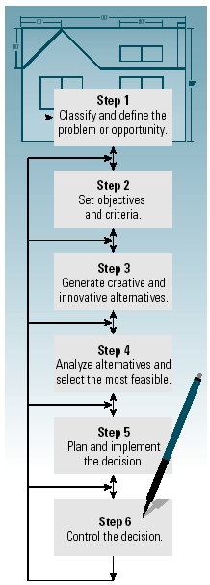
The Decision-Making Model
A six-step model that when properly utilized increases chances of success in decision making and problem solving.

Slide 10
Decision-Making Styles
Reflexive Style
  Makes quick decisions without taking the time to get all the information that may be needed and without considering all the alternatives.
Reflective Style
  Takes plenty of time to make decision, gathering considerable information and analyzing several alternatives.
Consistent
  Tends to make decisions without rushing or wasting time.

Slide 11
Types of Decisions
Programmed Decisions
  Recurring or routine situations in which the decision maker should use decision rules or organizational policies and procedures to make the decision.
Nonprogrammed Decisions
  Significant and nonrecurring and nonroutine situations in which the decision maker should use the decision-making model.

Slide 12
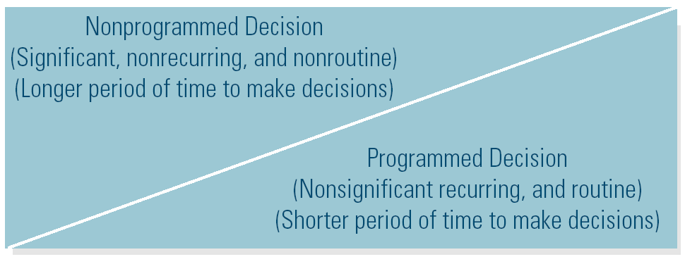
Decision-Making Structure

Slide 13
Decision-Making Models
Rational Model (Classical Model)
  The decision maker attempts to use optimizing, selecting the best possible alternative.
The Bounded Rationality Model
  The decision maker uses satisficing, selecting the first alternative that meets the minimal criteria for solving the problem.

Slide 14
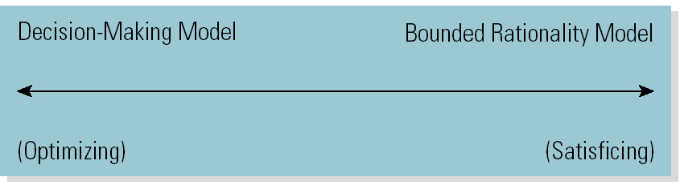
Which Decision Model to Use

Slide 15
Decision-Making Conditions
Certainty
  Each alternative’s outcome is known in advance.
Risk
  Probabilities can be assigned to each alternative.
Uncertainty
  Lack of information or knowledge makes the each alternative unpredictable such that no probabilities can be determined.

Slide 16
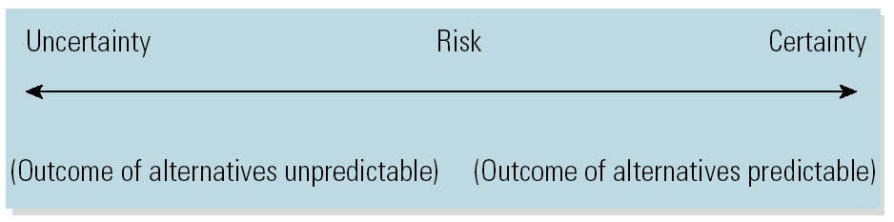
Decision-Making Conditions Continuum

Slide 17
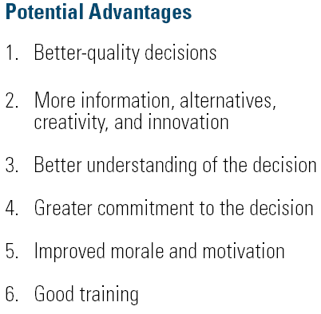
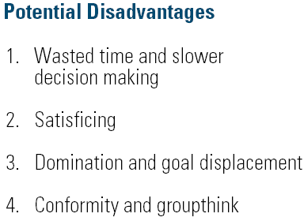
Potential Advantages and Disadvantages of Using Group Decision Making

Slide 18
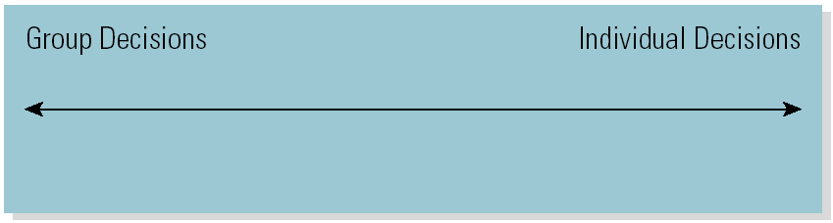
When to Use Group or
Individual Decision Making

Slide 19
Define the Problem or Opportunity
Distinguish Symptoms from the Cause of the Problem
  List the observable and describable occurrences (symptoms) that indicate a problem exists.
  Determine the cause of the problem.
  Removing the cause should cause the symptoms to disappear or cease.
    Symptom: Customer dissatisfaction
    Cause: Poorly trained employees
    Solution: Implement customer relations training program for employees

Slide 20
Set Objectives and Criteria
Setting Objectives
  Involves establishing clear objectives that will make for better decisions.
  Objectives state what the decisions should accomplish in solving a problem or taking advantage of an opportunity.
Setting Criteria
  Involves setting standards that an alternative must meet to be selected as the decision that will accomplish the objective.

Slide 21
Generate Creative Alternatives
Innovation
  The implementation of a new idea
    Product innovation (new things)
    Process innovation (new way of doing things)
Creativity
  A way of thinking that generates new ideas
The Creative Process
  Preparation
  Incubation and illumination
  Evaluation

Slide 22
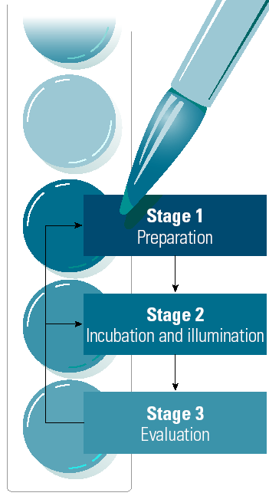
Stages in the Creative Process
Become familiar with the problem; generate as many alternatives as possible.
Take some time before working on the problem again to gain additional insight.
Before implementing the solution, evaluate the alternative to be sure it is practical.
Exhibit 4–5

Slide 23
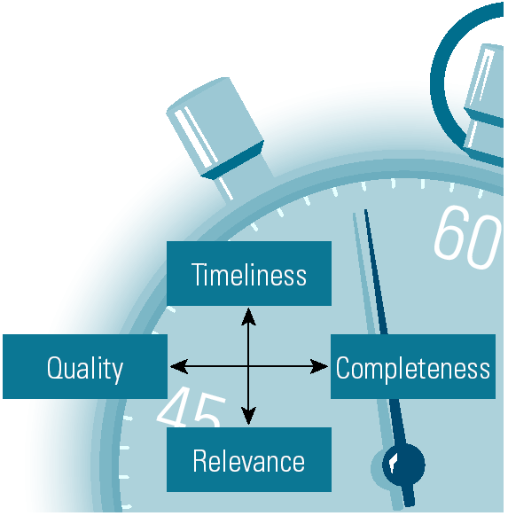
Characteristics of Useful Information
Timeliness
Quality (Accuracy)
Completeness (Amount)
Relevance

Slide 24
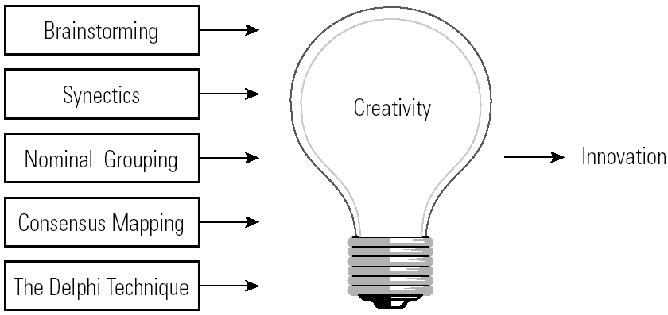
Group Decision-Making Techniques
That Foster Creativity

Slide 25
Generating Creative Alternatives
Brainstorming
  The process of suggesting many possible alternatives without evaluation.
Synectics
  The process of generating novel alternatives through role playing and fantasizing.
Nominal Grouping
  The process of generating and evaluating alternatives using a structured voting method that includes listing, recording, clarification, ranking, discussion, and voting to select an alternative.

Slide 26
Generating Creative Alternatives
Consensus Mapping (Ringi)
  The process of developing group agreement on a solution to a problem.
Delphi Technique
  The process of using a series of confidential questionnaires posed to experts to refine a solution.

Slide 27
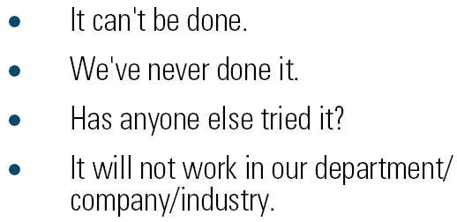
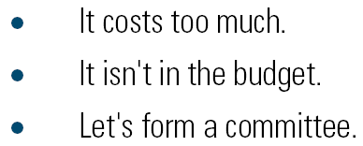
Responses That Kill Creativity

Slide 28

Analyzing the Feasibility of Alternatives
Quantitative Techniques
  Break-even analysis
  Capital budgeting
    Payback
    Discounted cash flow
  Linear programming
  Queuing theory
  Probability theory

Slide 29
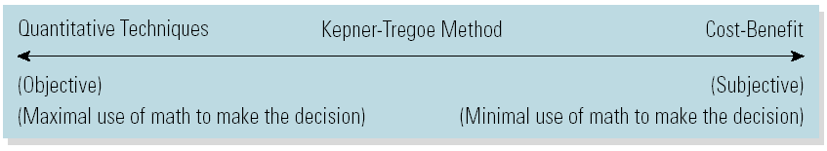
Cost-Benefit (Pros and Cons) Analysis
Cost-Benefit Analysis
  A technique for comparing the cost and benefit of each alternative course of action using subjective intuition and judgment along with math.
The Alternative Analysis Techniques Continuum:

Slide 30
Plan, Implement, and Control
Plan
  Develop a plan of action and a schedule of implementation.
Implement the Plan
  Communicate and delegate for direct action.
Control
  Use checkpoints to determine whether the alternative is solving the problem.
  Avoid escalation of commitment to a bad alternative.

Slide 31
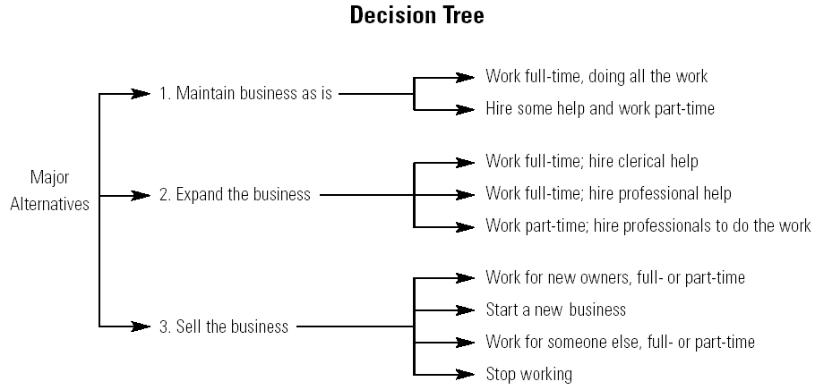
Decision Tree

