Slide 1
Issues in public administration
MPA 509
Impact of Energy Crisis on Development

Slide 2
Agenda
Preview of Last Lecture
Pakistan and it’s MDGs
What will it take to achieve MDGs?
What is Energy Crises?
Causes of Energy Crises
Effects of Energy Crises

Slide 3


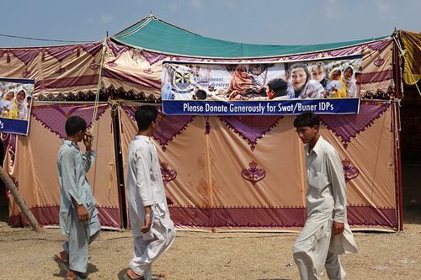
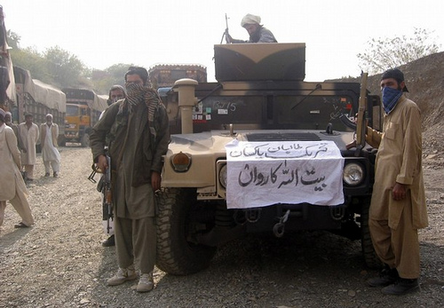
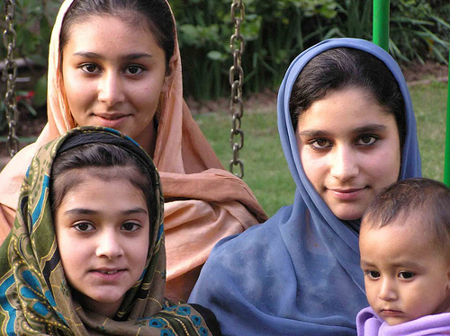
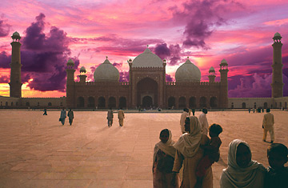
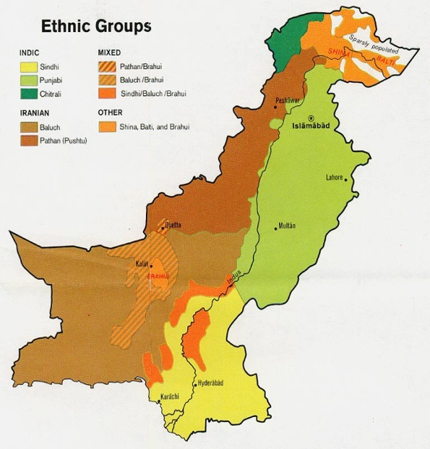
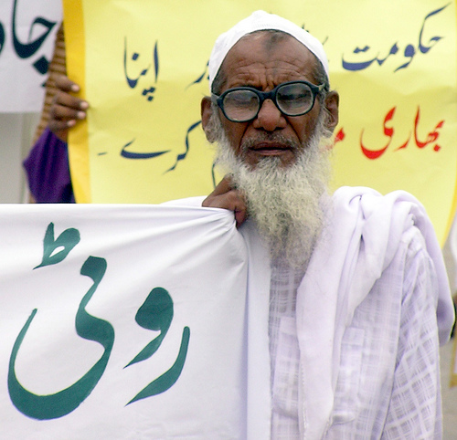


Slide 4
Pakistan and the Millennium Development Goals (2015)
Eradicate Extreme Hunger and Poverty
Achieve Universal Primary Education
Promote Gender Equality
Reduce Child Mortality
Improve Maternal Health
Combat HIV/AIDS, Malaria and other diseases
Ensure Environmental Sustainability
Develop a Global Partnership for Development

Slide 5
What will it take to achieve the Millennium Development Goals?
Political will , commitment & focus
Monitoring the process
Economies need to grow to provide jobs & more income for poor people
Health & Education system must deliver services to everyone, men & women, rich & poor
Infrastructure has to work and be accessible to all

Slide 6
Policies need to empower people to participate in the development process
Fortify partnerships with private sector to complement & supplement government programs
Prioritization and context setting in development work at each country level
Overcoming financial, human and institutional resource constraints
Increased resources & new financial commitments by the wealthiest nations
While sustained growth would be necessary for poverty reduction, concomitant improvement in institutional delivery mechanisms will be essential for achieving progress in all other dimensions of MDGs.

Slide 7

WHAT IS ENERGY CRISIS?
An Energy Crisis is any great shortfall in the supply of energy to an economy.
It usually refers to the shortage of oil, electricity or other natural resources.

Slide 8

CAUSES OF ENERGY CRISIS
AGING OF THE EQUIPMENT
WASTAGE OF ENERGY
HIGH COST OF FUEL
UNUSE OF COAL

Slide 9
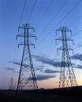
DISTRIBUTION SYSTEM
UNPRODUCTIVE EFFORTS
FLUCTUATION OF OIL PRICES IN INTERNATIONAL MARKET

Slide 10

EFFECTS
Energy crisis badly effects Education
Great effect on Industries
Effects on Economy

Slide 11
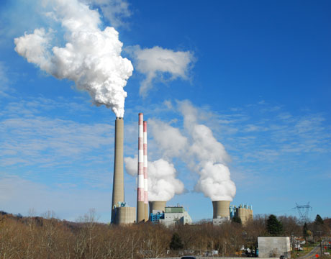

Higher electricity prices
Effect on agriculture
Unemployment increases

Slide 12
Power crisis of Pakistan

Slide 13
Contents
Demand of electricity
Supply of electricity
Shortfall of electricity
Dams
Other methods to produce electricity

Slide 14
Demand of Electricity
Demand of electricity in Pakistan is 19,000 MW.
Electricity demand is increasing by 10 % annually
in Pakistan

Slide 15
Supply of Electricity
At this time Pakistan produce electricity up
to 13000 MW while present installed capacity is
19,500 MW.

Slide 16
Shortfall of Electricity
In the beginning of the year 2013, the total
shortfall was 3000 MW and it is expected to
increase up to 8000 MW in the year 2014.
But in 2013, it has crossed the record level
of 7,075 MW.
The WAPDA is facing 7750 MW electricity
shortfall within its own system whereas 1325 MW
shortfall was recorded from IPPs. (independent power producers)

Slide 17
How To Remove This Shortfall
There is no shortage in the electricity
production capacity in Pakistan at all. It is lack
of commitment on government part that is
pushing the country and its economy deeper
into this crisis.

Slide 18
Dams
The permanent solution of
this problem is Dams.
Dams not only generate the electricity but also
provide water which is necessary for our
agricultural and household purposes.

Slide 19
Dams
We categorize the dams into three types.
1. Constructed Dams
2. Under Construction Dams
3. Future Projects

Slide 20
Constructed Dams
Pakistan produce electricity from following dams
Dams
1. Tarbela Dam
2. Mangla Dam
3. Warsik Dam
4. Malakund Dam
5. Dergai Dam
6. Rasool Head works
7. Shadiwal Dam
8. Chicho ki Malian
9. Nandipur Dam
10. karmgarrhi
Capacity
2100 MW
1000 MW
3240 MW
20 MW
20 MW
22 MW
14 MW
13 MW
14 MW
4 MW

Slide 21
Under Construction Dams
These dams are being under construction.
Projects Capacity
1. Allai Khwar Hydropower 121 MW
2. Duber Khwar Hydropower 130 MW
3. Jinnah Hydropower 96 MW
4. Neelum Jhelum Hydropower 969MW

Slide 22
Future Projects
1. Diamer Basha Dam project
2. Kurram Tangi Dam Project
3. Munda Dam Project
4. Akhori Dam Project
Kalabagh Dam ?????

Slide 23
kalabagh Dam
Features
3600 MW generation capacity.
Average power benefits Rs. 35.94 billion per annum.
Retention level of dam is 915 ft while Nowshera’s height is 940 ft.

Slide 24
Kalabagh Dam and Political Pressures
THE Kalabagh controversy refuses to go away, even in its “abandoning”. As it appears, it would not get resolved in future either and keep haunting the nation.
PPP government announced it intends to abandon the Kalabagh dam, it would only add fuel to the fire. Instead of taking up the project for democratic debate at the national level and at the proper forum like parliament to resolve it either way, the government has simply “shelved it for good.”
it was a technically sound project. If the three smaller provinces somehow view it as a Punjab project, farmers in Punjab would hold people from other federating units responsible for abandoning it.

Slide 25
Methods to Produce Electricity
The following methods can also be used to
produce electricity other than hydro power.
1. Thermal Electricity
2. Nuclear Electricity
3. Bio Electricity
4. Solar Power
5. Wind Power

Slide 26
Thermal Electricity
Electricity can be generated by natural resources like Oil, gas and coal.
A large coal-field, having
a resource potential of
about 175 billion tones, has
been discovered at Thar
(Sindh).

Slide 27
Nuclear Electricity
Nuclear electricity generated
by Uranium. More electricity
can be produce with little
quantity of Uranium.
Plants in Pakistan
Karachi 137 MW
Chashma1 325 MW
Chashma2 300 MW

Slide 28
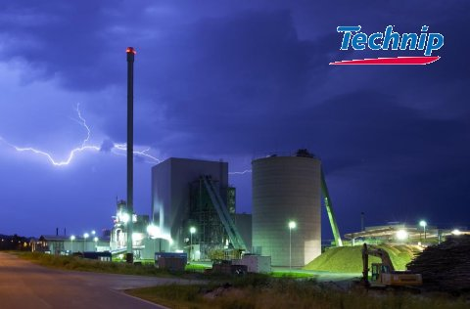
Bio Mass Power
Factories producing
organic waste material
can utilize this method
that is textile mill, leather
tanneries and sugar
mills.

Slide 29
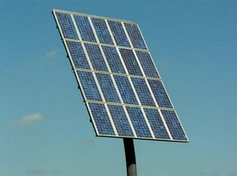
Solar Power
We can also generate
electricity from Sun light
by Photovoltaic cells.
If only 0.25% of Balochistan is
covered with solar panels
with an efficiency of only 20%,
enough electricity would be
generated to cover all of
Pakistan’s demand.

Slide 30
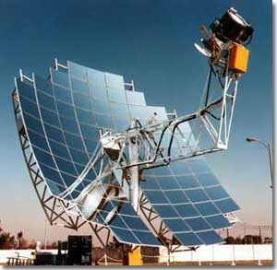
Solar Power
Reasons
Firstly, 70% of the population
lives in 50,000 villages that are
very far away from the national
grid.
Connecting villages to the
national grid would be very
costly, thus giving each house a
solar panel would be cost
efficient and would empower
people both economically and
socially.

Slide 31
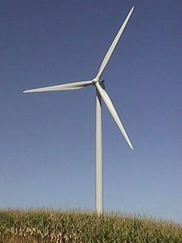
Wind Energy
Pakistan can also generate
electricity by wind turbines.
Pakistan is fortunate to
have high wind speeds,
something many other
countries do not have.
Near Islamabad, the wind speed is between 13.8 to 16.5 mps
and near Karachi it is 13.8 to
15.4 mps.

Slide 32
Wind Energy
Suzlon manufactures wind turbines in
India. Working with Suzlon, Pakistan can
begin to build its own wind-turbine industry
and create thousands of new jobs while
solving its energy problems. Suzlon turbines
start to turn at a speed of 3 meters per
second.

Slide 33
Energy resources of Pakistan
❶
Pakistan’s Conventional Energy Resources
Energy Type | Potential | Source
Crude Oil | 339 million barrels recoverable reserves. | Pak Eco Survey 2010-11
Natural Gas | 31,266 trillion cubic feet recoverable reserves. | Pak Eco Survey 2010-11
Coal | 185 billion tones recoverable reserves. | Pak Eco Survey 2010-11
❷
Pakistan’s Renewable Energy Resources
Wind Energy
Solar Energy
Bio-mass & Bio-fuels

Slide 34
Effects on economy
Energy crisis badly effects Education
Great effect on Industries
Effects on Economy
Effect on agriculture
Unemployment increased
Higher electricity prices

Slide 35
Impact on society
Imported oil and coal and shortage of natural gas will increase prices
Less agriculture yields
Dependent on other countries

Slide 36
Objective
Use own resources
Import electricity from China

Slide 37

Recommendations
To overcome present energy crisis, Pakistan needs to take the following steps in form of:
1. Short Term Plan
2. Medium Term Plan
3. Long Term Plan.

Slide 38
Recommendations
Overhaul the existing poor distribution system
Import electricity
Government should have strict monitoring system
1. Short Term Plan
2. Medium Term Plan
3. Long Term Plan

Slide 39
Recommendations
Transformation of existing system
Developing and installing solar and wind projects in villages
1. Short Term Plan
2. Medium Term Plan
3. Long Term Plan

Slide 40
Recommendations
Installing coal based powerhouses
Initiate agreements for mega projects
Explorations of more oil, gas and coal reserves
1. Short Term Plan
2. Medium Term Plan
3. Long Term Plan

Slide 41
Conclusion
Government of Pakistan to take strong steps to overhaul its existing infrastructure and transform it to utilize renewable energy for future needs along with continuous updating of equipment
Government should also take steps to utilize the coal reserves which will give us energy for next 25 years.

Slide 42
Some questions
Crisis of its history?
Reasons?
Utilization?
Pakistan importing coal?
Access to electricity?

Slide 43
Quote of the Day
It is no use saying, 'We are doing our best.' You have got to succeed in doing what is necessary.
Winston Churchill

