Slide 1
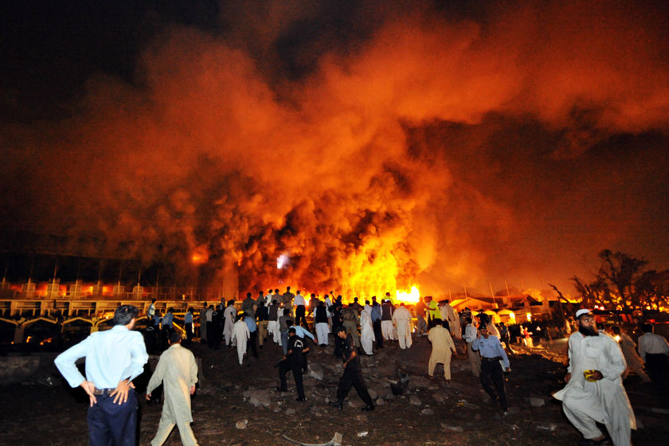
Issues in Public Administration
MPA 509
Pakistan:
Political
Institution-Building Challenges

Slide 2
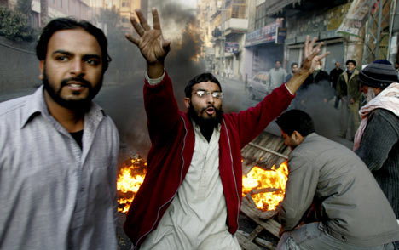
Challenges to institution-building
Pakistan’s list of political malaises is infinite, but includes:
Pervasive corruption,
Incompetent politicians,
Military-dominated state and bureaucracy,
Ineffective political parties,
Ethnically divided nation,
Unproductive foreign policy,
and
Persistent internal conflict (including terrorist activity).
Riots ensued across Pakistan after the assassination of Prime Minister Benazir Bhutto.

Slide 3
Judicial accountability and inaction
regarding extra-constitutional actions of federal officials. Judiciary the 3rd most corrupt sector in Pakistan; 86% of those surveyed by TI reported having to produce bribes to secure themselves a fair trial or to have their complaints addressed.
In 2008, Transparency International ranked Pakistan as the 138th most corrupt out of 179 countries.

Slide 4
Issues:
Disruption of balance in the power sector. 17th amendment passed by Musharraf in 2003 in order to perpetuate his rule; ceded many of the Prime Minister’s powers to the President.
Lack of transparency in the public procurement process. Bribery a major obstacle in the effective and equitable provision of public services; federal law permits open competition for government contracts, but state officials award in exchange for bribes.

Slide 5
The army
Recurring seizures of state power. The military is
Pakistan’s most powerful institution and claims a role as
the nation’s almighty guardian; it harbors an intense
mistrust for politicians and has repeatedly seized control
of the state from elected officials, citing their
incompetence and corruption.
  Failure of the military to denounce Musharraf’s
  unconstitutional declaration of martial law in November
  2007; though they disagreed with his actions, they did not
  want to infringe upon their “right” to take control in the
  event of political failure in the state.

Slide 6
The army
Monopolization of
state/bureaucratic affairs.
Military officials constitute an overwhelming majority of positions in civil sector jobs; Zia passed legislation that gives army personnel precedence over civilians in consideration for government posts, which is still in effect today. The military is also in ownership of numerous private enterprises…the total balance of its assets is US $20 billion, roughly 1/8 of Pakistan’s GDP.
“The army appears unable to govern Pakistan itself, but will not allow anyone else the opportunity to do so either.”
– Stephen Cohen, The Idea of Pakistan

Slide 7
Ineptitude of political parties
Aside from PPP, ethnonationalism divides parties
When conflict arises within party, party breaks up instead of resolving issues
Chronic history of military leaders vs. untapped long-term potential of civilian leaders

Slide 8
Issues:
Punjabi dominance.
Given their higher accessibility to education in comparison to the other ethno-linguistic groups, Punjabis have been able to monopolize high-status positions within the state/bureaucracy. Causes much resentment in other groups, who see no share of Punjabi success.

Slide 9
Pakhtun separatism.
Pakhtuns in Khyber Pakhtunkhwa complain of underrepresentation in government and a lack of institutionalized Islamic law; they demand either an autonomous homeland of “Pakhtunkhwa” or a “Greater Afghanistan” that would erase the Durand line and unite the Pakhtun peoples dispersed between Pakistan and Afghanistan. The possibility of a fusion of Pakhtun separatism with the Islamic militancy brewing in the tribal areas is of major concern to the state, which has had extreme difficulties extracting these militants in their current numbers.

Slide 10
Baloch insurgency.
Balochistan is Pakistan’s most resource-rich province, containing large reserves of coal and natural gas; the state has control of these resources. It has made much money off of these operations by attracting FDI and has distributed them to much of the richer, higher-status areas (especially Punjab), but not to the Baloch. This has resulted in a renewed Baloch insurgency against the state, which began in 2004.
“Islam was meant to be the binding force – but for many, ethnic ties have proved to be stronger.”
– Owen Bennet Jones, Pakistan: the eye of the storm

Slide 11
Foreign policy
U.S. aid to Pakistan has fluctuated in last couple of decades
Questions of Pakistani sovereignty and U.S. intervention
Nuclear standoff with India, border issues with Afghanistan
The continued conflict in Kashmir has radically politicized many Pakistani youth and is deepening the already-great social divide between Pakistanis and Indians.

Slide 12
Terrorism and religious/ethnic conflict
In 2000, the Central Intelligence Agency National Intelligence Council published a document that predicted what the world may look like in 2015, with special notes about Pakistan; lawlessness, corruption, and failures resulting from decades of mismanagement.
Musharraf weary of confronting militants in FATA (Federally Administered Tribal Areas) and NWFP (now Khyber Pakhtunkhwa)
General Ashfaq Kayani knew how important victory was to ease tensions with U.S. and win U.S. aid, must prove to Pakistani people that it is Pakistan’s war, not America’s
Kayani talked to tribal leaders, formed Lashkars and saw the restrictions of the Taliban

Slide 13
Pakistan … isolated
US: help with terrorism but little opening for textiles
textiles 60% manufacturing exports
Doesn’t receive preferences from anyone
Geopolitically isolated
Limited regional trade agreements

Slide 14

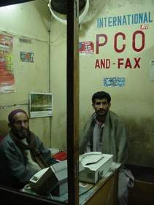
Growth Without Development
Compared to other countries, similar income, Pakistan has
  36% lower attended births
  42% less health spending per capita
  27 excess infant deaths per 1,000
  23% less population access to sanitation
  24% higher illiteracy
Massive spending on defense and roads etc…
  defense spending 3.3% more GDP than countries same income
  overspending on defense = under spending on health and education
Easterly, William. 2003. “The Political Economy of Growth Without Development: A Case Study of Pakistan.” In Rodrik, Dani, In Search of Prosperity: Analytic Narratives on Economic Growth, Princeton University Press, Princeton and Oxford.

Slide 15
How and Why
Pakistani economist Ishrat Husain, once wrote “The ruling elites found it convenient to perpetuate low literacy rates. The lower the percentage of literate people, the lower the probability that the elite could be displaced.”
In the 1960s, 22 families controlled 66% of industrial wealth and 87% banking and insurance
Landowners – great power
  rural gentry captured 70% of parliamentary seats in 2000
  blocked direct taxation of agricultural income
  school teachers related to land owners… protected – and absent
Male elite: does not want to invest in women’s education-will demand greater rights
Foreign donors: low emphasis on social progress instead of
GDP growth

Slide 16
Duality the Challenge
International community has a challenge
Development requires active participation in institutions and decision making
Pakistan faces difficulties in gaining voice in international institutions
Pakistan needs to promote at home
  health and education required for more people to profitably participate in the workforce
Inequality in holdings of assets, including land.

Slide 17
ECONOMIC CHALLENGES FOR PAKISTAN
The Pakistan’s economy is currently passing through the most difficult phase of its economic history.
Once a robust economy, with economic growth over 6% of GDP, now it has been transformed into a fragile economy, due to serious economic challenges, the most important being our country’s frontline role in ‘War on Terror’ and the persistent ‘Power and Energy Crisis’ which has crippled our industrial sector.

Slide 18
The statement of IMF Mission:
“The country’s GDP in 2012-13 is likely to grow at the annual rate of 3% to 3.5%, not enough to provide jobs to the growing labor force. Decisive and far-sighted action is needed to address this challenging outlook”.

Slide 19
The Challenges that our Country faces today do not commensurate with the abundant and vast potential that it possesses.
Pakistan offers huge potential and opportunities for trade and investment to both foreign investors and the local economy.
Pakistan is ranked number one in the World Bank’s ‘Ease of Doing Business Index.’ in Asia

Slide 20
Pakistan is world’s 2nd largest producer of water,
buffalo meat and milk
Pakistan is world’s 3rd largest producer of cotton
Pakistan is the 4th largest goat meat supplier
Pakistan has 5th largest Coal and Gold reserves
Pakistan is the 7th largest wheat grower

Slide 21
The State Bank comments on the economy recovery prospects as follows:
“Although Pakistan’s economy has shown some recovery in terms of GDP growth, the key macro indicators still remain weak. Persistent inflation and pressure on the fiscal and current accounts, remain the key challenges for the economy”
Like IMF, the State Bank of Pakistan also pinpoints that “Low investment and energy shortages have direct growth implications. Other areas that poses challenge and major risk to the macro-economy is the ‘persistently high fiscal deficit’

Slide 22
Political Mindsets and Issues
Abject Poverty
Low Intra-regional trade
Low- Intra-regional or cross-border Investment
Poor Transport Network or Infrastructure to facilitate trade
Sizable Sensitive List, Para Tariff and Non-Tariff Barriers
Food Security issues
Climatic Change Issues (floods and natural disasters)
Under-utilization of renewable energy resources
Stringent visa requirements

Slide 23
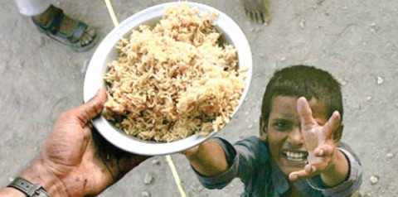
Food Security Issues
Considering that the estimated population of South Asia will rise by 25% to 2000 million in 2025, food security is the most tangible threat to all South Asian countries.
This threat cannot be mitigated by a variable increase in food production alone, but by efforts to drastically improve access to food sources and clean drinking water.

Slide 24

(4) Promising Youth leadership
The young business leaders of Pakistan should be prepared as the next generation of business leaders for South Asia and to identify their role in the formation of an integrated future business community. There is strong need for youth empowerment and focus on business leadership for Pakistan’s economic development.

Slide 25
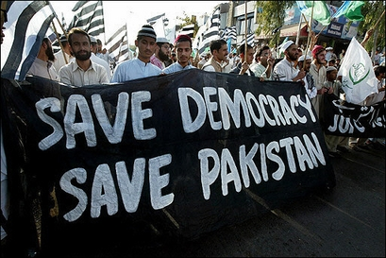

Slide 26
Recommendations
#3
Foreign Policy
Bilateral negotiations on disarmament; a reduction of India’s nuclear program in exchange for a reduction of Pakistan’s
#1
Terrorism and Religious/Ethnic Conflict
Work to cut funding for terrorist activities
Convince peoples of FATA to turn against terrorists
#2
Ineptitude of political parties
Negotiation amongst party members as disagreements arise as opposed to party splits
Properly training civilians for careers in politics; production of a competent civil leadership

Slide 27
Quote of the Day
The marvel of all history is the patience with which men and women submit to burdens unnecessarily laid upon them by their governments.
George Washington

