Slide 1
Issues in Public Administration
MPA 509
Corruption in the Perspective of Pakistan

Slide 2
Agenda
Preview of Last Lecture
Causes of Corruption
Types of Corruption
Institutional Framework for Anti Corruption
Approaches to fight Corruption
Contours of Corruption
Remedies
Conclusion

Slide 3
Definition
Misuse of entrusted power for private gain or benefit.
The most comprehensive definition of corruption approved by Transparency International, Asian Development Bank and world bank is
“Misuse of Public office for Private profit or political gain”.

Slide 4
Definition
“Corruption can be regarded as a form of organisational deviance where
it is engaged in as a means to an organisational goal, or
(b) the tacit encouragement of corruption serves organisational goals, or (c)
the pursuit of profit through corruption itself becomes an organisational goal”.
Green & Ward (2004: 13)

Slide 5
Some More Definitions
More widely used definition – the abuse of public office for ‘private economic gain’ (Rose-Ackerman, 1999: 75)
Extrapolating from firm and household survey data, the World Bank Institute estimates that total bribes in a year are about $1 trillion.

Slide 6
Institutional Framework For
Anti-Corruption in Pakistan
FIA
Provincial Anti Corruption Establishments
NAB
Accountability Courts

Slide 7
Causes of Corruption
Lack of Accountability(31.68%)
Low Salaries(16.54%)
Monopoly of Power(16.43%)
Discretionary Power(12.61%)
Lack of Transparency(9.97%)
Power of Influential People(4.59%)
Red Tapism(4.28%)
Others (4.9%)
Source NACS, NAB, Government of Pakistan.

Slide 8
Some Figures About Corruption in Pakistan
Pakistan has one of the highest rates of corruption in the entire world. Bribe Payers Survey 2010 carried out by Transparency Intl. showed that the actions of the government in Pakistan’s fight against corruption were seen as ineffective by 72% people whereas same the value for India stood at 42%. The survey also revealed the institutions considered to be the most corrupt shown
Police 4.7
Political Parties 4.6
Customs 4.3
Revenue 3.7
Education 3.6
Private Business 3.2

Slide 9
Grand Corruption
Describes cases where massive personal wealth is accrued by senior public officials using corrupt means.
Occurs at highest level of government
Involves major government projects and programmes
Two main activities – bribe payments (direct payments and/or kickbacks) and embezzlement or misappropriation of state assets.
Includes payments to obtain major contracts and concessions. Why?
  Pay to be included on the list of tenders
  Pay for inside information
  Pay to tailor the criteria so that they win contract
  Pay to increase costs or skimp on quality after winning contract.

Slide 10
Petty Corruption
‘Grease payments’ sought by officials for things that the public are entitled to for free of charge anyway! – e.g. to customs officers to allow good through a border crossing, to immigration officers to get a passport stamped, to avoid prosecution for traffic offences etc.
Element of extortion – service required would not be obtained if the payment were not made.
Sums involved are usually small

Slide 11
Systemic Corruption
Brought about, encouraged or promoted by the state itself.
Permeates a country’s political and economic institutions
Closely related to poor governance, weak states, failed states, no independent judiciary, media and no active civil society.

Slide 12
Types of corruption
(see Bracking, 2007: 5-6)
Type 1 | Definition | Involves
Administrative or bureaucratic corruption | Illicit payments sought from users by civil servants in the (often distorted and arbitrary) implementation of existing regulations, policies and laws. | Wide constituency usually involved, experienced by citizens as harassment in their efforts to obtain even small administrative goods. Companies will seek tax advantages, licences or influence in formation of rules and law.

Slide 13
Types of corruption
Type 2 | Definition | Involves
Petty corruption | Refers to small acts , or rent-taking actions, by civil servants. Bribery, influencing and gift giving are sometimes seen as different forms of petty corruption. | Public administrator in direct contact with public, who accept bribes for expediting documents or, in case of police, not charging a suspect.

Slide 14
Types of corruption
Type 3 | Definition | Involves
Graft | Involves the utilisation of public resources to serve individual or private interests | Use of resources, time or facilities by a staff member (without a transaction with an external member). Often used interchangeably with corruption.

Slide 15
Types of corruption
Type 4 | Definition | Involves
Influencing | Forcing a decision in one’s favour | Political lobbying (though this is legitimate); secretive contacts or suspicion of favouritism or influence suspected to be disproportionate to public interest is considered corrupt.

Slide 16
Types of corruption
Type 5 | Definition | Involves
Bureaucratic corruption |  | Individuals pay money to get in or get on; officials give friends and family jobs which they would not otherwise have got…

Slide 17
Types of corruption
Type 6 | Definition | Involves
Political corruption | Misuse of entrusted power by political leaders; and/or corruption within the political or electoral process. | Vote buying; use of illicit funds for campaigning; sale of public appointments; abuse of state resources.

Slide 18
Types of corruption
Type 7 | Definition | Involves
Political patronage (clientalism) or nepotism | Government resources are directed to patrons, clients, family, ethnic clans of office holders. | Patron can sometime present himself as a ‘social altruist’ – discharging an obligation to political supporters, family members etc.

Slide 19
Types of corruption
Type 8 | Definition | Involves
High level corruption | Misuse of high public office, pubic resources or public responsibility for private, personal or group gain. | Term is used interchangeably with grand corruption or endemic corruption.

Slide 20
Types of corruption
Type 9 | Definition | Involves
State capture | Private payment to public officials and ‘capture’ of their area of jurisdiction in order to affect laws, rules, decrees, regulations or capture resources, for example, contracts | Firms, who need to pay, and the public in general, whose interests are sidelined.

Slide 21
Eight Key Questions about Public Corruption
1) What is corruption?
2) Which countries are the most corrupt?
3) What are the common characteristics of countries with high corruption?
4) What is the magnitude of corruption?
5) Do higher wages for bureaucrats reduce corruption?
6) Can competition reduce corruption?
7) Why have there been so few (recent) successful attempts to fight corruption?
8) Does corruption adversely affect growth?
See Svensson, J. (2005)’ Eight key questions about public corruption’, Journal of Economic Perspectives, 19 (3), pp.19-42.

Slide 22
What is corruption?
Not just the misuse of public office for private gain…
Corruption is also an outcome—a reflection of a country’s legal, economic, cultural and political institutions.
Corruption can be a response to either beneficial or harmful rules.
“Some activities will hover on a legal borderline: for example, legal payments that involve lobbying, campaign contributions or gifts can seem quite close to illegal payments that constitute bribery, or legal offers of postretirement jobs in private sector firms to officials and politicians assigned to regulate these same firms can seem quite close to illegal kickbacks”. (Svensson, 2005: 21)

Slide 23
Which countries are the most corrupt?
TEN MOST CORRUPT STATES
Somalia
Burma
Iraq
Haiti
Afghanistan
Sudan
Guinea
Chad
Equatorial Guinea
DR Congo
Source: Transparency International 2008

Slide 24
What are the common characteristics of countries with high corruption?
Those with the highest levels of corruption are developing or transition countries.
Many are governed, or have recently been governed, by socialist governments.
The most corrupt countries have low income levels.

Slide 25
What is the magnitude of corruption?
Most studies do not claim to capture all corruption within the program or sectors.
Huge variation in corruption, ranging from a few percent in the Oil for Food Program that affected Iraq to 80 percent in the primary education program in Uganda.

Slide 26
Do higher wages for bureaucrats reduce corruption?
Recommendation to fighting corruption by paying higher wages to public servants (as happened in Sweden)
“Thus, wage incentives can reduce bribery, but only under certain conditions. This strategy requires a well-functioning enforcement apparatus; the bribe being
offered (or demanded) must not be a function of the official’s wage; and the cost of paying higher wages must not be too high. In many poor developing countries where corruption is institutionalized, these requirements appear unlikely to hold”. (p.33)

Slide 27
Today’s Case Study: UN Oil for Food Programme in Iraq 1995-2003
A response to concerns about the economic sanctions against Iraq in the post Kuwait war era.
Ordinary people suffering as a consequence of sanction
UN initiates an oil for food programme to allow food, medicine and other ‘goods’ to be purchased by Iraq with money from selling oil.
Terminated in 2003 after US invasion of Iraq
Revelations of corruption in fund became apparent once the programme ended.

Slide 28
How corruption was alleged to have taken place:
Saddam sold oil at below market value to handpicked group of contractors whom he knew would give a ‘kickback’ in return for cheap oil.
Companies supplying food and medicine were charged ‘after-sales-service’ fees and inland transportation fees funnelling $1.5 billion directly back to Saddam.
+$13.6 billion generated through illegal oil sales (but everyone looked the other way because the sales went to Turkey and Jordan who were allies of the US and UK)
Also, allegations that UN officials may have profited from the programme

Slide 29
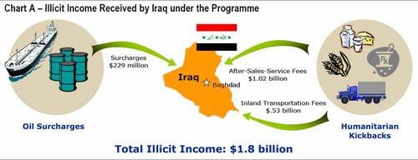

Slide 30
How it was discovered:
Allegations of corruption surfaced with the discovery of alleged Iraqi government papers in Baghdad after US forces took control of the city in 2003
Al Mada, a daily newspaper in Iraq, published a list of individuals and organizations alleged to have received oil sales contracts via the UN's Oil-for-Food Programme.
The list came from over 15,000 documents which were reportedly found in the state-owned Iraqi oil corporation.

Slide 31
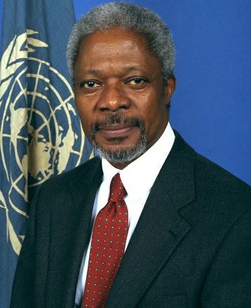
Establishment of Independent Inquiry Committee (IIC)
April 2004, Kofi Annan, announces the creation of the IIC
Tasked with investigating allegations of impropriety in the operation and management of the oil for food programme.
Provided $34 million funding for the investigation to be carried out.

Slide 32
Who was involved
– state and individual?
Known oil voucher recipients: the list indicates that 30% Russian; 15% French; 10% Chinese; 6% each Swiss, Malaysian, and Syrian; and 4% each were Jordanian and Egyptian.
American and German recipients were included in the approximate 20 percent of "recipients from other nations."
Benon Sevan, head of the programme, a Cypriot and career UN diplomat, was singled out for actions that were "ethically improper and seriously undermined the integrity of the UN".

Slide 33
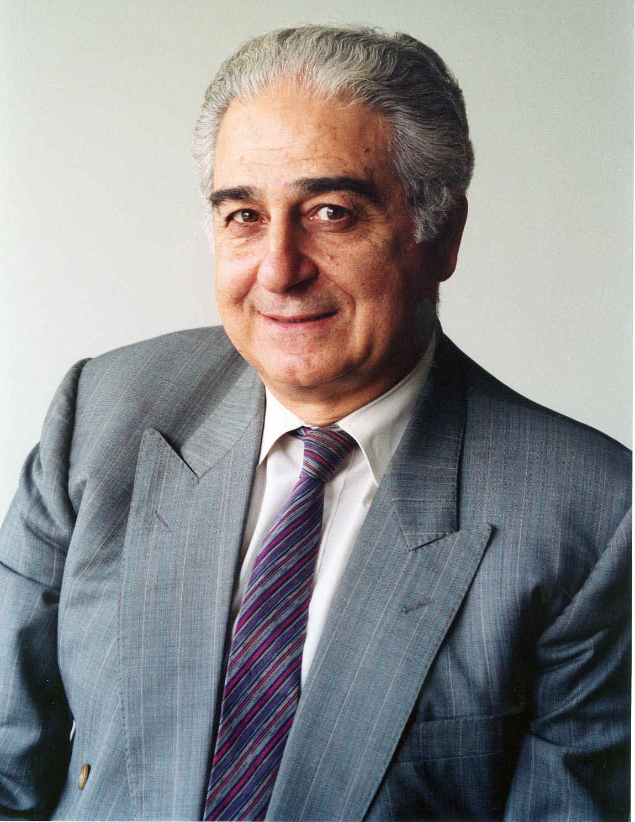
Benan Sevan,
Head of the UN Oil for Food Programme until 2003.

Slide 34
Outcomes
2,253 firms were listed by the inquiry, many of them household names, had made illegal payments totalling $1.8 billion to the Saddam regime. See:
  Daimler Chrysler AG, Germany
  Siemens, Germany
  Volvo, Sweden
  Daewoo, South Korea
  Wier Group, UK
  Bayoil, US

Slide 35
Outcomes
Five years after the scandal broke, how many beneficiaries have been tried in court and found guilty?
None in Russia, the country that won the lion's share (nearly a third) of oil deals.
As Mr Volcker (Chair of IIC) noted, the programme gave Iraq a freeish hand in choosing its oil clients.
It used oil sales to reward people, firms and countries (such as Russia) that were known to be pro-Iraqi.

Slide 36
Outcomes
Other countries, including China, Cyprus, Yemen, Egypt, Vietnam, Malaysia and the United Arab Emirates, have ignored the IIC report. Of the 52 countries it named, only 28 have asked to consult the tonnes of incriminating documents assembled by Mr Volcker and his 75 investigators.

Slide 37
Some convictions in relation to this
Of just seven people so far convicted worldwide on oil-for-food charges, all were prosecuted in America, which began its legal moves before the Volcker panel reported.
David Chalmers, the Texan head of Bayoil, was sentenced to two years in jail and ordered to repay $9m in fines and restitution.
Oscar Wyatt, another Texas oil man, was jailed in for one year and ordered to pay $11m.
Vladimir Kuznetsov, the Russian ex-chairman of the UN's budget oversight committee, is serving 51 months for money laundering.
Tongsun Park, a South Korean who lobbied for Iraq, is serving five years.

Slide 38
Resources
Transparency International
UN Convention Against Corruption
http://www.unodc.org/documents/treaties/UNCAC/Publications/Convention/08-50026_E.pdf
Oil for Food Scandal – Key Reports
http://news.bbc.co.uk/1/hi/world/americas/4550859.stm

