Slide 1
Issues in Public Administration MPA 509
Lecture 2
by Khursheed Yusuf

Slide 2
AGENDA
Preview of the Last Lecture
Part 1: Meaning, Nature and Scope
Views about Public Administration
Views about Public Administration as a Field of Practice
Views about Public Administration as a Field of Study
Example about Public Administration as a Field of study
An applied Discipline
Views about Public Administration-As an Art and Science
Definitions
The Difference between Public and Private Administration.

Slide 3
Part I:
Meaning,
Nature,
Scope and Significance of Public administration

Slide 4
What is Public Administration?
There is, however, a core of diverse meanings of terms administration and public administration, linked with the origin of the word administration.
Administration has originated from Latin verb ministrare, strengthened by the preposition ad-, meaning „to serve”. Words „minister” and „ministration” also conform that „servant” aspect of the derivatives of ministrare.
Therefore, administration always means a certain service or executive activity, carried out with respect to somebody and/or something more important.

Slide 5

Views of Public Administration

Slide 6
The Concept of Public Administration
Luther Gulick
Administration has to do with getting things done; with the accomplishment of defined objectives.
George E. Berkley
Administration is a process involving human beings jointly engaged in
working towards common goals.
Keith Henderson
Administration is the arrangement of men and materials in the rational
carrying out of purposes.
Two essential elements of administration:
collective effort
common purpose

Slide 7
The Concept of Public Administration
Administration is an universal process and occurs in diverse institutional settings. Based on its institutional settings, administration is divided into:
public administration (refers to the administration which operates in governmental setting)
private administration (refers to the administration which operates in non-governmental setting)

Slide 8
Other definitions
Woodrow Wilson
  Public administration is detailed and systematic execution of the law
    excludes policy formulation as well as elected officials
Russell—the public interest
  Whatever governments do for good or ill. It is public administration’s political context that makes it public--that distinguishes it from private or business administration.

Slide 9
Wlado
Definitions of Public
Administration
Waldo, 1955
PA is the organization and management of men
and materials to achieve the purposes of
government
PA is the art and science of management as
applied to the affairs of the state

Slide 10
Definition of Public
Administration
According to Waldo (1955), Public Administration has dual usages: as a field of practice and a field of study. The meaning invoked is the activity or process of administering public affairs and carrying out governmental functions.
Example of Public Administration practices
Enacting a law
Making decision on the best policy concerning an issue
Formulating the plan
Maintaining law and order
Processing of claims
Building roads and bridges
Issuance of license
Setting standard and Processes

Slide 11
Definition of Public
Administration
Caiden, 1971
is a cooperative group effort in a public setting
covers all three branches – executive, legislative and judicial and interrelationships
has important role in the formulation of public policy and is , thus, part of the political process
as a field of study and practice , it has been influenced by human relations approach
is closely associated with numerous private groups and individuals in providing services to the community

Slide 12
Definition of Public
Administration
Fry, 1989
PA is policy-making. It is not autonomous, exclusive or isolated policy making.
PA is one of a number of basic political processes by which this people achieves and controls governance

Slide 13
Definition of Public
Administration
Rossenbloom, 1989
PA is the action part of government. The means by which the purposes and goals of government are realized. PA as a field is mainly concerned with the means for implementing political values
PA differs from political science in its emphasis on bureaucratic structure and behavior and its methodologies
PA differs from administrative science in the evaluative techniques used by non profit organizations because profit-seeking organizations are considerably less constrained in considering public interest in their decision-making structures and the behavior of their administrators

Slide 14
Definition of Public
Administration
Public
De Guzman, 1993
From a very broad perspective, PA may be viewed to refer not only in activities carrying out or implementing policies and programs of the government but also to the processes and contents of these policies and programs
From a broader perspective, PA may refer to the cooperative human action whether within the public bureaucracy, the private sector or in nongovernmental organizations aimed at delivering services to the people

Slide 15
The Concept of Public Administration
David H. Rosenbloom, Robert S. Kravchuk
Public administration […] is difficult to define. […] In part, this is be-cause public administration covers such a vast amount of activity. Public administration jobs range from the exploration of outer space to sweeping the streets. Some public administrators are highly educated professionals, who may be at the forefront of their fields of specializa-tion; others possess few skills that differentiate them from the mass of the citizenry. Some public administrators make policies that have a nationwide impact and may benefit millions of people; others have virtually no responsibility for policy making and simply carry out mundane governmental tasks like word processing, filing, and record keeping. Public administrators are doctors, lawyers, scientists, engi-neers, accountants, budgeters, policy analysts, personnel officers, ma-nagers, clerks, keyboarders, manual laborers, and individuals engaged in a host of other occupations and functions.
[…] public administration as a category is so abstract and varied that it can only be described in vague, general, amorphous, and somewhat competing terms.

Slide 16
What is also considered an applied discipline?
It has practical use for government, particularly in improving government performance
it prepares persons for careers in public service and trains them to be good public administrators

Slide 17
Views of Public Administration
As: Both an Art and a Science
As an Art:
PA involves creativity, leadership, a good sense of the intangibles in administration.

Slide 18
Views of Public Administration
As: Both an Art and a Science
As a Science:
There is a body of knowledge or theories that can explain or predict phenomenon or variables in the field of PA
The PA theories and concepts are built on empirical research using systematic methods
These theories can be used not only to explain but also improve the art and practice of PA (Bautista, 1990)

Slide 19
The Concept of Public Administration
Administration is an universal process and occurs in diverse institutional settings. Based on its institutional settings, administration is divided into:
public administration (refers to the administration which operates in governmental setting)
private administration (refers to the administration which operates in non-governmental setting)

Slide 20
Public and Private Administration
Criteria | Public Administration | Private Administration
1.Relations to environment | subject to public scrutiny; public demand and expectations; political pressures | Less exposed to public inspection; internal processes are kept from public; response to public guided by market dynamics
2. Accountability | Accountable to the public; transparency in transactions is expected | management accountable to owners of firms/corporations
3. Measure of performance | general public satisfaction is the gauge in the improvement in the quality of life | profit is bottomline
4. Nature of goods and services | open to all | availment based on ones ability to pay

Slide 21
The Concept of Public Administration
Woodrow Wilson
Public administration is a detailed and systematic execution of law. Every particular application of law is an act of administration. […] Administration is the most obvious part of the government; it is the government in action; it is the executive, the operative, the most visible part of the government.
Edgar N. Gladden
Public administration is concerned with the administration of the government.
Marshall E. Dimock
Public administration is the fulfillment or enforcement of public policy as declared by the competent authorities. It deals with the problems and powers of the organizations and techniques of management involved in carrying out the law and policies formulated by the policy-making agencies of government. Public administration is the law in action. It is the executive side of a government.

Slide 22
The Concept of Public Administration
Felix A. Nigro
Public administration:
is a cooperative group effort in a public setting;
covers all three branches – executive, legislative, and judicial – and their interrelationships;
(3) has an important role in the formulation of public policy, and is thus part of a political process;
(4) is different in significant ways from private administration; and
(5) is closely associated with numerous private groups and individuals in providing services to the community.

Slide 23
The Concept of Public Administration
The Constitution of the Republic of Poland
Art. 10
The system of government of the Republic of Poland shall be based on the separation of and balance be-tween the legislative, executive and judicial powers.
Legislative power shall be vested in the Sejm and the Senate, executive power shall be vested in the Pre-sident of the Republic of Poland and the Council of Ministers, and the judicial power shall be vested in courts and tribunals.

Slide 24
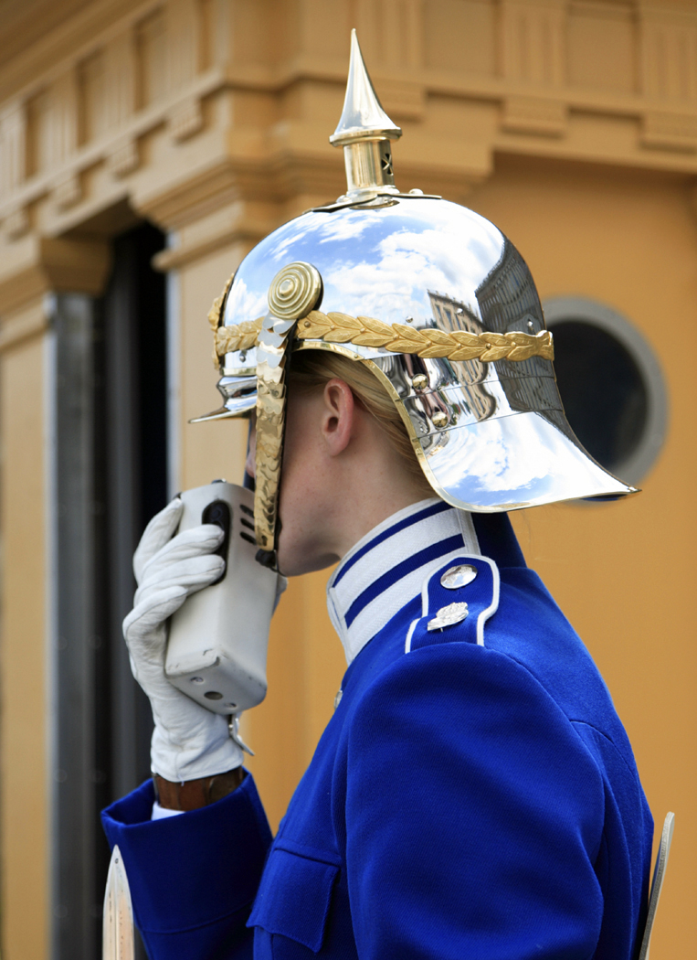

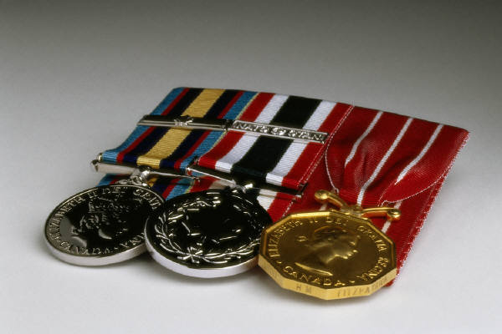

Slide 25

War cemetery. Lest we should dream that we may die in vain!

Slide 26
The Concept of Public Administration
Characteristics of public administration:
acting on behalf of the state or another public authority, to which the state has ceded a part of its power
administrative coercion – performing a function with the possibility of applying public power to enforce decisions
political nature in Poland e.g. when the government is dismissed, the governors of the provinces resign
acting on the basis and within the limits of law
(a rule applicable to individuals )
a continuous and stable operation
employing mainly professional personnel
(in particular a corps of civil servants)

Slide 27
The Concept of Public Administration
Political system
Law
Public
administration
Market
economy
Civil society (citizens)

Slide 28
Summary:
What is Public Administration
Public administration is what government does.
Public administration is both direct and indirect.
Public administration is a phase in the policy-making cycle.
Public administration is implementing the public interest.
Public administration is doing collectively that which cannot be done so well individually.
Because public administration is what a state does, it is both created and bound by an instrument of the law.
Public administration is the law in action.
Public administration is regulation.

Slide 29
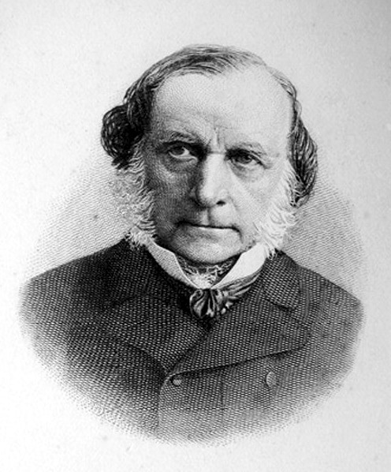
The Quote of the Day
German public administration scholar Stein,
the modern state
is an administrative state:
Administration
is what I cannot name.

