Slide 1
Lecture—5
Decision making in npo
Riffat abbas Rizvi
Lecturer
Strategic Planning
AND need Assessment

Slide 2

Change is inevitable by Heraclius of Greece in 535 B.C

Slide 3
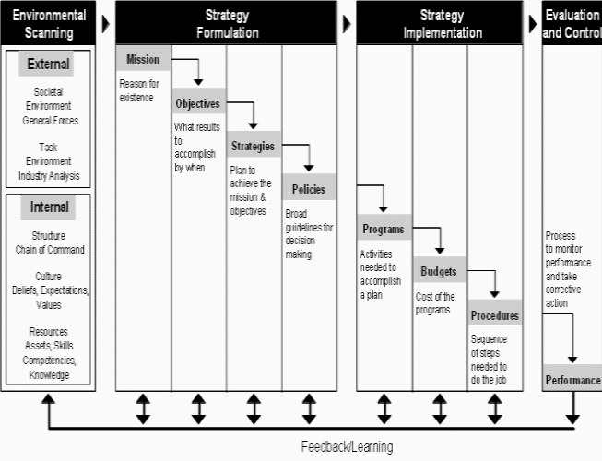

Slide 4
Sectors of The Country
Majorly, two sectors exist in the country; Development sector and Commercial.
Development sector invests for the betterment of the Society.
Commercial sector invests for the sake of earning profits or revenue.

Slide 5
Project
Temporary endeavors undertaken to create product, service or result.
They are not permanent like operations of non profit sector organizations.

Slide 6

Why Project Management
Every social organization – whether working on service delivery or process issue, undertakes projects. Projects come in many forms and can range from the very simple to the very complex. Every project is unique and presents unique challenges. Project Management is essential to manage projects.
Notes:
6

Slide 7
Examples of Project Oriented Industries
NASA and DOD (Department of Defense)
Construction, architecture, new product development
NGOs
Financial/Service Institutions
Banks, Insurance, Telecommunication
Manufacturing Units and Plants’ operation
7

Slide 8
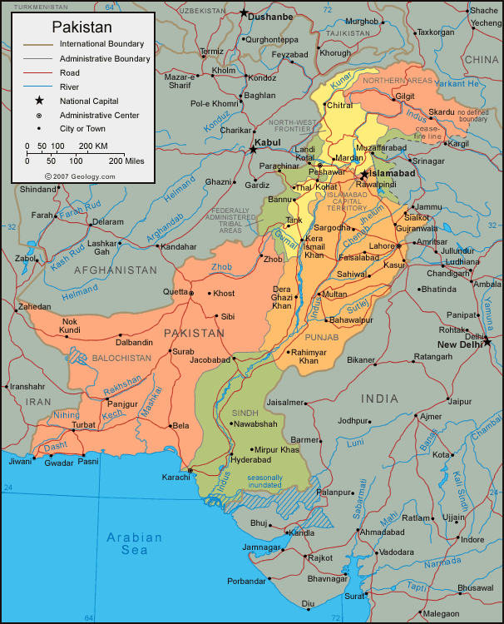


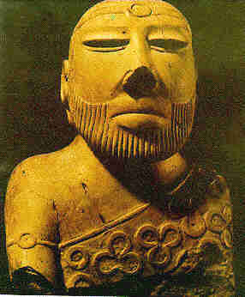





Examples of Major Projects in Pakistan
Tarbela Dam
Mangla Dam
Ghazi-Barotha
HUBCO
Jinnah International Airport
Allama Iqbal International Airport
Muslim Commercial Bank
National Stadium Karachi
Shah Faisal Mosque
Shaukat Khanum Memorial Hospital
JF-17 Sino-Pakistan Combat Aircraft
Notes:
8

Slide 9
Examples of Social Sector Projects in Pakistan
Voter Education Project
Constituency Relations Group
Tobacco Free Initiative
Polio Eradication Program
Family Planning Project
Governance Monitoring
Khuda Ki Basti
Orangi Pilot Project
Clean Drinking Water Project
Awaz
Youth Parliament
Diya
Iodine Use
Notes:
9

Slide 10
What is a Project ?
Need/ Scope / Requirement
Quality
Budget / Cost
Time / Schedule
10

Slide 11
Project Management
Application of knowledge, skills, tool and techniques to the project environment to satisfy the stakeholder needs or expectations.

Slide 12
What Projects Are Not?
Projects must not be confused with an organization‘s on-going and recurring operations.
For example:
Routine procurement, administration and other operations
Routine meetings of governing bodies of organizations
Ongoing industrial manufacturing
Airline flights
Bank and stock operatoins
Routine hospital services and operations
War
are not projects even though they may exhibit project characteris-tics (goal, time-frame, cost).
Notes:
12

Slide 13
What is a Program?
Program
  More than one project that aims to contribute to a common goal consistent with vision and mission statement of the implementers
  A group of projects managed in a coordinated way to obtain benefits not available from managing them individually
  A project results in the creation of a set of results that outlive the project life although the project stands closed at a defined point in time.
  A program must integrate and maintain the operationality of expected result for a specified period of time.
Project A
Program
X
Project D
Project B
Project E
Project C
Project F
13

Slide 14
Project Structure
Portfolio
Program
Project
Project
Project
Sub Project
14

Slide 15
Project Output & Outcome: Example
Project Phase
Project Output
Project Life-Cycle
Concieving, Initiation, Planning, Implementation and Closure of the Project
Short-term
Economic – Impact on investment, trade, local businesses, tourism, inflation, employment,, wealth accumulation and distribution
Medium-term
Selected
Project Outcomes
(+ and -)
Long-term
Environmental – Impact on fauna and flora, pollution levels, depletion of natural resources, waste accumulation and disposal
Social – Impact on services like democracy, governance, interfaith harmony, community capacity building, health and education, crime, social relations, communities‘ out-look and values
Notes:
Slide: „.....“
There may be benefits in other areas (for e.g. political) also which are not reviewed here.
15

Slide 16
Project consist of Process groups and knowledge areas and their relationship
Five Process Groups
Initiating
Planning
Executing
Monitoring and control
Closing

Slide 17
9 Knowledge areas
Project Integration Management
Project Scope Management
Project Time Management
Project Cost Management
Project Quality Management
Project Human Resource Management
Project Communication Management
Project Risk Management
Project Procurement Management

Slide 18
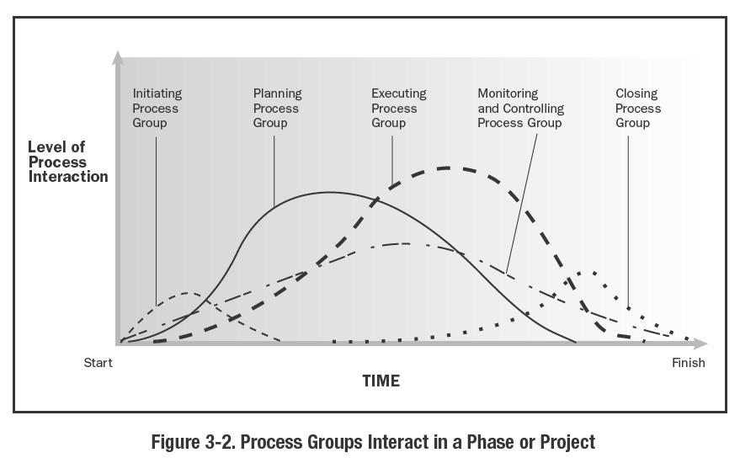

Slide 19

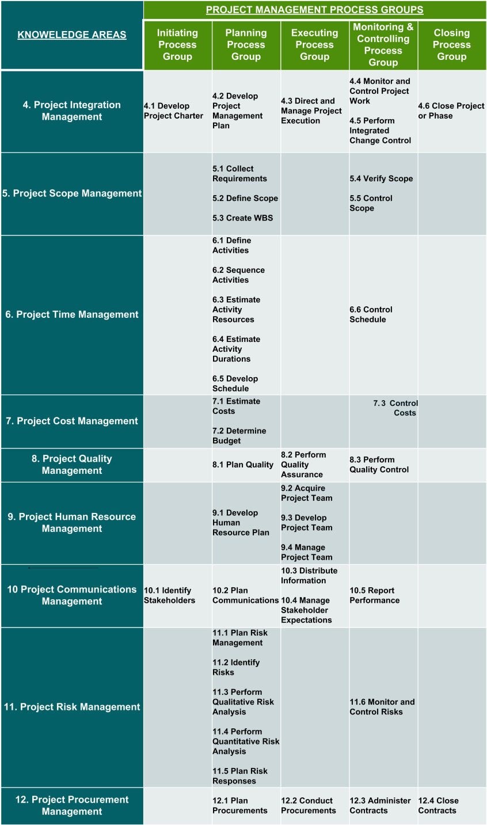
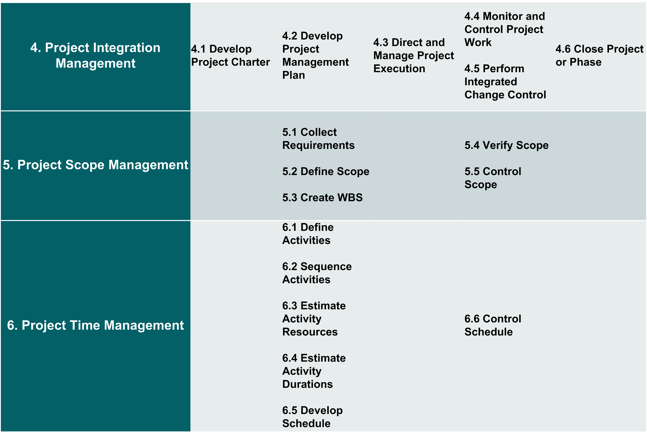
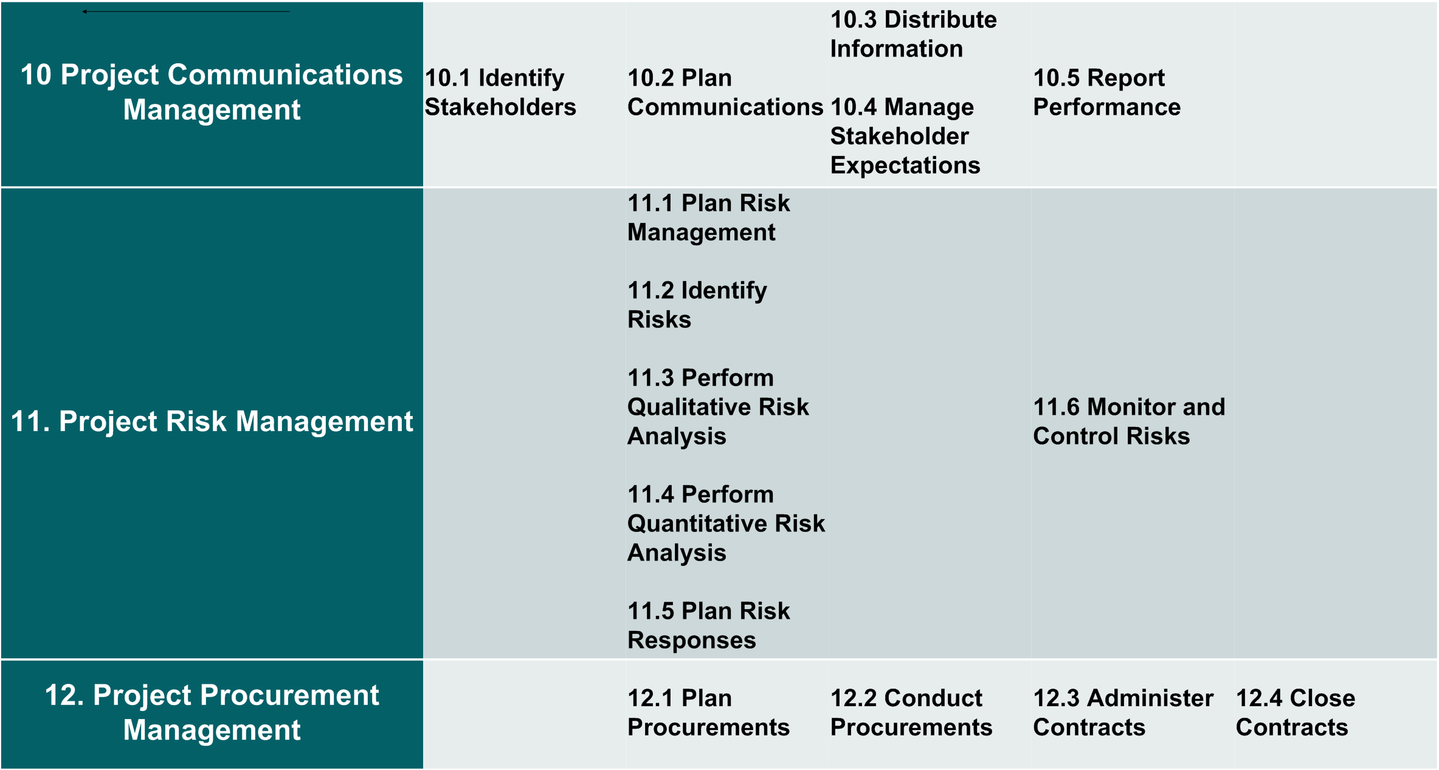
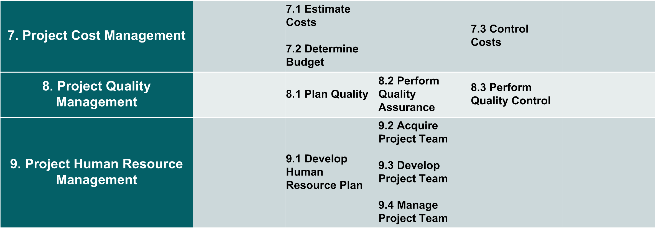

Slide 20
2
2
Collect Requirements
Scope
Planning
Process 5.1
Process of defining and documenting stakeholders’ needs to meet the project objectives.
5.1
Inputs
1
Tools and Techniques
2
Outputs
3
Project Charter
Stakeholder Register
____________
Interviews
Focus Groups
Facilitated Workshops
Group Creativity Techniques
Group Decision Making Techniques
Questionnaires and Surveys
Observations
Prototypes
____________
Requirements Documentation
Requirements Management Plan
Requirements Traceability Matrix
____________
Reference: Figure 5.2.
PMBOK® Guide, 4th Ed
Notes:
Picture with three text columns
(Intermediate)
To reproduce the picture effects on this slide, do the following:
On the Home tab, in the Slides group, click Layout, and then click Blank.
On the Insert tab, in the Illustrations group, click Picture.
In the Insert Picture dialog box, select a picture and then click Insert.
Select the picture. Under Picture Tools, on the Format tab, in the bottom right corner of the Size group, click the Size and Position dialog box launcher.
In the Size and Position dialog box, on the Size tab, resize or crop the picture as needed so that under Size and rotate, the Height box is set to 1.48” and the Width box is set to 9.17”. Resize the picture under Size and rotate by entering values into the Height and Width boxes. Crop the picture under Crop from by entering values into the Left, Right, Top, and Bottom boxes.
On the Home tab, in the bottom right corner of the Drawing group, click the Format Shape dialog box launcher. In the Format Shape dialog box, click Line Color in the left pane, select Gradient line in the right pane, and then do the following:
In the Type list, select Linear.
Click the button next to Direction, and then click Linear Up (second row, second option from the left).
Under Gradient stops, click Add or Remove until two stops appear in the drop-down list.
Also under Gradient stops, customize the gradient stops that you added as follows:
Select Stop 1 from the list, and then do the following:
In the Stop position box, enter 0%.
Click the button next to Color, and then under Theme Colors click White, Background 1 (first row, first option from the left).
Select Stop 2 from the list, and then do the following:
In the Stop position box, enter 100%.
Click the button next to Color, and then under Theme Colors click White, Background 1, Darker 25% (fourth row, first option from the left).
Also in the Format Shape dialog box, click Line Style in the left pane, and then in the right pane, in the Width box, enter 1 pt.
On the Home tab, in the Drawing group, click Shape Effects, point to Glow, and then do the following:
Under Glow Variations, select any option in the first row (5 pt glow options).
Point to More Glow Colors, and then under Theme Colors click White, Background 1, Darker 25% (fourth row, first option from the left).
On the Home tab, in the Drawing group, click Arrange, point to Align, and then click Align Center.
To reproduce the first column heading on this slide, do the following:
On the Home tab, in the Drawing group, click Shapes, and then under Rectangles, click Rectangle (first option from the left). On the slide, drag to draw a rectangle.
Under Drawing Tools, on the Format tab, in the Size group, do the following:
In the Shape Height box, enter 1”.
In the Shape Width box, enter 2.92”.
On the Home tab, in the bottom right corner of the Drawing group, click the Format Shape dialog box launcher. In the Format Shape dialog box, click Fill in the left pane, select Gradient fill in the right pane, and then do the following:
In the Type list, select Linear.
Click the button next to Direction, and then click Linear Down (first row, second option from the left).
Under Gradient stops, click Add or Remove until two stops appear in the drop-down list.
Also under Gradient stops, customize the gradient stops that you added as follows:
Select Stop 1 from the list, and then do the following:
In the Stop position box, enter 32%.
Click the button next to Color, and then under Theme Colors click Tan, Background 2 (first row, third option from the left).
Select Stop 2 from the list, and then do the following:
In the Stop position box, enter 100%.
Click the button next to Color, and then under Theme Colors click Tan, Background 2, Darker 25% (third row, third option from the left).
Also in the Format Shape dialog box, click Line Color in the left pane, select Gradient line in the Line Color pane, and then do the following:
In the Type list, select Linear.
Click the button next to Direction, and then click Linear Up (second row, second option from the left).
Under Gradient stops, click Add or Remove until two stops appear in the drop-down list.
Also under Gradient stops, customize the gradient stops that you added as follows:
Select Stop 1 from the list, and then do the following:
In the Stop position box, enter 0%.
Click the button next to Color, and then under Theme Colors click White, Background 1 (first row, first option from the left).
Select Stop 2 from the list, and then do the following:
In the Stop position box, enter 100%.
Click the button next to Color, and then under Theme Colors click White, Background 1, Darker 25% (fourth row, first option from the left).
Also in the Format Shape dialog box, click Line Style in the left pane. In the right pane, in the Width box, enter 1 pt.
On the Home tab, in the Drawing group, click Shape Effects, point to Glow, and then do the following:
Under Glow Variations, select any option in the first row (5 pt glow options).
Point to More Glow Colors, and then under Theme Colors click White, Background 1, Darker 25% (fourth row, first option from the left).
On the slide, right-click the rectangle and then click Edit Text.
Enter text in the text box and select the text. On the Home tab, in the Font group, select Gill Sans MT from the Font list and then select 24 from the Font Size list.
On the Home tab, in the Paragraph group, click Align Text Left to align the text left within the text box.
Under Drawing Tools, on the Format tab, in the WordArt Styles group, click the arrow next to Text Fill, and then under Theme Colors click Tan, Background 2, Darker 75% (fifth row, third option from the left).
On the Home tab, in the bottom-right corner of the Drawing group, click the Format Shapes dialog box launcher. In the Format Shapes dialog box, click Text Box in the left pane. In the right pane, under Internal margin, enter 1” in the Left box to increase the left margin in the rectangle to accommodate the embossed number.
On the Home tab, in the Drawing group, click Shapes, and then under Lines, click Line (first option from the left).
Press and hold SHIFT, and then on the slide, drag to draw a straight, vertical line.
Under Drawing Tools, on the Format tab, in the Size group, in the Width box, enter 0.75”.
On the Home tab, in the bottom-right corner of the Drawing group, click the Format Shapes dialog box launcher. In the Format Shapes dialog box, click Line Style in the left pane, and then do the following in the right pane:
In the Width box, enter 2.25 pt.
Click the button next to Dash type, and then click Round Dot (second option from the top).
Also in the Format Shapes dialog box, click Line Color in the left pane. In the right pane, click the button next to Color, and then under Theme Colors click White, Background 1 (first row, first option from the left).
On the slide, drag the line onto the rectangle, just left of the text box.
On the Insert tab, in the Text box, click Text Box and then on the slide, drag to draw another text box.
Enter 1 in the text box and select the text. On the Home tab, in the Font group, select Calisto MT from the Font list and then enter 50 in the Font Size box.
On the Home tab, in the Paragraph group, click Center to center the text within the text box.
Under Drawing Tools, on the Format tab, in the WordArt Styles group, click the arrow next to Text Fill, and then under Theme Colors click Tan, Background 2, Darker 25% (third row, third option from the left).
Drag the text box onto the rectangle, left of the dotted vertical line.
On the Home tab, in the Editing group, click Select, and then click Selection Pane.
In the Selection and Visibility pane, press and hold CTRL to select the text box, line, and rectangle.
On the Home tab, in the Drawing group, click Arrange, point to Align, and then click Align Middle.
To reproduce the other column headings on this slide, do the following:
On the Home tab, in the Editing group, click Select, and then click Selection Pane.
In the Selection and Visibility pane, press and hold CTRL to select the text box, line, and rectangle.
On the Home tab, in the Drawing group, click Arrange, and then under Group Objects click Group.
On the Home tab, in the Clipboard group, click the arrow under Paste, and then click Duplicate. Repeat the process until you have a total of three groups of shapes.
Select each group in the Selection and Visibility pane and drag it on the slide to form a row under the picture.
Also in the Selection and Visibility pane, press and hold CTRL and select all three groups. On the Home tab, in the Drawing group, click Arrange, point to Align, and then do the following:
Click Align Middle.
Click Distribute Horizontally.
To change the numbers in the duplicate text boxes (second and third from the left), click in each text box and edit the text.
To reproduce the first column (the “subtext” portion) on this slide, do the following:
On the Home tab, in the Drawing group, click Shapes, and then under Rectangles click Rectangle (first option from the left).
On the slide, drag to draw the rectangle so that the top edge is just below the first column heading and the bottom edge is at the bottom of the slide.
Under Drawing Tools, on the Format tab, in the Size group, in the Shape Width box, enter 2.92” so that the subtext column is the same width as the column heading above it.
On the Home tab, in the Drawing group, click the arrow next to Shape Outline, and then click No Outline.
On the Home tab, in the bottom right corner of the Drawing group, click the Format Shape dialog box launcher. In the Format Shape dialog box, click Fill in the left pane, select Gradient fill in the right pane, and then do the following:
In the Type list, select Linear.
Click the button next to Direction, and then click Linear Down (first row, second option from the left).
Under Gradient stops, click Add or Remove until three stops appear in the drop-down list.
Also under Gradient stops, customize the gradient stops that you added as follows:
Select Stop 1 from the list, and then do the following:
In the Stop position box, enter 0%.
Click the button next to Color, and then under Theme Colors click White, Background 1 (first row, first option from the left).
In the Transparency box, enter 100%.
Select Stop 2 from the list, and then do the following:
In the Stop position box, enter 50%.
Click the button next to Color, and then under Theme Colors click Tan, Background 2, Darker 25% (third row, third option from the left).
In the Transparency box, enter 25%.
Select Stop 3 from the list, and then do the following:
In the Stop position box, enter 100%.
Click the button next to Color, and then under Theme Colors click White, Background 1 (first row, first option from the left).
In the Transparency box, enter 100%.
On the slide, right-click the column and then click Edit Text.
Enter text in the text box and select the text. On the Home tab, in the Font group, select Gill Sans MT from the Font list and then enter 22 in the Font Size box.
On the Home tab, in the Paragraph group, click Center to center the text within the rectangle.
Under Drawing Tools, on the Format tab, in the WordArt Styles group, click the arrow next to Text Fill, and then under Theme Colors click White, Background 1, Darker 50% (sixth row, first option from the left).
On the Home tab, in the bottom-right corner of the Drawing group, click the Format Shapes dialog box launcher. In the Format Shapes dialog box, click Text Box in the left pane. In the right pane, under Text layout, in the Vertical Alignment list, select Top.
To reproduce the other columns (the “subtext” portion) on this slide, do the following:
Select the first “subtext” rectangle. On the Home tab, in the Clipboard group, click the arrow under Paste, and then click Duplicate. Repeat the process until you have a total of three “subtext” rectangles.
Drag each duplicate on the slide to form a row under the “text heading” rectangles.
Press and hold SHIFT and select all three “subtext” rectangles. On the Home tab, in the Drawing group, click Arrange, point to Align, and then click Distribute Horizontally.
To reproduce the background on this slide, do the following:
Right-click the slide background area, and then click Format Background. In the Format Background dialog box, click Fill in the left pane, select Gradient fill in the right pane, and then do the following:
In the Type list, select Radial.
Click the button next to Direction, and then click From Center (third option from the left).
Under Gradient stops, click Add or Remove until two stops appear in the drop-down list.
Also under Gradient stops, customize the gradient stops that you added as follows:
Select Stop 1 from the list, and then do the following:
In the Stop position box, enter 0%.
Click the button next to Color, and then under Theme Colors click White, Background 1 (first row, first option from the left).
Select Stop 2 from the list, and then do the following:
In the Stop position box, enter 100%.
Click the button next to Color, and then under Theme Colors click Tan, Background 2 (first row, third option from the left).

Slide 21
2
2
Define Scope
Scope
Planning
Process 5.2
Process of developing a detailed description of the project and product.
5.2
Inputs
1
Tools and Techniques
2
Outputs
3
Project Charter
Requirements Documentation
Organizational Process Assets
____________
Expert Judgment
Product Analysis
Alternatives Identification
Facilitated Workshops
____________
Project Scope Statement
Project Document Updates
____________
Reference: Figure 5.4.
PMBOK® Guide, 4th Ed
Notes:
Picture with three text columns
(Intermediate)
To reproduce the picture effects on this slide, do the following:
On the Home tab, in the Slides group, click Layout, and then click Blank.
On the Insert tab, in the Illustrations group, click Picture.
In the Insert Picture dialog box, select a picture and then click Insert.
Select the picture. Under Picture Tools, on the Format tab, in the bottom right corner of the Size group, click the Size and Position dialog box launcher.
In the Size and Position dialog box, on the Size tab, resize or crop the picture as needed so that under Size and rotate, the Height box is set to 1.48” and the Width box is set to 9.17”. Resize the picture under Size and rotate by entering values into the Height and Width boxes. Crop the picture under Crop from by entering values into the Left, Right, Top, and Bottom boxes.
On the Home tab, in the bottom right corner of the Drawing group, click the Format Shape dialog box launcher. In the Format Shape dialog box, click Line Color in the left pane, select Gradient line in the right pane, and then do the following:
In the Type list, select Linear.
Click the button next to Direction, and then click Linear Up (second row, second option from the left).
Under Gradient stops, click Add or Remove until two stops appear in the drop-down list.
Also under Gradient stops, customize the gradient stops that you added as follows:
Select Stop 1 from the list, and then do the following:
In the Stop position box, enter 0%.
Click the button next to Color, and then under Theme Colors click White, Background 1 (first row, first option from the left).
Select Stop 2 from the list, and then do the following:
In the Stop position box, enter 100%.
Click the button next to Color, and then under Theme Colors click White, Background 1, Darker 25% (fourth row, first option from the left).
Also in the Format Shape dialog box, click Line Style in the left pane, and then in the right pane, in the Width box, enter 1 pt.
On the Home tab, in the Drawing group, click Shape Effects, point to Glow, and then do the following:
Under Glow Variations, select any option in the first row (5 pt glow options).
Point to More Glow Colors, and then under Theme Colors click White, Background 1, Darker 25% (fourth row, first option from the left).
On the Home tab, in the Drawing group, click Arrange, point to Align, and then click Align Center.
To reproduce the first column heading on this slide, do the following:
On the Home tab, in the Drawing group, click Shapes, and then under Rectangles, click Rectangle (first option from the left). On the slide, drag to draw a rectangle.
Under Drawing Tools, on the Format tab, in the Size group, do the following:
In the Shape Height box, enter 1”.
In the Shape Width box, enter 2.92”.
On the Home tab, in the bottom right corner of the Drawing group, click the Format Shape dialog box launcher. In the Format Shape dialog box, click Fill in the left pane, select Gradient fill in the right pane, and then do the following:
In the Type list, select Linear.
Click the button next to Direction, and then click Linear Down (first row, second option from the left).
Under Gradient stops, click Add or Remove until two stops appear in the drop-down list.
Also under Gradient stops, customize the gradient stops that you added as follows:
Select Stop 1 from the list, and then do the following:
In the Stop position box, enter 32%.
Click the button next to Color, and then under Theme Colors click Tan, Background 2 (first row, third option from the left).
Select Stop 2 from the list, and then do the following:
In the Stop position box, enter 100%.
Click the button next to Color, and then under Theme Colors click Tan, Background 2, Darker 25% (third row, third option from the left).
Also in the Format Shape dialog box, click Line Color in the left pane, select Gradient line in the Line Color pane, and then do the following:
In the Type list, select Linear.
Click the button next to Direction, and then click Linear Up (second row, second option from the left).
Under Gradient stops, click Add or Remove until two stops appear in the drop-down list.
Also under Gradient stops, customize the gradient stops that you added as follows:
Select Stop 1 from the list, and then do the following:
In the Stop position box, enter 0%.
Click the button next to Color, and then under Theme Colors click White, Background 1 (first row, first option from the left).
Select Stop 2 from the list, and then do the following:
In the Stop position box, enter 100%.
Click the button next to Color, and then under Theme Colors click White, Background 1, Darker 25% (fourth row, first option from the left).
Also in the Format Shape dialog box, click Line Style in the left pane. In the right pane, in the Width box, enter 1 pt.
On the Home tab, in the Drawing group, click Shape Effects, point to Glow, and then do the following:
Under Glow Variations, select any option in the first row (5 pt glow options).
Point to More Glow Colors, and then under Theme Colors click White, Background 1, Darker 25% (fourth row, first option from the left).
On the slide, right-click the rectangle and then click Edit Text.
Enter text in the text box and select the text. On the Home tab, in the Font group, select Gill Sans MT from the Font list and then select 24 from the Font Size list.
On the Home tab, in the Paragraph group, click Align Text Left to align the text left within the text box.
Under Drawing Tools, on the Format tab, in the WordArt Styles group, click the arrow next to Text Fill, and then under Theme Colors click Tan, Background 2, Darker 75% (fifth row, third option from the left).
On the Home tab, in the bottom-right corner of the Drawing group, click the Format Shapes dialog box launcher. In the Format Shapes dialog box, click Text Box in the left pane. In the right pane, under Internal margin, enter 1” in the Left box to increase the left margin in the rectangle to accommodate the embossed number.
On the Home tab, in the Drawing group, click Shapes, and then under Lines, click Line (first option from the left).
Press and hold SHIFT, and then on the slide, drag to draw a straight, vertical line.
Under Drawing Tools, on the Format tab, in the Size group, in the Width box, enter 0.75”.
On the Home tab, in the bottom-right corner of the Drawing group, click the Format Shapes dialog box launcher. In the Format Shapes dialog box, click Line Style in the left pane, and then do the following in the right pane:
In the Width box, enter 2.25 pt.
Click the button next to Dash type, and then click Round Dot (second option from the top).
Also in the Format Shapes dialog box, click Line Color in the left pane. In the right pane, click the button next to Color, and then under Theme Colors click White, Background 1 (first row, first option from the left).
On the slide, drag the line onto the rectangle, just left of the text box.
On the Insert tab, in the Text box, click Text Box and then on the slide, drag to draw another text box.
Enter 1 in the text box and select the text. On the Home tab, in the Font group, select Calisto MT from the Font list and then enter 50 in the Font Size box.
On the Home tab, in the Paragraph group, click Center to center the text within the text box.
Under Drawing Tools, on the Format tab, in the WordArt Styles group, click the arrow next to Text Fill, and then under Theme Colors click Tan, Background 2, Darker 25% (third row, third option from the left).
Drag the text box onto the rectangle, left of the dotted vertical line.
On the Home tab, in the Editing group, click Select, and then click Selection Pane.
In the Selection and Visibility pane, press and hold CTRL to select the text box, line, and rectangle.
On the Home tab, in the Drawing group, click Arrange, point to Align, and then click Align Middle.
To reproduce the other column headings on this slide, do the following:
On the Home tab, in the Editing group, click Select, and then click Selection Pane.
In the Selection and Visibility pane, press and hold CTRL to select the text box, line, and rectangle.
On the Home tab, in the Drawing group, click Arrange, and then under Group Objects click Group.
On the Home tab, in the Clipboard group, click the arrow under Paste, and then click Duplicate. Repeat the process until you have a total of three groups of shapes.
Select each group in the Selection and Visibility pane and drag it on the slide to form a row under the picture.
Also in the Selection and Visibility pane, press and hold CTRL and select all three groups. On the Home tab, in the Drawing group, click Arrange, point to Align, and then do the following:
Click Align Middle.
Click Distribute Horizontally.
To change the numbers in the duplicate text boxes (second and third from the left), click in each text box and edit the text.
To reproduce the first column (the “subtext” portion) on this slide, do the following:
On the Home tab, in the Drawing group, click Shapes, and then under Rectangles click Rectangle (first option from the left).
On the slide, drag to draw the rectangle so that the top edge is just below the first column heading and the bottom edge is at the bottom of the slide.
Under Drawing Tools, on the Format tab, in the Size group, in the Shape Width box, enter 2.92” so that the subtext column is the same width as the column heading above it.
On the Home tab, in the Drawing group, click the arrow next to Shape Outline, and then click No Outline.
On the Home tab, in the bottom right corner of the Drawing group, click the Format Shape dialog box launcher. In the Format Shape dialog box, click Fill in the left pane, select Gradient fill in the right pane, and then do the following:
In the Type list, select Linear.
Click the button next to Direction, and then click Linear Down (first row, second option from the left).
Under Gradient stops, click Add or Remove until three stops appear in the drop-down list.
Also under Gradient stops, customize the gradient stops that you added as follows:
Select Stop 1 from the list, and then do the following:
In the Stop position box, enter 0%.
Click the button next to Color, and then under Theme Colors click White, Background 1 (first row, first option from the left).
In the Transparency box, enter 100%.
Select Stop 2 from the list, and then do the following:
In the Stop position box, enter 50%.
Click the button next to Color, and then under Theme Colors click Tan, Background 2, Darker 25% (third row, third option from the left).
In the Transparency box, enter 25%.
Select Stop 3 from the list, and then do the following:
In the Stop position box, enter 100%.
Click the button next to Color, and then under Theme Colors click White, Background 1 (first row, first option from the left).
In the Transparency box, enter 100%.
On the slide, right-click the column and then click Edit Text.
Enter text in the text box and select the text. On the Home tab, in the Font group, select Gill Sans MT from the Font list and then enter 22 in the Font Size box.
On the Home tab, in the Paragraph group, click Center to center the text within the rectangle.
Under Drawing Tools, on the Format tab, in the WordArt Styles group, click the arrow next to Text Fill, and then under Theme Colors click White, Background 1, Darker 50% (sixth row, first option from the left).
On the Home tab, in the bottom-right corner of the Drawing group, click the Format Shapes dialog box launcher. In the Format Shapes dialog box, click Text Box in the left pane. In the right pane, under Text layout, in the Vertical Alignment list, select Top.
To reproduce the other columns (the “subtext” portion) on this slide, do the following:
Select the first “subtext” rectangle. On the Home tab, in the Clipboard group, click the arrow under Paste, and then click Duplicate. Repeat the process until you have a total of three “subtext” rectangles.
Drag each duplicate on the slide to form a row under the “text heading” rectangles.
Press and hold SHIFT and select all three “subtext” rectangles. On the Home tab, in the Drawing group, click Arrange, point to Align, and then click Distribute Horizontally.
To reproduce the background on this slide, do the following:
Right-click the slide background area, and then click Format Background. In the Format Background dialog box, click Fill in the left pane, select Gradient fill in the right pane, and then do the following:
In the Type list, select Radial.
Click the button next to Direction, and then click From Center (third option from the left).
Under Gradient stops, click Add or Remove until two stops appear in the drop-down list.
Also under Gradient stops, customize the gradient stops that you added as follows:
Select Stop 1 from the list, and then do the following:
In the Stop position box, enter 0%.
Click the button next to Color, and then under Theme Colors click White, Background 1 (first row, first option from the left).
Select Stop 2 from the list, and then do the following:
In the Stop position box, enter 100%.
Click the button next to Color, and then under Theme Colors click Tan, Background 2 (first row, third option from the left).

Slide 22
2
2
Create WBS
Scope
Planning
Process 5.3
Process of subdividing project deliverables and project work into smaller, more manageable components.
5.3
Inputs
1
Tools and Techniques
2
Outputs
3
Project Scope Statement
Requirements Documentation
Organizational Process Assets
____________
Decomposition
____________
WBS
WBS Dictionary
Scope Baseline
Project Document Updates
____________
Reference: Figure 5.6.
PMBOK® Guide, 4th Ed
Notes:
Picture with three text columns
(Intermediate)
To reproduce the picture effects on this slide, do the following:
On the Home tab, in the Slides group, click Layout, and then click Blank.
On the Insert tab, in the Illustrations group, click Picture.
In the Insert Picture dialog box, select a picture and then click Insert.
Select the picture. Under Picture Tools, on the Format tab, in the bottom right corner of the Size group, click the Size and Position dialog box launcher.
In the Size and Position dialog box, on the Size tab, resize or crop the picture as needed so that under Size and rotate, the Height box is set to 1.48” and the Width box is set to 9.17”. Resize the picture under Size and rotate by entering values into the Height and Width boxes. Crop the picture under Crop from by entering values into the Left, Right, Top, and Bottom boxes.
On the Home tab, in the bottom right corner of the Drawing group, click the Format Shape dialog box launcher. In the Format Shape dialog box, click Line Color in the left pane, select Gradient line in the right pane, and then do the following:
In the Type list, select Linear.
Click the button next to Direction, and then click Linear Up (second row, second option from the left).
Under Gradient stops, click Add or Remove until two stops appear in the drop-down list.
Also under Gradient stops, customize the gradient stops that you added as follows:
Select Stop 1 from the list, and then do the following:
In the Stop position box, enter 0%.
Click the button next to Color, and then under Theme Colors click White, Background 1 (first row, first option from the left).
Select Stop 2 from the list, and then do the following:
In the Stop position box, enter 100%.
Click the button next to Color, and then under Theme Colors click White, Background 1, Darker 25% (fourth row, first option from the left).
Also in the Format Shape dialog box, click Line Style in the left pane, and then in the right pane, in the Width box, enter 1 pt.
On the Home tab, in the Drawing group, click Shape Effects, point to Glow, and then do the following:
Under Glow Variations, select any option in the first row (5 pt glow options).
Point to More Glow Colors, and then under Theme Colors click White, Background 1, Darker 25% (fourth row, first option from the left).
On the Home tab, in the Drawing group, click Arrange, point to Align, and then click Align Center.
To reproduce the first column heading on this slide, do the following:
On the Home tab, in the Drawing group, click Shapes, and then under Rectangles, click Rectangle (first option from the left). On the slide, drag to draw a rectangle.
Under Drawing Tools, on the Format tab, in the Size group, do the following:
In the Shape Height box, enter 1”.
In the Shape Width box, enter 2.92”.
On the Home tab, in the bottom right corner of the Drawing group, click the Format Shape dialog box launcher. In the Format Shape dialog box, click Fill in the left pane, select Gradient fill in the right pane, and then do the following:
In the Type list, select Linear.
Click the button next to Direction, and then click Linear Down (first row, second option from the left).
Under Gradient stops, click Add or Remove until two stops appear in the drop-down list.
Also under Gradient stops, customize the gradient stops that you added as follows:
Select Stop 1 from the list, and then do the following:
In the Stop position box, enter 32%.
Click the button next to Color, and then under Theme Colors click Tan, Background 2 (first row, third option from the left).
Select Stop 2 from the list, and then do the following:
In the Stop position box, enter 100%.
Click the button next to Color, and then under Theme Colors click Tan, Background 2, Darker 25% (third row, third option from the left).
Also in the Format Shape dialog box, click Line Color in the left pane, select Gradient line in the Line Color pane, and then do the following:
In the Type list, select Linear.
Click the button next to Direction, and then click Linear Up (second row, second option from the left).
Under Gradient stops, click Add or Remove until two stops appear in the drop-down list.
Also under Gradient stops, customize the gradient stops that you added as follows:
Select Stop 1 from the list, and then do the following:
In the Stop position box, enter 0%.
Click the button next to Color, and then under Theme Colors click White, Background 1 (first row, first option from the left).
Select Stop 2 from the list, and then do the following:
In the Stop position box, enter 100%.
Click the button next to Color, and then under Theme Colors click White, Background 1, Darker 25% (fourth row, first option from the left).
Also in the Format Shape dialog box, click Line Style in the left pane. In the right pane, in the Width box, enter 1 pt.
On the Home tab, in the Drawing group, click Shape Effects, point to Glow, and then do the following:
Under Glow Variations, select any option in the first row (5 pt glow options).
Point to More Glow Colors, and then under Theme Colors click White, Background 1, Darker 25% (fourth row, first option from the left).
On the slide, right-click the rectangle and then click Edit Text.
Enter text in the text box and select the text. On the Home tab, in the Font group, select Gill Sans MT from the Font list and then select 24 from the Font Size list.
On the Home tab, in the Paragraph group, click Align Text Left to align the text left within the text box.
Under Drawing Tools, on the Format tab, in the WordArt Styles group, click the arrow next to Text Fill, and then under Theme Colors click Tan, Background 2, Darker 75% (fifth row, third option from the left).
On the Home tab, in the bottom-right corner of the Drawing group, click the Format Shapes dialog box launcher. In the Format Shapes dialog box, click Text Box in the left pane. In the right pane, under Internal margin, enter 1” in the Left box to increase the left margin in the rectangle to accommodate the embossed number.
On the Home tab, in the Drawing group, click Shapes, and then under Lines, click Line (first option from the left).
Press and hold SHIFT, and then on the slide, drag to draw a straight, vertical line.
Under Drawing Tools, on the Format tab, in the Size group, in the Width box, enter 0.75”.
On the Home tab, in the bottom-right corner of the Drawing group, click the Format Shapes dialog box launcher. In the Format Shapes dialog box, click Line Style in the left pane, and then do the following in the right pane:
In the Width box, enter 2.25 pt.
Click the button next to Dash type, and then click Round Dot (second option from the top).
Also in the Format Shapes dialog box, click Line Color in the left pane. In the right pane, click the button next to Color, and then under Theme Colors click White, Background 1 (first row, first option from the left).
On the slide, drag the line onto the rectangle, just left of the text box.
On the Insert tab, in the Text box, click Text Box and then on the slide, drag to draw another text box.
Enter 1 in the text box and select the text. On the Home tab, in the Font group, select Calisto MT from the Font list and then enter 50 in the Font Size box.
On the Home tab, in the Paragraph group, click Center to center the text within the text box.
Under Drawing Tools, on the Format tab, in the WordArt Styles group, click the arrow next to Text Fill, and then under Theme Colors click Tan, Background 2, Darker 25% (third row, third option from the left).
Drag the text box onto the rectangle, left of the dotted vertical line.
On the Home tab, in the Editing group, click Select, and then click Selection Pane.
In the Selection and Visibility pane, press and hold CTRL to select the text box, line, and rectangle.
On the Home tab, in the Drawing group, click Arrange, point to Align, and then click Align Middle.
To reproduce the other column headings on this slide, do the following:
On the Home tab, in the Editing group, click Select, and then click Selection Pane.
In the Selection and Visibility pane, press and hold CTRL to select the text box, line, and rectangle.
On the Home tab, in the Drawing group, click Arrange, and then under Group Objects click Group.
On the Home tab, in the Clipboard group, click the arrow under Paste, and then click Duplicate. Repeat the process until you have a total of three groups of shapes.
Select each group in the Selection and Visibility pane and drag it on the slide to form a row under the picture.
Also in the Selection and Visibility pane, press and hold CTRL and select all three groups. On the Home tab, in the Drawing group, click Arrange, point to Align, and then do the following:
Click Align Middle.
Click Distribute Horizontally.
To change the numbers in the duplicate text boxes (second and third from the left), click in each text box and edit the text.
To reproduce the first column (the “subtext” portion) on this slide, do the following:
On the Home tab, in the Drawing group, click Shapes, and then under Rectangles click Rectangle (first option from the left).
On the slide, drag to draw the rectangle so that the top edge is just below the first column heading and the bottom edge is at the bottom of the slide.
Under Drawing Tools, on the Format tab, in the Size group, in the Shape Width box, enter 2.92” so that the subtext column is the same width as the column heading above it.
On the Home tab, in the Drawing group, click the arrow next to Shape Outline, and then click No Outline.
On the Home tab, in the bottom right corner of the Drawing group, click the Format Shape dialog box launcher. In the Format Shape dialog box, click Fill in the left pane, select Gradient fill in the right pane, and then do the following:
In the Type list, select Linear.
Click the button next to Direction, and then click Linear Down (first row, second option from the left).
Under Gradient stops, click Add or Remove until three stops appear in the drop-down list.
Also under Gradient stops, customize the gradient stops that you added as follows:
Select Stop 1 from the list, and then do the following:
In the Stop position box, enter 0%.
Click the button next to Color, and then under Theme Colors click White, Background 1 (first row, first option from the left).
In the Transparency box, enter 100%.
Select Stop 2 from the list, and then do the following:
In the Stop position box, enter 50%.
Click the button next to Color, and then under Theme Colors click Tan, Background 2, Darker 25% (third row, third option from the left).
In the Transparency box, enter 25%.
Select Stop 3 from the list, and then do the following:
In the Stop position box, enter 100%.
Click the button next to Color, and then under Theme Colors click White, Background 1 (first row, first option from the left).
In the Transparency box, enter 100%.
On the slide, right-click the column and then click Edit Text.
Enter text in the text box and select the text. On the Home tab, in the Font group, select Gill Sans MT from the Font list and then enter 22 in the Font Size box.
On the Home tab, in the Paragraph group, click Center to center the text within the rectangle.
Under Drawing Tools, on the Format tab, in the WordArt Styles group, click the arrow next to Text Fill, and then under Theme Colors click White, Background 1, Darker 50% (sixth row, first option from the left).
On the Home tab, in the bottom-right corner of the Drawing group, click the Format Shapes dialog box launcher. In the Format Shapes dialog box, click Text Box in the left pane. In the right pane, under Text layout, in the Vertical Alignment list, select Top.
To reproduce the other columns (the “subtext” portion) on this slide, do the following:
Select the first “subtext” rectangle. On the Home tab, in the Clipboard group, click the arrow under Paste, and then click Duplicate. Repeat the process until you have a total of three “subtext” rectangles.
Drag each duplicate on the slide to form a row under the “text heading” rectangles.
Press and hold SHIFT and select all three “subtext” rectangles. On the Home tab, in the Drawing group, click Arrange, point to Align, and then click Distribute Horizontally.
To reproduce the background on this slide, do the following:
Right-click the slide background area, and then click Format Background. In the Format Background dialog box, click Fill in the left pane, select Gradient fill in the right pane, and then do the following:
In the Type list, select Radial.
Click the button next to Direction, and then click From Center (third option from the left).
Under Gradient stops, click Add or Remove until two stops appear in the drop-down list.
Also under Gradient stops, customize the gradient stops that you added as follows:
Select Stop 1 from the list, and then do the following:
In the Stop position box, enter 0%.
Click the button next to Color, and then under Theme Colors click White, Background 1 (first row, first option from the left).
Select Stop 2 from the list, and then do the following:
In the Stop position box, enter 100%.
Click the button next to Color, and then under Theme Colors click Tan, Background 2 (first row, third option from the left).

Slide 23

Community need assessment
The goal of need assessment is to identify the assets of the community and determine potential concerns that it faces. The Straight forward way to estimate the needs of a community is to simply ask residents their opinions about the development of services within the community. Their satisfaction with services and what particular services are needed.

Slide 24

Planning and organizing phase
Information gathering
Learn About Organization and Programme
Identify goals and objectives for the need assessment.

Slide 25

Need assessment methodology
Getting ready
Developing a need assessment Survey
Creating a need assessment Survey

Slide 26
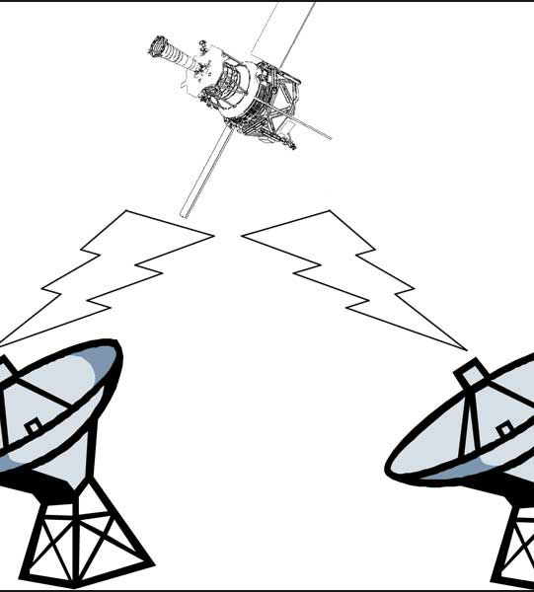
The need assessment survey data collection
Obtaining the representation of the community.
Providing incentives.
Flyers, Advertising the public forums.
Getting ready to conduct the survey.
Administering the door to door survey.

Slide 27
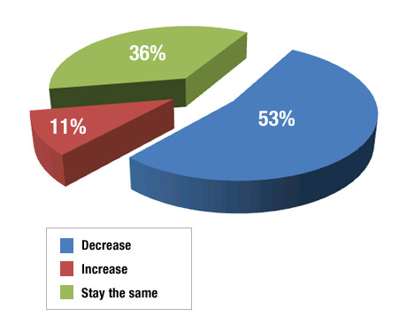
Summarizing and distributing the need assessment results
Summarizing the data on the public forums.
Writing the final report.

Slide 28

Community need assessment guide

Slide 29
Recap
Topic 1.3
PROJECT MANAGEMENT PROCESS GROUPS
Project Management Process Groups
Planning
Executing
PROJECT
Initiating
Monitoring and Control
Closing

Slide 30
What is Project Management?
Topic 1.3
PROJECT MANAGEMENT KNOWLEDGE AREAS
Integration
Scope
Procurement
Time
Risk
Cost
Human
Resource
Quality
Communication

Slide 31

Conclusion
In Development Sector Projects are designed keeping in view results of need assessment.
In order to develop community and fulfill the gaps identified after a need assessment. Projects and Programs are initiated to support marginalized communities.

Slide 32


