Slide 1
DECISION MAKING IN NPO SECTOR
Riffat Abbas Rizvi
Lecturer
Department of Management Sciences
Friday, October 04, 2013

Slide 2
Agenda
Preview of Last Lectures
Strategy
SWOT and PEST Analysis
Strategy Formulation
Strategy Implementation
Strategy Evaluation

Slide 3
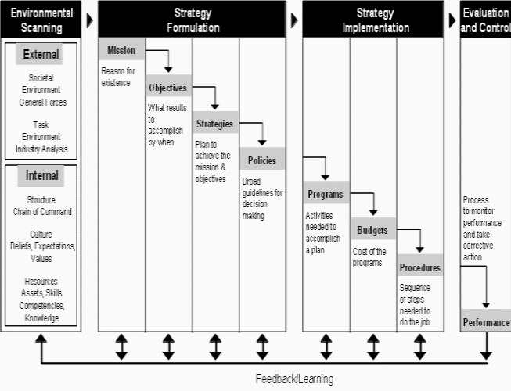

Slide 4
Lecture-3
Strategic Management Perspective-1
Strategy(Why it is Important)
Role of Strategy in NPO Sector

Slide 5
SWOT and Pest
Internal Environment
External Environment
SWOT Analysis

Slide 6
Articulating Vision and Mission
One thing that most people don’t know about organizational planning is that strategic planning is neither the first nor the most important step in the planning process. The highest step in the planning process is establishing a clear mission, articulating a vision of the future, followed by creating strategic plans to fulfill the mission and vision.

Slide 7
Strategy Formulation
Vision
- Guiding Philosophy
- Intangible Image
-World Vision:
For every child, life in all its fullness; Our prayer for every heart, the will to make it so

Slide 8
Vision Examples
Amnesty International: To undertake research and action focused on preventing and ending grave abuses of these rights.
Save the Children: Our vision is a world in which every child attains the right to survival, protection, development and participation.
WWF: We seek to save a planet, a world of life. Reconciling the needs of human beings and the needs of others that share the Earth…

Slide 9
Vision Examples
Special Olympics: To transform communities by inspiring people throughout the world to open their minds, accept and include people with intellectual disabilities an thereby anyone who is perceived as different.
Make-A-Wish: We grant the wishes of children with life-threatening medical conditions to enrich the human experience with hope, strength and joy.

Slide 10
Vision Examples
Oxfam: A just world without poverty.

Slide 11
Edhi’s Vision
Edhi's vision is to create an institution that will carry on his life's work and survive for a long time to come.
His dream is that of a Pakistan as a modern welfare state, which provides a safety net for the poor and needy while providing basic health and education with vocational skills.
A welfare state Edhi feels is the only way to tackle Pakistan’s myriad social problems. He hopes that one day; Pakistan will be a model for other developing countries

Slide 12
PAKISTAN SOCIETY FOR THE REHABILIATION OF THE DISABLED - PSRD
Vision
They SEEK a Society which:
RESPECTS and VALUES all those with disabilities.
LISTENS and LEARNS form them.
GIVES hope and opportunity to all handicapped people.

Slide 13
Difference between Vision and Mission
Mission is the purpose for which the organization exists. A mission statement tends to be a paragraph or less, and is frequently broadly cast, and not compelling. A typical mission statement of an association of traffic light painters might be, “To promote the art and science of traffic light painting, and improve the safety and welfare of motorists and maintenance workers on public roadways.”

Slide 14
Difference between Vision and Mission
Virtually every organization has a mission statement, and the majority of organizations have strategic plans. Most organizations do not have a clearly articulated vision.
Yet, strategic planning without a vision is like building flying machine without a clear picture of what the machine must do, or what it will look like. The organization drifts, frequently changes course, and may be consumed by personal agendas and petty political squabbles. Under such circumstances, the machine will never fly (achieve greatness) without major divine intervention.

Slide 15
Difference between Vision and Mission
Vision is an inspiring, long-term view of where the organization is headed.
A vision statement includes a brief articulation of (1) core values, (2) core purpose, (3) a huge goal, and (4) a vivid description of what it will be like to achieve the goal. Any interested person looking at the vision statement, which should be less than one page in length, should immediately be able to identify with it, and know whether they want to be part of it or not. Vision remains fixed for decades at a time; it does not change with environment or circumstances.

Slide 16
Vision
Vision and Mission both should be based on concept of rationality.
E.g., If we say we will finish poverty from the face of earth, then it is emotionally charged vision and kind of impossible.
Yes, if we say we will finish poverty from one village or tehsil then it looks rational vision.
President J. F Kennedy

Slide 17
Objectives
Specific
Measurable
Attainable
Realistic
Time-bound

Slide 18
Sectors of The Country
Majorly, two sectors exist in the country; Development sector and Commercial.
Development sector invests for the betterment of the Society.
Commercial sector invests for the sake of earning profits or revenue.

Slide 19
Strategy
  “The future just doesn’t happen. It’s shaped by decisions.”
  Paul Tafliabue, former commissioner
  National Football League

Slide 20
E.g., Formulation of Strategy
Vision: DELTA( Development, Economic, Legislative, Training Advocates) want to make 30 Cardiac hospitals in All over Pakistan by 2040.
Formulation of Strategy
Phase 1- 2013-2020(10 Cardiac Hospitals)
Phase 2-2020-2030(10 Cardiac Hospitals)
Phase 3- 2030-2040(10 Cardiac Hospitals)

Slide 21

Policies
Field Staff Policies
Administrative Policies

Slide 22
History of HR Manual
O ye who believe! When ye deal with each other, in transactions involving future obligations in a fixed period of time, reduce them to writing Let a scribe write down faithfully as between the parties: let not the scribe refuse to write: as Allah Has taught him, so let him write. Let him who incurs the liability dictate, but let him fear His Lord Allah, and not diminish aught of what he owes Al Quran [ Surah-Al-Baqarah ]
                Chapter No 2, Verse No 282

Slide 23
At-will employment statement policy
Employment Relationship can be terminated at any time with or without notice
Critical in defending against claims of wrongful termination

Slide 24
Right to revise statement
This Statement makes your employee handbook a legal document
Gives flexibility when your employee handbook needs to be changed

Slide 25
Equal employment opportunity
Federal and state laws require employers to communicate with employees about commitment to equal opportunity to every one
EEO ensures that all applicants and employees receive equal treatment without regard to race, color, religion, sex, age, disability, martial status etc.
Policy should also state that it prohibits harassment

Slide 26
Harassment Policy
Policy should state how to identify harassment & the company complaint process
A well written policy and follow through will help avoid these potential costs

Slide 27
Employment Benefit policy
Communicate the federal and state mandate benefits: worker’s compensation insurance, social security, state disability, unemployment insurance etc.
Communicate company sponsored benefits: Vacation/sick plans, holidays, health, insurance.

Slide 28
Employee conduct policy
Informs the employee what behavior is appropriate and the potential consequences for breaking company rules
Employee conduct policy may include: conflicts of interest, personal appearance, attendance and punctuality, drug and alcohol abuse, etc.
Helps protect employer against claims of unlawful disciplinary actions or discrimination

Slide 29
Employee Acknowledgement of receipt form
Acknowledges that employee understands everything in the employee handbook
Holds the employee accountable
Have employee sign and date and put in their personal file .

Slide 30
Common Contents of HR Manual
1. Recruitment Policy
2. Promotion Policy
3. Salary Policy
4. Job description, specification and Evaluation Policy
5. Leave Policy
6. Promotion Policy
7. Training Policy
8. Welfare Policy
9. Communication Policy
10. Environment Policy
11. Health And Safety Policy
12. Anti Harassment Or Abuse Policy

Slide 31
Recruitment Policy
How Recruitment will be done ?
What will be the criteria ?
How much time will be given for the recruitment procedure
What type of recruitment will it be ? ( Internal or External )

Slide 32
Health And Safety Policy
What health and safety standards will be followed in the organization
Emergency Evacuation procedure in case of emergency
What standard operating procedure will be followed in filed and in office

Slide 33
Environment Policy
What are the environmental aspects
Legal and other requirement
Environmental management program ( EMP )

Slide 34
Communication Policy
What will be the reporting method
The hierarchal design
Language of communication
Method of communication

Slide 35
Welfare Policy
Will the policy be based on Religion ?
Will the policy be based on Area ?

Slide 36
Leave Policy
Family and Illness Leave
Leave of Absence Without Pay
Personal Day
Leaves of Absence
Annual Leave
Sick Leave
Personal Leave
Bereavement Leave
Military Leave
Voting
Education Leaves of Absence With Pay / without pay
Family and Medical Leave Policy
Leaves of Absence Without Pay
Parental Leave Policy
Personal Leave
Committee Work
Return to Work After Disability
Short Term Disability
Sick Leave
Unemployment Insurance
Voting
Funeral Leave

Slide 37
Salary Policy
Grading / Pay Scales (Position, Skills, Experience, Education, Market Competitive )
Basic Salary
Allowances (Communication Allowances, Medical, Transportation etc
Increments
Bonuses
Gratuity
End of Service/ Terminal benefits

Slide 38
Job Description, Specification
Job Description is about the Job (Environment etc)
Requirements
Eligibility
Authority

Slide 39
Sexual Harassment Policy
Gender Harassment Includes any unwanted sexual advance, requests for sexual favors or other verbal or physical conduct of a sexual nature, causing interference with work performance, which is made a condition of employment.

Slide 40
Training Policy
Indoctrination
On Job Training
Internal / External
Job Enrichment
Class Room Training

Slide 41
Promotion Policy
Experience
Target
Performance
Appraisal
Opportunity

Slide 42
Operational Policy
Safety and Security of Field office and Staff
Security Meetings of NPOs

Slide 43
Conclusion
Vision with out Actions is a day dream
and
Actions without Vision is a nightmare.
(Japanese Proverb)

