Slide 1
Decision making in non profit sector
Lecture 32
MPA 505
Riffat Abbas Rizvi

Slide 2
agenda
Review from lecture 16 till lecture 32.

Slide 3
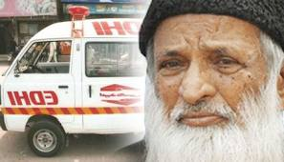
Leadership

Slide 4
What is leadership?
Leading people
Influencing people
Commanding people
Guiding people

Slide 5
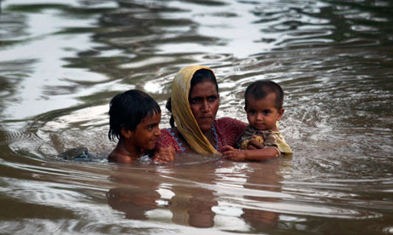
Confidence on leader

Slide 6
Types of Leaders
Leader by the position achieved
Leader by personality, charisma
Leader by moral example
Leader by power held
Intellectual leader
Leader because of ability to accomplish things

Slide 7
Managers vs. Leaders
Managers
Focus on things
Do things right
Plan
Organize
Direct
Control
Follows the rules
Leaders
Focus on people
Do the right things
Inspire
Influence
Motivate
Build
Shape entities

Slide 8
LEADERSHIP IN A NON FOR PROFIT WORLD (A MIXED TOOL BOX)
“Great leaders often inspire their followers to high levels of achievement by showing them how their work contributes to worthwhile ends. It is an emotional appeal to some of the most fundamental of human needs-the need to be important, to make a difference, to feel useful, to be a part of a successful and worthwhile enterprise.”Warren Bennis, Ph.D., Founding Chairman of the leadership Institute at the University of Southern California.

Slide 9
“Non Profits have to start acting like for-profit organizations.”
“They need to be more business like”
“Non Profits need to operate efficiently”
Experts in for-profit and non profit industries and businesses proclaim these mantras, and non profits today are paying attention.

Slide 10
Environmental organizations, cultural institutions, civic organizations, health care advocacy non profits, animal rights groups, senior centers:
The non-for-profit mission is usually pursued with passion and zeal.

Slide 11
(IRS) Recognition About NPOs
A non-for-profit organization recognized by the Internal Revenue Service(IRS) must have a clearly defined mission and financial controls.

Slide 12
IRS Eight broad missions
According to 501© Section of the tax code:
Religious
Educational
Charitable
Scientific
Literary
Testing for public safety
Fostering certain nation or international amateur sports competition
Prevention to cruelty to children or animals

Slide 13
IRS
IRS more states that if an organization wants to be tax exempt, it has to serve the purpose or mission to advance public welfare instead of a profit motive.

Slide 14
EFFECTIVE NON PROFIT LEADER
Effective non profit leaders know that there are many sides to running a successful organization.
Firstly, there should be clarity regarding the mission itself.
Then there are pressures to become more professionally managed, and to articulate and to achieve those bottom-line performance objectives.

Slide 15
Why this is done both ways?
Because of a shift in context of demand for services, changing operating environments and frequent financial pressures.

Slide 16
Need
Non profit leaders recognize the need of strategic management perspective for translating their missions into objectives, developing plan and programs to accomplish their objectives and implementing those plans or programs.

Slide 17
Balance between Mission and Passion
There should be a balance between the mission and passion that drive non profit sector organizations and the effective and efficient management and operations may be the single most important factor for success.

Slide 18
Strong Leadership
Achieving the delicate balance between the efficiency and effectiveness requires strong leadership.

Slide 19
Professional Leaders (i.e., paid chief executive officers(CEOs), executive directors, vice president, deputy directors, etc.)
Volunteer Leaders(i.e., board of trustees or directors, event and committee chairs)
They believe that more business like approach is require in and plus the balance between the mission and passion to work.

Slide 20
Non Profit World
Today’s non profit world environment requires a good return on investment.
Donors demand it.
The challenges, changes, and qualities of non profit leaders reveal a number of opportunities and lessons for success.

Slide 21
Resources-The Boon and The Bane
The challenge of creating opportunities, enriching lives and communities, and creating fundamental change drives many leaders in to the non profit sector.
Those who get in the non profit world carry an obligation to implement programs and procedures, provide services, and manage many institutions effectively against the backdrop of challenging issues.

Slide 22
In author’s view
“We need to stand on the shoulders of those who came before us for 90 years, yet we still look forward. We need to stick to our mission, yet be adaptive to stay relevant in order to deliver on it. The messages have to expressed differently to make sense to the community. We need to stay in the cutting edge and use our resources fully”(Interview of an author)

Slide 23
Financial Resources
Non profits range in size from the Teachers Insurance and Annuity Association to your neighborhood block part planning committee.
Social investors and non profit stakeholders look for a return on their investment of donations to the more than 1.4 million charities in the United States, including religious organizations.

Slide 24
Chronicle of Philanthropy
Total giving to the nation’s 400 largest charities fell in 2002, for the first time in a dozen years, after several; years of double digit growth.

Slide 25
“We donot pay our staff members enough” (Head, Girls scout)
Most non profit organizations are blessed with dedicated staff and volunteers. Rarely a Staff members paid their worth.

Slide 26
Biggest Issue
“The biggest issue is to find a competent leadership when the pay is not high”(personal interview).

Slide 27
Problem
Problem is that non profit leaders are not following their mission and not translating it through programs, procedures with zeal and understanding.

Slide 28
Serve
Effective leaders in non profit organizations know how to serve multiple stakeholders, balance competing demands, satisfy customers and employees, cut cost and grow on more projects.

Slide 29
Changing from non profit to profit
In an era when non profit organizations have to fight harder for contributions and use their resources with greater care, many have turned to the business sector for management, and increasingly it is witnessed that more business executives are becoming directors of non profit sector organizations.

Slide 30
Non Profits Like Businesses
Non profits, like businesses, “must identify their markets, establish goals and objectives and devise strategic plans”.

Slide 31
Competition
In Non profits today, there is the added challenge of increasingly competitive environments, competition for patrons and support, competition of good employees, competition for volunteers, awareness and time.

Slide 32
Volunteer Leadership
Every non profit organization look for three key factors for executives
Work
Wisdom
Wealth

Slide 33
Qualities
Effective boards and volunteer leadership teams or committees depend on the combined qualities and characteristics of the individual members.

Slide 34
Leadership Tool Box
Context
Balance the focus on mission with efficient operations.
Strive for continuous improvement in professional leadership.
Clearly define roles and responsibilities.
Lead inclusive change initiatives with board and staff.
Play to strengths of staff and board leaders.
Ensure financial stability for non profit’s future.

Slide 35
Nonprofit Leadership Tool box
Preparation
Invest in people
Spend more time in strategic planning
Ensure financial stability for non profit’s future
Regularly evaluate plans, people, and performance
Share best practices
Groom tomorrow’s staff and volunteer Leaders
Create a culture that encourages innovation and accountability
Pay attention to governance.

Slide 36
Non Profit Leadership Tool Box
Persuasion
Acquire the art of persuasion
Persuade stakeholders of value of non profit mission and work.
Be a vocal ambassador to bring awareness and support.

Slide 37
Development of Team
Tuckman, 2001
Forming
Storming
Norming
Performing

Slide 38
Selecting Team Members
Selection
Manager
Dictated

Slide 39
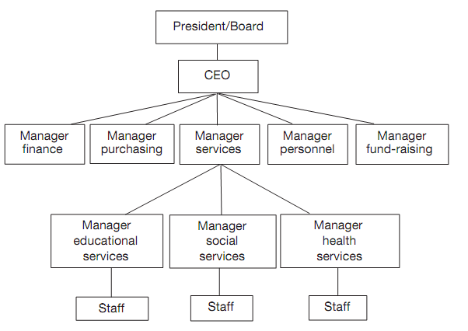
Functional organization-U Form

Slide 40
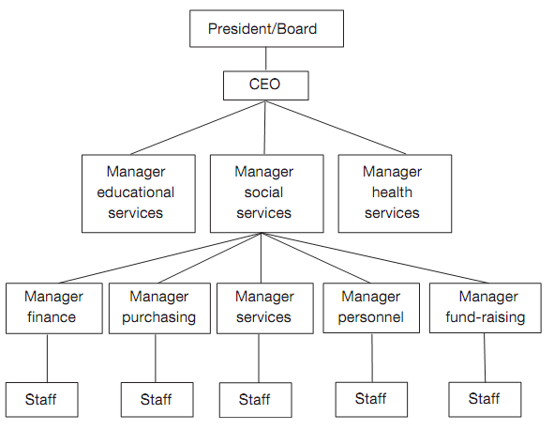
Divisional Structure-M form

Slide 41
Linkage between values, power and politics
The link between values, power, and politics is critical, and values form one of the bases of power. In Pfeiffer's terms: “Power is a property of the system at rest; politics is the study of power in action”; politics are “those activities taken within organizations to acquire, develop and use power and other resources to obtain one’s preferred outcome in a situation in which there is uncertainty due to dissensus about choices” (1981: 7).

Slide 42
Power and authority
Power and authority are closely related. The latter refers to the right to seek compli- ance. Authority is legitimate power and is deﬁned in relation to the overall goals and objectives of the organization.

Slide 43
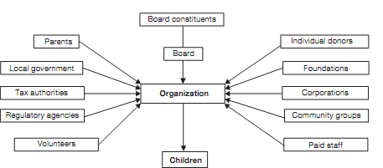
Example 1-Child Care Hospital

Slide 44
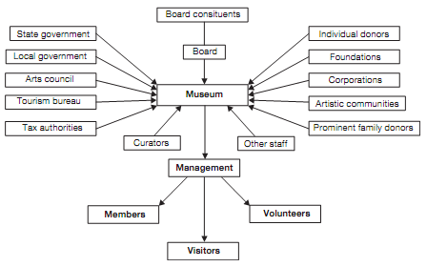
Example 2-Museum

Slide 45
Policy Formulation
Pakistan Centre for Philanthropy
Policies Manual
Changes in Policy Manual
Personnel Policy
Definition of Employee
Non Discrimination

Slide 46
Management Structure
SDPI has five streams of operations i.e., Support Activities, Research Programmes, Advocacy, Centre for Capacity Building and Internal Audit.

Slide 47
Core Activities
Core activities consist of infrastructure staff assigned the charge to provide support to researchers or policy makers, primarily but not exclusively, linked to SDPI.

Slide 48
The support comprises information management and retrieval, library systems, database management and analysis, electronic/audio-visual communications, advocacy, and basic support in the form of administration and financial services.

Slide 49
Units in SDPI
Core programme has the following units:
• Finance and Administration
• Human Resource
• Management Information System
• Information and Library Management
• Center for Capacity Building
• Data Base Management
Each of the units is staffed with relevant professional and support personnel.

Slide 50
Research Programmes
The research programme is undertaken by a flexible group of distinguished, inter-disciplinary scholars, who conduct original research on policy issues of sustainable development.

Slide 51
The goals of the research programme are twofold: to produce high quality, evidence based research output and to enhance the research capacity of the Institute.

Slide 52
Main spheres in Research Programme
The main spheres of the research programme:
Governance
Lower Judicial Reforms
Devolution/Democratic Decentralization
Environment
Sustainable Industrial Development
Environmental Conservation
Sustainable Agriculture and Forestry
Climate Change
Renewable Energy/Clean Fuels
Hazardous Waste Management
Water
Reducing Emissions from Deforestation and Forest Degradation (REDD)

Slide 53
Social Policy and Political Economy
Gender
Education
Population and Development
Community Development
Labour
Poverty
Peace and Security
Health
Food Security
Access to clean drinking water

Slide 54
Economy
Macro-Economic Policies and Structural Adjustment
Emerging Technologies and Pakistan’s economy
Trade and environment
Micro-Finance/Credit
Process Review and Surveys

Slide 55
What data NPO use?
Too often barriers keep nonprofits from collecting and integrating important data into their daily work.

Slide 56
What data NPO Use?
The barriers are familiar to those who work in and with nonprofits: not enough staff or time
to collect or analyze this data; not knowing what data to collect or how to make use of it; competing demands or conflicting reporting requirements; money or technology limitations.

Slide 57
Most nonprofits are tracking financial and operations data and using it to make decisions about budgeting or programs.

Slide 58
Data offers nonprofits a means of measuring their progress toward their missions, but also a way of improving that progress.

Slide 59
What data NPO use?
Too often barriers keep nonprofits from collecting and integrating important data into their daily work.

Slide 60
What data NPO Use?
The barriers are familiar to those who work in and with nonprofits: not enough staff or time
to collect or analyze this data; not knowing what data to collect or how to make use of it; competing demands or conflicting reporting requirements; money or technology limitations.

Slide 61
Most nonprofits are tracking financial and operations data and using it to make decisions about budgeting or programs.

Slide 62
Data offers nonprofits a means of measuring their progress toward their missions, but also a way of improving that progress.

Slide 63
The RBM life cycle approach
Managing for results
Committing to results
Defining Results
Evaluating results
Reporting on results
Monitoring indicators and targets
Choosing indicators and targets
Strategizing + Acting for results
Trocaire, 2011

Slide 64
3 Levels of Results in RBM
The 3 levels of results in RBM are based on the nature of the results involved and the timeframe over which they appear.
Impacts/Ultimate results
Outcomes/Intermediate Results
Outputs/Immediate Results
.
Notes:
Outputs/Immediate results are the immediate, tangible and visible consequences of the activity and actions of the project/program. Time frame is over one or two years (short term)
Outcomes/ intermediate results :. Outcomes are the cumulative product of immediate results; they are the unleashing of potential. Outcomes usually take place in families, organizations and communities that are influenced by the project.
Time frame : over three to five years (medium term)
Ultimate results/Impacts: they are the cumulative effects of outcomes. These usually describe 'big picture' changes that your project is working towards, but which you alone cannot bring about. Impacts illustrate the underlying goal of your work; they answer why your work is important. The ideal impact: a. Inspires people toward a certain future b. allows your project to demonstrate a contribution in the future with some kind of social, economic or environmental change.
Time frame: long term (5 to 10 years or more)

Slide 65
3 Levels of Results in RBM
Expected Impact: Rise in awareness of the potential of sustainable organic farming within Pakistani communities.
Outcome: Villagers apply new skills in growing vegetables
Output: trained villagers have new skills in growing vegetables

Slide 66
Need for resources
Resources are needed by all types of organizations and so as for the civil society organizations(CSOs).
The resources should be effective as well as should be able to inculcate sustainability in the overall systems.
While forming strategies at/by any level of the management resource considerations are always given due importance.

Slide 67
Resource Mobilization Action Plan
Step1: Organizational Situational Analysis
Step2: Resource mobilization environment
Step3: Constructing your statement of funding needs.
Step4: Prospecting and communicating with potential donors and contributors.
Step5:Monitoring and evaluation your Resource mobilization efforts.

Slide 68
Selecting the Right Mix
core donors / contributors
Repeat donors/ contributors
First time donors/contributors

Slide 69
Strategy
Acquisition strategy
Nurturing Strategy

Slide 70
Acquisition Strategy
To bring in front first time donors / contributors raising awareness about your organization
Email/ Boucher
Little / No contact
Friends
Supporters
Volunteers

Slide 71
Nurturing / Cultivating Strategy
To maintain or promote the existing donors/contributors to the next level of the pyramid.
Grant competition
Invitation to visit your organization
News/ Letter
Member card.

Slide 72

Components of Negotiation
Differences
Needs
Behaviour
Settlement
Issue
Process
Discussion
Preferences
Attitude
Interest
Give-n-Take
Management
Arrangement
Limit Variation

Slide 73

WHAT IS NEGOTIATION
“The process to arrive at an agreement between different parties, each with their Own interests and preferences”.
“The process we use to satisfy our needs when someone else controls what we want”.
“The act of discussing an issue Between two or more parties with Competing interests with an aim of coming to an agreement”

Slide 74

FOR ME..........
    “The procedure to achieve an end through Informal or formal steps of Resolving the Differences”.

Slide 75


Theoretical Framework (way in)
Human mind
Effect of political, Psychological, Spiritual, Social needs
Ideas
interests
Perception experience
Individuality
Sharing
Exchanging
Leads toward
Process
Influence
Difference
in
opinion
Conflict
Yes/No
(Conditioned)
Solution
Changing Mind
NEGOTIATION

Slide 76
Theoretical Framework (way out)
Failure
Success
Follow-up, Out-come
Review/ Evaluation
Satisfaction & Future plan
Agreement
Settlement
Compromise
Expressing interests
Deal Stress & Conflict
Bargaining
Changing Mind
Pre-Negotiation Negotiation Post-Negotiation
Be positive, Concentration
Options, Position
Proposal
Discussion
Rapport building, Empathy, sympathy, Trust, Comm.
Friendly relationship
Decide Agenda, Share interest
Planning, Objectives, Language
Preparation
Issue judgement, both Party’s Interests,
Conflict- Difference- Problem

Slide 77
Conclusion
Revision two based on the rest of the lectures from lecture 16 till lecture 32.
Alone we do so little and together we do so much Hellen Keller

