Slide 1
Decision Making in Non Profit Sector (NPO)
Lecture 31
MPA 505
MPA Program
Course Instructor: Riffat Abbas Rizvi

Slide 2
AGENDA
REVISION ONE OF FIRST FIFTEEN LECTURES

Slide 3
NPO (History)
Voluntary and Philanthropic initiatives and practices date back in the history in the region now Pakistan before recorded history and are mentioned in regional folklore.

Slide 4
NPO (History)
In recent times, these activities were manifested through the creation of trusts to supplement the state’s provision in the fields of:
  Education
  Health
  Social Welfare
  Cultural Activities

Slide 5
NPO (History)
Following independence, in 1947:
The role of non profit organizations gained momentum.
Initially, the state was unable to provide emergency relief to the large influx of refugees that resulted from Pakistan’s Creation.
So non profit sector stepped in to fill the gap.

Slide 6
NPO (History)
Most recently, as a result of the erosion of good governance practices and lack of confidence in the governmental capabilities and capacity, International Donor organizations, Multilateral, Bilateral and Private Philanthropists have resorted to funding non-government organizations directly (SPDC, 1998)

Slide 7
NPO (History)
Government of Pakistan itself is committed:
-to deliver a substantial part of Social Action Program(SAP) and the programs under poverty reduction strategy through Non- government organizations.
Thus, Rapid growth is witnessed in non profit organizations involved in social service delivery.

Slide 8
NPO (History)
In addition to the individual voluntary activities, there have been significant organized efforts of Pakistan’s “Non profit sector”.
Most NGOs and Community base organizations are supported by:
  Community Donors,
  Local and International Donors
  Government Funds

Slide 9
NPO (History)
In recent years, non profit organizations(NPOs) have become increasingly involved in community based initiatives for social and economic development in order to improve quality of life and help Alleviate poverty.

Slide 10
NPO (History)
The spirit of voluntarism and philanthropy in the people of Pakistan stems from religious impulses.
The system of “Zakat” and other mechanisms outlined in Islamic teachings to help the poor by devoting resources to them.

Slide 11
NPO (History)
In the year (2000), Agha khan Development network recorded that people of Pakistan contributed 41 billion rupees(1.5% of GDP) in 1998 and volunteered 1.6 billion hours of time to philanthropic activities in 1998.

Slide 12
NPO (History)
History of philanthropy and voluntary activities goes back to the early-recorded history with the geographical boundaries now called “Pakistan”.
Religion has been the foremost driving force behind this phenomenon.

Slide 13
NPO (History)
Hinduism
Buddhist
Islam
Christianity
Sikhism
Has provided strong basis and spiritual motivation to cater the needs of the poor, sick and underprivileged in society.

Slide 14
NPO-An Overview
What exactly are NPOs?
The many existing definitions of ‘nonprofit’ add to the confusion, as do the activities undertaken by these organizations. Known variously as the ‘non-governmental’, ‘voluntary’, ‘community based’, ‘charitable’, ‘welfare societies’, this set of institutions include within it a sometimes bewildering array of entities – schools, hospitals, dispensaries, human rights organizations, sports clubs, madarsa (schools primarily providing religious education), residents welfare associations, organizations involved in material assistance to the needy, community based organizations involved in lobbying for civic amenities, and many more.

Slide 15
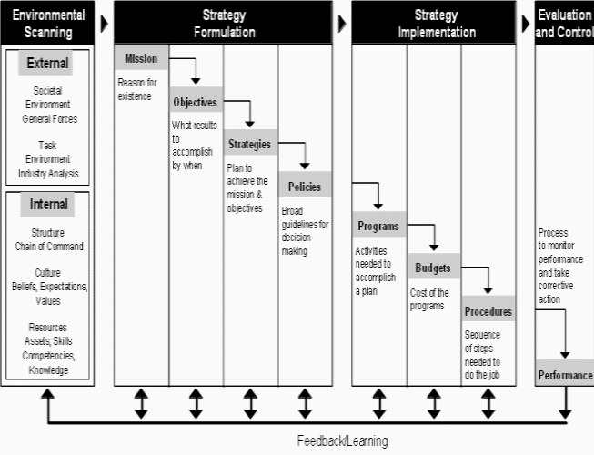

Slide 16
Vision
Vision and Mission both should be based on concept of rationality.
E.g., If we say we will finish poverty from the face of earth, then it is emotionally charged vision and kind of impossible.
Yes, if we say we will finish poverty from one village or tehsil then it looks rational vision.
President J. F Kennedy

Slide 17
Common features in All NPOs
They have an institutional presence and structure;
They are institutionally separate from the state;
They do not return profits to their members, managers or directors
They are fundamentally in control of their own affairs;
They attract some level of voluntary contribution of time or money and also membership in them is not legally required.

Slide 18
Legal Status of NPOs
The legal framework governing the nonprofit sector in Pakistan is both archaic and confusing.
There does not appear to be a legal definition of the term ‘nonprofit organization’ under any law that gives legal status to these types of organizations.

Slide 19
Legal Status
A significant number of organizations are registered under four laws: the Voluntary Social Welfare Agencies (Registration and Control Ordinance), 1961; the Society Registration Act, 1860; the Companies Ordinance, 1984; and The Trust Act II, 1882.

Slide 20
Legal Status
Voluntary Social Welfare Agencies (Registration and Control Ordinance), 1961
A voluntary social agency is an organization, association, undertaking established by persons of their own free will for the purpose of rendering welfare services and depending for its resources on public subscription, donation or government aid (NGO Resource Centre, 1991).
These agencies can carry out their function in one or more fields such as child welfare, youth welfare, women’s welfare, welfare of physically and mentally handicapped, welfare of beggars, recreational programs, social education, family planning etc.

Slide 21
Legal Status
Societies Registration ACT, 1860
The society is an organization, association or undertaking established by persons of their own free will.
These societies may be established for the promotion of science; literature; the fine arts; instructions; the diffusion of useful knowledge; political education; charitable services; the foundation and maintenance of libraries/reading rooms; painting galleries; collection of natural history; mechanical and philosophical inventions; religious and educational services.

Slide 22
Legal Status
Companies Ordinance (Section 42), 1984
Associations, formed for promoting commerce, arts, science, religion, sports, social services, charitable or any other useful purposes may be registered as nonprofit companies, provided that they apply or intend to apply their profits, if any, or other income in promoting their objectives and prohibit the payment of dividends to their members.
In most cases, registered nonprofit companies are organizations engaged in research with donor funding, clubs and very large organizations engaged in delivering social and welfare services

Slide 23
Legal Status
The Trust Act, 1882
A trust is an obligation annexed to the ownership of property. It is a ‘gift’ of property to a person or institution providing benefit to both parties. For the creation of a trust it is necessary that there should be a creator or author of the trust, a person in whom the confidence is reposed i.e. the trustee, and a person for whose benefit the trust is created i.e. the beneficiary (Janjua, 2000).
A trust may be created for any lawful purpose, which can be revoked. The Trust Act, with a component for Public Trusts, provides legal cover for private acts of public charity, and allows the creators of the trust tremendous flexibility in their operations.

Slide 24
Data Collection Strategy
Specifically, the purpose of the data collection exercise was to estimate;
• The size of the nonprofit sector in terms of paid and voluntary employment, operating and development expenditure, number of organizations and number of memberships;
• The sectorial composition according to the characteristic activities of organizations in the sector and according the International Classification of Non Profit Organizations (ICNPO)
• Nonprofit sector revenue by sources

Slide 25
The origins of charity and philanthropy are probably based on religious underpinnings - the gift to the gods for an act of largesse to benefit the community as a whole such as a good harvest or relief from a natural disaster or in thanksgiving for such munificence.

Slide 26
Charity and Philanthropy
Charity is used for the relief of an immediate
need or a lack of something.
Philanthropy, on the other hand, has a wider context “for the public benefit”.
Both involve giving.

Slide 27
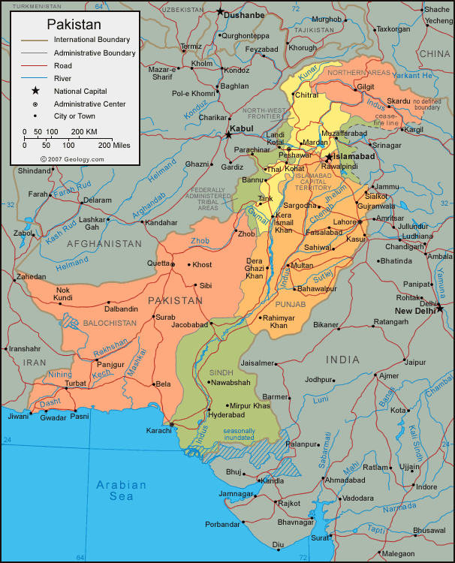
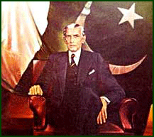
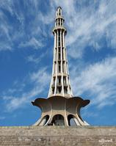
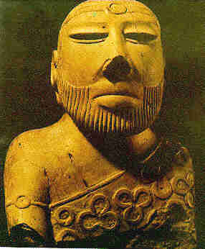
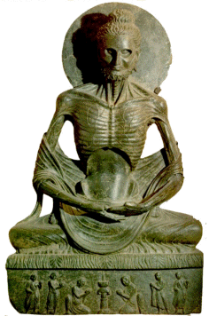
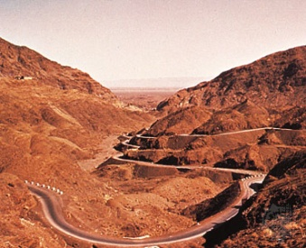



Examples of Social Sector Projects in Pakistan
Voter Education Project
Constituency Relations Group
Tobacco Free Initiative
Polio Eradication Program
Family Planning Project
Governance Monitoring
Khuda Ki Basti
Orangi Pilot Project
Clean Drinking Water Project
Awaz
Youth Parliament
Diya
Iodine Use
Notes:
27

Slide 28
Pakistan civil society: Past and present
Philanthropy and charity are codified in the doctrines of the Islamic faith.
Just as critically, however, the political and social developments of the country have directly impacted the growth of non-governmental organizations (NGOs).
Pakistan’s lack of democracy, poverty, and underdevelopment make it difficult for civil society to flourish.

Slide 29
Pakistan civil society: Past and present
Since Pakistan’s independence in 1947, NGOs have been filling gaps in the delivery of social services, such as healthcare and education, that the government of the day was able or unwilling to provide.
In the late 1980s, when the government began recognizing the use of NGOs to deliver government programs, the number of NGOs increased and the types of services expanded from healthcare and education to advocacy and development.

Slide 30
In Pakistan
According to researchers, the “contribution of [the NGO sector] to the economy of Pakistan is substantial.”.
This important role, however, has not resulted in a harmonious relationship with the state or wide spread support for NGOs among the people of Pakistan.
As in most non-democratic countries, while the Pakistan government does not actively discourage NGOs that provide education, healthcare, and welfare services, it attempts to obstruct NGOs that engage in social and political advocacy.

Slide 31
Further fueling the appearance
In the latter role, NGOs are seen as competition for the government in “funds and influence.”
Further fuelling the appearance that NGOs are engaging in anti-state activities is the presence of foreign-funding.

Slide 32
Pakistan ngo legal regulations
There is no single body of law that governs NGOs in Pakistan.
The Constitution guarantees citizens the right to assembly “subject to any reasonable restrictions imposed by law in the interest of Public order.”
In addition, depending on the source, there are between 10 to 18 different laws in Pakistan that may govern an NGO.
Several of these laws are based on British laws enacted by colonial rulers in the mid- to late 1800s before Pakistan was partitioned from India.

Slide 33
Kinds of laws that govern ngo
The kinds of laws that govern NGOs fall into two categories: registration laws that define internal governance and the reporting relationship between the state and the NGO, and second is taxation laws.

Slide 34
Why most of the NGOs unregistered
Many NGOs in Pakistan are unregistered. According to a 2000 study, unregistered NGOs comprised 38% of all NGOs.
Reasons for this high rate vary, but may include high registration fees and the discretionary and inconsistent implementation of the registration laws by the governing authority.

Slide 35
For those NGOs that do choose to register
For those NGOs that do choose to register, the benefits, although not necessarily enjoyed by every registered NGO, include:
the ability to enforce by-laws;
statutory requirements that force an NGO to become organized;
legal status “at the official level and among donors;”
the ability to open a bank account;
the ability to sign contracts;
the ability to indemnify employees; and
the ability to qualify for financial assistance and tax exemption.

Slide 36
Registration laws
There are four main registration laws:
the Societies Registration Act of 1860,
the Trusts Act, 1882,
The Voluntary Social Welfare Agencies (Registration and Control) (VSWA) Ordinance, 1961, and
The Companies Ordinance, 1984.

Slide 37
estimates
Except under the VSWA Ordinance, registration is optional.
According to the 2000 study, 40.5% of all registered NGOs are societies, 15% are agencies registered under the VSWA Ordinance, and 6% are trusts.

Slide 38
Similarities under the law
Similarities can be found between and among the laws.
For example, none of the registration laws proscribe a time period by which the government must accept or reject the application.

Slide 39
United Nations and NPOs
BINGOs Big International NGOs
BONGOs Business Organized NGOs
CBOs Community Based Organizations
CSOs Civil Society Organizations
ENGOs Environmental NGOs
GONGOs Government Organized NGOs
IPOs Indigenous Peoples Organizations
GROs Grassroots Organizations
GSCOs Global Social Change Organizations
NPOs Nonprofit Organizations
VOs Voluntary Organizations

Slide 40
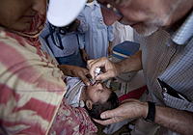
Donor-UNICEF
camps on the outskirts of Charsadda city. The camps are hosting a total of 332 families, including some 1,460 children and 440 women. UNICEF is providing water and sanitation, health, hygiene and child-protection services for the displaced. UNICEF Executive Director Anthony Lake (right) administers oral polio vaccine to a baby at the Prang Government Primary School shelter in Charsadda district, located in the Pakistani province of Khyber-Pakhtunkhwa.

Slide 41
UNICEF-
UNICEF is going to do everything it can, not just during this emergency but as Pakistan works its way out of this emergency as well,” Mr. Lake

Slide 42
UNICEF REQUIREMENT
To continue life-saving activities in response to the 2012 monsoon floods, UNICEF urgently needs US$15.4 million to provide flood-affected communities with timely and adequate assistance through the next three months.

Slide 43
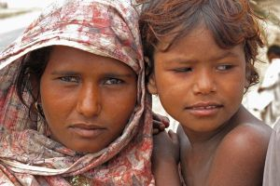
Pakistan’s Hunger Facts
The monsoon floods in August hit a country already grappling with high levels of malnutrition, high food prices and a humanitarian crisis along its border with Afghanistan.

Slide 44
Facts Behind Hunger
20 million affected by the floods
The Pakistan floods this summer impacted the lives and livelihoods of some 20 million people, around 10 million of whom required emergency food assistance.

Slide 45
2. Nearly one in two Pakistanis at risk
Pakistan suffered from widespread hunger even before the monsoon floods, with an estimated 82.6 million people – a little less than half the population – estimated to be food insecure.

Slide 46
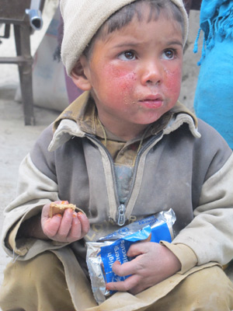
3. Widespread poverty
An estimated 36 percent of Pakistanis live below the poverty line and almost half are illiterate.
Poorer households typically spend over 60 percent of their income on food.

Slide 47
4. Poor sanitation
50 percent of all Pakistanis have little or no access to clean toilets and drinking water, a condition that renders them vulnerable to infectious diseases.

Slide 48
5. Child mortality
The biggest killers of children under five in Pakistan are diarrhea and acute respiratory infections. Undernourishment is an underlying cause in 38 percent of those cases.

Slide 49
6. Violent conflict
Conflict along Pakistan’s northwestern border with Afghanistan has forced millions of people to flee their homes. Since 2008, WFP has provided over 2.6 million of them with food assistance.

Slide 50
7. Rising hunger
Volatile food prices over the past seven years have pushed the number of people who depend on food assistance in Pakistan from 38 percent of the population in 2003 to 49 percent in 2009.

Slide 51
8. Wheat dependent
Wheat is Pakistan’s main staple crop and most important source of calories. As a result of the flooding, which submerged around 16 percent of all arable land in Pakistan, the upcoming wheat harvest is expected to be around 15 percent smaller than usual.

Slide 52
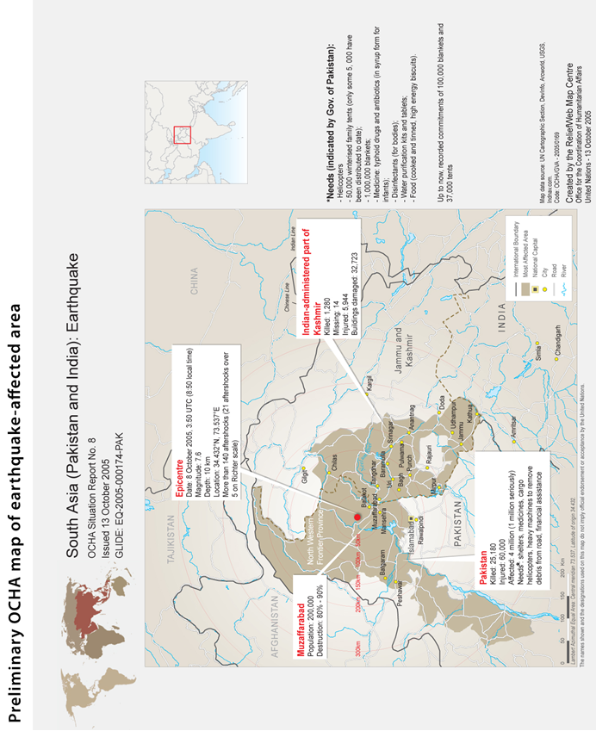

Slide 53
Policy research report
At 8:50 a.m. on October 8, 2005, a devastating earthquake measuring 7.6 on the Richter scale struck northern Pakistan and the disputed territory of Kashmir, which is divided into Pakistan-Administered Kashmir (PaK) and Indian-Administered Kashmir (IaK).
The earthquake killed approximately 75,000 people, injured another 70,000, and left an estimated 3.5 million people homeless.
A massive humanitarian rescue and relief operation followed that was led by the Pakistan Army.

Slide 54
Objective
The purpose of this case study was not to conduct an evaluation of the earthquake response.
The objective was to learn from the perceptions of those affected by the Pakistan earthquake, as well as those involved in relief and reconstruction efforts, to better understand some of the key challenges facing humanitarian action and humanitarian assistance organizations.

Slide 55
Feinstein International Center
This study is part of a broader study undertaken by the Feinstein International Center at Tufts University entitled, “The Humanitarian Agenda 2015: Principles, Politics and Perceptions” (HA2015), which aims to help equip the humanitarian enterprise to better address emerging challenges during the coming decade. In particular, the study is looking at four interrelated issues that are likely to shape the humanitarian agenda.

Slide 56
Universality
The universality of humanitarianism – is there anything truly universal about what we call humanitarian action or are the principles and apparatus of humanitarian action perceived to be primarily Western and Northern?

Slide 57
Terrorism and Counter Terrorism
The implications of terrorism and counter-terrorism for humanitarian action – to what extent is the humanitarian enterprise perceived to be part of the security agenda of the US and its allies, and if so what are the implications for humanitarian action?

Slide 58
Coherence
The search for greater coherence and integration between humanitarian and political/security agendas – does the cost of more integrated approaches exceed the benefits?

Slide 59
Security
The security of humanitarian personnel and the beneficiaries of humanitarian action.

Slide 60
Methodology(Continued)
The field research was conducted over a three-week period in Islamabad, and in the three districts most badly affected by the earthquake – Mansehra and Battagram districts in the Northwest Frontier Province (NWFP), and Muzaffarabad district in Pakistan-administered Kashmir (PaK).

Slide 61
Sources of Information
55 key informant interviews with government officials, staff from NGO, UN, RedCross/Crescent, and donor agencies, and with politicians, religious leaders, journalists and academics.
30 focus group discussions using a semi-structured interview format with 262 community members affected by the earthquake, including internally displaced persons (IDPs), local politicians, professionals, and one with NGO national staff.
Eight detailed questionnaires completed by international aid workers working for NGO, UN and donor agencies.

Slide 62
Sources of Information
These included 19 male focus group discussions with162 participants, seven female focus group discussions with 54 participants, and four mixed focus group discussions with 46 male and female participants.
The author conducted seven focus group discussions, and the rest were conducted by three Pakistani researchers.

Slide 63
Conclusion
In the first fifteen chapters we have gone through various themes of non profit sector which involves its existence, how it should be make, Legitimate context and United nations approach in context with non government organizations and lastly report on “Perceptions of people of Pakistan-Post Earthquake study 2005”.

