Slide 1
Decision making in npo sector
Lecture 29
MPA 505
Riffat Abbas Rizvi

Slide 2
agenda
Preview of Last Lecture
Learning Organizations
Non-Governmental Organizations (NGOs)
NGOs and Results-Based Management (RBM)
RBM
Results
Results Chain
Measuring Results
Indicators
Examples of Indicators
RBM Framework
Conclusion

Slide 3
Learning Organizations
The learning organization is one which is “continuously expanding its capacity to create its future” (Peter Senge, The Fifth Discipline)
Good learning tests an organization’s management, its strategies and its values.

Slide 4
Non-Governmental Organizations (NGOs)
NGOs claim to be ‘learning organizations’
They rely on both formal and informal processes to:
generate new learning,
reflect on past experience and
experiment with new approaches.

Slide 5
NGOs and Results-Based Management (RBM)
RBM is a relatively new (1990’s) formal approach being ‘learned’ by NGOs
Donor agencies have played a vital role in the adoption of RBM by NGOs.
NGOs are adopting RBM to improve, for example:
governance
accountability
capacity development
Notes:
Same was true for Management by Objectives and zero- based budgeting in the 1970s , Total Quality Management (TQM) in the 1980’s and RBM a decade later.
The term “capacity” refers to the abilities, skills, understandings, attitudes, values, relationships, knowledge, conditions and behaviors that enable organizations, groups and individuals in a society to generate benefits and achieve their objectives over time. Capacity also reflects the abilities of these actors to meet the needs and demands of the stakeholders for whom they were established or to whom they are accountable. These attributes cover formal, technical and organizational abilities and structures and also the more human, personal characteristics that allow people to make progress.
Accountability can be defined as the right to be involved in all phases and levels of the performance management cycle of an entity (Murtaza 2011, p.4)
Accountability can also be defined as “the obligation to demonstrate and take responsibility for performance in light of agreed expectations” (Treasury Board, 2001a:33). Accountability is more than accountability for results. It also includes concern for other dimensions of accountability such as cost-effectiveness, prudence and compliance (Lavergne 2002, p.4)

Slide 6
Important of RBM and Evaluation
Growing pressures in developing countries to improve the performance of their public sectors.
One strategy to address this need is to design and construct results based monitoring and evaluation(M&E) systems.
These strategies track the results produced(or not produced) by governments and other entities.

Slide 7
Results based M&E System
Conducting a readiness assessment
Agreeing an outcomes to monitor and evaluate
Selecting key indicators to monitor outcomes
Baseline data on indicators-Where are we today?
Planning for improvement selecting realistic targets.
Monitoring for results
The role of evaluations
Reporting findings
Using findings
Sustaining the M&E systems within the organizations.

Slide 8
The power of measuring results monitoring
If you donot measure results, you cannot tell success.
If you cannot see success, you cannot reward it.
If you cannot reward success. You are probably rewarding failure.
If you cannot see success, you cannot learn from it.
If you cannot recognize failure, you cannot correct it.
If you can demonstrate results, you can win public support

Slide 9
RESULTS BASED MONITORING
Results based monitoring is a continuous process of measuring progress toward explicit short, intermediate, and long term results.
It can provide feedback on progress(or lack of progress) to staff and decision-makers who can use the information in various ways to improve performance.

Slide 10
Results based monitoring
Results based monitoring(What we call “monitoring”) is a continuous process of collecting and analyzing information, and comparing actual results to expected results in order to measure how well a projects, program or policy is being implemented.

Slide 11
Results based evaluation
Results based evaluation is an assessment of a planned, ongoing, or completed intervention to determine its relevance, efficiency, effectiveness, impact, and sustainability.

Slide 12
Difference between RBM&RBE
Evaluation takes a broader view of an intervention, asking if the progress towards the target or explicit results is caused by the intervention or if there is some other explanation for the changes showing up in the monitoring systems.

Slide 13
Difference (continued)
Whether the goals were relevant and worthwhile in the first place?
How effectively and efficiently they are being achieved?
What other unanticipated effects have been caused by the intervention?
Whether the intervention as a package represents the most cost-effective and sustainable strategy for addressing a particular set of identified needs?

Slide 14
TRADITIONAL VR Results based M&E
Traditional M&E focuses on the monitoring and evaluation of inputs, activities, and outputs (i.e. on project or program implementation.
Results based M&E combines the traditional approach of monitoring implementation with the assessment of results.

Slide 15
What is RBM (History)?
It developed as a result of globalization, competition and the entrepreneurial culture.
In the late 1990s, the UN system adopted RBM in its major agencies.
Origins of RBM Method
Introduced as “management by objectives” by Peter Drucker (1954)
Grew out of the Logical Framework Approach (LogFrame, LFA) by Practical Concepts Inc
Notes:
Management by objectives was mentioned by Peter Drucker in his book “ The Practice of Management”. It would further be developed by George O Odorne in his book Management by Objectives. It was a departure from the “bureaucracy model” of Weber.
Practical Concepts Inc was an American firm that designed the Logframe for USAID.

Slide 16
What is RBM?
Logframe Matrix/Project Matrix/RBM, is a chart used to organize the expected results from a programme or project.
It is a broad management strategy aimed at changing the way institutions operate, by improving performance, programmatic focus and delivery.
It is a participatory and team-based approach to programme planning
It focuses on achieving defined and measurable results and impact.
It serves as a “blueprint” for managers

Slide 17
What is RBM?
It is a life-cycle approach since a programme under RBM focuses on results from planning and implementation to monitoring, evaluation and reporting.

Slide 18
The RBM life cycle approach
Managing for results
Committing to results
Defining Results
Evaluating results
Reporting on results
Monitoring indicators and targets
Choosing indicators and targets
Strategizing + Acting for results
Trocaire, 2011

Slide 19
What is a Result?
According to Peter Drucker (1990), a non-for-profit institution has had no results until the end “user” becomes a “doer” or is a changed human being.
It is a positive change happening in the life of people (in the community, in society) as a consequence of a project.
It is a describable or measurable development change resulting from a cause and effect relationship.

Slide 20
3 Levels of Results in RBM
The 3 levels of results in RBM are based on the nature of the results involved and the timeframe over which they appear.
Impacts/Ultimate results
Outcomes/Intermediate Results
Outputs/Immediate Results
.
Notes:
Outputs/Immediate results are the immediate, tangible and visible consequences of the activity and actions of the project/program. Time frame is over one or two years (short term)
Outcomes/ intermediate results :. Outcomes are the cumulative product of immediate results; they are the unleashing of potential. Outcomes usually take place in families, organizations and communities that are influenced by the project.
Time frame : over three to five years (medium term)
Ultimate results/Impacts: they are the cumulative effects of outcomes. These usually describe 'big picture' changes that your project is working towards, but which you alone cannot bring about. Impacts illustrate the underlying goal of your work; they answer why your work is important. The ideal impact: a. Inspires people toward a certain future b. allows your project to demonstrate a contribution in the future with some kind of social, economic or environmental change.
Time frame: long term (5 to 10 years or more)

Slide 21
3 Levels of Results in RBM
Expected Impact: Rise in awareness of the potential of sustainable organic farming within Pakistani communities.
Outcome: Villagers apply new skills in growing vegetables
Output: trained villagers have new skills in growing vegetables

Slide 22
Types of Results
Type of Result | Phase
Expected | Planning
Achieved/Attained | Evaluation and Reporting
Unexpected | Monitoring and Evaluation

Slide 23
Results Chain
A series of expected achievements linked by causality
Each link in the chain is characterized by:
– Increased importance of achievement with respect the program goal.
– Decreased control, accountability, and attribution.

Slide 24
Results Chain
Vision/Values/ Key Principles
Inputs
Activities
Outputs
Outcomes
Impact
Mission
Objectives
Goal
Notes:
Inputs are the human, financial and physical resources required to undertake your planned activities. This is where you identify expertise, equipment and supplies. Having a good understanding of your input requirements allows you to draft a budget.
Activities: These are what you do with those ingredients - how you combine them. This is the 'what you do' each day to work towards that big goal. Typically, projects involve tens and hundreds of definable activities. You should group activities into between five and eight activity sets. Common headings for these sets include Promotion, Group Formation, Counseling, Networking, Advocacy, Training and Construction.

Slide 25
Ten steps to build a RBM M&E System
Conducting a readiness assessment.
Agreeing on performance outcomes to monitor and evaluate.
Selecting key indicators to monitor outcomes
Baseline data on indicators. Where are we today?
Planning for improvement-setting realistic targets.
Monitoring for results
The role for evaluations
Reporting findings
Using findings
Sustaining the M&E System within the organization.

Slide 26
Step one: conducting a readiness assessment.
Readiness assessment is a way of determining the capacity and willingness of a government, or an organization and its development partners to construct a results-based M&E systems.
This assessment address such issues as the presence and absence of incentives, roles and responsibilities, organizational capacity, and barriers to getting started.
Incentives: The first part of the readiness assessment involves understanding what incentives exist for moving forward to construct this M&E System and conversely, what disincentives will hinder positive progress.

Slide 27
Step 2: Agreeing on performance outcomes to monitor and evaluate
It is important to generate an interest in assessing the outcomes and impacts the organization or government is trying to achieve, rather than simple focusing on implementation issues(inputs, activities, and outputs).
Strategic outcomes and impacts focus and drive the resource allocation and activities of the organization and its partners. These impact should be derived from the strategic priorities of an organization.

Slide 28
Step three: developing key indicators to monitor outcomes
CREAM
CLEAR(Precise and unambiguous)
RELEVANT(appropriate to the subject in hand)
ECONOMIC(available at reasonable cost)
ADEQUATE(able to provide sufficient basis to assess performance)
MONITORABLE(amenable to independent validation)

Slide 29
Step four: gathering base line data
WRITTEN RECORDS(PAPER AND ELECTRONIC)
INDIVIDUALS INVOLVED WITH THE INTERVENTION
THE GENERAL PUBLIC
TRAINED OBSERVERS
MECHANICAL MEASUREMENTS AND TESTS
GEOGRAPHICAL INFORMATION SYSTEM

Slide 30
STEP FIVE: PLANNING FOR IMPROVEMENTS-SETTING REALISTIC TARGETS
Desired level of improvement
Baseline indicator slevel
Target performance

Slide 31
Step six: monitoring for results
Impacts +outcomes=Performance monitoring
Outputs+activity+input=implementation monitoring.

Slide 32
Step seven: the role of evaluations
Any time there is an unexpected result that requires further investigation.
When resource or budget allocations are being made across projects, programs, or policies.
When a decision is being made whether or not to expand a pilot.
Whether there is a long period with no improvement and its is not clear what the reasons for this are
When similar policies or programs are reporting divergent outcomes(or when indicators for the same outcome are showing divergent trends)

Slide 33
Step eight: reporting findings
Analyzing and reporting finings

Slide 34
Step nine: Using indicators
Development partners and civil society have important roles in using the information to strengthen accountability, transparency, and resource allocation procedures.

Slide 35
Step ten: sustaining the m&e system within the organization
Six crucial components of sustainable system
Demand
Clear roles and responsibilities
Trust worthy and credible information
Accountability
Capacity
Incentives.
Each of this component requires continued attention over time to ensure the viability of the system.

Slide 36
Measuring Results
Instruments used to measure results in RBM, are called indicators.
Indicators are the evidence/proof needed to show progress towards outputs, outcomes and finally impact.

Slide 37
Indicators
Quantitative Indicators (number, % or ratio)
Qualitative Indicators (reflect perceptions, opinions or level of satisfaction)

Slide 38
A Good Indicator is :
Valid
Reliable
Sensitive
Simple
Utilitarian
Feasible
Affordable

Slide 39
Characteristics of indicators
Quality means:
Complete in accordance with specifications
No faults, errors, omissions
Never assume an output is complete or fault free

Slide 40
Typical quality indicators
Percentage of errors
Percentage of rejections
Hours spent on re-work
Number of amendments or corrections
Number of community complaints on quality

Slide 41
Timeliness means
Time it takes for the customer to receive the service.
Time it takes to use the service
Time it takes for the service to be fully delivered.
Elapsed time from one point to another (in minutes, hours, days or work days.

Slide 42
Access
Availability of the service to the customer.
Convenience of getting to the service.
Practicality of using the service.
Affordability of buying the service.
Access can be limited by terrain, weather, location, public transport, security, culture, illness, gender, reading and writing literacy, computer access or literacy.

Slide 43
Unit cost
Unit cost means
Cost per patient bed night
Number of vaccinations per one nurse day
Number of resource hours to process any activity
Cost per bus kilometer
Construction cost per road lane kilometer
Cost per emptied bin
Cost per seat kilometer

Slide 44
Customer satisfaction
We satisfy the community expectations
Community do not complain

Slide 45
RBM Framework
START: END: | PRIORITY(IES) | RESULT(S): | COUNTRY(IES):
Budget total / Total Budget: |  | OBJECTIVES: | GOAL(S):
ACTIVITIES | OUTPUTS | OUTCOMES | IMPACT(S)
 | PERFORMANCE INDICATORS
 | REACH
RISKS & ASSUMPTIONS

Slide 46
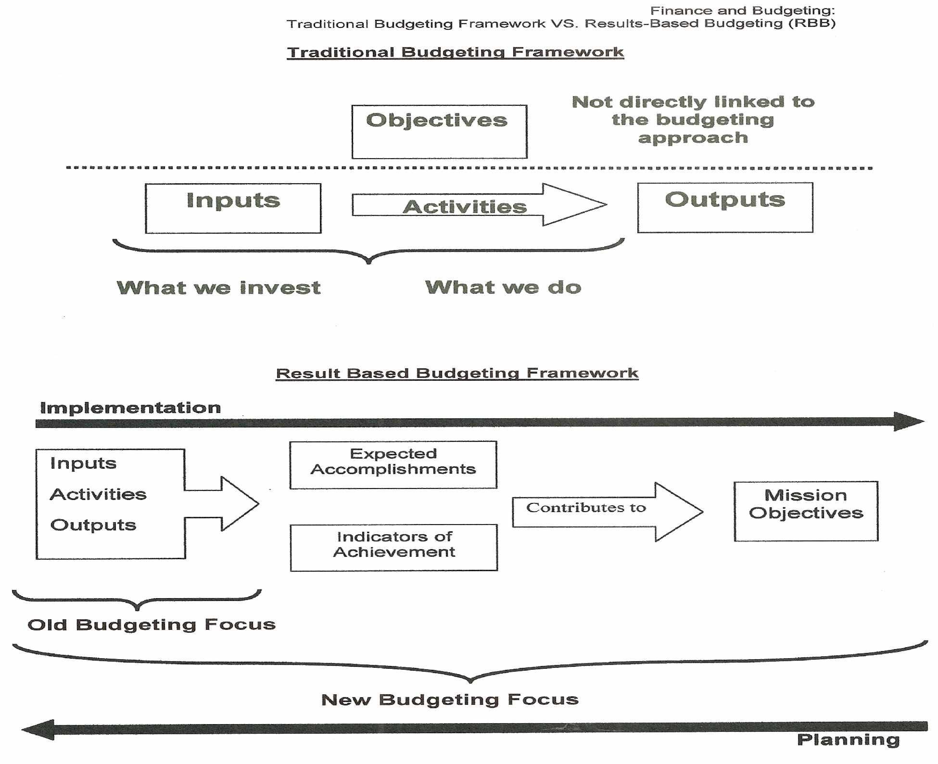
Results- Based Budgeting

Slide 47
RBM ..
Allows the project holder, implementer, coordinator to manage a project more effectively when used properly
Offers the benefits that come with any real system: rigor, depth and effectiveness
Allows NGOs to better communicate about the impacts of their work on people and societies.
Is a means to an end. Not an end!
Is not a “technical marvel” of development.
Notes:
RBM is not used properly when :
• completed activities are confused with outputs
• there are unclear linkages between the different levels of results so that it becomes hard to establish how a specific result has been achieved
• results are unrealistic (that are usually too ambitious!) given the resources at hand and the duration of the project
• there is too much reliance on quantitative indicators vs qualitative indicators
• indicators are confused with results
Not being sufficiently explicit in how the project will reduce gender gaps or constraints faced by women and/or men, boys and/or girls.
Is a means to an end and should not be considered as a replacement to work and thinking.

Slide 48
CONCLUSION
RESULTS BASED MANAGEMENT IS THE APPROACH UTILIZED BY VARIOUS ORGANIZATION IN ORDER TO EVALUATE NPO PROGRESS.
Management must manage "Harold S Green”
Lots of folks confuse bad management with destiny “kin Hubbard”

Slide 49
Bibliography
Smille, I & Hailey, J 2001, Managing for Change: Leadership, Strategy & Management in Asian NGOS, Earthscan Publications Ltd, London.
World Bank 2004, Ten steps to a results-based monitoring and evaluation system : a handbook for development practitioners, Washington.
Doyle, N & Nolan D , RBM (Results-Based Management) Booklet, VSO Indonesia - SPARK Livelihoods Programme, Indonesia.
Murtaza, N 2011, ‘Putting the Lasts First: The Case for Community- Focused and Peer-Managed NGO Accountability Mechanisms’, Springerlink.com, DOI 10.1007/s11266-011-9181-9
Soakell Ho, M & Myers, MD 2011, ‘Knowledge management challenges for nongovernment organizations :Health and Disability Sector in NEW Zealand’, VINE: The journal of information and knowledge management systems, Vol 41, No.2 , pp. 212-228.

Slide 50
Bibliography
Tips Publishing Service 2010, Performance Monitoring & Evaluation Building A Results Framework, 2nd edn, TIPS
Lavergne, R 2002, Results-Based Management and Accountability for Enhanced Aid Effectiveness, Canadian International Development Agency, Canada.
United Nations Development Group Publication 2010, Results-Based Management Handbook.
Kumar, NS, Result- Based Budgeting, Ministry of Finance, India, viewed 25 November 2011,<http://www.cga.nic.in/pdf/ResultBasedBudgeting1.pdf>.
Based on the UNESCO publication 2008, Results-Based Management (RBM) Guiding Principles ,UNESCO, Paris.

