Slide 1
Decision Making in Non Profit Sector (NPO)
Lecture-19
MPA 505
MPA Program
Course Instructor: Riffat Abbas Rizvi

Slide 2
Agenda
Preview of Last Lecture
NPO Structures
Power, Authority and Leadership
Eight dimensions of leadership
Alliances, Mergers and Acquisitions
Conclusion

Slide 3
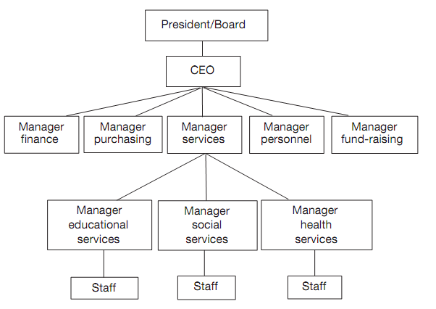
Functional organization-U Form

Slide 4
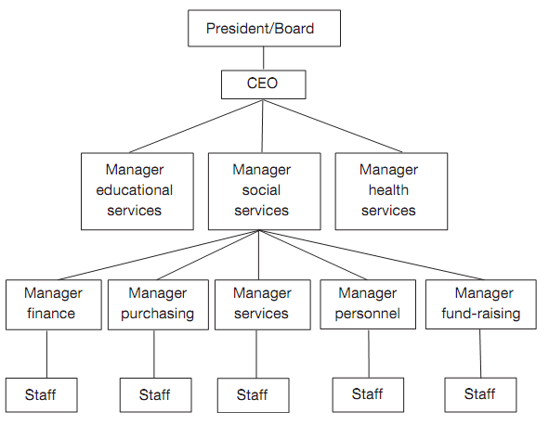
Divisional Structure-M form

Slide 5
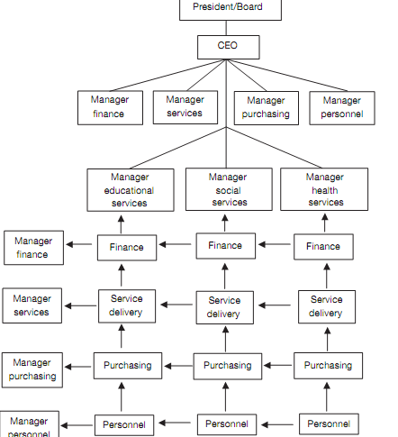
MATRIX TYPE

Slide 6
POWER, AUTHORITY AND LEADERSHIP
The issues of power, authority, and leadership are among the most political and complex in any organization, but they appear even more demanding in nonproﬁts due to the important inﬂuence of values on organizational behavior, management style, and decision- making.

Slide 7
Examples
Working for a supermarket, a computer factory, or a law ﬁrm requires little in terms of value commitment on behalf of managers or employees; working for a nonproﬁt, and indeed becoming a trustee, member, or volunteer, requires a closer examination of value alignment.

Slide 8
In the case of non profits
This is particularly the case for nonproﬁts that are deeply based on, and guided by, religious, political, or cultural values.
In such situations, questions of power, authority, and leadership are not only a matter of goal attainment and job performance but also a matter of personal commitment and expectations.

Slide 9
Importance of value in npos
The importance of values in nonproﬁt organizations makes them intrinsically political institutions.
Values do not exist in isolation but are imprinted in organizational cultures, enacted through day-to-day activities, and evoked on special occasions and during decision- making.

Slide 10
Linkage between values, power and politics
The link between values, power, and politics is critical, and values form one of the bases of power. In Pfeffer’s terms: “Power is a property of the system at rest; politics is the study of power in action”; politics are “those activities taken within organizations to acquire, develop and use power and other resources to obtain one’s preferred outcome in a situation in which there is uncertainty due to dissensus about choices” (1981: 7).

Slide 11
Power definition
Weber deﬁned power as the probability that one actor within a social relationship will be in a position to carry out his own will despite resistance (1978).

Slide 12
Sociologist emerson stated that:
Sociologist Emerson (1962: 32) added an important corollary: “The power actor A has over actor B is the amount of resistance on the part of B which can be potentially overcome by A.”

Slide 13
Meaning of power
Power means that one party changes behavior because of the preferences of another, although in most cases the exercise of power does not involve actual threats or force.
In modern organizations, power is frequently codiﬁed, be it in labor or contract law, or staff rules and regulations.

Slide 14
Power and authority
Power and authority are closely related.
The latter refers to the right to seek compliance.
Authority is legitimate power and is deﬁned in relation to the overall goals and objectives of the organization.

Slide 15
Example
For example, the supervisor of a social service agency can ask an employee or a volunteer to take on a particular case, provided it is within the realm of the relevant job description, but she may not ask them to run personal errands.
Authority is limited power, and power speciﬁc to contractual and work-related circumstances.

Slide 16
Referent power
Referent power is of particular importance in nonproﬁt organizations.
It results from identiﬁcation with, and commitment and dedication to, a particular organization, cause, or person.
Given the value-based nature of many nonproﬁts, those representing the organization have referent power in addition to formal authority.

Slide 17
Legitimate power
Legitimate power stems from the location of a particular position in the organizational hierarchy and unit-of-command system and represents the authority vested in it.

Slide 18
Reward power
Reward power is the capacity to provide or withhold rewards from others, including promotions, pay rises, and bonuses, as well as recognition, feedback, greater autonomy, challenging projects, better ofﬁce, etc.

Slide 19
Coercive power
Coercive power is the ability, vested in one’s position, to sanction and punish others for failing to obey orders, meet commitments and contractual obligations, and for underperforming; coercive power includes the use of reprimands, demotions, exclusion from project, and employment termination. In membership organizations sanctions could imply expulsions, loss of voting rights, or ﬁnes.

Slide 20
Information power
Information power originates from access to, and control over, information that is critical to the organization’s operations and future.
In most organizations, including membership-based ones, informational elites emerge that control information ﬂows and thereby organizational decision-making.

Slide 21
Expert power
Expert power refers to the possession of expertise and knowledge valued by members of the organization.
Professions such as physicians, nurses, lawyers, social workers, accountants, and teachers possess expert power, which affords them greater autonomy as well.

Slide 22
Six sources of power
The six sources of power differ in the extent to which they are likely to bring about commitment, compliance, and resistance among subordinates

Slide 23
Minimizing the use of coercive power
Minimizing the use of coercive power and maximizing the use of other power bases are least likely to create resistance to leadership, and most likely to reinforce commitment and increase compliance.

Slide 24
Relying on referent and expert power
Relying more on referent and expert power is more likely to increase commitment, and use of legitimate power as well as information and reward power is likely to boost compliance.

Slide 25
Leadership
Not only are power and authority closely related to each other, but so are both closely related to leadership. This last is the ability of one individual (or a board) to exercise inﬂuence on people’s decisions and behaviors over and above what is required by authority relations and contractual or other obligations.

Slide 26
What is leadership
Leadership is a process of inﬂuencing others to do what they would not do otherwise.
Or, in the words of Tannenbaum et al., “Leadership is a behavioral process in which one person attempts to inﬂuence other people’s behavior toward the accomplishment of goals” (1961: 24).

Slide 27
Autocratic leadership
Autocratic leadership involves unilateral decisions, limited inclusion of employees or members in decision-making, dictating of work methods and performance criteria, and punitive feedback.

Slide 28
Democratic leadership
Democratic leadership is based on group involvement in decision-making where the group has a commonly shared mission, devolved power, and feedback based on helpful coaching.

Slide 29
Laissez-faire
Laissez-faire leadership is largely symbolic and implies that the group has far-reaching freedom in decision-making as long as it is in compliance with agreed-upon values and principles.

Slide 30
Three types of leadership
These ﬁrst three types of leadership were suggested by psychologist Kurt Lewin ([1948],
1999) in the mid twentieth century and have been reﬁned since by two concepts: initiating structure and consideration.

Slide 31
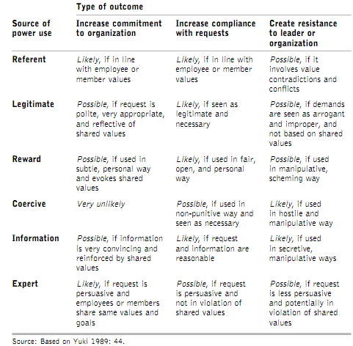

Slide 32
Structures
Initiating structures refers to the degree to which deﬁne the role of employees and members in terms of organizational mission and goal achievement.
Initiating structure is about group inclusion and participation, and centers largely on task-related issues.

Slide 33
structures
Consideration is the degree to which a leader builds commitment and mutual trust among members, respects their opinions and inputs, and shows concerns for their personal lives and feelings.

Slide 34
COGNITIVE DIMENSIONS
In this respect, leadership has a cognitive dimension that is about conceptualizing, guiding, planning, decision-making, and accom- plishment; it also has an affective component that emphasizes emotional, social, and human relations, and, indeed, appeals to people’s values but also to their frustrations and aspirations.

Slide 35
Charismatic leadership
Charismatic leadership refers to the personal characteristics of leaders that inspire pride, faith, identiﬁcation, dedication, and commitment and a willingness to follow directives and accept decisions.

Slide 36
Examples of leadership
Political leaders such as Nelson Mandela, religious leaders such as Pope John Paul II, or organizational leaders such as Lee Iaccoca (Chrysler Corporation) and Bernard Kouchner (Médecins sans Frontières) are positive examples of charismatic leadership, but the annals of history show many abuses of such leadership as well. Charismatic leadership is most useful in times of organizational uncertainty and transformation.

Slide 37
Transformational leadership
Transformational leadership involves the motivation of employees and members to perform normal expectations for meeting the organization’s mission and for achieving organizational goals.
It inspires staff and members to put aside personal self-interest for the common good of the organization and to have conﬁdence in their ability to achieve the “extraordinary” challenges before them.

Slide 38
Charismatic leadership
By contrast, charismatic leadership can be dysfunctional for “steady-state” organizations that perform in relatively stable task environments. In such circumstances, transactional leader- ship is more appropriate.

Slide 39
Transactional leadership
Transactional leadership is about maintaining an alignment between the organization’s mission and goals on the one hand, and the motivation and interests of employees and members in achieving set objectives on the other.

Slide 40
Four dimensions
Nanus and Dobbs (1999) suggest that nonproﬁt leaders need to focus on six dimensions.

Slide 41
DIMENSION ONE
internal organizational aspects, in particular the board, staff, volunteers, members, and users that the leader has to inspire, encourage, and unite behind a common mission.

Slide 42
DIMENSION TWO
external organizational aspects, in particular donors, policymakers, the media, and other constituencies whose support the leader needs for ﬁnancial resources and legitimacy.

Slide 43
DIMENSION THREE
present operations such as organizational performance and service quality, demand, information ﬂows, organizational conﬂicts and motivation, and community support

Slide 44
DIMENSION FOUR
future possibilities, where the leader addresses questions of sustainability and potential threats and opportunities that may have important implications for the organization and its direction.

Slide 45
Typology of non profit leadership roles
By combining these dimensions, Nanus and Dobbs (1999) arrive at a typology of nonproﬁt leadership roles , and suggest that effective leaders not only succeed in per- forming fairly well in all four, but also know when to focus on some more than others which is shown in next slide through diagrammatic view.

Slide 46
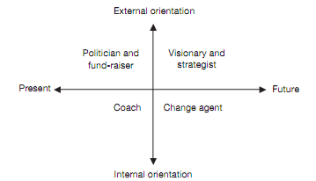
Typology of non profit leaders role

Slide 47
DIMENSION FIVE
focus on outside aspects and present operations requires leaders to generate resources from the environment (fund-raiser), and champion the organization’s cause among crucial constituencies (politician).

Slide 48
DIMENSION SIX
focus on present operations and the internal environment of the organization requires the leader to empower and inspire individuals and make it possible for them to realize their potential; in this scenario, the role of the leader is that of a coach.

Slide 49
DIMENSION SEVEN
focus on the internal environment and future operations, however, sees the leader less as a coach but more as a change agent by changing its structure to ﬁt better with the anticipated future task environment; and ﬁnally

Slide 50
DIMENSION EIGHT
focus on external aspects and future operations requires leaders to act as both visionaries and strategists: visionaries, because they need to formulate a coherent vision of the organization that can be shared widely among core constituencies and provide legitimacy for change; strategists, because leaders have to identify and implement strategies that hold promise for achieving future objectives.

Slide 51
ALLIANCES, PARTNERSHIPS AND MERGERS
Alliances, partnerships, and mergers are part of a continuum that ranges from the coordination of activities to the full integration of two or more organizations into a new entity

Slide 52
COOPERATION, PARTNERSHIP
While cooperation, partnership, and other forms of collective action have long been commonplace in the nonproﬁt sector, usually among organizations that share the same values, the topic of mergers and acquisitions is relatively new.

Slide 53
Critics and npo leadership
Some argue that too many small nonproﬁt organizations exist that are organizationally weak, ineffective, and with little capacity to provide professional services.
As a result, the total impact of the nonproﬁt sector, in terms of service provision, is less than it could be if larger and more effective organizations were in place.

Slide 54
Counter argument to crtics
The counter-argument is that the very smallness of nonproﬁts allows them to be close to the communities they serve and remain sensitive to client needs.
By turning into large-scale professional bureaucracies, they would lose this crucial advantage.

Slide 55
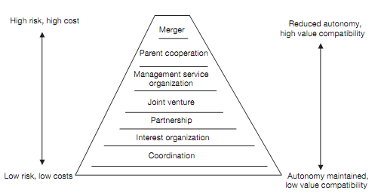
The cooperation–merger continuum

Slide 56
Conclusion
I love power. But it is as an artist that I love it. I love it as a musician loves his violin, to draw out its sounds and chords and harmonies.
NAPOLEON BONAPARTE, Havelock Ellis, The Dance of Life

