Slide 1
Decision Making in Non Profit Sector
Lecture-18
MPA 505
Riffat Abbas Rizvi

Slide 2
Agenda
Preview of Last Lecture
How to develop, build and lead teams by Leaders
Groups, People and Teams
Definition of Group
Characteristics of Groups
Types of Groups
Difference between formal and informal groups
Team
Purpose of Team
Team Roles
Development of Team
Factors of Team
Difference between an Effective and Un Effective Teams
Qualitative and Quantitative Factors
Conclusion

Slide 3



HOW TO DEVELOP, BUILD AND LEAD TEAMS

Slide 4



People
Groups
Teams
ORGANIZATION

Slide 5

What Is A Group?

Slide 6

What Do You Think?

Slide 7
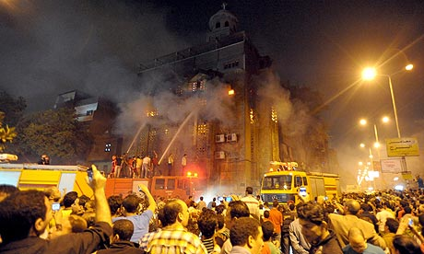

Slide 8
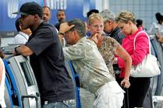

Slide 9
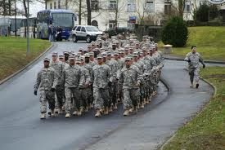

Slide 10
Temporary Aggregations
Groups
Random Crowd

Slide 11

NO. OF GROUPS YOU BELONG?

Slide 12
Definition Of A Group
Who interact with each other, usually face to face, over time in order to reach goals.
A group is any collection of people who perceive themselves to be a group.

Slide 13
Characteristics of a Group?
Interaction
Interdependence
Time
Goals

Slide 14
Cont…..
Sense of identity (in-out)
Loyalty
Purpose
Leadership

Slide 15
Types of groups
Informal
Formal

Slide 16
Formal
Put together by organization
Task oriented, formal structure
Informal
Workplace cliques other people in order to exchange information
“Mates” who socialize outside work
Individual member satisfaction
Teams

Slide 17

TEAM

Slide 18
Definition of Team
Formal group
Assigned task
Accountable
Group vs. Team

Slide 19
Characteristics of a Real Team | Characteristics of a Work Group
Shared Leadership roles | Strong, clearly focused leader solo leader
Team discusses, decides, and does real work together | The Leader discusses, decides and delegates
Specific Team purpose that the team delivers itself | The group’s purpose is the same as the organizational mission
Individual and mutual team accountability | Individual Accountability
Collective work products | Individual work products
Measures performance directly by assessing collective work products | Measures effectiveness indirectly e.g financial performance of the business
Encourages open-ended discussion and active problem-solving meetings | Runs efficient meetings with information sharing main activity

Slide 20
Teams….
Team is a formal group
established to achieve particular objectives.

Slide 21
Purpose Of Teams?
Teams
Task cannot be handled by one person
Exchange Of Knowledge and Ideas
Increasing Communication
New Ideas
(Hitchhiking)
Evaluating Ideas from many viewpoints

Slide 22
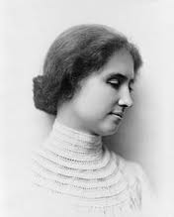
“Alone we can do so little and together we can do so much”
Hellen Keller

Slide 23


Building Effective Teams

Slide 24
Development of Team
Tuckman, 2001
Forming
Storming
Norming
Performing

Slide 25
Selecting Team Members
Selection
Manager
Dictated

Slide 26

Dictated By
Existing Arrangement
Politics
By Manager
Specialist Skill
Experience
Organization
Election
Political Power
Access to Resources
Competence

Slide 27

Team Roles
“RM Belbin”

Slide 28
PEOPLE - ORIENTED ROLES
Coordinator
Team Worker
ACTION - ORIENTED ROLES
Shaper
Implementer
Cerebral Roles
Plant
Monitor/evaluator
Resource investigator
Finisher
Specialist

Slide 29

Team Building
Encouraging the team members to work as a team

Slide 30
Team Building

Slide 31
Team Identity
Name
Uniform
Team Solidarity
Expressing Solidarity
Encouraging Interpersonal Relationship
Commitment to Shared Objectives
Clarification of Goals
Positive Reinforcement
Self Image
Mythology
Controlling Conflict
Controlling Intra-group Competition
Encouraging Inter-Group Competition
Regular , Clear Feedback and Encouragement

Slide 32

Types of Teams

Slide 33

Multdisciplinary Teams
Addict
Psychologist
Vocational
Religion
Medical

Slide 34
Multi- skilled Team
Each Team Member Is Versatile Enough To Handle Different Tasks

Slide 35
Effective Teams
Team work simply stated as “ Less Me And More We”

Slide 36
Team Effectiveness
Achieves its objectives
Cooperative Working
Effective Team

Slide 37
Factors
Quantifiable
Qualitative

Slide 38
Quantifiable Factors

Slide 39
Effective Team | Ineffective Team
Low rate of labor turnover | High rate of labor turnover
Low accident rate | High accident rate
Low absenteeism | High absenteeism
High Output | Low Output
Good Quality | Poor Quality Output
Individual Targets are achieved | Individual Targets are not achieved
Few stoppage at work | Time is wasted due stoppages at work

Slide 40
Qualitative Factors

Slide 41
Effective Work Team | Ineffective Work Team
High commitment for achievement of organizational goal | Low commitment for achievement of organizational goal
Clear understanding of group’s goal | Little understanding of group’s goal
Group problem solving | Group problem solving
Consensus of opinion sought, though argument and mutual adjustment | Interpersonal hostility, grudges and attempts to dominate
Trust and open communication between members | Mistrust between group members and open suspicion of leaders
Idea sharing | Little idea sharing
Mutual Help and encouragement through constructive criticism | Competition, Self interest and hostile criticism within group
Motivation and ability to work in the leader’s absence | Need for leadership to direct and control

Slide 42


