Slide 1
Decision Making in Non Profit Sector (NPO)
Lecture-14
MPA 505
MPA Program
Course Instructor: Riffat Abbas Rizvi

Slide 2
Agenda
Preview of the Last Lecture
Perceptions of Pakistan Earth Quake Response(Part-1)
Feinstein International Centre
Humanitarian agenda 2015
Introduction
Overview of Pakistan Earthquake response
The Universality of Humanitarianism
Conclusion

Slide 3
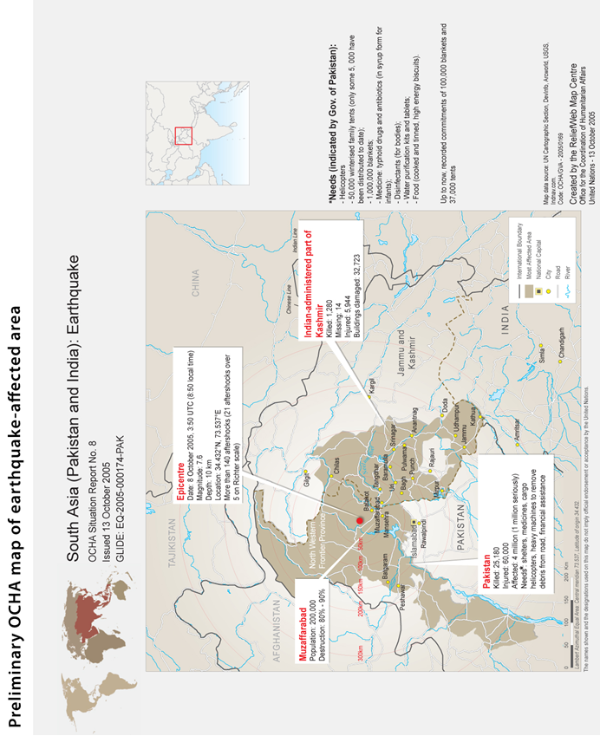

Slide 4
Introduction
At 8:50 a.m. on October 8, 2005, a devastating earthquake measuring 7.6 on the Richter scale struck northern Pakistan and the disputed territory of Kashmir, which is divided into Pakistan-Administered Kashmir (PaK) and Indian-Administered Kashmir (IaK).
The earthquake killed approximately 75,000 people, injured another 70,000, and left an estimated 3.5 million people homeless.
A massive humanitarian rescue and relief operation followed that was led by the Pakistan Army.

Slide 5
Introduction
The response included thousands of private citizens who were in most cases the first to respond, Islamic militant groups based in the region, search and rescue teams from several countries, US and NATO military forces, UN agencies, and more than one hundred national and international NGOs.

Slide 6
Introduction
The response created some compelling images of the universality of humanitarian action, with erstwhile enemies – including militant jihadi groups, US and NATO military forces, and 2,500 Cuban doctors and nurses – working alongside each other to save lives and respond to the needs of earthquake survivors.

Slide 7
Introduction
Despite daunting challenges, including the difficult mountainous terrain and the race against time to provide basic shelter to the homeless prior to the arrival of the Himalayan winter, the humanitarian response to the earthquake was perceived by many to be “one of the largest and most effective responses to a natural disaster to date.”

Slide 8
Objective
The purpose of this case study was not to conduct an evaluation of the earthquake response.
The objective was to learn from the perceptions of those affected by the Pakistan earthquake, as well as those involved in relief and reconstruction efforts, to better understand some of the key challenges facing humanitarian action and humanitarian assistance organizations.

Slide 9
Feinstein International Center
This study is part of a broader study undertaken by the Feinstein International Center at Tufts University entitled, “The Humanitarian Agenda 2015: Principles, Politics and Perceptions” (HA2015), which aims to help equip the humanitarian enterprise to better address emerging challenges during the coming decade. In particular, the study is looking at four interrelated issues that are likely to shape the humanitarian agenda.

Slide 10
Universality
The universality of humanitarianism – is there anything truly universal about what we call humanitarian action or are the principles and apparatus of humanitarian action perceived to be primarily Western and Northern?

Slide 11
Terrorism and Counter Terrorism
The implications of terrorism and counter-terrorism for humanitarian action – to what extent is the humanitarian enterprise perceived to be part of the security agenda of the US and its allies, and if so what are the implications for humanitarian action?

Slide 12
Coherence
The search for greater coherence and integration between humanitarian and political/security agendas – does the cost of more integrated approaches exceed the benefits?

Slide 13
Security
The security of humanitarian personnel and the beneficiaries of humanitarian action.

Slide 14
Case studies examining these four issues have been conducted in 12 countries where humanitarian action is being undertaken.
The Pakistan case study differs from the others in several important respects.
First, it is the only one where local conflict was not an important dimension to the humanitarian response.
Second, the Pakistan case study is the only one looking exclusively at the humanitarian response to a rapid onset natural disaster, in contrast to the other case studies examining humanitarian action in situations of armed conflict.
Finally, a notable difference in the case of the Pakistan earthquake response was the central role played by the Pakistan Army in leading relief and reconstruction efforts.

Slide 15
Methodology
The field research for this case study was conducted in March 2007, 1.5 years after the earthquake struck northern Pakistan and Kashmir.
While the focus of the research was on perceptions of the humanitarian response during the initial six months of rescue and relief efforts, respondents inevitably also communicated their perceptions – usually much more negative – of the subsequent reconstruction phase since April 2006.
The study therefore includes analysis of the contrasting perceptions of the relief and reconstruction phases.

Slide 16
Methodology(Continued)
The field research was conducted over a three-week period in Islamabad, and in the three districts most badly affected by the earthquake – Mansehra and Battagram districts in the Northwest Frontier Province (NWFP), and Muzaffarabad district in Pakistan-administered Kashmir (PaK).

Slide 17
Sources of Information
55 key informant interviews with government officials, staff from NGO, UN, RedCross/Crescent, and donor agencies, and with politicians, religious leaders, journalists and academics.
30 focus group discussions using a semi-structured interview format with 262 community members affected by the earthquake, including internally displaced persons (IDPs), local politicians, professionals, and one with NGO national staff.
Eight detailed questionnaires completed by international aid workers working for NGO, UN and donor agencies.

Slide 18
Sources of Information
These included 19 male focus group discussions with162 participants, seven female focus group discussions with 54 participants, and four mixed focus group discussions with 46 male and female participants.
The author conducted seven focus group discussions, and the rest were conducted by three Pakistani researchers.

Slide 19
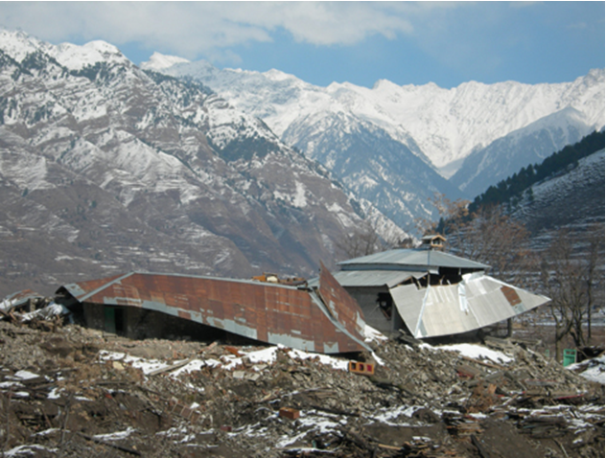

Slide 20
Overview of Pakistan Earthquake
In the space of a minute on the morning of October 8, 2005, the powerful earthquake that struck northern Pakistan and the disputed territory of Kashmir leveled towns and villages, killed or injured 145,000 people, and destroyed or seriously damaged 600,000 homes and most of the area’s education, health, and transportation infrastructure.
The map below identifies the areas affected by the earthquake – a 30,000 square kilometer area approximately the size of Belgium.

Slide 21
Table 1: Key Earthquake Statistics
Killed | 73,338 (including an estimated 18,000 children killed when schools collapsed) (plus 1,309 in India)
Injured | 69,412 (plus 6,622 in India)
Population Affected | 3.5 million
Affected Area | 30,000 square kilometers
Houses severely damaged/destroyed | 600,000 (76% of the entire housing stock)
Health facilities severely damaged/destroyed | 796 (80% of primary level facilities severely damaged/destroyed)
Education facilities severely damaged/destroyed | 6,298 destroyed or severely damaged, and education work force reduced by 60-70% through death, injury or migration
Roads damaged | 6,440 kilometers
International Humanitarian & Reconstruction Aid | US$ 1.4 billion in humanitarian aid, US$ 6.2 billion pledged in grants and loans at November 2005 Donor Conference

Slide 22
Overview
The earthquake measured 7.6 on the Richter scale, considerably less than the 9.2 magnitude Indian Ocean earthquake that resulted in the December 2004 tsunami that killed 225,000 people.
However, several interviewees for this study emphasized that in many ways the Pakistan earthquake rescue, relief, and reconstruction challenges were much greater.

Slide 23
UN OFFICIAL INTERVIEW
One UN official noted that the greater number of dead in the tsunami “is a false measure because dead people don’t need help.
In the earthquake there were 3.5 million homeless compared to 1.5 million displaced by the tsunami, and more injured than in the tsunami.” Geographical and climatic differences were also highlighted, including the often remote and inaccessible mountainous terrain in northern Pakistan and Kashmir and the bitterly cold Himalayan winters.

Slide 24
ONE AID OFFICIAL VIEW
As one aid official noted, “People can live one month without food, one week without water, but only one night without shelter under these climatic conditions.”
Finally, while the burden of responding to the tsunami was spread among several countries, the burden of responding to the earthquake fell primarily on Pakistan.

Slide 25
Rescue And Relief Phase
By all accounts the first on the scene to aid in rescue efforts and to provide relief goods were individual Pakistani citizens.
In an unprecedented outpouring of public sympathy, private citizens throughout the country donated relief supplies and thousands of volunteers flocked to the earthquake-affected areas to assist in rescue and relief operations.

Slide 26
Rescue and Relief Phase
As one government official exclaimed: “The Pakistani nation responded – children sent their pocket money from Karachi to the Khyber.”
While the public response was generous and enthusiastic, it was not well-organized.
Soon there were traffic jams of well-intentioned volunteers transporting relief supplies for earthquake victims, often blocking the only roads leading into the earthquake zone.

Slide 27
Rescue and Relief Phase
Much of what was donated was extremely useful but lots was not, and within a few days of the earthquake there were reports of piles of inappropriate second-hand clothes littering the streets or being burned as fuel.
Despite these problems, the work of these individual volunteers played a critically important role in the rescue and relief operations during the first few days following the earthquake.

Slide 28
Relief and rescue phase
Individual volunteers were soon joined by workers from a wide range of national and international organizations.
The first organizations to respond were reportedly the Islamic militant or “jihadi” groups already based in the area at camps used to train anti-Indian Kashmiri militant groups

Slide 29
Relief and rescue phase
Within the first day or two the staff of national and international NGO and UN agencies that were already working in Pakistan, and in some cases already working in the earthquake areas, were actively involved in rescue and relief efforts.

Slide 30
Relief and rescue Phase
Less than 24 hours after the earthquake the first international search and rescue team deployed by the Turkish Red Crescent Society arrived in Islamabad.
It was soon followed by many other search and rescue teams, over 100 national and international NGOs, several private sector organizations, and international military forces.

Slide 31
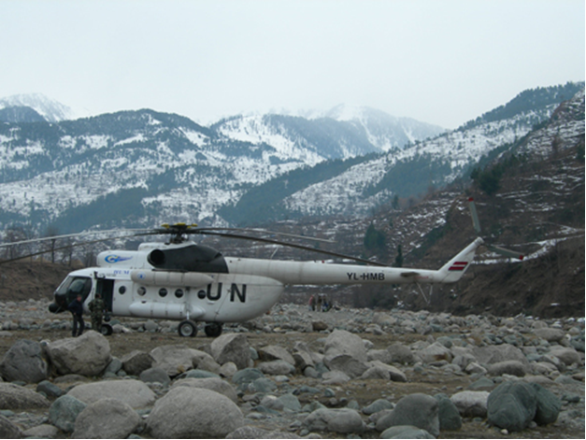

Slide 32
Relief and rescue Phase
Within 24 hours of the earthquake the UN Disaster Assessment and Coordination (UNDAC) team flew into Islamabad and worked with the Government of Pakistan (GoP), donors, UN agencies, and NGOs to establish coordination structures.
Within three days it had prepared and issued a Flash Appeal for $312 million to support a six-month emergency response, which two weeks later was increased to $550 million.

Slide 33
Relief and rescue Phase
During these initial days an important decision was also made to adopt and pilot the “Cluster Approach”, the framework for humanitarian coordination devised by the Inter-Agency Standing Committee (IASC).
Based on this decision, different UN agencies were appointed to lead different sectoral and thematic coordination clusters that operated in Islamabad as well as in the four “humanitarian hubs” – in the towns of Mansehra, Battagram, Muzaffarabad, and Bagh – within the earthquake zone.

Slide 34
Relief and rescue Phase
The Pakistan government was ill-prepared for a disaster of this magnitude, despite the knowledge that this region of northern Pakistan and Kashmir is highly earthquake prone as it is the meeting place of two tectonic plates that have created the Himalayan Mountain range.
No disaster response organization existed to respond to major natural disasters, and it was therefore not surprising that the country’s most powerful, best organized and best resourced institution, the army, took charge of relief operations.

Slide 35
Relief and rescue Phase
On the day after the earthquake President Musharraf appointed a serving military officer, Major General Farooq Ahmad, to establish and lead a Federal Relief Commission (FRC). The FRC was intended to be a “one-window operation” to coordinate and integrate all relief efforts including the work of both civilian and military actors.

Slide 36
Relief and rescue Phase
Perceptions of the central role played by the army in leading the earthquake response (discussed in more detail later in the paper) have been mixed.
It was initially severely criticized in the press for doing little to rescue civilians during the first few days following the earthquake, and for instead focusing on rescuing only military personnel and re-supplying and deploying new troops to man the Line of Control (LoC) separating Pakistan- and Indian-administered Kashmir.

Slide 37
Relief and rescue Phase
It has also been criticized for prolonging its central role into the reconstruction phase where it has been blamed for many of the perceived problems with reconstruction programs.
However, nearly all the interviewees for this study were full of praise for the effective leadership the army provided during the six month relief phase following the earthquake.

Slide 38
USAID OFFICIAL REPORTED:
One report quoted a USAID official with 20 years of experience responding to Asian disasters as saying: “In terms of a host government, this was the best response – the most competent I have ever seen.”

Slide 39
One of the noteworthy features of the Pakistan earthquake response was the important role of international military forces in the earthquake rescue and relief phase.

Slide 40
US AND NATO
Factors contributing to the significant involvement of US and NATO forces in the response included Pakistan’s geostrategic importance in the US-led “War on Terror” (WoT), and the proximity of US and other NATO forces and equipment in neighboring Afghanistan.
Within 48 hours of the earthquake the first of 24 US helicopters arrived in Islamabad from Afghanistan.

Slide 41
MASH
Soon approximately 1,200 US military personnel had arrived in Pakistan to assist with relief efforts, which included a medical team to run a US Army Mobile Army Surgical Hospital (MASH) in Muzaffarabad, and a 125-person Naval Mobile Construction Battalion to clear roads and debris, assist in setting up IDP camps, and rebuild infrastructure.

Slide 42
In addition to US military forces, the NATO Response Force also deployed approximately 1,200 specialist personnel including engineers and medical staff from 17 NATO countries to participate in NATO’s first purely humanitarian mission.
NATO forces also operated two “air-bridges” to fly relief supplies to Pakistan from bases in Germany and Turkey.

Slide 43
MAJOR SUCCESES
One of the major successes of the earthquake response, and one of the best examples ever of effective civil- military collaboration in a humanitarian relief operation, was the helicopter operation that ended up being the largest helicopter airlift of aid in history.

Slide 44
In much of the remote and mountainous terrain of the earthquake zone – where the few roads that had existed prior to the earthquake were blocked by landslides and destroyed bridges or had simply slipped down the mountainside – helicopters were the only effective way to rapidly transport relief supplies.

Slide 45
Although there were reports of considerable confusion during the critical first two weeks after the earthquake, the subsequent operation was described by one interviewee as “seamless.”

Slide 46
The Pakistan Army, US Navy, and the UN Humanitarian Air Service managed a highly effective Air Operations Cell (AOC) that at its peak coordinated over 100 helicopters that delivered 100 tons of food to the earthquake zone, transported injured to medical facilities outside the earthquake zone, and transported aid workers to and from the earthquake zone.

Slide 47
According to one report, “Never before had a home military, foreign allied support, and the United Nations worked so well in the delivery of air support.”

Slide 48
Most aid workers interviewed for this study believed that despite numerous shortcomings and frustrations, the earthquake relief effort was a tremendous success.
Many pointed to the fact that after the earthquake very few people died in the “second wave of deaths” which often follows disasters due to lack of shelter or capacity to treat injuries.

Slide 49
There was also not a “third wave of deaths” caused by outbreaks of disease.
According to a WHO official, fewer Pakistanis died in the earthquake zone after the earthquake than die in an average winter season in that region.

Slide 50
LOW MORTALITY REASON
An important reason that was given for the low mortality rates was the success of “Operation Winter Race,” which was literally a race to provide adequate shelter to the estimated 3.5 million homeless prior to the onset of the normally harsh Himalayan winter.

Slide 51
DISTRIBUTION
More than 500,000 tents, five million corrugated galvanized iron (CGI) sheets, six million blankets and 2.2 million tarpaulins and plastic sheeting were distributed.

Slide 52
Nevertheless, there was still a major shortage of winterized tents that would keep those living at higher altitudes warm enough throughout the winter.

Slide 53
STRATEGY
To address this critical problem a strategy was adopted of constructing “one warm room” using the rubble from destroyed homes and corrugated iron roofing sheets, which played an important role in contributing to the success of Operation Winter Race.
Nature was also kind – perhaps the most important contributing factor to the success of Winter Race was the fact that the 2005-2006 winter was uncharacteristically mild.

Slide 54
CONCLUSION
In this first part, we found out the evidences related to relief effort done after the disaster by various organizations. In the nutshell, all organizations especially Pakistan Armed Forces, NATO and US Army led the rescue operations followed by the distribution of relief items from various organizations.

