Slide 1
Decision Making in Non Profit Sector (NPO)
Lecture-13
MPA 505
MPA Program
Course Instructor: Riffat Abbas Rizvi

Slide 2
Agenda
Preview of Last Lecture
United Nations Perspective 2
What are Human Rights
What is United Nations
Main Aim of UN
History of UN
Purpose of UN
Bodies of UN
Sanctions
UN Peace Keepers
Major Missions
International Court of Justice(ICJ)
UN Human Rights Bodies
Where Do Human Rights Begin?
UNICEF And Humanitarian Action In the World
Conclusion
Reference

Slide 3
HUMAN RIGHTS are the rights that all people have by virtue of being human beings.
HUMAN RIGHTS are derived from the inherent dignity of the human person and are defined internationally, nationally and locally by various law making bodies.
HUMAN RIGHTS are the rights that all people have by virtue of being human beings.

Slide 4

The United Nations
Main Aims:
Tolerance and friendship among all nations, racial or religious groups.
Maintenance of peace

Slide 5
What is the UN?
an international organization designed to make the enforcement of international law, security, human rights, economic and social progress easier for countries around the world
192 member countries
headquarters in New York City

Slide 6
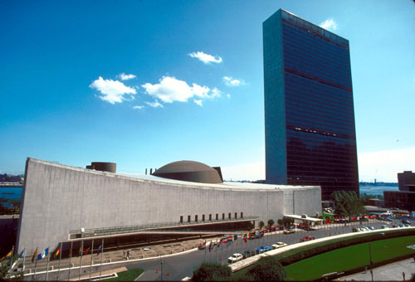
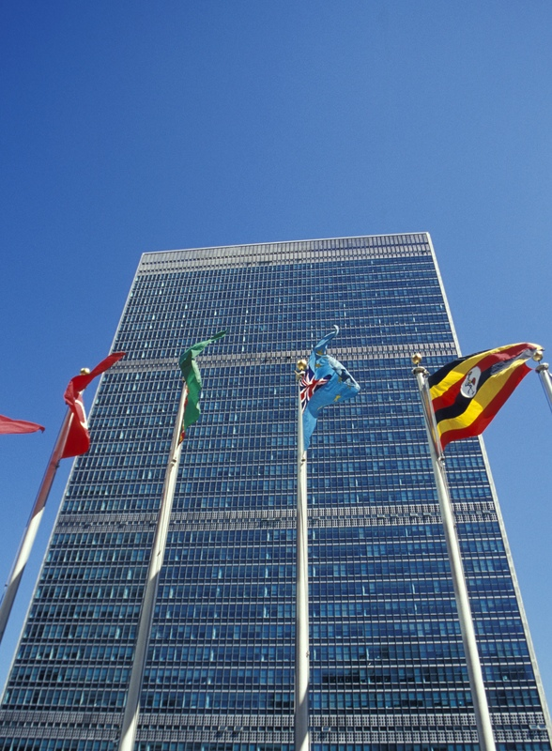
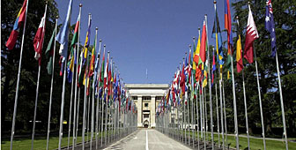
UN World Headquarters
New York

Slide 7
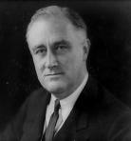
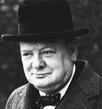
History of the UN
the League of Nations was the predecessor to the UN, it was founded in1919 and was responsible for ensuring peace and cooperation between world nations
the term ‘’United Nations’’ was coined in 1942 by Winston Churchill and Franklin D. Roosevelt

Slide 8
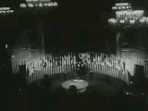
History of the UN
the UN was founded on October 24, 1945, when the Charter of the UN was drafted at the UN Conference on International Organization in San Francisco
the conference was attended by 50 nations and several non governmental organizations

Slide 9
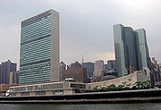
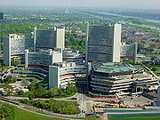
History of the UN
main principles: save future generations from war, reaffirm human rights, and establish equal rights for all nations
United Nations day is celebrated on October 24

Slide 10
Organization of the UN
purposes of the UN:
  maintaining international peace and security
  developing friendly international relations among world nations
  solving international problems of any nature (economic, cultural, social, humanitarian…)

Slide 11
Organization of the UN
principal organs of the UN:
  the General Assembly
  the Secretariat
  the Security Council
  the International Court of Justice
  the Economic and Social Council
  the Trusteeship Council

Slide 12
Parts of the United Nations
1. The General Assembly – the ‘town meeting’ of the world.
2. UN Security Council – maintains world peace (most powerful branch)
3. Economic and Social Council - works with the UN’s economic, cultural, health and educational activities.
4. Trusteeship Council - territories
5. ICJ – International Court of Justice
6. The Secretariat – administrative duties and can bring any topic before the SC.

Slide 13
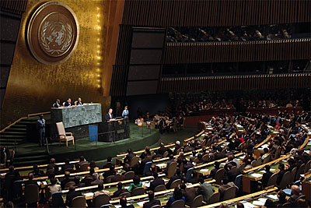
The General Assembly
main function: assessing member countries and deciding on the budget
the only organ where every member state is represented
consists of committees
convenes annually in September, special sessions can also be held

Slide 14
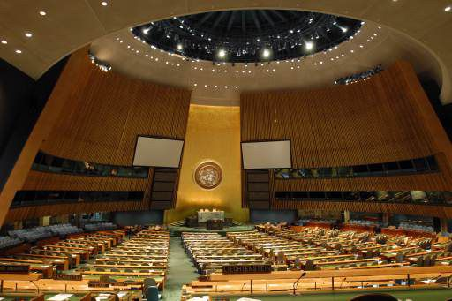
The General Assembly
Inside UN Headquarters

Slide 15
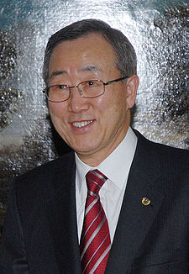
The Secretariat
includes the Secretary General and the Secretariat staff
primarily has an administrative function
the Secretary General holds office for five years per term
The first ever Secretary General was Trygve Lie, the office is currently held by Ban Ki-moon

Slide 16
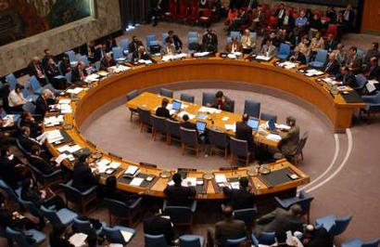
The Security Council
UN’s most powerful organ
deals with threats to international peace and security
has 15 members, 5 of which are permanent: the USA, China, Russia, Britain and France
permanent members have veto power when the Council decides on important issues

Slide 17
UN Security Council
Made up of 15 countries:
  The “Permanent Five” countries
  10 non-permanent countries (elected every two years)
The strong-arm of the UN
Maintains international peace
How does it do this:
  Recommends peaceful negotiations (peace talks)
  Can use Economic Sanctions
  Can use Military Sanctions

Slide 18
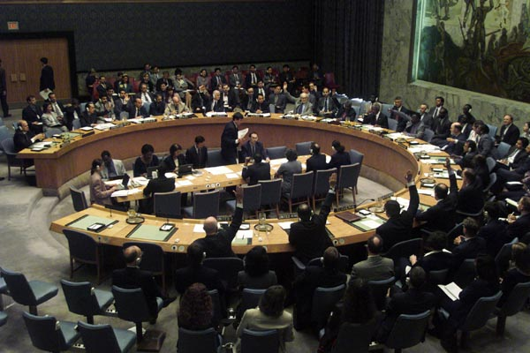
The UN Security Council
Inside World Headquarters

Slide 19
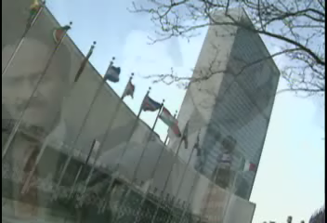
Security Council Speaking on a Solution for Haiti’s Violence

Slide 20
Sanctions
Sanctions are used to punish a country for violating international law. They can be used to force a country to follow a law.
In order for sanctions to be used by the UN Security Council, ALL FIVE permanent members must have a unanimous vote.

Slide 21
Types of Sanctions
Diplomatic Sanctions – removal of all political ties (like embassies)
Economic Sanctions – ban on all trade with a country (except food)
Military Sanctions – using a military to force compliance.

Slide 22
Military Sanctions
UN Peacekeepers – a group of armed soldiers sent to a hostile area to promote peace. They ARE NOT COMBAT TROOPS.
These soldiers maintain peace.
They don’t go on combat missions.
They are not an ‘army’
UN Military Force – an army made up of soldiers from more than one UN country that can serve as combat troops.
  They are not very effective and are not used very often.

Slide 23
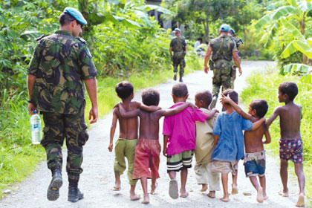
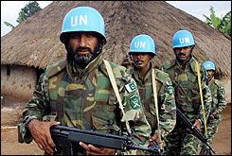
UN Peacekeepers
They always wear blue berets or blue helmets to identify themselves.

Slide 24
Major UN Missions
East Timor (Asia) – the UN supervised the independence of this country
Iraq (Middle East) – UN tried to cut all trade with Iraq after it failed to comply with international law, but some nations continued to trade with them.
Somalia (Africa) – UN humanitarian mission to get food and supplies to people in need
Haiti (Caribbean) – UN helped strengthen government, army, and hold elections
Congo
Bosnia Herzegovina

Slide 25
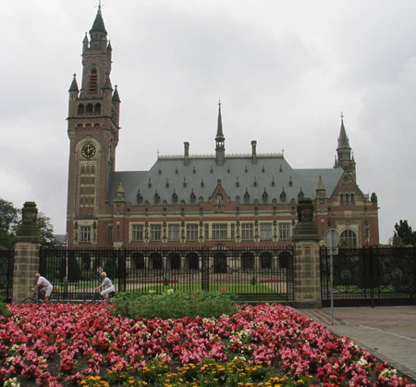
The ICJ
the principal judicial organ of the UN
based in the Hague, Netherlands
consists of 15 judges elected by the General Assembly and Security Council
applies international law
not bound by precedents
no appeals can be made by parties to its judgment

Slide 26
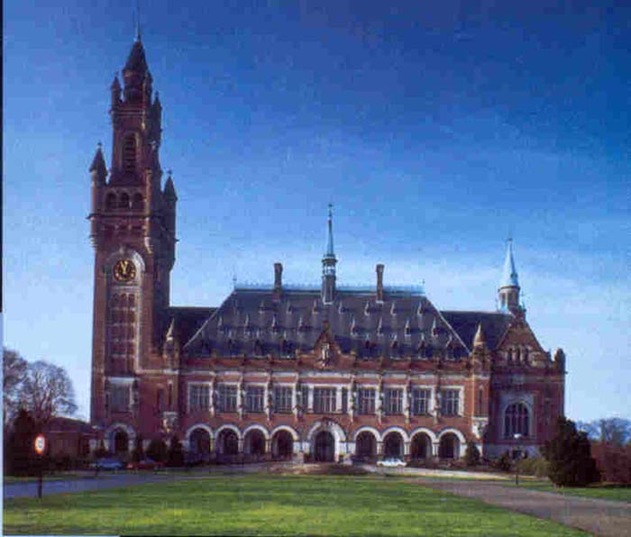
International Court of Justice
The Hague, Netherlands

Slide 27
The Charter of the UN
The United Nations Charter is the treaty that forms and establishes the international organization called the United Nations.

Slide 28
History
It was signed at the South Dakota Civic Center of the San Francisco War Memorial and Performing Arts Center (part of the Civic center) in San Francisco, United States, on June 26, 1945, by 50 of the 51 original member countries (Poland, the other original member, which was not represented at the conference, signed it later).

Slide 29
It entered into force on October 24, 1945, after being ratified by the five permanent members of the Security Council (China, France, The Union of Soviet Socialist Republics, The United Kingdom and the United States) and a majority of other signatories

Slide 30
Preamble
"We the peoples of the United Nations determined: to save succeeding generations from the scourge of war, which twice in our lifetime has brought untold sorrow to mankind, and to reaffirm faith in fundamental human rights, in the dignity and worth of the human person, in the equal rights of men and women and of nations large and small, and to establish conditions under which justice and respect for the obligations arising from treaties and other sources of international law can be maintained, and to promote social progress and better standards of life in larger freedom…”

Slide 31
Chapter I
Chapter I sets forth the purposes and principles of the United Nations, including provisions of the maintenance of international peace and security

Slide 32
Purposes of the UN
To maintain international peace and security
To develop friendly relations among nations
To achieve international co-operation in solving international problems of an economic, social, cultural or humanitarian character
To be a centre for harmonizing the actions of nations in the attainment of these common ends

Slide 33
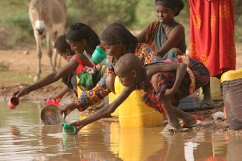
What does the UN do?
The UN aims to ensure that people don’t suffer from hunger and homelessness.
It has a special section called Unicef that tries to help children.
The UN has a convention on children's rights. They would like it to be followed by all countries, as a set of rules about the treatment of children.

Slide 34
Why is it important to have an organisation that is bigger than any one country?
Stops governments mistreating people
Helps stop wars between countries
Looks after all the world's young people

Slide 35
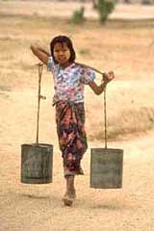
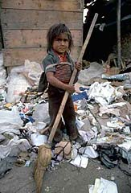
Why might the UN have problems getting all countries to treat children fairly?
Some countries use children in their armies
Many children work in factories
Poor countries can't afford to provide schools

Slide 36
UN Human Rights Bodies
Security Council
General Assembly
Economic and Social Council
Commission on Human Rights
Subcommission on the Promotion and Protection of Human Rights
Commission on the Status of Women

Slide 37
UN Human Rights Bodies
Commission on Crime Prevention and Criminal Justice
International Court of Justice
International Criminal Court
Office of the High Commissioner for Human Rights (created by the General Assembly in 1993)

Slide 38
UN Human Rights Bodies
Treaty Monitoring Bodies
  Human Rights Committee
  Committee on the Elimination of All Forms of Racial Discrimination
  Committee on the Elimination of Discrimination Against Women
  Committee Against Torture
  Committee on the Rights of the Child
  Committee on Economic Social and Cultural Rights

Slide 39
Local Non-Governmental Organizations
Minnesota Advocates for Human Rights
American Refugee Committee
Center for Victims of Torture
Institute on Agricultural and Trade Policy
University of Minnesota Human Rights Center

Slide 40
NGO Activities
Monitor elections and political trials
Investigate human rights and conditions
  Analyze human rights practices in closed countries – Albania, North Korea, Saudi Arabia
  Identify and analyze conflicts in Chiapas and Kosovo
  Child slavery in Haiti; child health in Mexico, Uganda and the United States

Slide 41
NGO Activities
Lobby United Nations
Draft model statutes
  Inquest procedures
  Forensic techniques
  Domestic violence laws
Represent political asylum seekers
Promote ratification of human rights treaties

Slide 42
Where Do Human Rights Begin?
“In small places, close to home, so close and so small that they cannot be seen on any maps of the world. Yet they are the world of the individual person, the neighborhood he lives in, the factory, farm, or office where he worked. Such are the places where every man, woman, and child seeks equal justice, equal opportunity, equal dignity without discrimination. Unless these rights have meaning there, they have little meaning anywhere.”
Eleanor Roosevelt, 1958
2742410v1

Slide 43
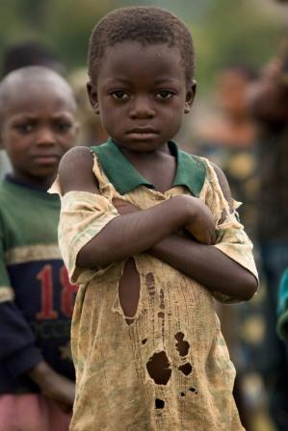
Humanitarian Action is Central to UNICEF’s Work
Children and women are the most affected by humanitarian situations
UNICEF is on the ground before, during and after emergencies.
The Convention on the Rights of the Child and its optional protocols guide UNICEF’s work on child protection and children in armed conflict.
Humanitarian action is central to UNICEF’s equity refocus.
UNICEF supports countries to respond to over 250 humanitarian situations per year on average

Slide 44
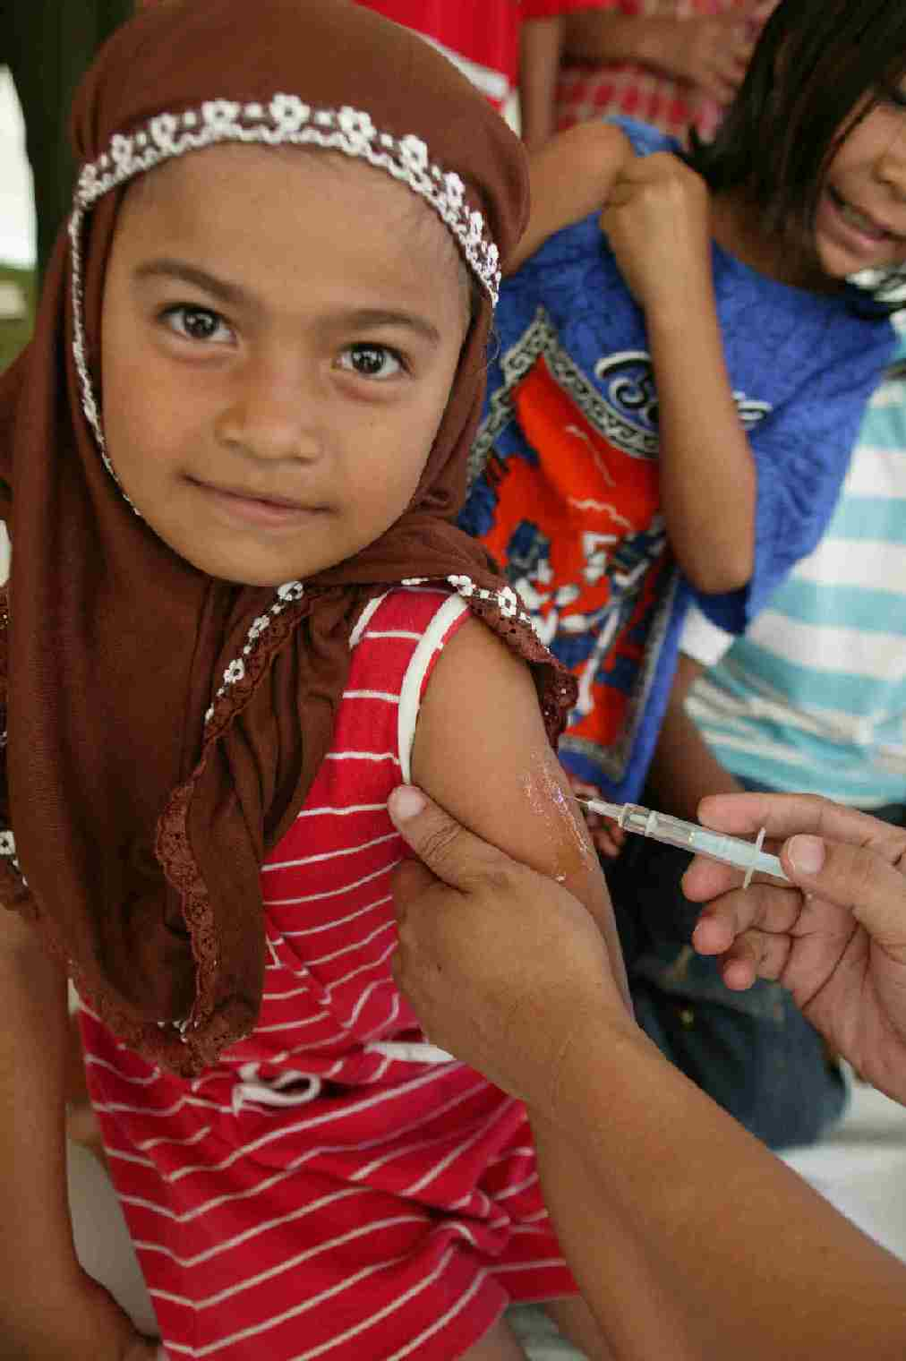
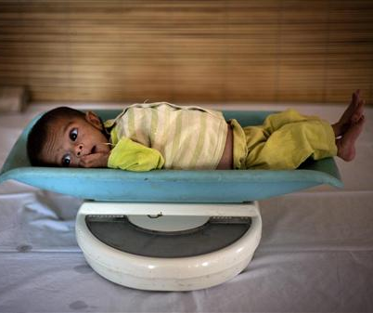
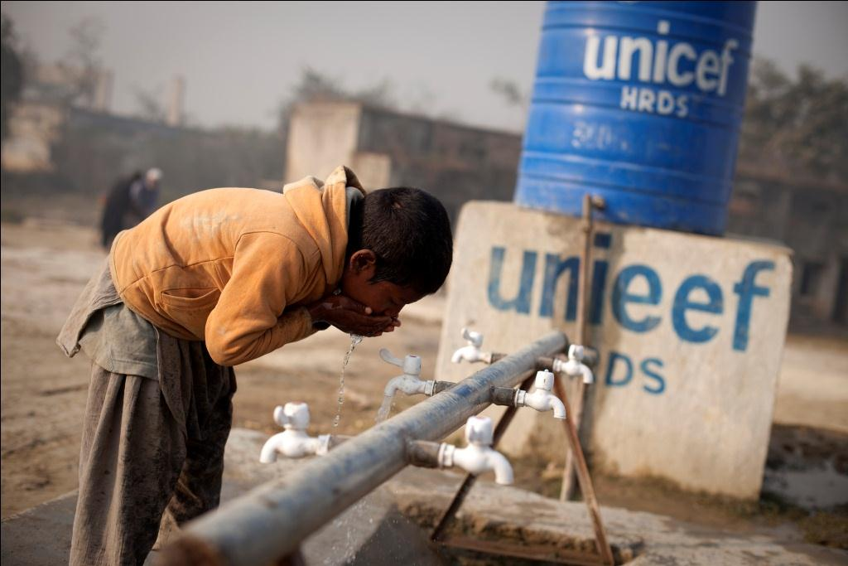
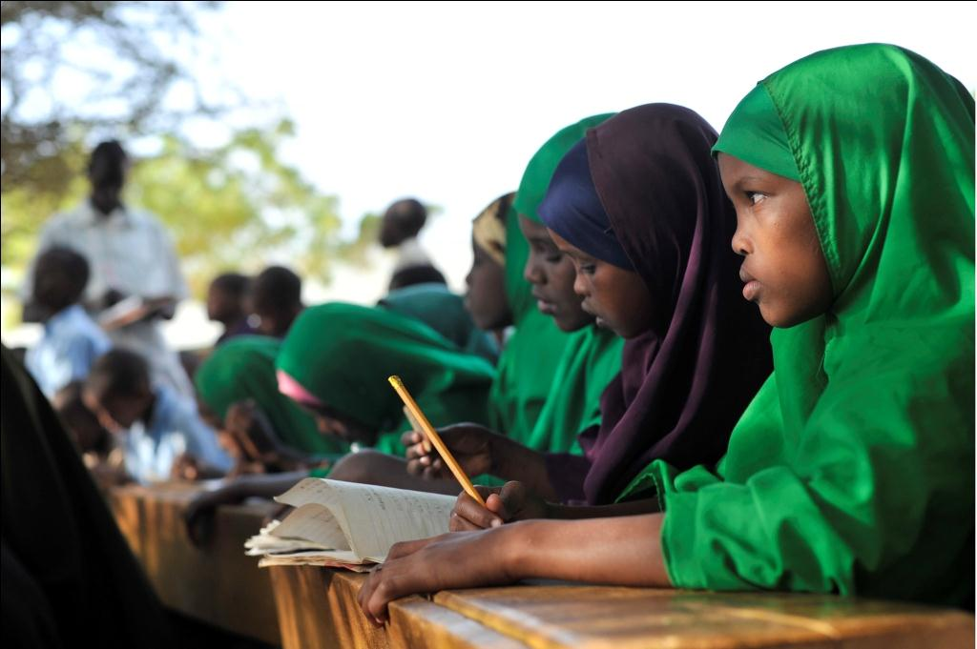
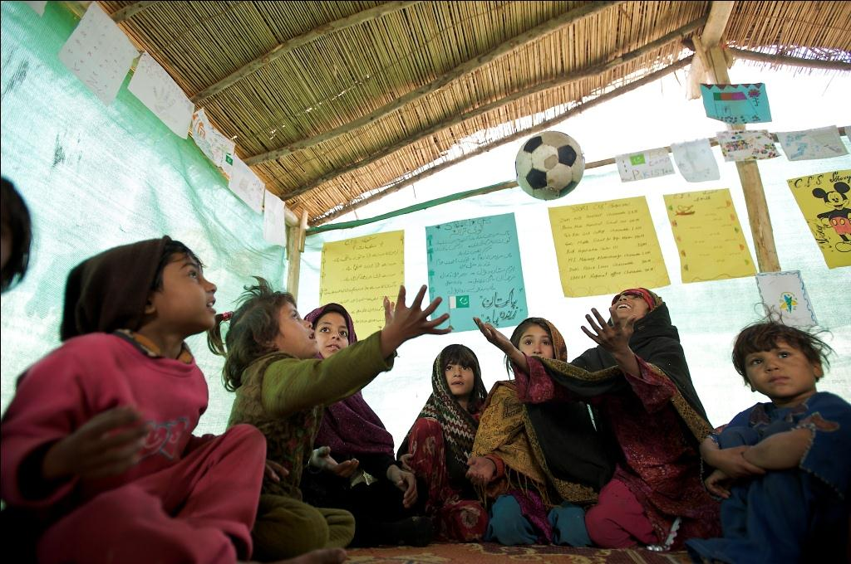
UNICEF’s Core Commitments for Children
Health
Nutrition
Water, Sanitation
& Hygiene
Education
Child Protection

Slide 45
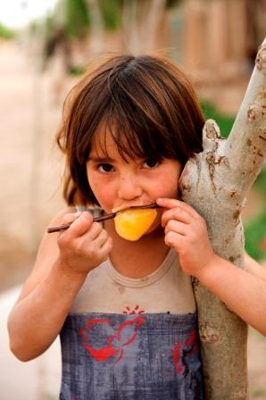
Vision of UNICEF’s Humanitarian Action
Save lives and protect rights
Address underlying causes of vulnerability and conflict

Slide 46
The Humanitarian Situation in 2012 & Response

Slide 47
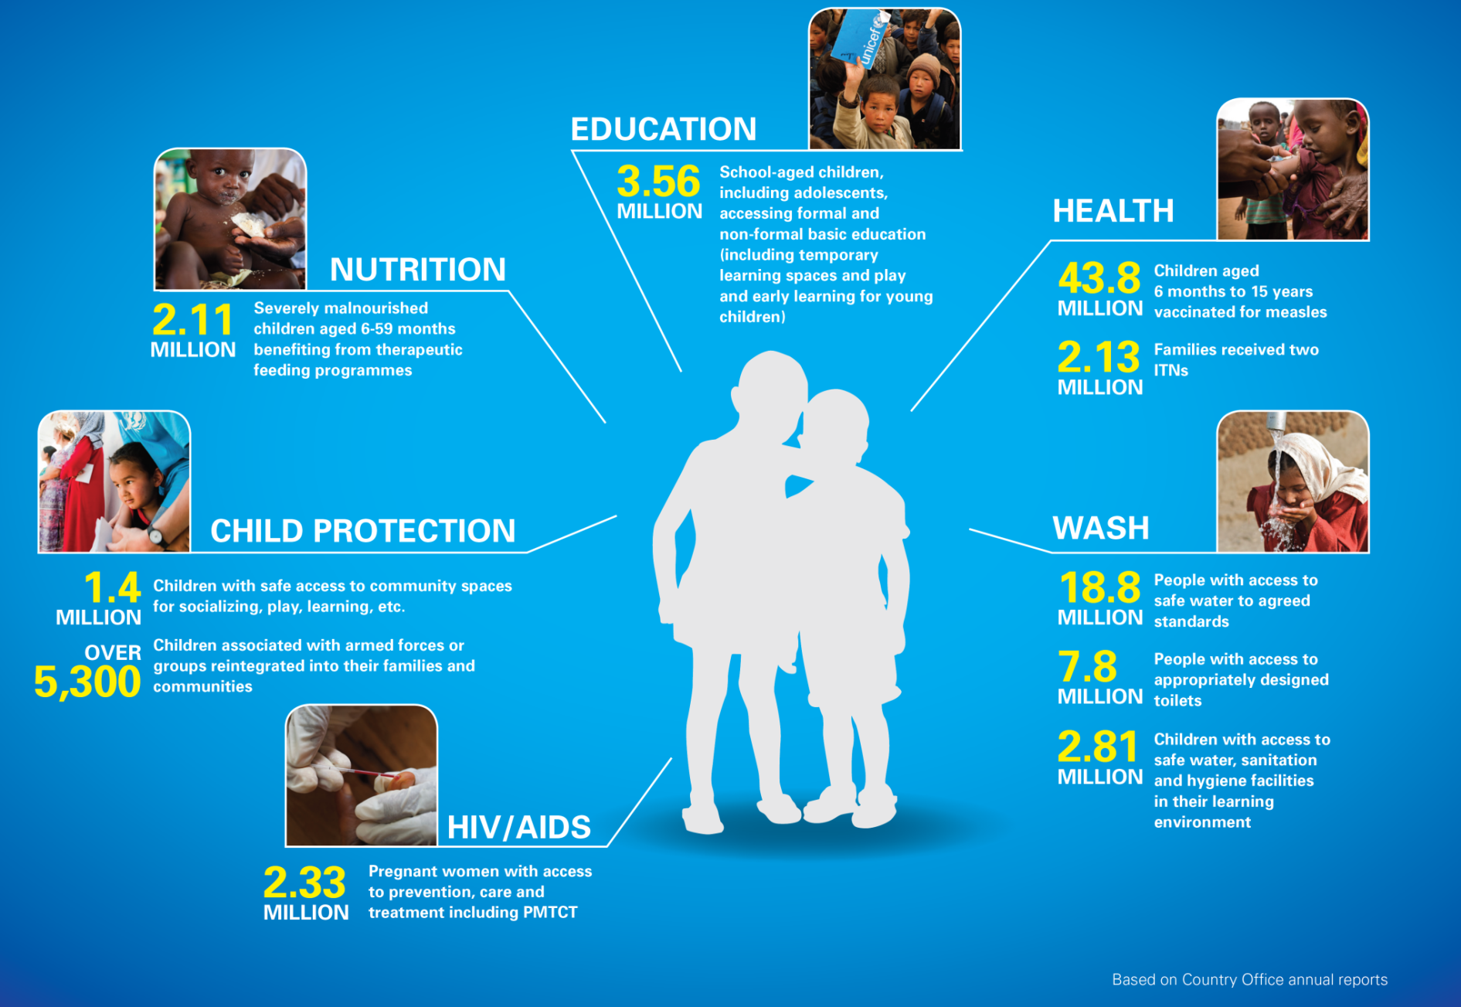
Results in 2012:

Slide 48
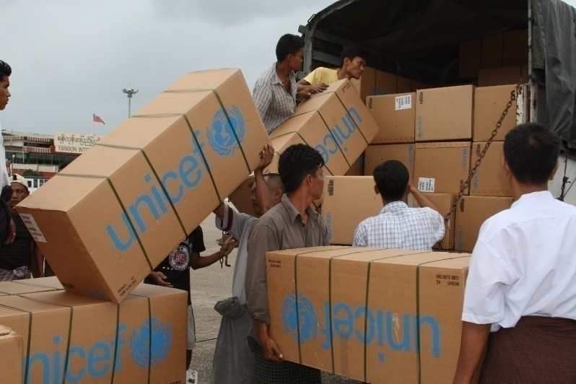
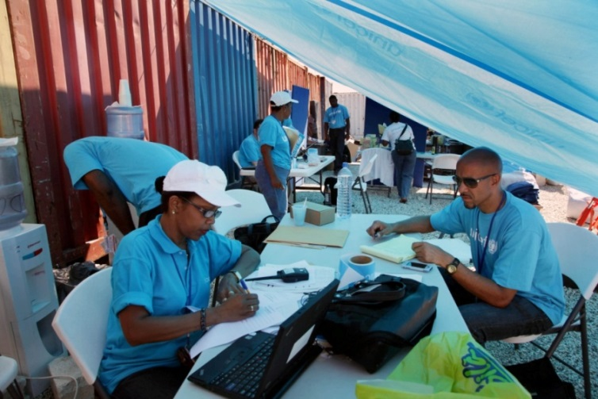
Global Operation Mechanism
UNICEF GENEVA
Partnerships with other UN agencies
Fundraising
Global Cluster Support
UNICEF NYHQ
Office of Emergency Programmes
Emergency Response Team
Global Support for Programme Areas
Global Cluster Support
COPENHAGEN SUPPLY DIVISION
Regional Offices (7 locations)
- Guidance and direct support
SHANGHAI SUPPLY HUB
County Offices
Emergency Response Plan
Stockpiling supplies
Working with partners
PANAMA SUPPLY HUB
DUBAI SUPPLY HUB
UNICEF

Slide 49
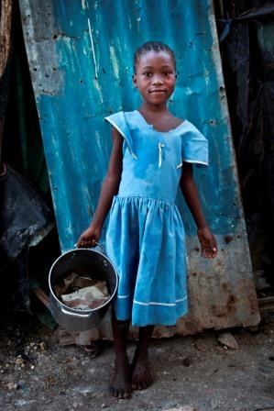
Emergency Preparedness
UNICEF works with governments and partners to support preparedness, in addition to response, recovery and risk reduction.
Target of our efforts:
Strengthening the preparedness capacity of national systems and communities (based on analysis of the threats facing children)
Internally, supporting UNICEF staff at all levels
Externally, supporting partners through cluster leadership
Tools of the trade:
Early warning/risk monitoring
Standard operating procedures for response
Contingency planning
Emergency training
Drills and simulations

Slide 50
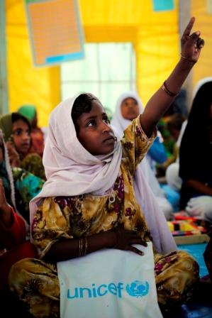
Building systems to strengthen resilience
Strengthening resilience to prevent and mitigate the worst consequences of disasters
Community empowerment, strengthening social service delivery and capacity development
  Brazil, Ethiopia, Kenya, Niger, Pakistan and Zimbabwe
Risk-informed programming, including disaster risk reduction and situation analysis
Peacebuilding, with focus on education in 13 countries

Slide 51
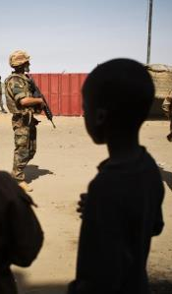
Addressing Grave Violations Against Children in Armed Conflict
In complex emergencies, children are particularly vulnerable to grave violations. State and non-state actors must protect children and other civilians.
SCR 1612 on Children and Armed Conflict established a compliance mechanism to end grave violations.
SCR 2068 called for strengthened measures to bring persistent perpetrators into compliance with international child rights standards.
  UNICEF supports the implementation of the monitoring and reporting mechanism for grave violations against children in 14 countries.
  Four new Action Plans negotiated in 2012 (two in Somalia, one in DRC, one in Myanmar)
  Programmes in place to assist survivors of grave violations

Slide 52
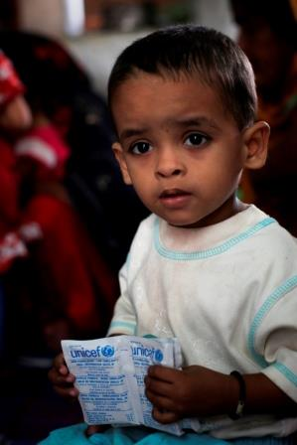
Recent Reforms and Successes
In response to the mega-emergencies of 2010, UNICEF took bold steps:
Human Resources (HR) in emergencies unit established and HR fast track adopted, which improved surge deployment
Level 2 & 3 Simplified Standard Operating Procedures (SSOP) finalized, which led to a more predictable and efficient response
Resources invested in strengthening monitoring for results in humanitarian action (e.g. Mali, Syria, etc.)
Supported the IASC Transformative Agenda

Slide 53
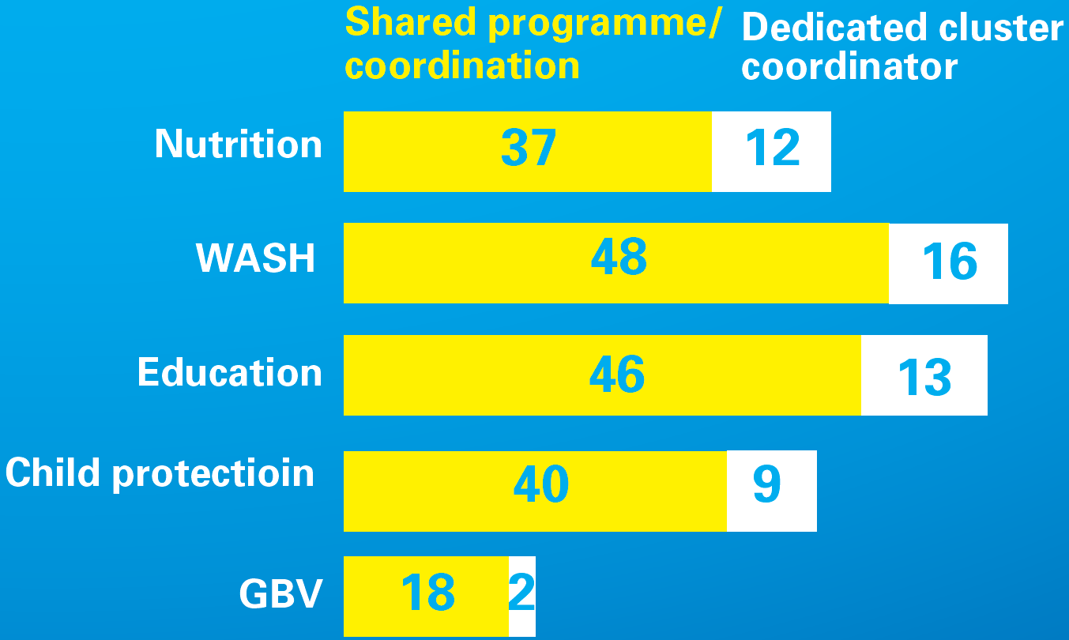
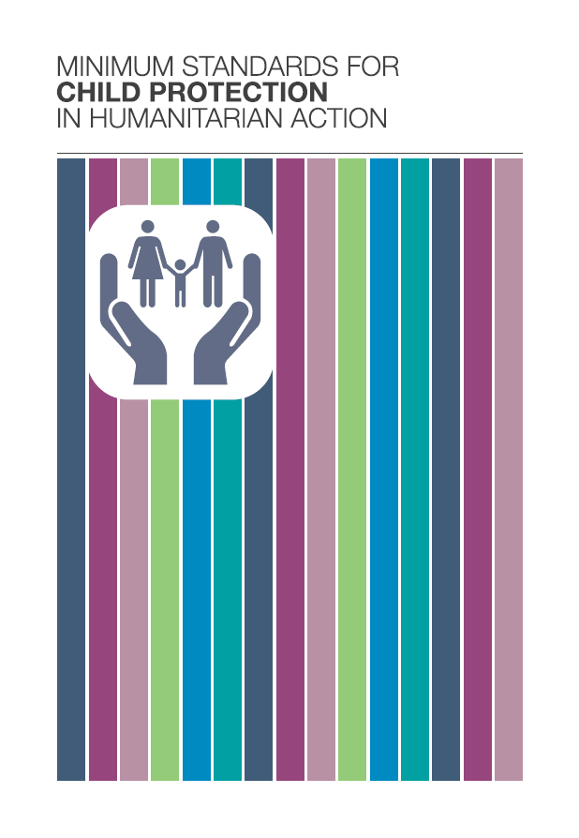
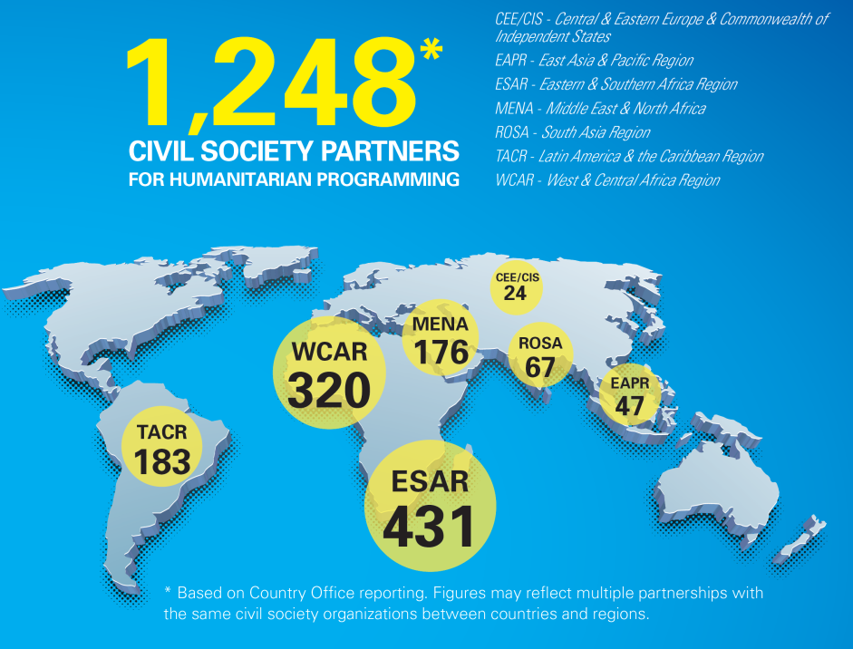
Strengthened collaboration / Coordination

Slide 54
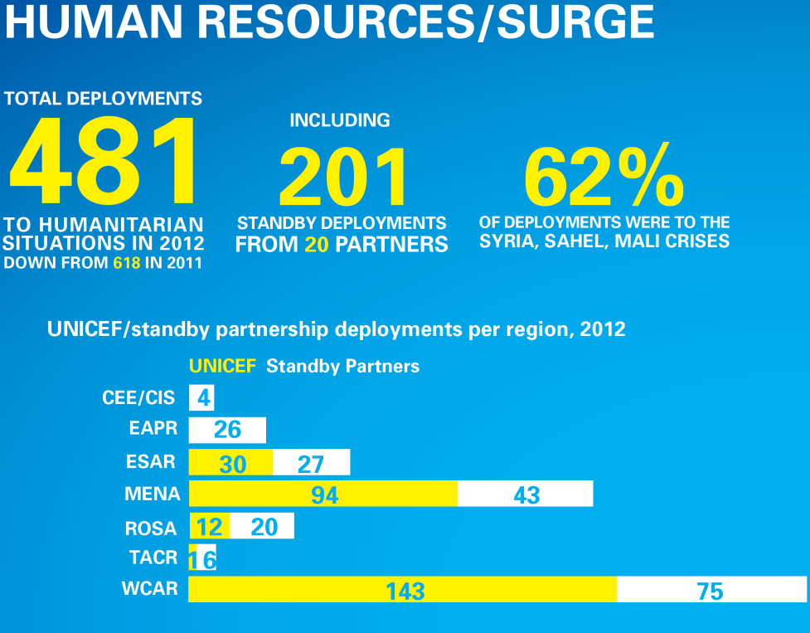

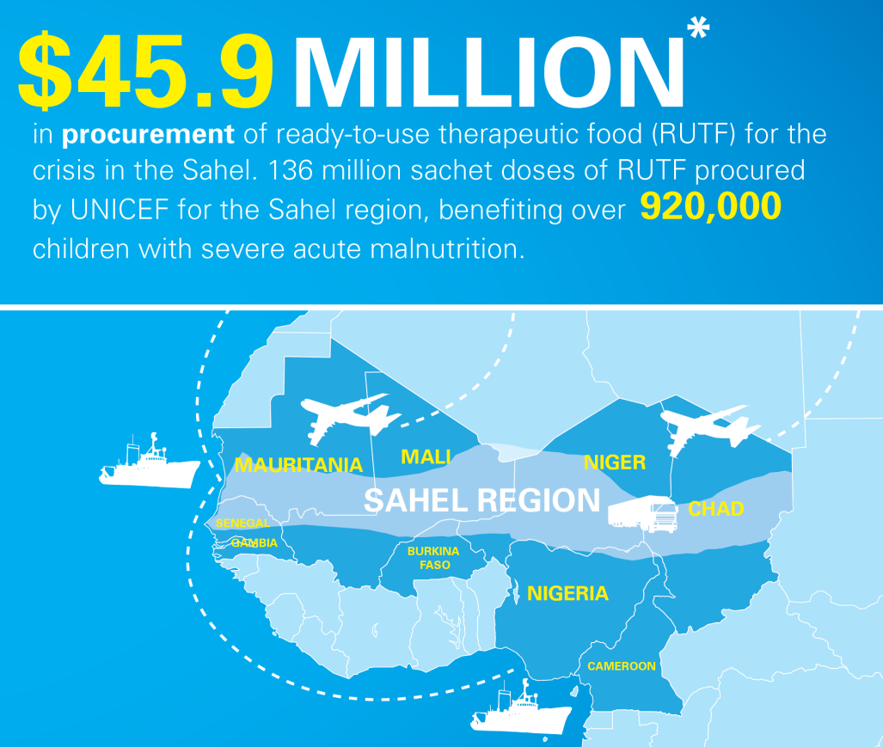
Operations

Slide 55
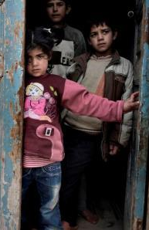
Syria: Example of a Major Response
A children’s crisis: Of the 9.3 million people affected by the crisis in Syria, nearly half are children.
Major Challenges to Response:
Attacks against humanitarian workers
Intensive armed conflict and presence of extremist groups hampering aid delivery
Limited partner movements and humanitarian access
Protection of civilians, in particular children

Slide 56
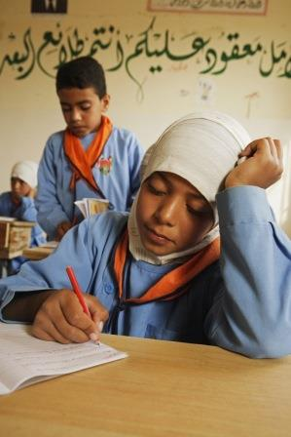
Syria: Example of a Major Response
In 2013, UNICEF reached 11.3 million people in the region in the sectors of Health, WASH, Child Protection and Education
In Syria in 2013:
1.1 million children vaccinated
10 million people provided with access to safe drinking water
400,000 children provided with remedial classes, psychosocial support and recreational activities
In the sub-region in 2013:
1.3 million people reached with combination of access to drinking and domestic water, immunization against measles, learning programmes and access to psychosocial support

Slide 57
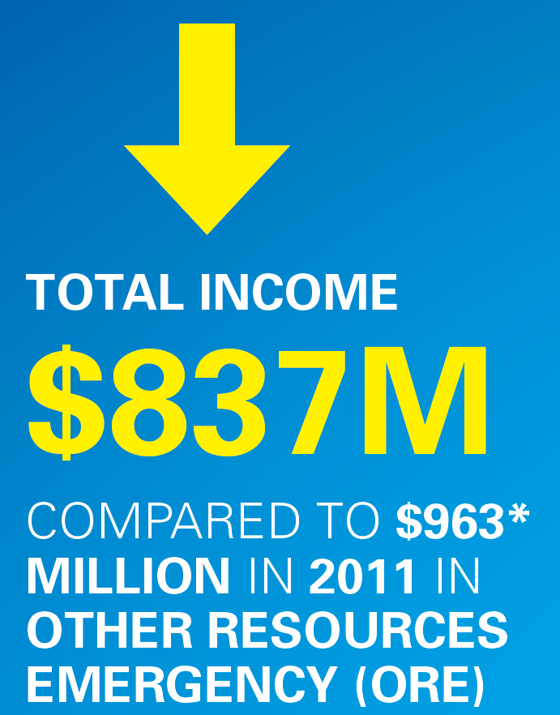
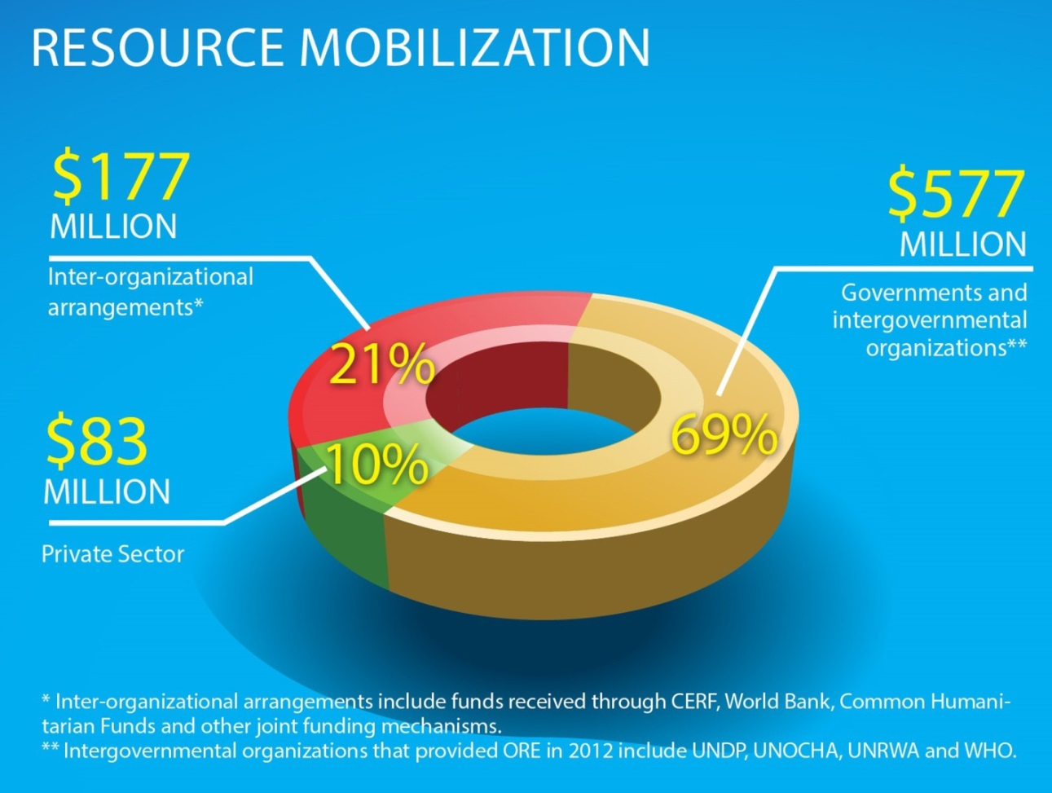
Humanitarian Income

Slide 58
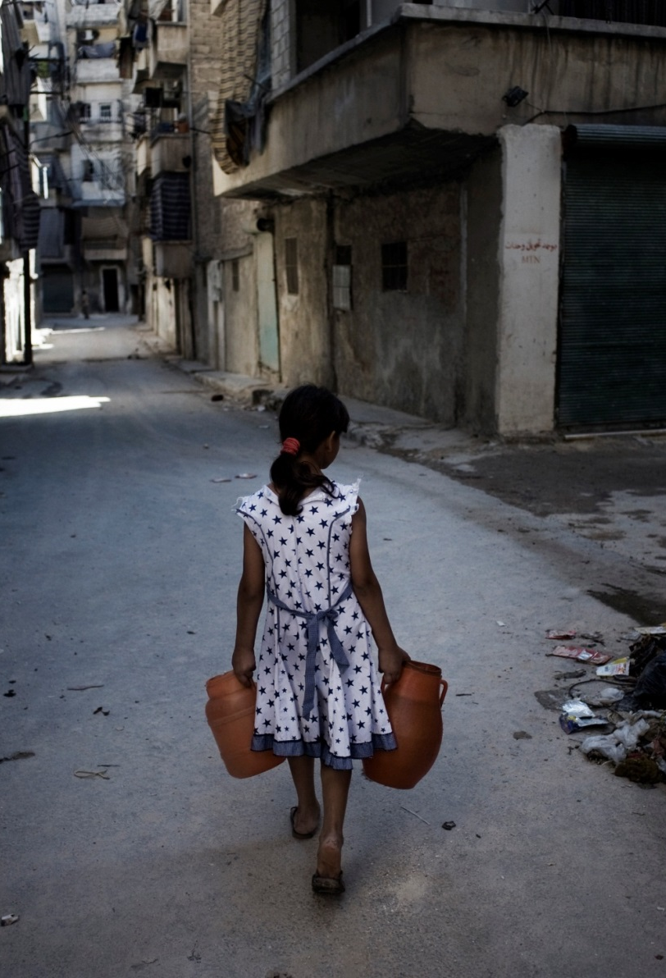
2013 Funding Gaps
Country | Funding Gap
Afghanistan | 9%
CAR | 65%
DRC | 44%
DPRK | 50%
Mali (+Burkina Faso, Mauritania, Niger, WCARO) | 62%
Pakistan | 29%
South Sudan | 56%
Sudan | 49%
Syria (+Lebanon, Jordan, Iraq, Turkey, Egypt) | 21%
Yemen | 48%
Funding Received as of 11 June 2013
Notes:
We are again seeing significant gaps
The Mali and Syria crises have large gaps, in part due to the enormous needs
But we’re also seeing significant shortfalls in acute crises, such as CAR, as well as chronic situations in DPRK, Pakistan, South Sudan and Sudan, and Yemen

Slide 59
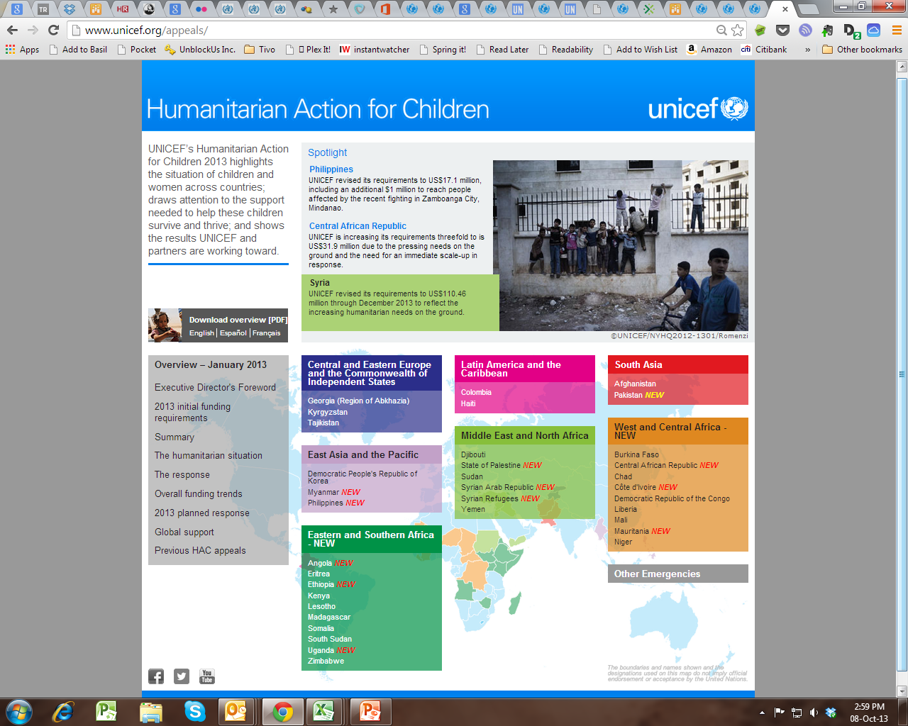
Humanitarian Action for Children: www.unicef.org/appeals

Slide 60
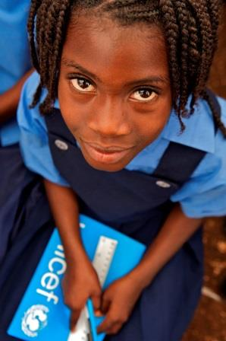
Looking ahead
Strategic Plan and post-2015 agenda: new opportunities for resilience
Further simplification
Helping to improve inter-agency response to non-Level 3 emergencies
A practical and inclusive humanitarian partnership system (regional and South-South)

Slide 61
conclusion
Great leaders often inspire their followers to high levels of achievement by showing them how their work contributes to worthwhile ends. It is an emotional appeal to some of the most fundamental of human needs-the need to be important, to make a difference, to feel useful, to be a part of a successful and worthwhile enterprise.
Warren Bennis, PhD, founding chairman of the leadership Institute at the University of Southern California.

Slide 62
Reference
*Source: “International Human Rights: Law, Policy and Process,” David Weissbrodt, Joan Fitzpatrick and Frank Newman (3d ed. 2001)

