Slide 1
Decision Making in Non Profit Sector (NPO)
Lecture-12
MPA 505
MPA Program
Course Instructor: Riffat Abbas Rizvi

Slide 2
Agenda
Preview of the last lecture
United Nations Terminologies
Civil Society
UN and NPOs
UNICEF
UNMOG
Conclusion

Slide 3
United Nations and NPOs
BINGOs Big International NGOs
BONGOs Business Organized NGOs
CBOs Community Based Organizations
CSOs Civil Society Organizations
ENGOs Environmental NGOs
GONGOs Government Organized NGOs
IPOs Indigenous Peoples Organizations
GROs Grassroots Organizations
GSCOs Global Social Change Organizations
NPOs Nonprofit Organizations
VOs Voluntary Organizations

Slide 4
United nations and npos
In short, there is no agreed terminology for describing the NGO sector.
In some ways, it is easier to describe what NGOs are not, rather than what they are.
It is generally agreed that NGOs are not: an art of government, or organized primarily for private profit.

Slide 5
Civil society
The Panel described civil society in the following way:
… the associations of citizens (outside their families, friends and businesses) entered into voluntarily to advance their interests, ideas and ideologies.
The term does not include profit-making activity (the private sector) or governing (the public sector).

Slide 6
United nations and npos
In short, there is no agreed terminology for describing the NGO sector.
In some ways, it is easier to describe what NGOs are not, rather than what they are.
It is generally agreed that NGOs are not: an art of government, or organized primarily for private profit.

Slide 7
Relevance to the united nations
Of particular relevance to the United Nations are mass organizations (such as organizations of peasants, women or retired people), trade unions, professional associations, social movements, indigenous people’s organizations, religious and spiritual organizations, academe and public benefit non-governmental organizations.

Slide 8
NGOs and United nations
“Ten years ago there was little talk of civil society in the corridors of power, but now the walls reverberate with at least the rhetoric of partnership, participation, and the role of citizens’ groups in promoting sustainable development”
The number of NGOs who are active at the UN has grown rapidly, especially since the 1990s.

Slide 9
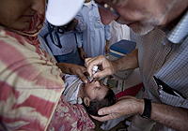
Donor-UNICEF
Camps on the outskirts of Charsadda city.
The camps are hosting a total of 332 families, including some 1,460 children and 440 women.
UNICEF is providing water and sanitation, health, hygiene and child-protection services for the displaced.
UNICEF Executive Director Anthony Lake (right) administers oral polio vaccine to a baby at the Prang Government Primary School shelter in Charsadda district, located in the Pakistani province of Khyber-Pakhtunkhwa.

Slide 10
UNICEF-
UNICEF is going to do everything it can, not just during this emergency but as Pakistan works its way out of this emergency as well,” Mr. Lake

Slide 11
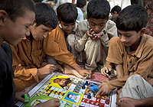
Boys play a board game in a UNICEF-supported child-friendly space at the Prang Government Primary School in Charsadda district, Khyber-Pakhtunkhwa, Pakistan. The school is being used as a relief camp for flood-affected families.

Slide 12

UNICEF
This is one of the last areas in the world where there is polio, so the whole world will be watching to see how well we can do in preventing another outbreak, not just with measles, not just with diarrhoea, but with polio,” said Mr. Lake.

Slide 13
UNICEF
The camps in Charsadda are a small oasis of safety in a country that has been devastated by its largest disaster in living memory.
Nearly 8.6 million children have been affected by the floods throughout Pakistan, and about 3.5 million are at risk of contracting waterborne diseases.
UNICEF is gravely concerned that further disaster will follow unless more aid becomes available immediately.

Slide 14
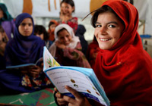
Safia Bibi, 11, reads a book provided by UNICEF at the Jalozai camp for the internally displaced in north-western Pakistan.
Camps and communities in Khyber Pakhtunkhwa Province have been receiving internally displaced people (IDPs) since 2008. However, a fresh influx of people due to heightened insecurity since the beginning of this year has placed added pressure on resources and services.

Slide 15
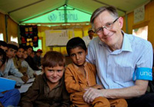
UNICEF Representative in Pakistan Dan Rohrmann said, “With 280,000 people having moved from the Khyber Agency to Nowshera District, of which over 50,000 are residing in Jalozai camp, we really have a critical emergency that is not drawing enough attention.”
The new IDPs are being housed in Jalozai, Togh Serai and New Durrani camps and many more reside with host communities in Peshawar and Nowshera districts.
UNICEF has issued a request for US$37.2 million to meet the needs of this complex emergency. Funding of only US$11.9 million has been received so far.

Slide 16
UNICEF
12 UNICEF-established primary schools in the camp.
Nearly 4,483 students are enrolled in the ‘child-friendly schools’, which offer important health and hygiene lessons as well as recreation
psychosocial support and other features that engage the children and their communities.

Slide 17
Essential services
UNICEF has also established 21 Protective Learning and Community Emergency Services (Places) centers in the camp to provide a protective environment for women and children. There, psychosocial support is provided in addition to educational and recreational activities.

Slide 18
unicef
“Families from tribal areas, especially females, do not stay in the camp for long. At times, they are here and at other times they move back to their villages.
Because of this back-and-forth, they face some psychological problems. Psychosocial support that we provide in these centers benefits them a lot,” said Saiqa Gigyani, a child protection monitor at one of the Places.

Slide 19
Jalozai Camp-UNICEF
In Jalozai camp, UNICEF and partners are providing safe water to more than 58,000 people and are maintaining 4,000 latrines, 1,800 washrooms, 1,000 washing pads and 200 solid waste collection points. Thousands of families have received hygiene kits, buckets and jerry cans.

Slide 20
UNICEF
UNICEF is providing critical services to the new IDPs.
Immunization is one of them because many of the children have not been vaccinated for years. Secondly, nutritional services are critical because many children who come here are severely malnourished.
Provision of clean water and sanitation helps prevent outbreak of waterborne diseases, and of course education provides a possibility to re-connect with a learning opportunity that has been dearly missed.

Slide 21
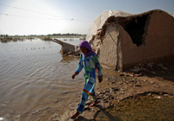
Ten-year-old Reshma walks in front of her destroyed house in Jacobabad district, Sindh.
Nearly 460,000 houses have been swept away or badly damaged by flooding.
Children are disproportionately affected in the aftermath of such emergencies

Slide 22
Disproportionate risk for children
Rain fell continuously for several days in early September, inundating many areas of southern Punjab, northern Sindh and northern Balochistan.
The National Disaster Management Authority puts the number of affected people at 5.06 million – with satellite imagery showing that large areas of 15 districts were flooded.
More than 1.12 million acres of crops have been affected, and nearly 460,000 houses have been swept away or badly damaged.
Reports from the field indicate that the families affected this year are even worse off than those affected by the previous floods, with higher standing water and more devastation across a smaller area. There are dire needs for shelter, food, water, sanitation, healthcare, malaria prevention and education.
In the aftermath of flood emergencies such as this one, children become disproportionately susceptible to diseases and malnutrition, and many are unable to attend school.

Slide 23
Disrupted lives
Reshma hasn’t been able to attend school for weeks.
The two-room school building quickly filled with household items as village residents rushed to save whatever they could from the rising water.
The downpours also deluged what had looked like a bountiful rice crop, just before harvest. Weeks later, the land is still inundated with the floodwaters.
The rice itself will be useless, although the grassy stems can be chopped off to use as fodder for livestock.

Slide 24
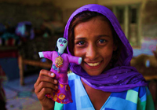
Reshma holds a doll she has made. She is waiting for the floodwaters to recede so she can return to school and also help her family build a new home. For now, “we need food and water,” she says.

Slide 25
Reshma spends her days waiting for the water to recede so she can go back to school and also help her family build a new home. Until then, her desires are modest. “We need food and water,” she says. “Right now, we live in others’ homes; I will be content once I go back to my own.”

Slide 26
Providing water, education and protective spaces
In response to the flood emergency, UNICEF and partners are providing safe drinking water to 267,900 flood-affected people in Balochistan, Punjab and Sindh.
If funding permits, UNICEF, government and cluster partners plan to provide emergency education services to more than 21,000 children by establishing 1,147 temporary learning centres, which aim to provide safe and secure learning environments that promote the protection and well-being of students.
Fifteen are already up and running, benefitting more than 2,100 children. Children in these centres will be mainstreamed back into regular schools, as either continuing or new students.

Slide 27
Child Protection-Sub Cluster
The child protection sub-cluster, including UNICEF, Save the Children and Action Aid, has established 16 protective spaces in Sindh, benefitting more than 1,658 children, of whom 46 per cent are girls. In addition, 379 children (49 per cent girls) and 73 women have received or are receiving psychosocial support and have access to recreational activities through the child protection sub-cluster response.

Slide 28
Preparing for the future
“The impact of devastating flooding in Pakistan over the past three years has been particularly severe for millions of children,” says Emergency Coordinator for UNICEF Pakistan Oscar Butragueño. “Recurrent natural disasters affect Pakistan’s ability to achieve development goals.
This is why UNICEF not only reaches out to flood-affected children and their families in the country’s most disadvantaged areas, but we are committed to mitigating the impact of disasters on children and increasing community resilience by integrating disaster risk reduction into all of our work.”

Slide 29
UNICEF REQUIREMENT
To continue life-saving activities in response to the 2012 monsoon floods, UNICEF urgently needs US$15.4 million to provide flood-affected communities with timely and adequate assistance through the next three months.

Slide 30
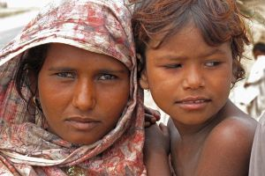
Pakistan’s Hunger Facts
The monsoon floods in August hit a country already grappling with high levels of malnutrition, high food prices and a humanitarian crisis along its border with Afghanistan.

Slide 31
Facts Behind Hunger
20 million affected by the floods
The Pakistan floods this summer impacted the lives and livelihoods of some 20 million people, around 10 million of whom required emergency food assistance.

Slide 32
2. Nearly one in two Pakistanis at risk
Pakistan suffered from widespread hunger even before the monsoon floods, with an estimated 82.6 million people – a little less than half the population – estimated to be food insecure.

Slide 33
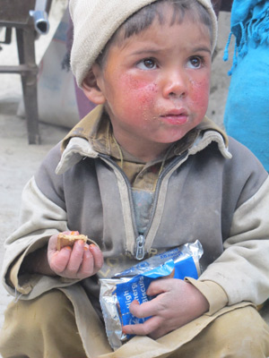
3. Widespread poverty
An estimated 36 percent of Pakistanis live below the poverty line and almost half are illiterate.
Poorer households typically spend over 60 percent of their income on food.

Slide 34
4. Poor sanitation
50 percent of all Pakistanis have little or no access to clean toilets and drinking water, a condition that renders them vulnerable to infectious diseases.

Slide 35
5. Child mortality
The biggest killers of children under five in Pakistan are diarrhea and acute respiratory infections. Undernourishment is an underlying cause in 38 percent of those cases.

Slide 36
6. Violent conflict
Conflict along Pakistan’s northwestern border with Afghanistan has forced millions of people to flee their homes. Since 2008, WFP has provided over 2.6 million of them with food assistance.

Slide 37
7. Rising hunger
Volatile food prices over the past seven years have pushed the number of people who depend on food assistance in Pakistan from 38 percent of the population in 2003 to 49 percent in 2009.

Slide 38
8. Wheat dependent
Wheat is Pakistan’s main staple crop and most important source of calories.
As a result of the flooding, which submerged around 16 percent of all arable land in Pakistan, the upcoming wheat harvest is expected to be around 15 percent smaller than usual.

Slide 39
Two months into the flooding, its economic loss and social impact on Pakistan is though to size up, millions of hungry affectees are awaiting emergency relief.
In the midst of such an unparalleled disaster, the United Nations World Food Program (WFP) said it is actively engaged in tackling the worst food crisis in Pakistan's history, with a shorter-run plan and a longer-term program.

Slide 40
Exclusive interview
In an exclusive interview with Xinhua, WFP Pakistan Country Director Wolfgang Herbinger said the aid agency, teamed up with the government of Pakistan, is leading a pilot UN development program to help the country for better disaster management and to improve the handling of food insecurity.
"WFP has a leading role working closely with the government at national, provincial, and district level to improve their own capacity to handle the disasters," Herbinger said.

Slide 41
Pakistan has been on a good track of development but since 2003 the food insecurity has deteriorated due to natural calamities, global food price hiking and militancy conflicts, he said, so WFP set a program for next two years, until the end of 2012, which would improve household food security particularly in the border area and the hardest-hit areas by the flood.
The WFP representative said the flooding is the biggest disaster ever in the history of natural or man-made disasters in Pakistan, affecting over 21 million. An assessment shows luckily that only half of them need urgent assistance.

Slide 42
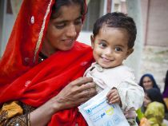
Locally produced supplementary food ‘Acha Mum” provides energy and micronutrients to children aged 6 to 59 months suffering from acute malnutrition. Copyright: WFP/Amjad Jamal

Slide 43
Steps taken by WFP
WFP is taking practical steps to stabilise and improve the nutritional and food security levels of the most affected and vulnerable population in the country.
Locally produced products called ‘Wawa Mum’ and ‘Acha Mum’ are being used in the community based management of acute malnutrition (CMAM) programme, in key districts across the country.
WFP has currently helped treat nearly half a million malnourished children under this programme, which has seen high recovery rates.

Slide 44
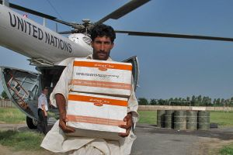
A man helps unload a shipment of supplementary plumpy, a specialized food product designed to protect young children from malnutrition. Copyright: WFP/Marco Frattini

Slide 45
Six Million People
As Pakistan continues to reel from a disastrous wave of monsoon flooding, WFP’s operation to bring emergency food aid to six million people a month is being extended in time and expanded so as to help long-term recovery. Further assistance from donors is needed.

Slide 46
Growing needs
WFP has been streaming emergency humanitarian assistance into Pakistan since the beginning of August and has so far received US$103 million.
The budget required for the new emergency food relief operation through to July 2011 is now USD $600 million.

Slide 47
WFP
WFP aims to provide emergency food assistance to an average of 6 million people each month while transitioning towards recovery activities, such as programmes that provide people with cash and food in return for work on projects to rebuild their communities

Slide 48
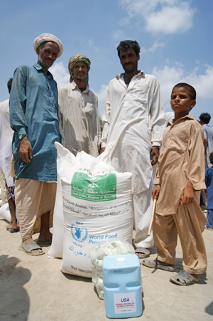
WFP estimates that more than 10 million people need immediate food assistance. WFP will aim to reach the majority of those affected, while the Pakistan government and NGOs are also providing food assistance.
In addition to providing food to families, WFP is also setting up a specialised feeding programme targeting small children, and pregnant and nursing mothers—who are particularly vulnerable to the effects of hunger and malnutrition.

Slide 49
Conclusion
United Nations Play a significant role in the humanitarian efforts.
Floods have recently devastated lots of communities thus marginalized community is provided necessary assistance from UNICEF And WFP.

