Slide 1
Strategic Human Capital

Slide 2
Learning Objectives
DEFINE organizational culture and IDENTIFY its core characteristics
DESCRIBE the major types of organizational culture identified in the competing values framework
IDENTIFY the factors responsible for creating organizational culture, for transmitting it, and for getting it to change
DEFINE creativity and DESCRIBE the basic components of individual and team creativity
DESCRIBE various approaches to promoting creativity in organizations
IDENTIFY the basic components of general innovation, its various forms, and the stages of the innovation process

Slide 3
Three Good Reasons Why You Should Care About . . . Culture, Creativity, Innovation
Organizational culture exerts profound influences on employees, both positive and negative
Managers play pivotal roles in developing, transmitting, and changing organizational culture
Individual and team creativity is an important determinant of an organization’s capacity to be innovative. This, in turn, plays an important role in organizational success
Notes:
2

Slide 4
Organizational Culture
Organizational culture is a cognitive framework consisting of assumptions and values shared by organization members

Slide 5
Core Cultural Characteristics
Sensitivity to others
Interest in new ideas
Willingness to take risks
The value placed on people
  Toxic organizational cultures - people do not feel valued
  Healthy organizational cultures - people are treated well and are inspired
Openness of available communication options
Friendliness and congeniality

Slide 6
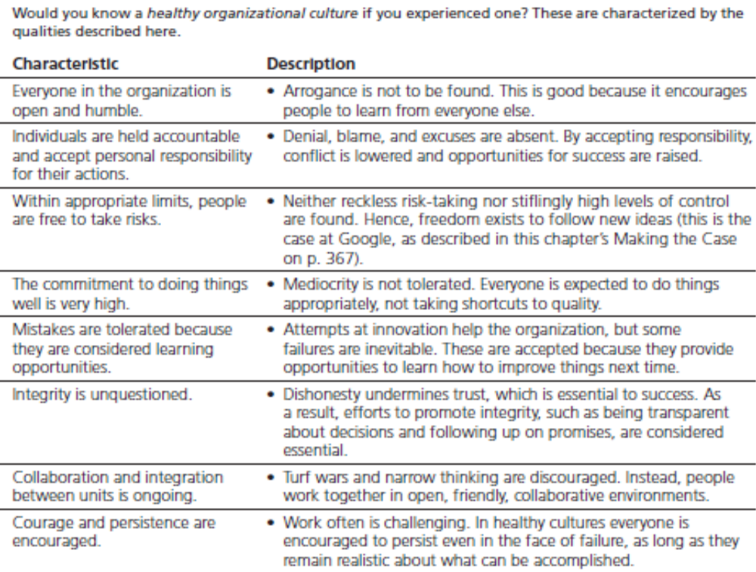
Core Cultural Characteristics

Slide 7
Strength of Organizational Culture
Strong culture - exerts a major influence on the behavior of individuals in the organizations
  Values are held intensely and shared widely
Weak culture - has a limited impact on the way people behave
Stronger organizational cultures are more common in smaller, newer organizations

Slide 8
Organizational Culture: One or Many?
Subcultures - cultures existing within parts of organizations rather than entirely throughout them
Dominant Culture - the distinctive, overarching “personality” of an organization , which reflects its core values
  Reflects core values

Slide 9
The Role of Organizational Culture
Cultures serve the following vital functions:
  Provide a sense of identity for members
  Generate commitment to the organization’s mission
  Clarify and reinforce standards of behavior

Slide 10
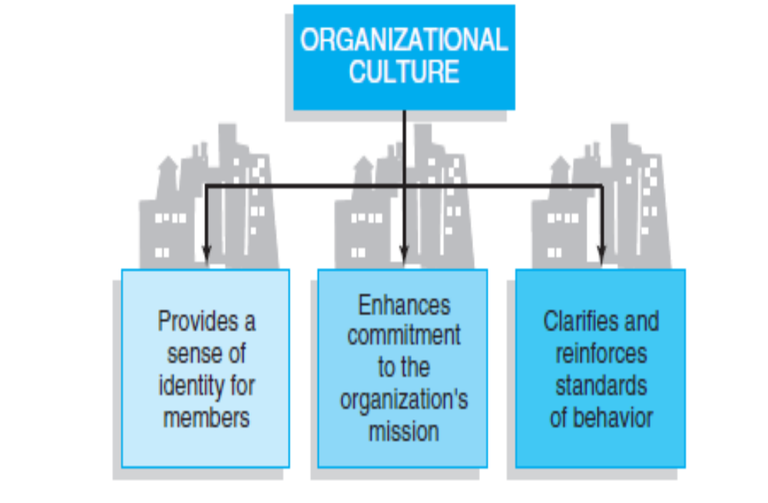
The Role of Organizational Culture

Slide 11
The Competing Values Framework
Competing values framework ― cultures of organizations differ with respect to two sets of opposite values
  Flexibility and discretion as opposed to stability, order, and control
  Attention to internal affairs as opposed to what’s going on in the external environment

Slide 12
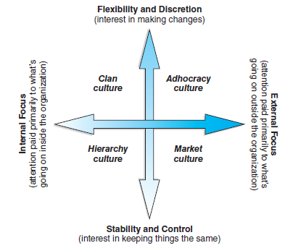
The Competing Values Framework

Slide 13
The Competing Values Framework
Four unique types of organizational culture:
  Hierarchy culture ― internal focus, stability, and control
  Market culture ― stability and control, but external in their orientation culture
  Clan culture ― strong internal focus with high degrees of flexibility and discretion
  Adhocracy culture ― flexibility yet attending to the external environment

Slide 14
Creating Organizational Culture
Two key factors:
  Company founders
  Experiences with the external environment
    Organizational memory – information from an organization’s history that its leaders draw upon later as needed

Slide 15
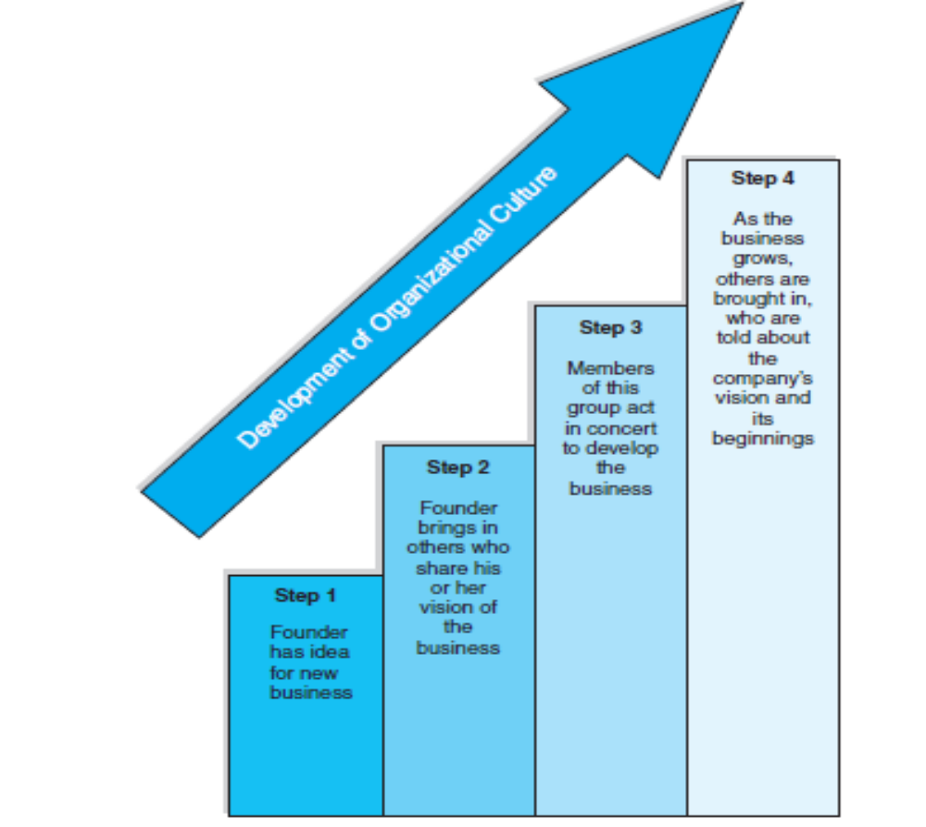
Founders and Organizational Culture

Slide 16
Transmitting Organizational Culture
Symbols ― material objects that connote meanings that extend beyond their intrinsic content
Slogans – send messages about the cultures of the organizations that use them
Jargon - the special language that defines a culture
Ceremonies ― special events that commemorate corporate values
Stories ― illustrate key aspects of an organization’s culture; telling them can effectively introduce those values to employees
Statements of principle ― define culture in writing

Slide 17
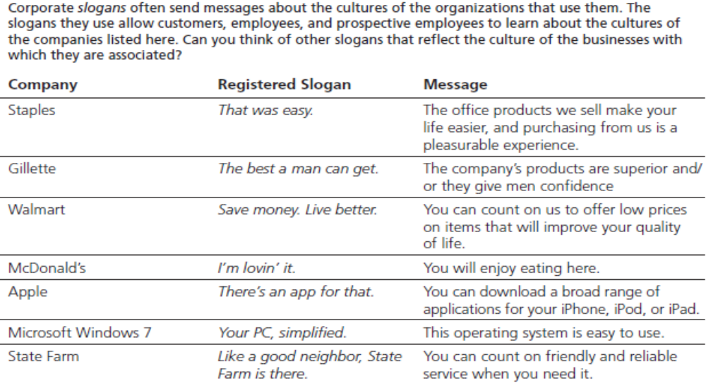
Slogans and Organizational Culture

Slide 18
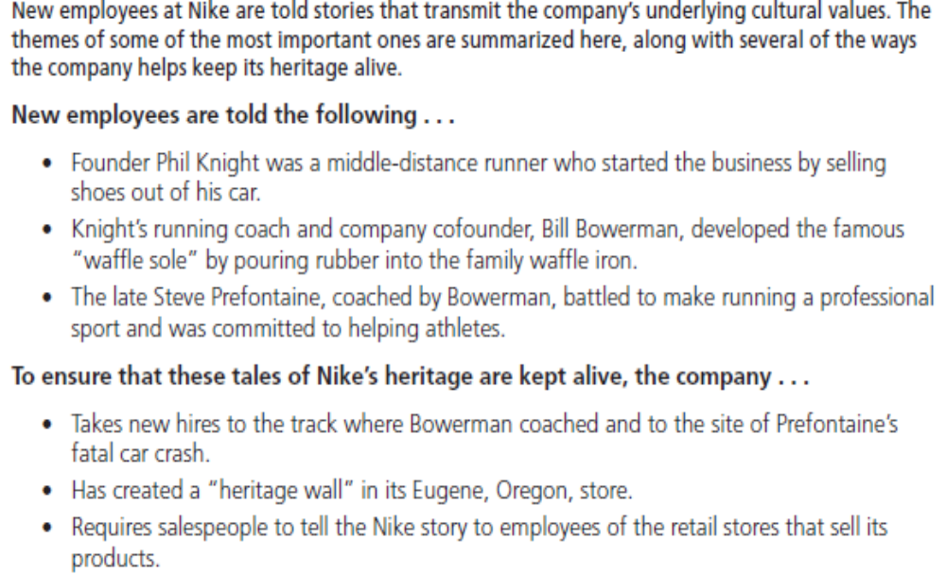
Stories and Organizational Culture

Slide 19

How Culture Changes
Composition of the workforce
Mergers and acquisitions
  Culture clashes ― merger of two organizations with incompatible cultures
Strategic organizational change
Responding to the Internet

Slide 20
Creativity
Creativity is the process by which individuals or teams produce novel and useful ideas
Components of individual and team creativity include:
  Domain-relevant skills - the capacity to perform a given task
  Creativity-relevant skills - the capacity to approach things in novel ways
  Intrinsic task motivation - the motivation to do work because it is interesting, engaging, or positively challenging

Slide 21
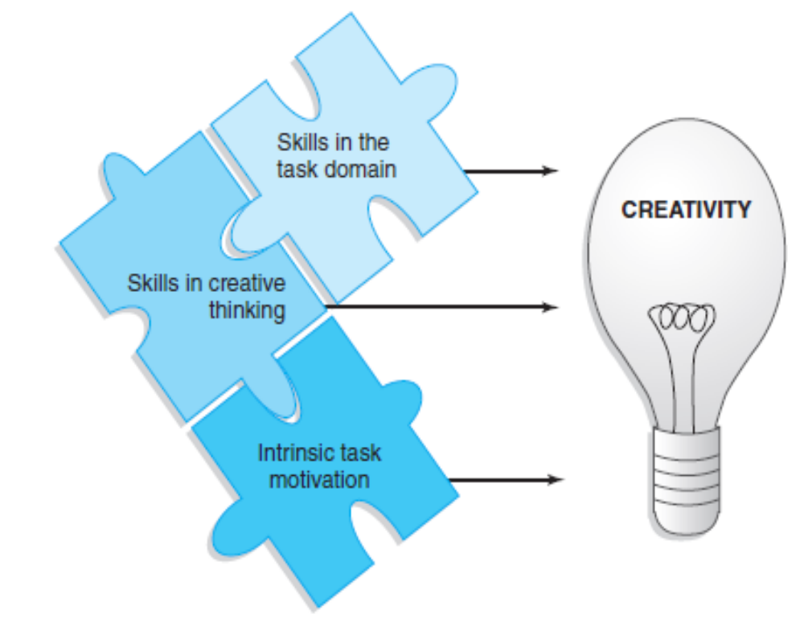
Components of Creativity

Slide 22
Creativity-Relevant Skills
Creativity-relevant skills ― special skills that foster creativity
  Break mental sets and take new perspectives
    Divergent thinking ― process of reframing familiar problems in unique ways
  Understand complexities
  Keep options open and avoid premature judgments
  Follow creativity heuristics ― strategies that help approach tasks in novel ways
  Use productive forgetting ― ability to abandon unproductive ideas and temporarily put aside stubborn problems until new approaches can be considered

Slide 23
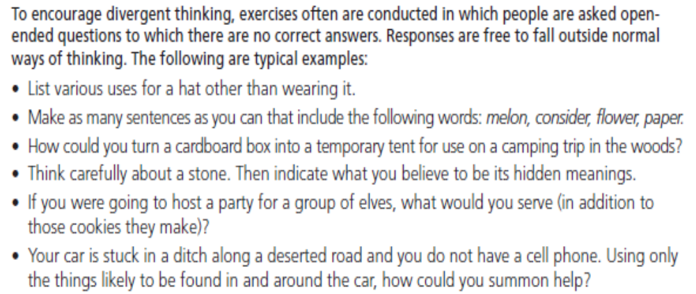
Triggering Divergent Thinking

Slide 24
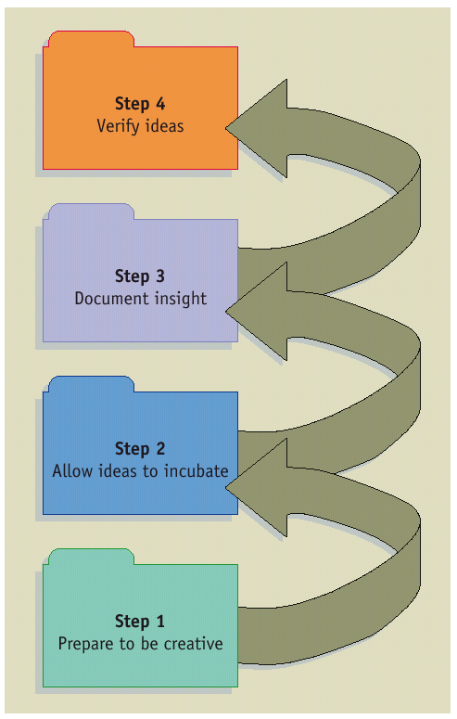
A Model of the Creative Process

Slide 25
Training People to be Creative
Think outside the box
  Encourage openness to experience
  Send employees on thinking expeditions
Set creative goals

Slide 26
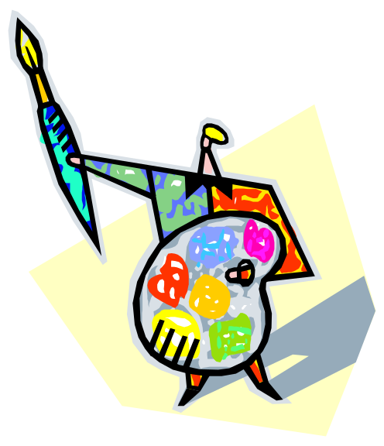
Developing Creative Environments
Ensure autonomy
Provide exposure to other creative people
Allow ideas to cross-pollinate
Make jobs intrinsically interesting
Set your own creative goals
Support creativity at high organizational levels

Slide 27

Innovation
Innovation - the successful implementation of creative ideas within an organization
Building blocks:
  Motivation to innovate
  Resources to innovate
  Innovation management
    Goals
    Rewards
    Time Pressure

Slide 28
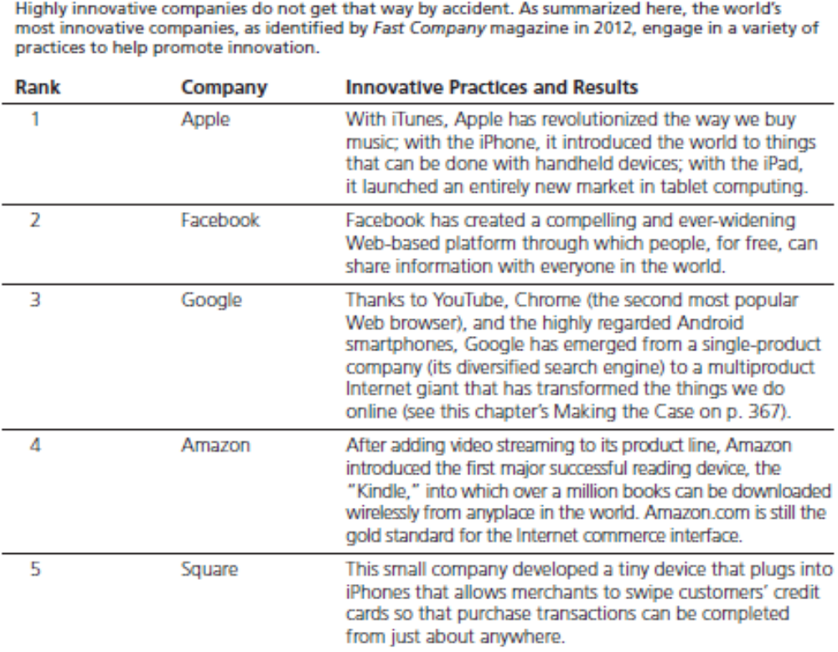
Five Most Innovative Companies

Slide 29
Major Forms of Innovation
Impact on existing business
  Sustaining innovation – the “better mousetrap”
  Disruptive innovation – completely changes the market
Degree of uncertainty
  Incremental innovation – slow and steady approach to innovation
  Radical innovation – quantum leaps in innovation
Source of innovation
  Manufacturer innovation – occurs when an individual or organization develops an innovation for the purpose of selling it
  End-user innovation – involves getting inspiration from users of goods or services

Slide 30
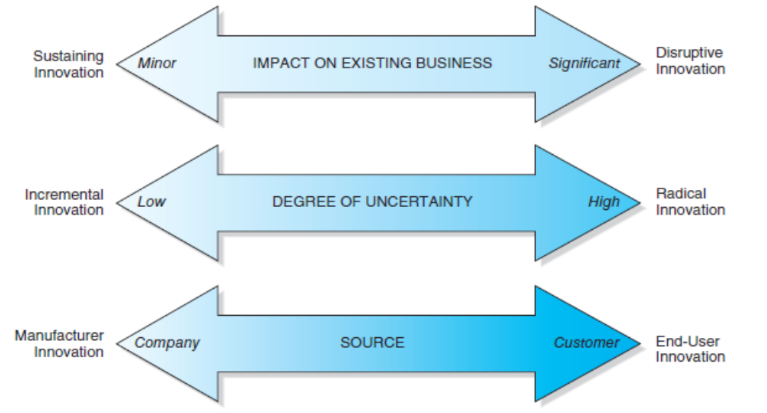
Major Forms of Innovation

Slide 31
Targets of Innovation
Product innovation – introducing goods that are new or substantially improved
Service innovation – introducing services that are new or substantially improved
Process innovation – creating new or significantly improved production or delivery methods
Marketing innovation – coming up with new and/or improved marketing methods
Supply chain innovation – developing quicker and more accurate ways to get products from suppliers into the hands of customers
Business model innovation - revising how business is done
Organizational innovation – changing key organizational practices

Slide 32
The Process of Innovation
Stage 1: Setting the agenda
  Creating a mission statement - provides overall direction and general goals
Stage 2: Setting the stage
  Using skills for innovation management
  Full use of human and financial resources
Stage 3: Producing the ideas
  Individual and small group creativity
  Coming up with new ideas and testing them
Stage 4: Testing and implementing the ideas
  Other parts of the organization get involved
Stage 5: Outcome assessment
  Assessing the new idea

Slide 33
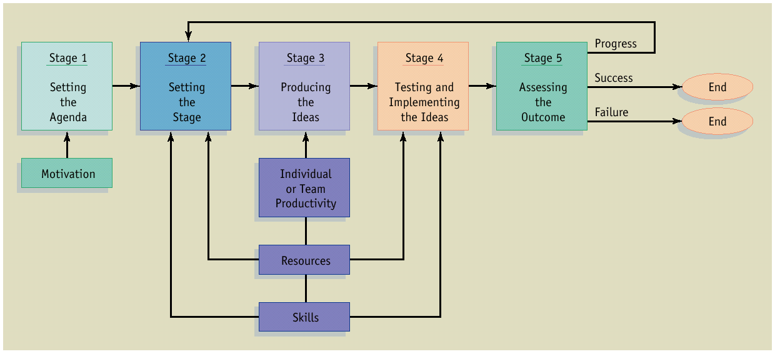
The Process of Innovation

Slide 34
Overview
Prerequisites
Performance Planning
Performance Execution
Performance Assessment
Performance Review
Performance Renewal and Recontracting

Slide 35
Prerequisites
Performance Planning
Performance Execution
Performance Management Process
Performance Renewal and Recontracting
Performance Assessment
Performance Review

Slide 36
Prerequisites
Knowledge of the organization’s mission and strategic goals
Knowledge of the job in question

Slide 37
Knowledge of Mission and Strategic Goals
Strategic planning
  Purpose or reason for the organization’s existence
  Where the organization is going
  Organizational goals
  Strategies for attaining goals

Slide 38
Mission and Goals
Cascade effect throughout organization
  Organization →Unit →Employee

Slide 39
Knowledge of the Job
Job analysis of key components
  Activities
  Tasks
  Products
  Services
  Processes

Slide 40
Knowledge of the Job (Continued)
KSAs required to do the job
  Knowledge
  Skills
  Abilities

Slide 41
Job Description
Job duties
KSAs
Working conditions

Slide 42
Job Analysis
Use a variety of tools
  Interviews
  Observation
  Questionnaires (available on the Internet)

Slide 43
Job Analysis Follow-Up
All incumbents should
  Review information
  Provide feedback
  Rate tasks and KSAs in terms of
    Frequency
    Criticality

Slide 44
Rater Biases
Rating of frequency and criticality of tasks and KSAs is susceptible to:
  Self-serving bias
  Social projection bias
  False consensus bias
  → These biases exaggerate the importance of certain tasks & KSAs

Slide 45
Performance Planning:
Results
  Key accountabilities
  Specific objectives
  Performance standards

Slide 46
Key Accountabilities
    Broad areas of a job for which
    the employee is responsible
    for producing results

Slide 47
Specific Objectives
    Statements of outcomes
      Important
      Measurable

Slide 48
Performance Standards
“Yardstick” to evaluate how well employees have achieved each objective
Information on acceptable and unacceptable performance, such as
  Quality
  Quantity
  Cost
  Time

Slide 49
Performance Planning:
Behaviors
How a job is done

Slide 50
Performance Planning:
Competencies
Measurable clusters of KSAs
Critical in determining how results will be achieved

Slide 51
Performance Planning:
Development Plan
  Areas for improvement
  Goals to be achieved in each area of improvement

Slide 52
Performance Execution:
Employee’s Responsibilities
Commitment to goal achievement
Ongoing requests for feedback and coaching
Communication with supervisor
Collecting and sharing performance data
Preparing for performance reviews

Slide 53
Performance Execution:
Manager’s Responsibilities
Observation and documentation
Updates
Feedback
Resources
Reinforcement

Slide 54
Performance Assessment
Manager assessment
Self-assessment
Other sources (e.g., peers, customers)

Slide 55
Multiple Assessments Are Necessary To…
Increase employee ownership
Increase commitment
Provide information
Ensure mutual understanding

Slide 56
Performance Review
Overview of Appraisal Meeting
Past
  Behaviors and results
Present
  Compensation to be received
Future
  New goals and development plans

Slide 57
Six Steps for Conducting
Productive Performance Reviews
Identify what the employee has done well and poorly
Solicit feedback
Discuss the implications of changing behaviors

Slide 58
Six Steps for Conducting
Productive Performance Reviews
Explain how skills used in past achievements can help overcome any performance problems
Agree on an action plan
Set a follow-up meeting and agree on behaviors, actions, and attitudes to be evaluated

Slide 59
Performance Renewal and
Recontracting
Identical to performance planning EXCEPT:
  Uses insights and information from previous phases
  Restarts the performance management cycle

Slide 60
Performance Management Process
Summary: Key Points
Ongoing process
Each component is important
  If one is implemented poorly, the whole system suffers
Links between components must be clear

Slide 61
Quick Review
Prerequisites
Performance Planning
Performance Execution
Performance Assessment
Performance Review
Performance Renewal and Recontracting

