Slide 1
COURSE ROUND-UP
Zeenat Jabbar

Slide 2
LECTURE 1
Course Introduction

Slide 3
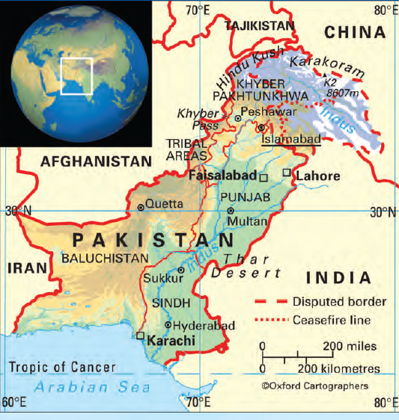

Slide 4
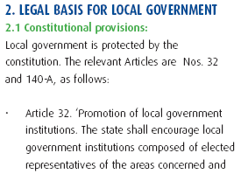
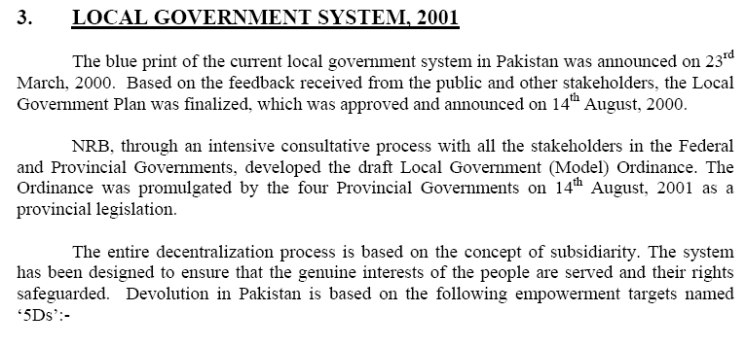

Slide 5
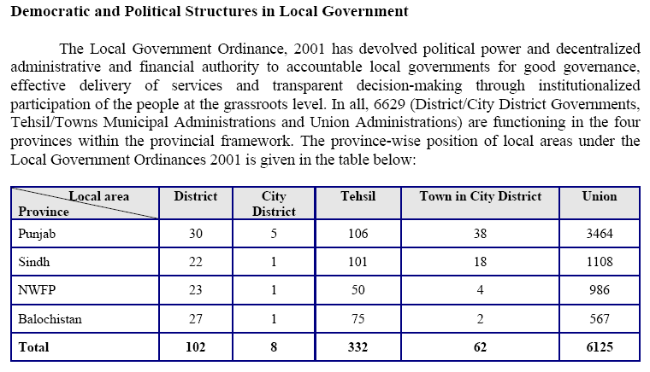

Slide 6
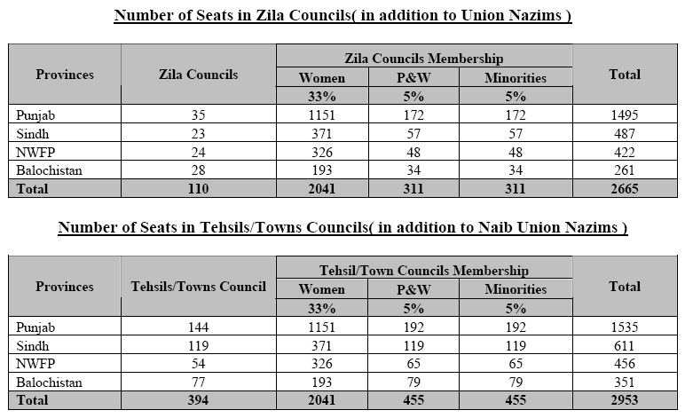

Slide 7
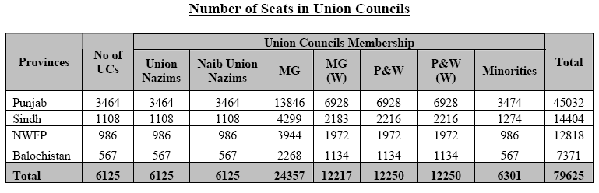

Slide 8
LECTURE 2
Local Governance:
Perceptions and Preferences

Slide 9
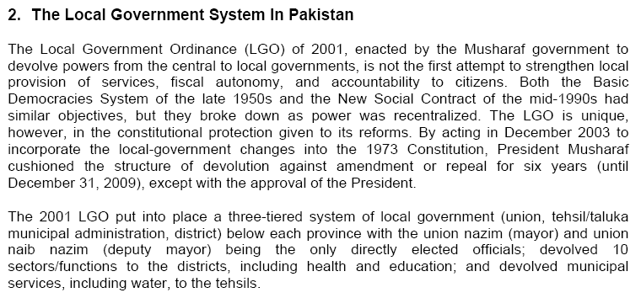

Slide 10
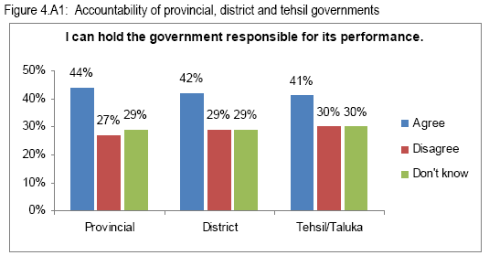

Slide 11
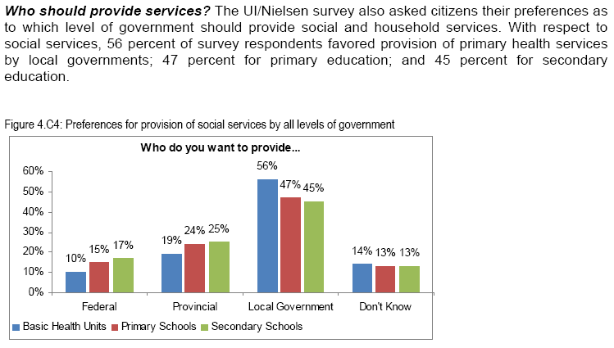

Slide 12
LECTURE 3
Local Governance:
Covenants

Slide 13
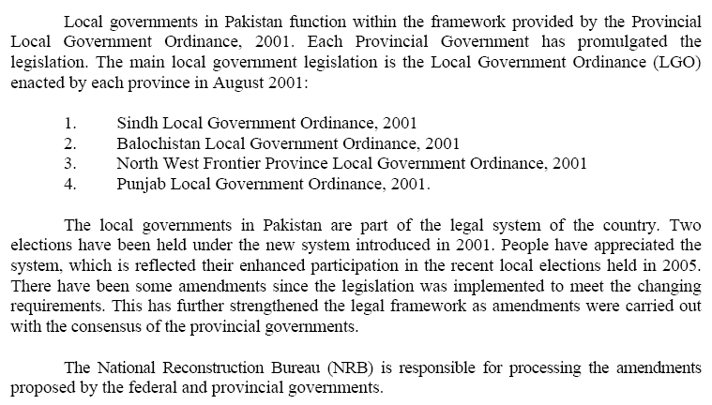

Slide 14
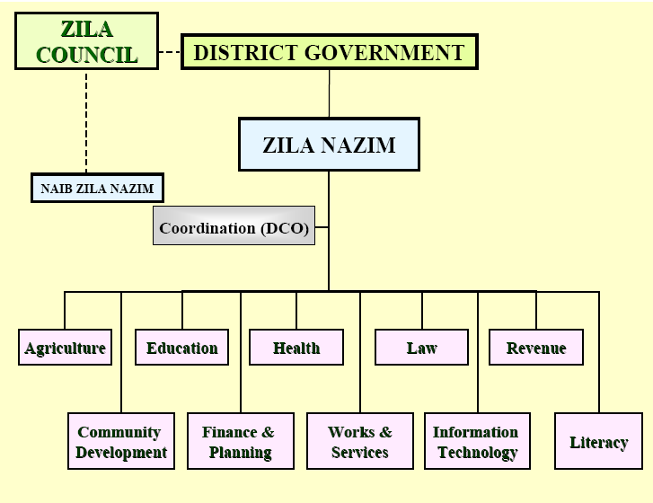

Slide 15
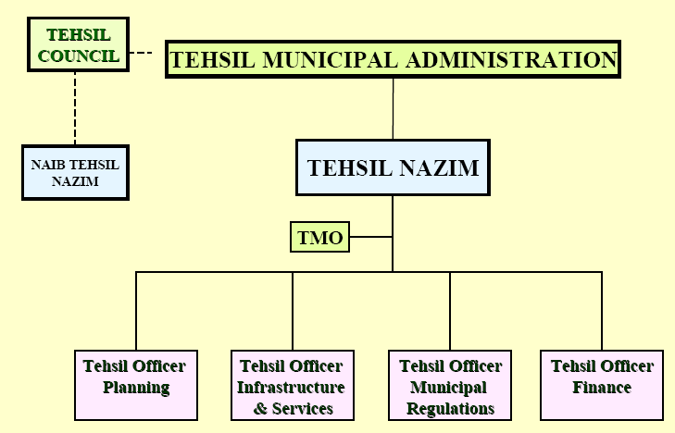

Slide 16
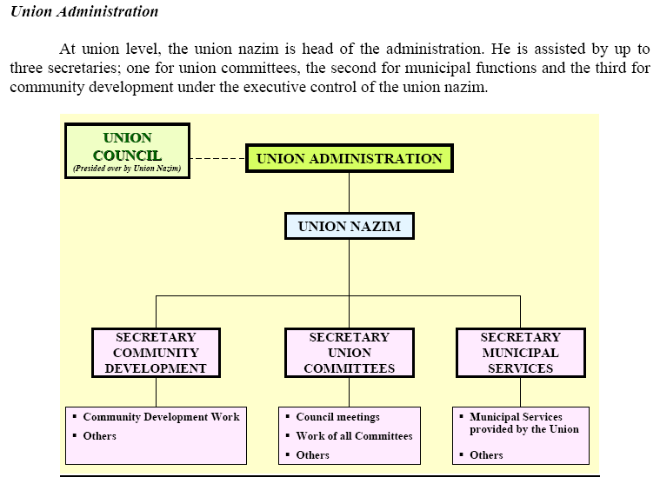

Slide 17
LECTURE 4
Local Government Finance in Pakistan

Slide 18
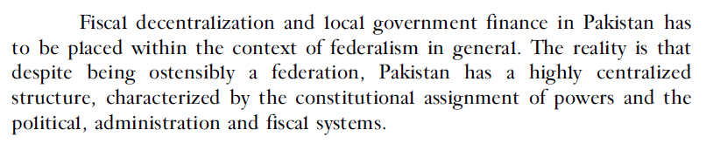

Slide 19
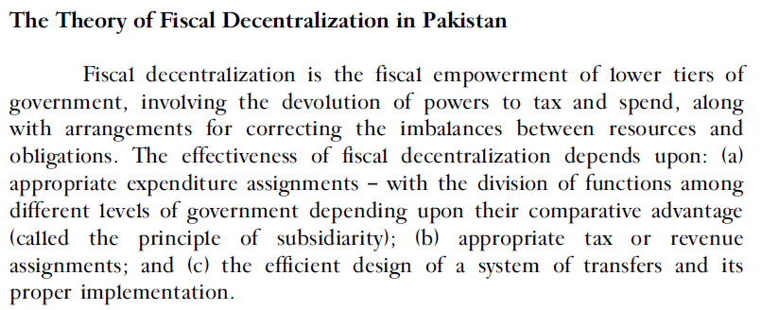

Slide 20
LECTURE 5
Local Government Taxation

Slide 21
LECTURE 6
The Political Economy

Slide 22
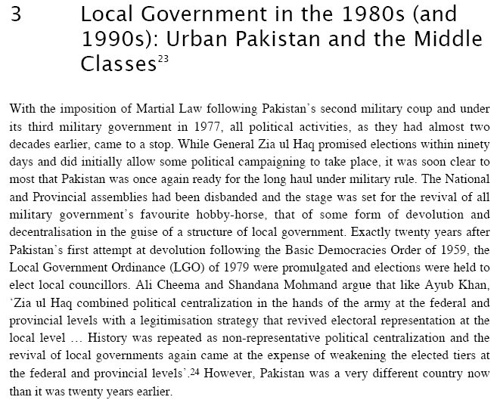

Slide 23
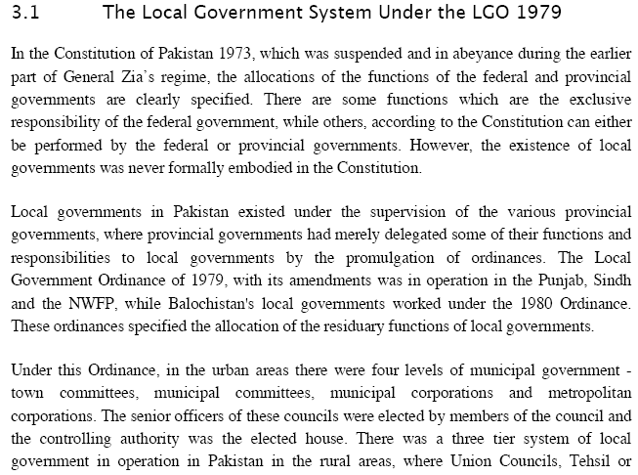

Slide 24
LECTURE 7
Women’s Representation & its Impact

Slide 25
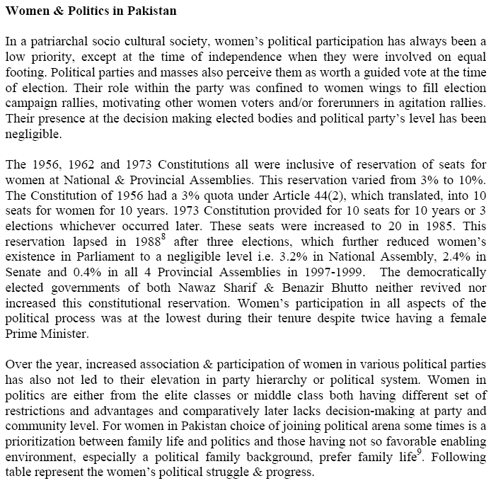

Slide 26
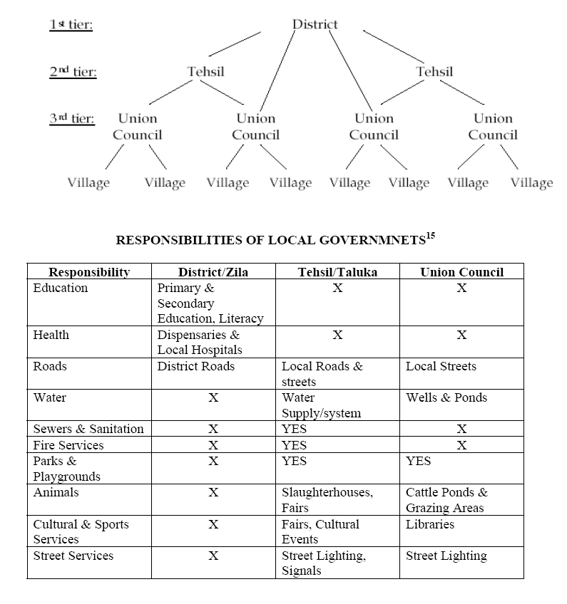

Slide 27
LECTURE 8
Values & Perspectives

Slide 28
DEFINE organizational culture and IDENTIFY its core characteristics
DESCRIBE the major types of organizational culture identified in the competing values framework
IDENTIFY the factors responsible for creating organizational culture, for transmitting it, and for getting it to change
DEFINE creativity and DESCRIBE the basic components of individual and team creativity
DESCRIBE various approaches to promoting creativity in organizations
IDENTIFY the basic components of general innovation, its various forms, and the stages of the innovation process

Slide 29
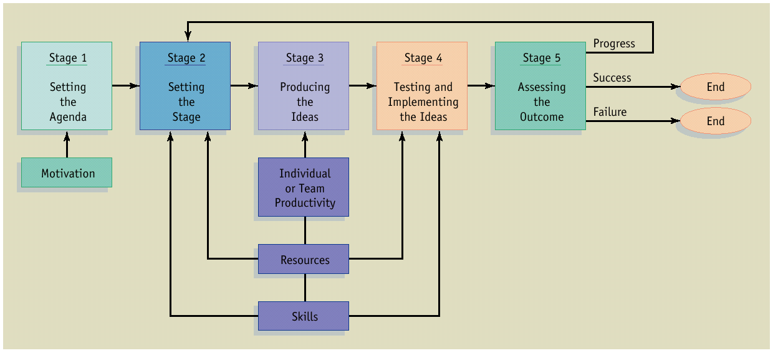
The Process of Innovation

Slide 30
LECTURE 9
Strategic Human Capital

Slide 31
Prerequisites
Performance Planning
Performance Execution
Performance Management Process
Performance Renewal and Recontracting
Performance Assessment
Performance Review

Slide 32
LECTURE 10
Motivation

Slide 33
DISTINGUISH between emotions and moods
EXPLAIN how emotions and moods influence behavior in organizations
DESCRIBE ways in which people manage their emotions in organizations
IDENTIFY the major causes of organizational stress
DESCRIBE the adverse effects of organizational stress
IDENTIFY various ways of reducing stress in the workplace

Slide 34
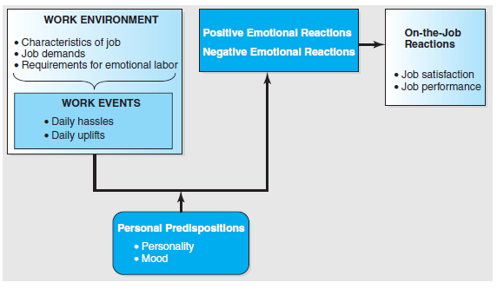
Affective Events Theory

Slide 35
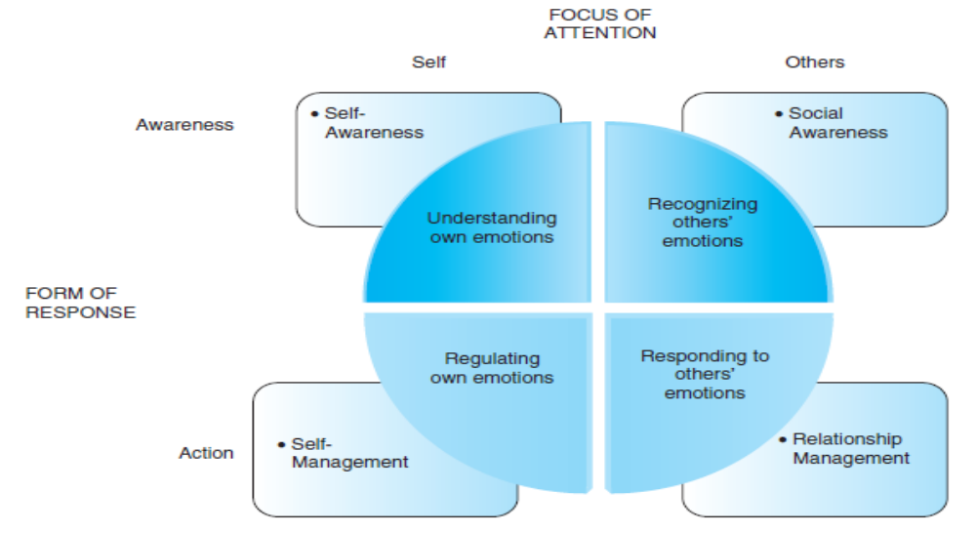
Emotional Intelligence

Slide 36
LECTURE 11:
Performance Management, Appraisals, and Careers

Slide 37
When you finish studying this chapter, you should be able to:
Explain the purpose of performance appraisal.
Answer the question, “Who should do the appraising?”
Discuss the pros and cons of at least eight performance appraisal methods.

Slide 38
Explain the purpose of performance appraisal.
Answer the question, Who should do the appraising?
Discuss the pros and cons of at least eight performance appraisal methods.

Slide 39
LECTURE 12
Workforce Planning

Slide 40
When you finish studying this chapter, you should be able to:
Explain each of the steps in the ADDIE training process.
Discuss at least two techniques used for assessing training needs.

Slide 41
Explain the pros and cons of at least five training techniques.
Explain what management development is and why it is important.
Describe the main management development techniques.

Slide 42
LECTURE 13:
Public Sector Issues

Slide 43
DEFINE what is meant by a group and IDENTIFY different types of groups operating within organizations
DESCRIBE the importance of norms, status, and cohesiveness within organizations
EXPLAIN how individual performance in groups is affected by the presence of others (social facilitation) and the number of others with whom one is working (social loafing)
DEFINE what teams are and DESCRIBE the various types of teams that exist in organizations
DESCRIBE the evidence regarding the effectiveness of teams in organizations
EXPLAIN why some teams fail to operate as effectively as possible and DESCRIBE steps that can be taken to build successful teams

Slide 44
LECTURE 14:
Benefits and Compensation

Slide 45
When you finish studying this chapter, you should be able to:
Discuss four basic factors determining pay rates.
Explain each of the steps in establishing market-competitive pay rates.
Compare and contrast piecework and team or group incentive plans.
List and describe each of the basic benefits most employers might be expected to offer.

Slide 46
LECTURE 15:
Designing and Managing
Service Processes

Slide 47
Flowcharting Customer Service Processes
Blueprinting Services to Create Valued Experiences and Productive Operations
Service Process Redesign
The Customer as Co-Producer
Self-Service Technologies

Slide 48
LECTURE 16:
Crafting the Service
Environment

Slide 49
What is the Purpose of Service Environments?
Understanding Consumer Responses to Service Environments
Dimensions of the Service Environment
Putting It All Together

Slide 50
LECTURE 17:
Managing People for
Service Advantage

Slide 51
Service Employees Are Crucially Important
Factors Contributing to the Difficulty of Frontline Work
Cycles of Failure, Mediocrity, and Success
Human Resources Management – How To Get It Right?
Service Leadership and Culture

Slide 52
LECTURE 18:
Managing Customer
Relationships &
Building Loyalty

Slide 53
The Search for Customer Loyalty
Understanding the Customer-Firm Relationship
The Wheel of Loyalty
Building a Foundation for Loyalty
Strategies for Building Loyalty Bonds with Customers and Reducing Customers' Defections
CRM: Customer Relationship Management

Slide 54
LECTURE 19:
Complaint Handling
and Service Recovery

Slide 55
Customer Complaining Behavior
Customer Responses to Effective Service Recovery
Principles of Effective Service Recovery Systems
Service Guarantees
Discouraging Abusive and Opportunistic Customer Behavior

Slide 56
LECTURE 20:
Striving for
Service Leadership

Slide 57
The Service-Profit Chain
Integrating Marketing, Operations, and Human Resources
Creating a Leading Service Organization
In Search of Human Leadership

Slide 58
LECTURE 21:
Improving Service
Quality and
Productivity

Slide 59
Integrating Service Quality and Productivity Strategies
What is Service Quality?
The Gaps Model
Measuring and improving service quality
Learning from Customer Feedback
Hard Measures of Service Quality
Tools to Analyze and Address Service Quality Problems
Defining and Measuring Quality
Improving Service Productivity

Slide 60
LECTURE 22:
CORPORATE GOVERNANCE

Slide 61
What Is Good Corporate Governance?
Obligation to society at large
National Interest
Political Non-alignment
Legal Compliances
Rule of Law
Honest and Ethical Conduct
Corporate Citizenship
Ethical Behaviour
Social Concerns
Corporate Social Responsibility

Slide 62
LECTURE 23:
CORPORATE CITIZENSHIP
VIS-A-VIS
CORPORATE SOCIAL RESPONSIBILITY

Slide 63
Introduction
Definitions of Corporate Social Responsibility (CSR)
Justification of CSR
The Scope of Social Responsibility

Slide 64
LECTURE 24:
The Securities and Exchange Commission

Slide 65
The Securities Acts
Organizational structure of the SEC
Need for the Acts and the SEC
SEC problem areas
International perspective

Slide 66
LECTURE 25:
New Governance Rules

Slide 67
Communication Strategy
Always involves five basic considerations:
  Communicator: who should send this message?
  Audience: who should receive this message?
  Message: what should we say?
  Channel Choice: how should we send this message?
  Cultural Context: what cultural factors will affect this attempt at communication?

Slide 68
Cultural Strategy
Not all cultures react to senders, messages, or channels in the same way. It’s best to consider your audience’s probable reaction from a cultural point of view.
  Time
  Power Distance
  Communication Style
  Non-verbal Mannerisms
  Language

Slide 69
LECTURE 26:
Management Communications and Intercultural Contexts

Slide 70
Cross-Cultural
Communication Skills
The capacity to accept the relativity of one’s own knowledge and perceptions
The capacity to be non-judgmental
A tolerance for ambiguity
The capacity to communicate respect for other people’s ways, their country, and their values

Slide 71
Cross-Cultural
Communication Skills
The capacity to display empathy
The capacity to be flexible
The capacity for turn-taking
The humility to acknowledge what you do not know or understand

Slide 72
LECTURE 27:
Conflict Management

Slide 73
Sources of Conflict
in Organizations
Limited resources
Values, goals, and priorities
Poorly defined responsibilities
Change in the the environment, the marketplace, society, or the economy
Human drives for success, competition

Slide 74
LECTURE 28:
Business Meetings That Work

Slide 75
Three Principal Types of Business Meetings:
Informational Meetings
Problem-Solving Meetings
Suggested-Solution Meetings

Slide 76
LECTURE 29:
DEALING WITH MEDIA

Slide 77
Organization of the Media Function
Media planner
Media research
Media buyer

Slide 78
Convergence
Interactivity
Creativity
Engagement

Slide 79
LECTURE 30:
Strategic Planning

Slide 80
Definition and Purposes of Strategic Planning
Linking Performance Management to the Strategic Plan
  Strategic Planning
  Developing Strategic Plans at the Unit Level
  Job Descriptions
  Individual and Team Performance
Building Support

Slide 81
LECTURE 31:
Work Force and Work Groups

Slide 82
IDENTIFY the steps in the decision-making process
DESCRIBE the different varieties of decisions people make in organizations
EXPLAIN the major approaches to individual decision making
IDENTIFY various factors that contribute to imperfect decision making in organizations
DESCRIBE the conditions under which individuals make better decisions than groups and groups make better decisions than individuals
EXPLAIN how various techniques may be used to improve the quality of decisions made by groups

