Slide 1
Work Force and Work Groups
Zeenat Jabbar

Slide 2
Learning Objectives
IDENTIFY the steps in the decision-making process
DESCRIBE the different varieties of decisions people make in organizations
EXPLAIN the major approaches to individual decision making
IDENTIFY various factors that contribute to imperfect decision making in organizations
DESCRIBE the conditions under which individuals make better decisions than groups and groups make better decisions than individuals
EXPLAIN how various techniques may be used to improve the quality of decisions made by groups
10-2

Slide 3
Three Good Reasons Why You Should Care About . . . Decision Making
Functioning effectively in today’s business environment requires awareness of ways to improve the quality of decisions made in organizations.
Human decision making is inherently imperfect, although these imperfections can be overcome if you know what they are and how they operate.
Groups are widely used to make organizational decisions, although they frequently are not well-equipped to be making the kinds of decisions they are called upon to make.
10-3
Notes:
2

Slide 4
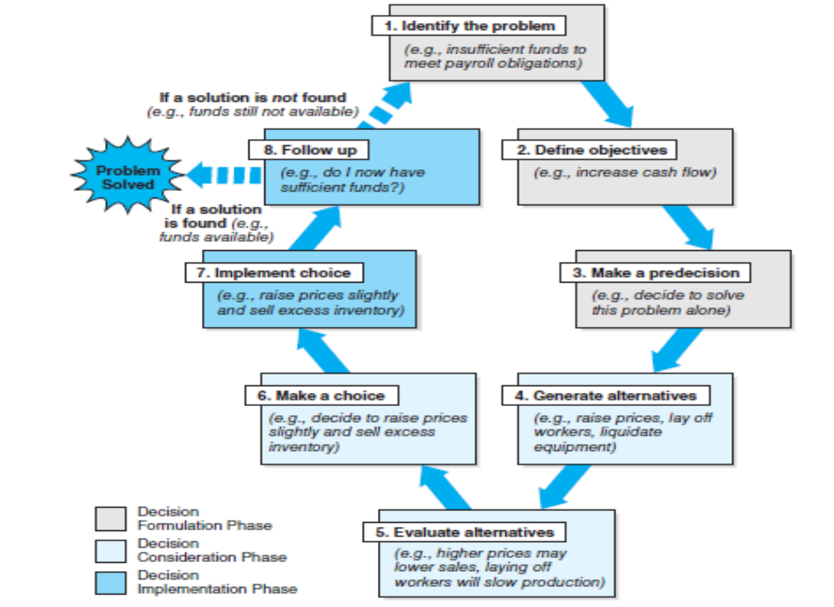
General, Analytical Model
10-4

Slide 5
General, Analytical Model
Decision formulation
  Identifying the problem
  Defining objectives
  Making a predecision – a decision about how to make a decision
    Decision support systems (DSS)
Decision consideration
  Generating alternatives
  Evaluating alternative solutions
  Making a choice
Decision implementation
  Implementing the decision
  Following up

Slide 6

Organizational Decisions
Programmed vs. Nonprogrammed
Certain vs. Uncertain
Top-down vs. Empowered
10-6

Slide 7
Programmed versus Nonprogrammed
Programmed decisions are routine decisions, made by lower-level personnel, that rely on predetermined courses of action.
Nonprogrammed decisions are decisions for which there are no ready-made solutions. The decision maker confronts a unique situation in which the solutions are novel.
  Strategic decisions are nonprogrammed decisions that have important long-term implications for the organization and are made by coalitions of high-level executives.
10-7
10-7

Slide 8
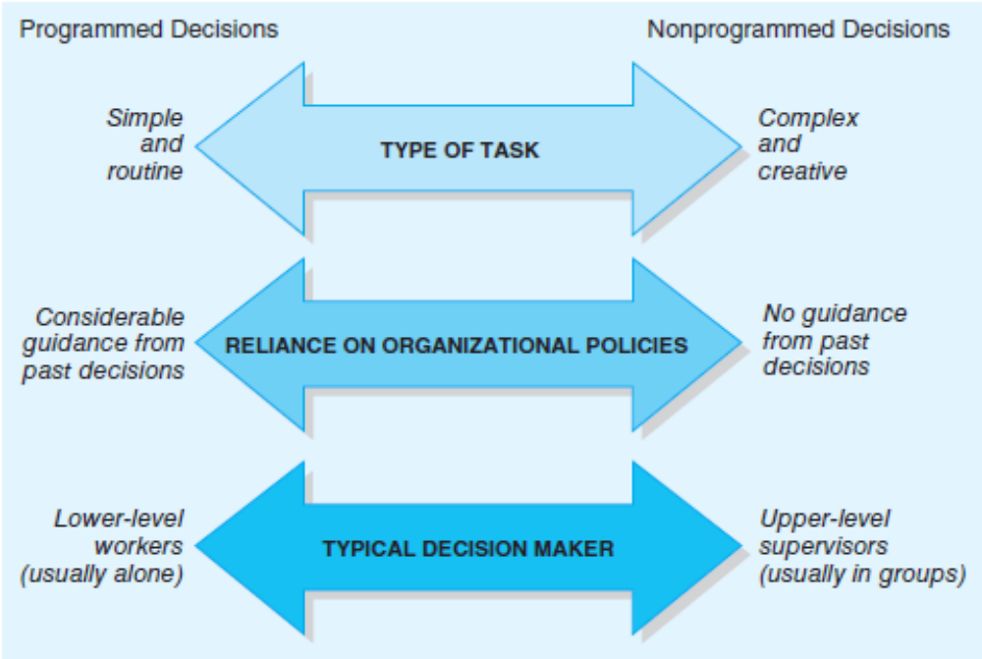
Programmed versus Nonprogrammed
10-8
10-8

Slide 9
Certain versus Uncertain
Consider:
  Risk
  Probability
  Subjective probability
  Information
10-9
10-9

Slide 10
Top-down versus Empowered
Top-down decision-making puts the power to make decisions in the hands of managers, leaving lower-level workers with little or no opportunity to make decisions.
Empowered decision-making allows employees to make the decisions required to do their jobs without seeking supervisory approval.
  More likely to lead to effective decisions
  Helps build commitment to decisions
10-10
10-10

Slide 11
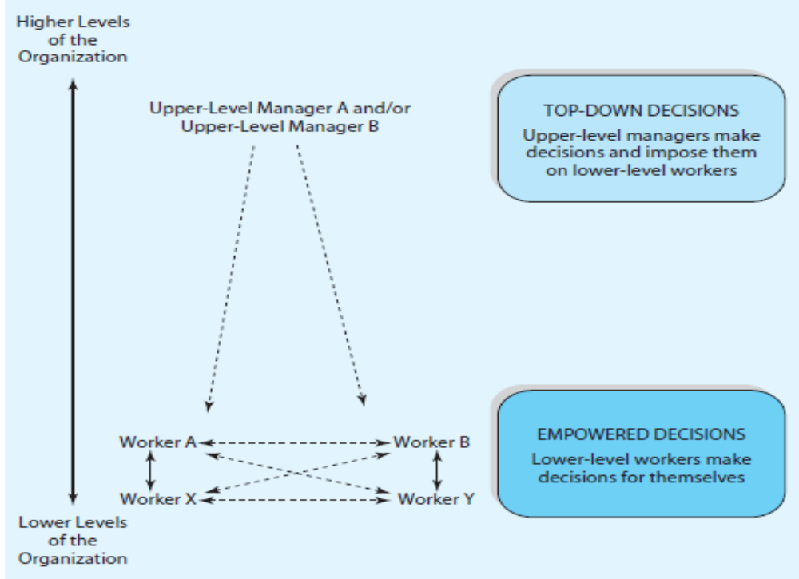
Top-down versus Empowered
10-11
10-11

Slide 12
Decision Making: Individual Differences
Decision style – the particular manner in which an individual approaches decisions
  Directive
  Analytical
  Behavioral
  Conceptual
Level of indecisiveness – the degree to which individuals approach decisions eagerly instead of putting them off.
10-12
10-12

Slide 13
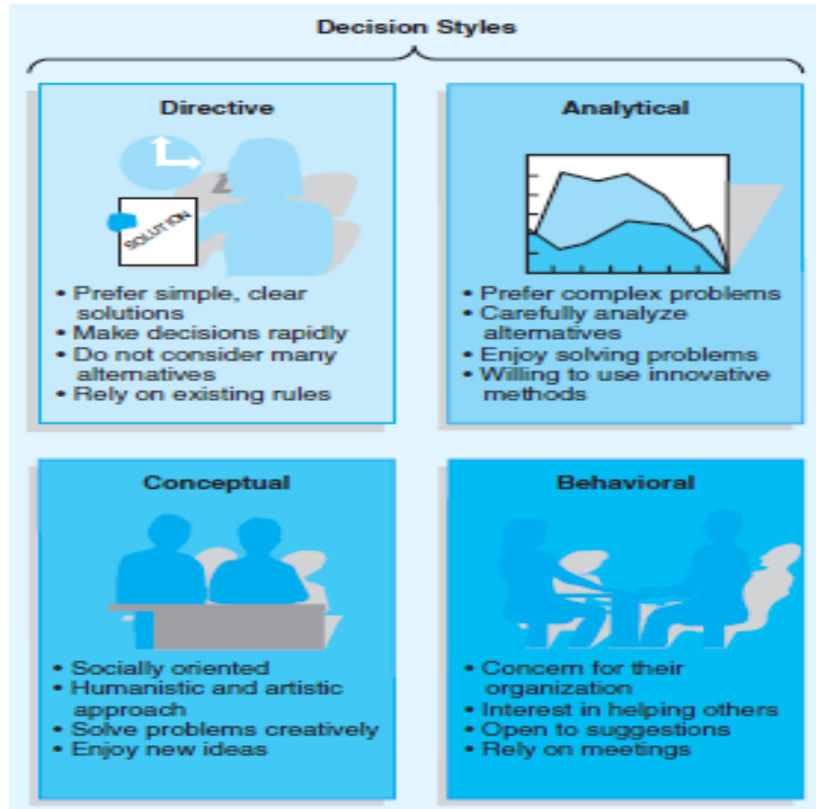
Decision Style Model
10-13
10-13

Slide 14
Group Influences: Trade-offs
Potential benefits of decision-making groups:
  Pooling of resources
  Specialization of labor
  Greater acceptance of decisions
Potential problems of decision-making groups:
  Wasting time
  Group conflict
  Intimidation by group leaders
Conclusion: neither groups nor individuals are always superior
10-14
10-14

Slide 15
Groupthink
When members of a group develop a very strong group spirit – high levels of cohesiveness – they sometimes become so concerned about not disrupting the like-mindedness of the group that they may be reluctant to challenge the group’s decisions.
  Result: group members tend to isolate themselves from outside information, and the process of critical thinking deteriorates.
10-15

Slide 16
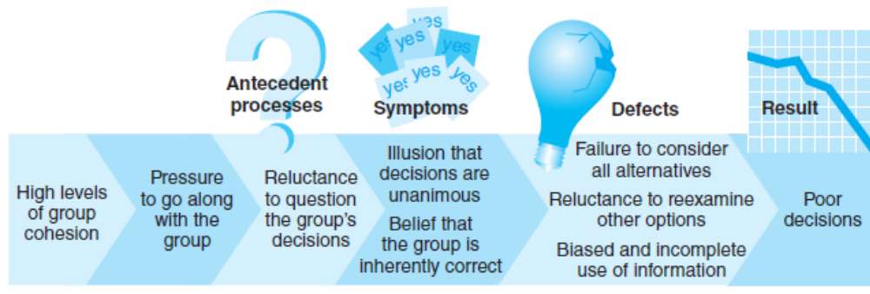
Groupthink: Too Much Cohesiveness
10-16
10-16

Slide 17
Organizational Influences
Characteristics of decisions:
  Decision makers face time constraints
  Decision makers are sensitive to political “face saving” pressure
10-17

Slide 18

Decision-Making Approaches
The Rational-Economic Model
The Administrative Model
Image Theory
10-18

Slide 19
The Rational-Economic Model
Rational decisions - decisions that maximize the attainment of individual, group, or organizational goals
Rational-economic model - the model of decision making according to which decision makers consider all possible alternatives to problems before selecting the optimal solution
10-19

Slide 20
The Administrative Model
Administrative model - model of decision making that recognizes that decision makers may have a limited view of the problems confronting them
  Descriptive approach
Decision makers consider solutions as they become available
  Satisficing - decisions made by selecting the first acceptable alternative as it becomes available
10-20

Slide 21
Imperfect Nature of Decisions
Bounded rationality - the idea that people lack the cognitive skills required to formulate and solve highly complex business problems in a completely objective, rational way
Bounded discretion – people limit their consideration of decision options to ones that fall within ethical or legal boundaries
10-21
10-21

Slide 22
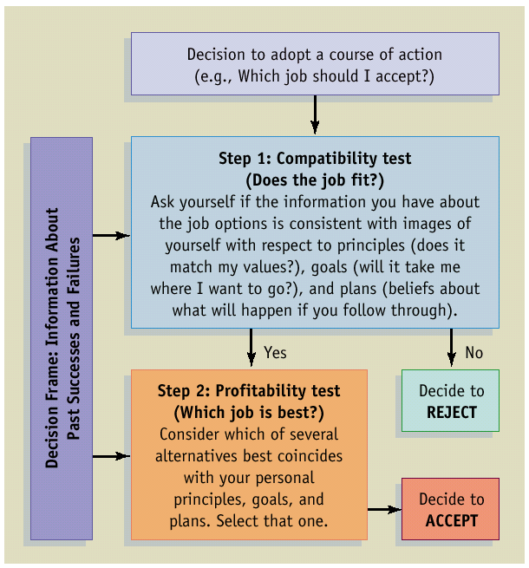
Image Theory
Image theory - a theory of decision making that recognizes that decisions are made in an automatic, intuitive fashion based on actions that best fit their personal standards, goals, and plans for the future.

Slide 23
Biases in Individual Decisions
Framing effects
Heuristics
Escalation of commitment
Person sensitivity
10-23

Slide 24

Framing Effects
Framing effects refers to the tendency for people to make different decisions based on how a problem is presented to them
  Risky choice framing effect - when problems are framed in a way that emphasizes the potential losses that could occur, people are more willing to take risks to avoid those loses
  Attribute framing effects - people evaluate the same characteristic more positively when it is described in positive terms then when it is described in negative terms
10-24

Slide 25
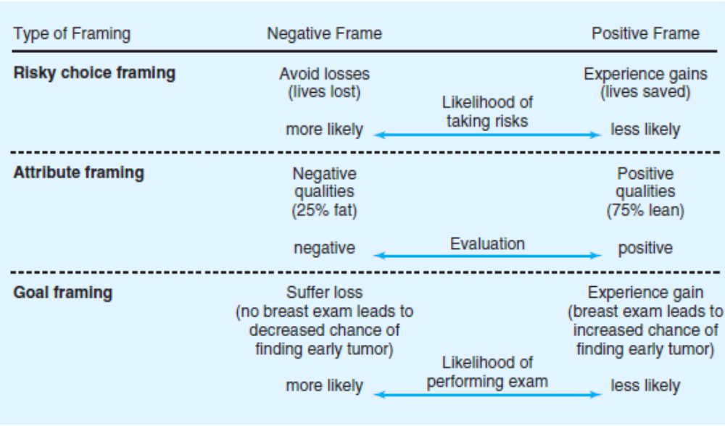
Framing

Slide 26
Heuristics
Heuristics are simple rules that are used to guide the decision maker through a complex array of decision alternatives
  Availability heuristic - the tendency for people to base their judgments on information that is readily available to them, although it may be inaccurate
  Representativeness heuristic - the tendency to perceive others in stereotypical ways if they appear to be typical representatives of the category to which they belong

Slide 27
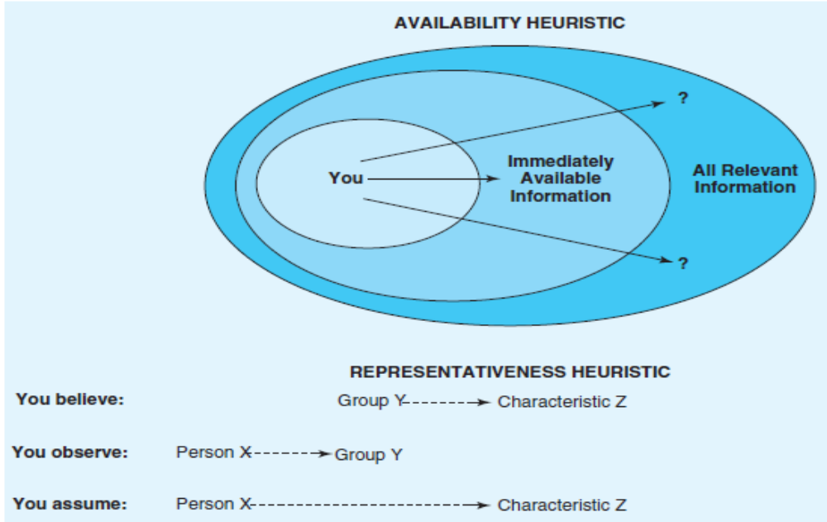
Heuristics

Slide 28
Biased Decision Making
People pick implicit favorites – preferred alternatives – early in the decision process.
People use other options to convince themselves that their choice was the right one – confirmation candidate.
Hindsight bias – the tendency for people to perceive outcomes as more inevitable after they have occurred
Person sensitivity bias – the tendency for people to blame others too much when things are going poorly and to give them too much credit when things are going well.
Escalation of commitment phenomenon – the tendency to continue to support previously unsuccessful courses of action because of sunk costs invested in them.

Slide 29
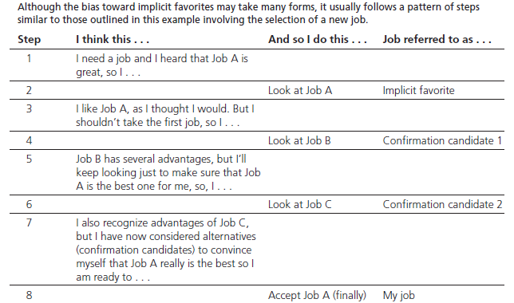
Bias Toward Implicit Favorites

Slide 30
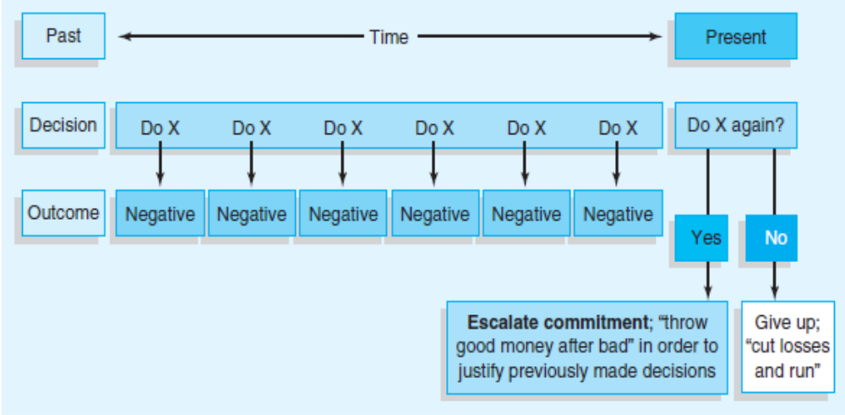
Escalation of Commitment

Slide 31
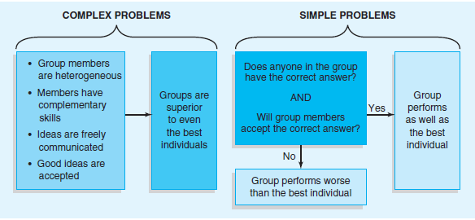
Group Decisions: Too Many Cooks?

Slide 32
Individuals vs. Groups
Improving the quality of group decisions:
  Brainstorming – group members are encouraged to present their ideas in an uncritical way and to discuss freely and openly all ideas presented by others
  Four rules:
    Avoid criticizing others’ ideas
    Share even far-out suggestions
    Offer as many comments as possible
    Build on others’ ideas to create your own

Slide 33
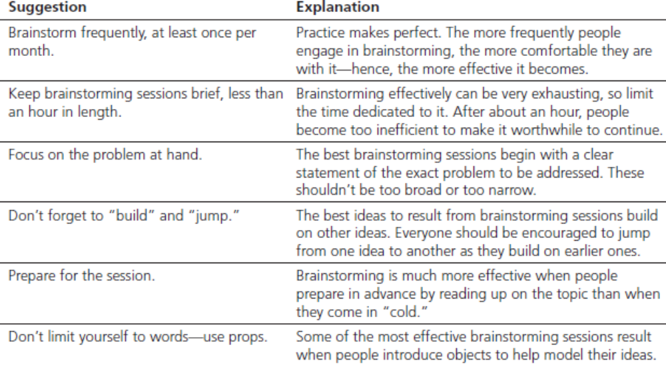
Tips for Successful Brainstorming

Slide 34
Training to Improve Group Performance
Hypervigilance – involves a frantic search for quick solutions to problems, going from one idea to the next in a sense of desperation looking for one that will work
Unconflicted adherence – sticking to the first idea that comes to mind, without considering alternatives
Unconflicted change – quickly changing course to adopt the first new idea to come along
Defensive avoidance – making an effort to actually avoid the problem at hand

Slide 35

Improving Group Decision Making
The Delphi Technique
The Nominal Group Technique

Slide 36
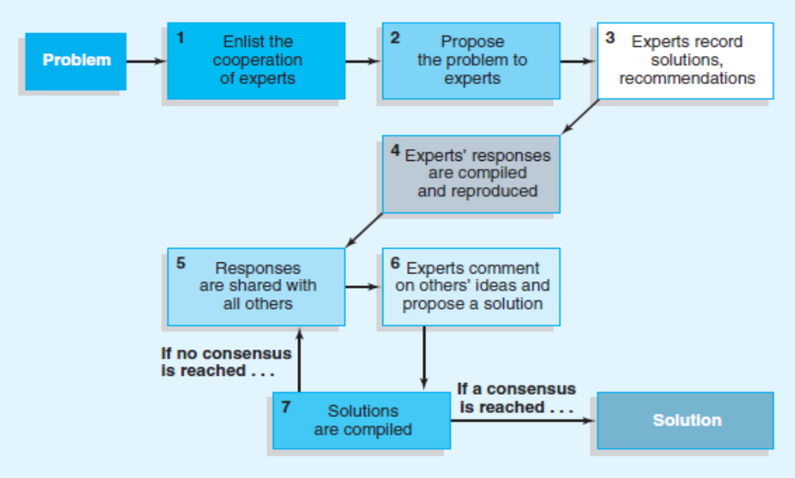
The Delphi Technique

Slide 37
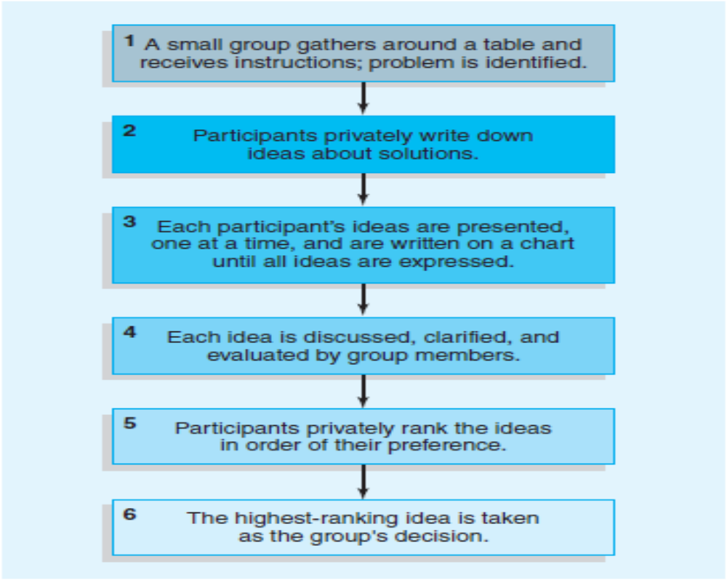
The Nominal Group Technique

