Slide 1
DEALING WITH MEDIA
Zeenat Jabbar

Slide 2
Overview
Why interviews/ advertisements are important
Should I or shouldn’t I?
A look at the media
Making it happen
Follow-up

Slide 3
Why Interviews Are Important
Chance to reach a large audience
Opportunity to tell your story:
  Inform
  Address public concerns
  Set the record straight
Reinforce credibility
Support policy

Slide 4
Should I Or Shouldn’t I?
No blanket rules.
Call Corporate Communication and ask for help.
Get background details before committing an interview.
Gut feelings are important.

Slide 5
A Look at the News Media
It’s a business.
Markets and sophistication.
They do make mistakes.
Few reporters are decision-makers.
Get to know local management.
Maintain a dialogue.

Slide 6
Developing a Strategy
Both your supervisor and your Public Affairs or Corporate Communication office should know of your interest in meeting and working with local news managers. You should go about cultivating a good working relationship with a strategy in mind. Your strategy should specify, in very clear terms, a number of issues . . .

Slide 7
Developing a Strategy
Goals you hope to achieve by working with local news professionals
General content of your message
Intended audience for your message
Visuals or photo opportunities you intend to offer

Slide 8
Developing a Strategy
Timing and sequence of events involved in your story
What makes this story different from others
What makes your story newsworthy
Media you plan to work with to tell your story

Slide 9
Getting Ready
Confirm your strategy with your supervisor and the corporate communication officer.
Research the reporter.
Refine your message and practice.
Confirm the details and ground rules.

Slide 10
Getting Ready
Read the morning paper and have a look at the early television news programs.
Remember: You really are the expert.
Help is only a phone call away. Carry a phone with you.

Slide 11
Making It Happen
Pocket card may help.
Arrive early, check out setting.
Appearance and make-up.

Slide 12
Making It Happen
Confirm the ground rules.
Get your points in early.
Think about the “Mother-in-Law Test.”

Slide 13
Making It Happen
Don’t become a spokesman for someone else.
Don’t use the media to speak with an audience you should contact directly.
Be yourself and stay in control.

Slide 14
Making It Happen
You don’t have to accept a reporter’s premise or use a reporter’s words.
Tell the truth.
Avoid arguments.

Slide 15
Making It Happen
Stay likeable.
You’re always on the record.
Use examples, illustrations, and brief anecdotes. Tell stories your audience can understand and identify with.

Slide 16
Follow-Up
Review the article or tape.
Inform the chain of command.
Provide feedback.
Consider follow-on opportunities.
Leave a record for your successor.

Slide 17
Organization of the Media Function
Media planner
Media research
Media buyer

Slide 18
EVERYDAY CAROM

Slide 19
Convergence
Interactivity
Creativity
Engagement

Slide 20
Major Components of a Media Plan
Marketing Analysis
Advertising Analysis
Media Strategy
Media Scheduling
Justification and Summary

Slide 21
TELENOR COMPLETE ADVERTISEMENT

Slide 22
The Marketing Analysis
Fundamental marketing strategy
  Sales
  Share of market
  Profitability goals
  Target market description
Product benefits and differentiating characteristics
Pricing strategy
Competitive environment

Slide 23
The Media Strategy
Media vehicles matched with target audience media preferences
Creative and communication considerations
  Need for product demonstration
  Need for complex message
  Daypart and/or seasonal requirements
  Media compatibility with message themes and competitive considerations

Slide 24
TELENOR TALKSHAWK

Slide 25
The Media Schedule
Print insertion dates and production requirements
Broadcast locations and availabilities
Budget allocation each medium and media vehicle
CPM estimates

Slide 26
Communication Considerations
Creative predispositions of the audience
Qualitative environment for the message
The synergistic effect
The creative approach

Slide 27
Media Tactics
Reach: the number of different people exposed to a single medium during the media schedule
Frequency: the number of times that each person in the audience is exposed to the media schedule
Continuity: the length of time a campaign will run
Budget: the monetary constraints placed on reach and frequency

Slide 28
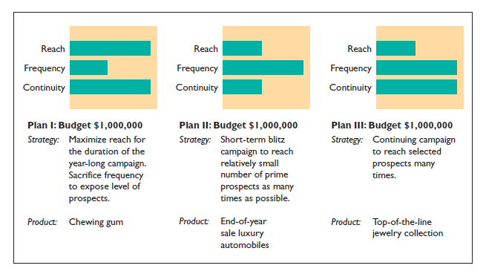
Reach, Frequency, and Continuity

Slide 29
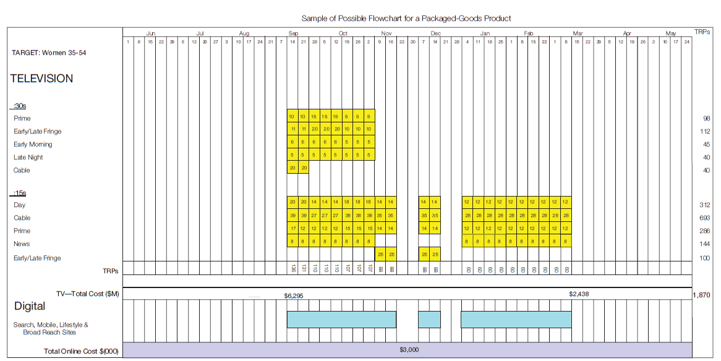
Media Flowchart Example

