Slide 1
Zeenat Jabbar
The Securities and Exchange Commission

Slide 2
Chapter Overview
The Securities Acts
Organizational structure of the SEC
Need for the Acts and the SEC
SEC problem areas
International perspective

Slide 3
The Securities Acts
The Securities Act of 1933
  Form S-1—the most common securities registration form.
The Securities Exchange Act of 1934
  10-Ks, 10-Qs, 8-Ks
  These reports can be filed using the EDGAR system.

Slide 4
The Securities Acts (Cont.)
The Trust Indenture Act of 1939
The Investment Company Act of 1940
The Investment Advisors Act of 1940
The Public Utility Holding Company Act of 1935
The Sarbanes-Oxley Act, otherwise known as the Public Company Accounting Reform and Investor Protection Act of 2002

Slide 5
The 2002 Act’s Effect on Accounting Oversight
SEC’s oversight over public accounting has dramatically expanded.
FASB still sets accounting standards known as GAAP.
However, the SEC’s PCAOB now oversees auditing and public accounting firms.
  The AICPA used to be the primary agency that governed external auditing and auditing standards.

Slide 6
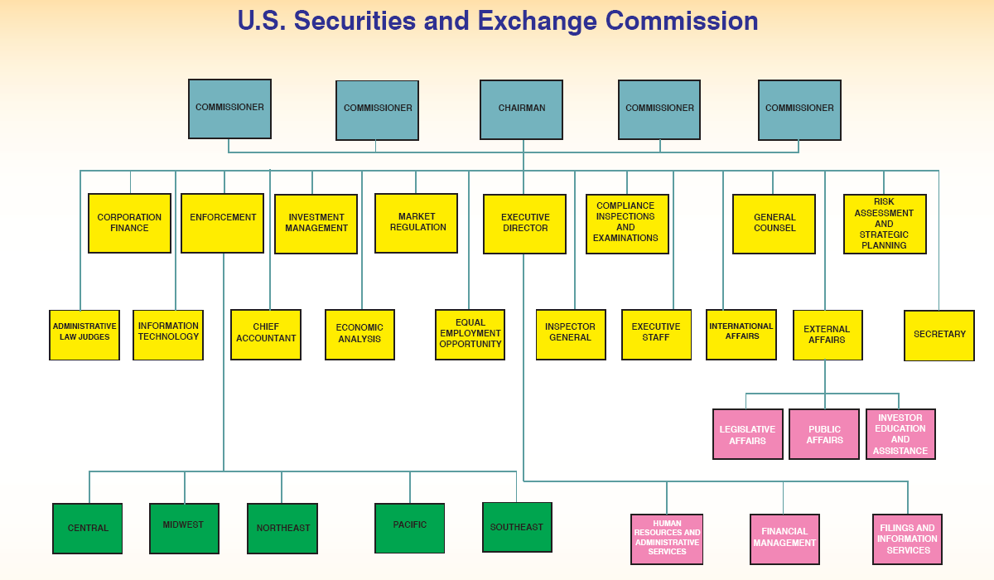

Slide 7

The 4 main divisions of the SEC:
  The Division of Corporate Finance
  The Division of Market Regulation
  The Division of Investment Management
  The Division of Enforcement

Slide 8

Need for the Acts and the SEC
Businesses and the securities industry are not always happy with SEC decisions.
The notion of market efficiency might make SEC oversight unnecessary.
It is still under debate whether or not the SEC makes securities markets better.

Slide 9
SEC Problem Areas
Reporting
  Is annual and quarterly reporting enough? And, is the information contained in them timely?
Two approaches that may improve reporting:
Require companies to submit their reports earlier. Right now, annual reports and quarterly reports can be filed 90 and 45 days after the fiscal-year end, respectively.
Force companies to reveal immediately any material information that investors will deem important.

Slide 10

SEC Problem Areas (Cont.)
Punishment
  The SEC cannot pursue criminal prosecution.
  The primary punishment tool employed by the SEC is to fine companies for wrongdoing. However, this means shareholders will end up suffering twice (they not only suffer from the wrongdoing, but the fines are usually paid by the company).

Slide 11
SEC Problem Areas (Cont.)
SEC Resources
  The SEC is underfunded, so it is hindered in its ability to hire and retain the best staff, and it is also understaffed.
  Due to understaffing, only about 1 out of 15 annual reports are carefully reviewed.

Slide 12

THE SEC AND LITIGATION
The SEC’s litigation usually results in 3 outcomes: financial penalties and fines, suspensions, and restructuring and reforms.
Penalties and Fines:
- SEC versus Martha Stewart & Peter Bacanovic
- SEC versus Adelphia
- SEC versus World Com
- SEC versus Enron
Restructuring and Reform:
- SEC versus CBOT

Slide 13

SEC vs. Martha Stewart
Date: June 4 ’03, the SEC filed charges against
Martha Stewart, chairman and CEO of Martha
Stewart Living, Omnimedia, Inc., and Peter
Bacanovic, a former Representative with Merrill
Lynch for insider trading.
Settlement:
- Stewart & Bacanovic ordered to disgorge of $45,673 (losses avoided by their sale of 3,928 Imclone stocks).
- Prevented Stewart from acting as a director, and limiting her activities as an officer, of a public corporation.

Slide 14

SEC versus Adelphia
Date: On July 24, 2002, the SEC filed charges
against Adelphia Communication Corp, its
founders John J. Rigas and his 3 sons, and 2
senior executives
Case:
• Accused of fraudulently excluding over $2.3billion in bank debt from its consolidated financial statements.
• Accused of falsifying operations statistics and profit earnings to meet Wall Street’s expectations.
• Accused of concealing rampant self-dealings, including undisclosed use of corporate funds.

Slide 15
International Perspective
A recent study finds that countries’ quality of public securities enforcement is unrelated to stock market development. In contrast, countries’ quality of disclosure is strongly related to their stock market development.
This study suggests that securities laws do mater but probably not as much as many of us would have thought.

Slide 16
Summary
The SEC is an important corporate monitor.
The SEC has encountered some problems in the performance of its duties.
A recent study suggests that securities laws do mater but probably not as much as many of us would have thought.

Slide 17
The Securities and Exchange Commission of Pakistan (SECP) was set up in pursuance of the Securities and Exchange Commission of Pakistan Act, 1997. This Act institutionalized certain policy decisions relating to the constitution and structure, powers, and functions of the SECP, thereby giving it administrative authority and financial independence in carrying out its regulatory and statutory responsibilities. The SECP became operational in January 1999 and has come a long way since then. It was initially concerned with the regulation of corporate sector and capital market. Over time, its mandate has expanded to include supervision and regulation of insurance companies, non-banking finance companies and private pensions. The SECP has also been entrusted with oversight of various external service providers to the corporate and financial sectors, including chartered accountants, credit rating agencies, corporate secretaries, brokers, surveyors etc. The challenge for the SECP has amplified manifold with its increased mandate.
Vision
The development of modern and efficient corporate sector and capital market, based on sound regulatory principles, that provide impetus for high economic growth and foster social harmony in the Country.
Mission
To develop a fair, efficient and transparent regulatory framework, based on international legal standards and best practices, for the protection of investors and mitigation of systemic risk aimed at fostering growth of a robust corporate sector and broad based capital market in Pakistan.
Strategy
To develop an efficient and dynamic regulatory body that fosters principles of good governance in the corporate sector, ensures proper risk management procedures in the capital market, and protects investors through responsive policy measures and effective enforcement practices.

Slide 18
20. Powers and functions of the Commission- (1) The Commission shall have all such powers as may be necessary to perform its duties and functions under this Act.
The Commission may, having regard to its functions and to exercise its powers efficiently, organize itself into divisions, wings or such other sub-divisions as it may consider expedient. The Commission may, from time to time, identify the matters requiring the Board to make policy decisions and may also make recommendations regarding policy to the Board for its consideration. The Commission shall be responsible for the performance of the following functions: regulating the issue of securities; regulating the business in Stock Exchanges and any other securities markets; supervising and monitoring the activities of any central depository and Stock Exchange clearing house; registering and regulating the working of stock brokers, sub-brokers, share transfer agents, bankers to an issue, trustees of trust deeds, registrars to an issue, underwriters, portfolio managers, investment advisers and such other intermediaries who may be associated with the securities markets in any manner;

Slide 19
proposing regulations for the registration and regulating the working of collective investment schemes, including unit trust schemes;
promoting and regulating self-regulatory organizations including securities industry and related organizations such as Stock Exchanges and associations of mutual funds, leasing companies and other NBFIs;
prohibiting fraudulent and unfair trade practices relating to securities markets;
promoting investors’ education and training of intermediaries of securities markets;
conducting investigations in respect of matters related to this Act and the Ordinance and in particular for the purpose of investigating insider trading in securities and prosecuting offenders;
regulating substantial acquisition of shares and the merger and take-over of companies;
calling for information from and undertaking inspections, conducting inquiries and audits of the Stock Exchanges and intermediaries and self-regulatory organizations in the securities market;
considering and suggesting reforms of the law relating to companies and bodies corporate, securities markets, including changes to the constitution, rules and regulations of companies and bodies corporate, Stock Exchanges or clearing houses;
encouraging the organized development of the capital market and the corporate sector in Pakistan;
conducting research in respect of any of the matters set out in this sub-section;
performing such functions and exercising such powers of the Authority, including any powers of the Federal Government delegated to the Authority, (other than the power to make any rules or regulations) under the provisions of the Ordinance, the Securities and Exchange Ordinance, 1969 (XVII of 1969), the Modaraba Companies and Modaraba (Floatation and Control) Ordinance, 1980 (XXXI of 1980) and under any other law for the time being in force under which any function or power has been conferred on the Authority including, but not limited to, the functions and powers set out in the Schedule to this Act;[Omitted][11]

Slide 20
The Team
Chairman
Policy Board
The Commission
Senior Management
Organogram
The Organization
Appellate Bench
Chairman Secretariat
Internal Audit Department
Information System and Technology Department
Market Development and Investor Education Department
Company Law Review Commission Wing
Litigation, Legislation and General Counsel Division
Support Services Division

Slide 21
Statute
Date | Title | Download
2012 | Stock Exchanges (Corporatisation, Demutualization and Integration) Act, 2012
2011 | Anti Money Laundering Act, 2010
2002 | Listed Companies (Substantial Acquisition of Voting Shares and Take-overs) Ordinance, 2002
2000 | Insurance Ordinance, 2000
1997 | Securities and Exchange Commission of Pakistan Act, 1997
1997 | Central Depositories Act, 1997
1984 | Companies Ordinance, 1984
1980 | Modaraba Companies and Modaraba (Floatation and Control) Ordinance, 1980
1974 | Companies (Appointment of Legal Advisers) Act, 1974
1969 | Securities and Exchange Ordinance, 1969

Slide 22
Rules
Date | Title | Download
08-03-13 | Public Sector Companies (Corporate Governance) Rules, 2013
22-02-11 | Securities (Leveraged Markets and Pledging) Rules, 2011
22-11-08 | Anti Money Laundering Rules, 2008
03-09-05 | Takaful Rules,2005
01-06-05 | Clearing Houses (Regulation and Registration) Rules, 2005
27-01-05 | Voluntary Pension System Rules, 2005
15-03-05 | Commodity Exchange and Futures Contract Rules, 2005
02-12-03 | Single Member Private Limited Companies Rules, 2003
25-07-03 | The SECP (Appellate Bench Procedure) Rules, 2003
01-04-2003 | NBFC (Establishment and Regulation) Rules, 2003 (Amended up to May 25, 2012): Amendments to NBFC Rules, 2003 (First Amendment, dated: 21-11-07) Amendments to NBFC Rules, 2003 (Second Amendment, dated: 21-04-10) Amendments to NBFC Rules, 2003(Third Amendment, dated: 25-05-12)

Slide 23
08-08-02 | Insurance Rules, 2002
05-03-09 | Amendments to the Insurance Rules 2002
12-12-02 | SEC (Insurance) Rules, 2002
18-12-09 | Amendments in the SEC (Insurance) Rules, 2002
25-06-08 | Amendments in SEC (Insurance) Rules, 2002.
27-06-01 | Balloters Transfer Agents and Underwriters Rules, 2001
10-05-01 | Brokers and Agents Registration Rules, 2001
10-05-01 | Public Companies (Employees Stock Option Scheme) Rules, 2001
26-04-01 | Stock Exchange Members (Inspection of Books and Record) Rules, 2001
09-03-01 | Members' Agents and Traders (Eligibility Standards) Rules, 2001
28-08-00 | Companies' Share Capital (Variation in Rights and Privileges) Rules, 2000
14-12-99 | Companies (Asset-Backed Securitization) Rules, 1999
14-12-99 | The Companies (Buy-Back of Shares) Rules, 1999
03-08-99 | The Companies (Rehabilitation of Sick Industrial Units) Rules, 1999
21-10-98 | The Companies (Audit of Cost Accounts) Rules, 1998
26-03-97 | The Companies (Court) Rules, 1997
07-10-96 | Central Depository Companies (Establishment and Regulation) Rules, 1996
02-02-96 | Companies (Issue of Capital) Rules, 1996

Slide 24
Laws and Policies
Statute Rules Regulations Guidelines Orders Directives Repealed and Lapsed Rules, Regulations and Statues Policies Circulars

