Slide 1

Improving Service
Quality and
Productivity
Zeenat Jabbar

Slide 2
Overview
Integrating Service Quality and Productivity Strategies
What is Service Quality?
The Gaps Model
Measuring and improving service quality
Learning from Customer Feedback
Hard Measures of Service Quality
Tools to Analyze and Address Service Quality Problems
Defining and Measuring Quality
Improving Service Productivity

Slide 3
Integrating Service Quality and Productivity Strategies

Slide 4
Integrating Service Quality and
Productivity Strategies
Quality and productivity create value for customers and companies
Quality focuses on the benefits created for customers; productivity addresses financial costs incurred by firm
Importance of productivity:
  Keep costs down to improve profits and/or reduce prices
  Enable firms to spend more on improving customer service and supplementary services
  Secure firm’s future through increased spending on R&D
  May impact service experience

Slide 5
What is Service Quality?

Slide 6
Different Perspectives of Service Quality
Quality = Excellence. Recognized only through experience
Manufacturing-based:
User-based:
Value-based:
Transcendent:
Quality is in conformance to the firm’s developed specifications
Quality lies in the eyes of the beholder
Quality is a trade-off between price and value

Slide 7
Dimensions of Service Quality
Tangibles
Reliability
Responsiveness
Appearance of physical elements
Dependable and accurate performance
Promptness; helpfulness
Assurance
Competence, courtesy, credibility, security
Empathy
Easy access, good communication, understanding of customer

Slide 8
The Gaps Model

Slide 9
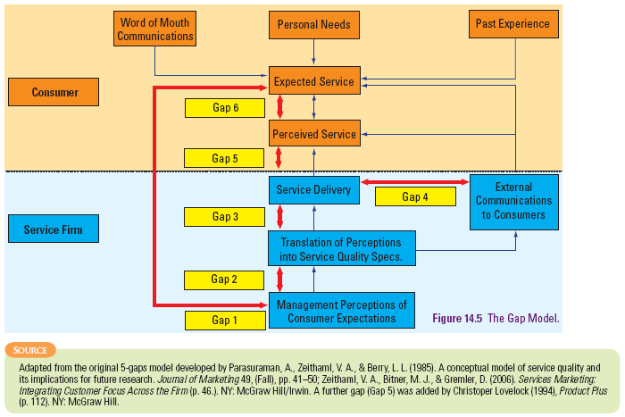
Six Service Quality Gaps

Slide 10
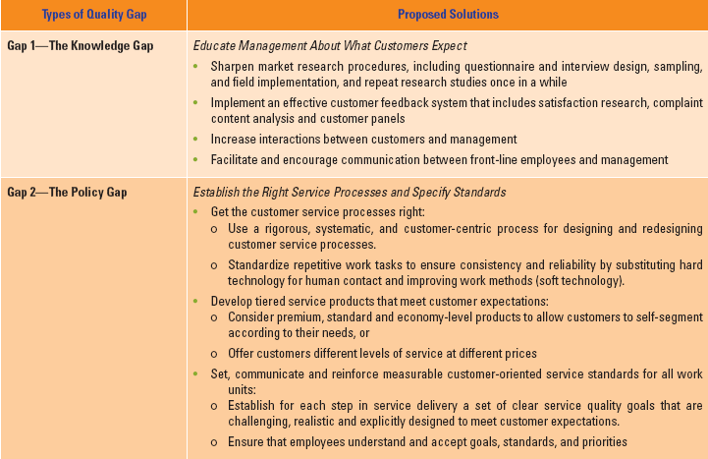
Suggestions for Closing the
Six Service Quality Gaps

Slide 11
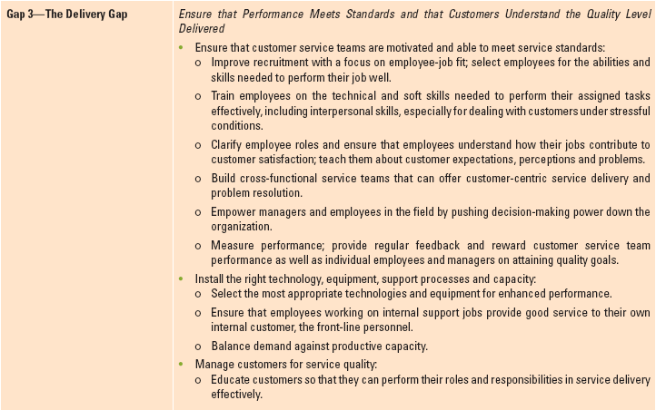
Suggestions for Closing the
Six Service Quality Gaps

Slide 12
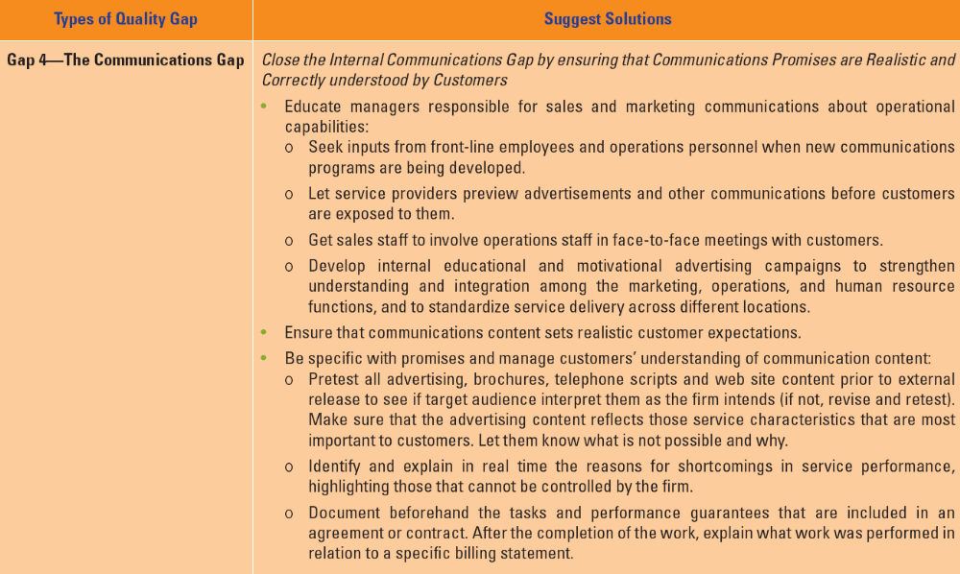
Suggestions for Closing the
Six Service Quality Gaps

Slide 13
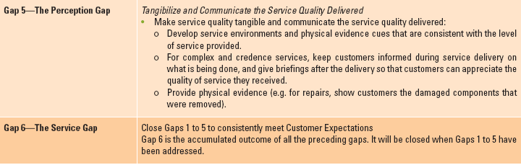
Suggestions for Closing the
Six Service Quality Gaps

Slide 14
Measuring and Improving Service Quality

Slide 15
Measures of Service Quality
Soft Measures
  Not easily observed, must be collected by talking to customers, employees or others
  Provide direction, guidance and feedback to employees on ways to achieve customer satisfaction
  Can be quantified by measuring customer perceptions and beliefs
  e.g., SERVQUAL, surveys, and customer advisory panel
Hard Measures
  Can be counted, timed, or measured through audits
  Typically operational processes or outcomes
  Standards often set with reference to percentage of occasions on which a particular measure is achieved

Slide 16
Learning from Customer Feedback

Slide 17
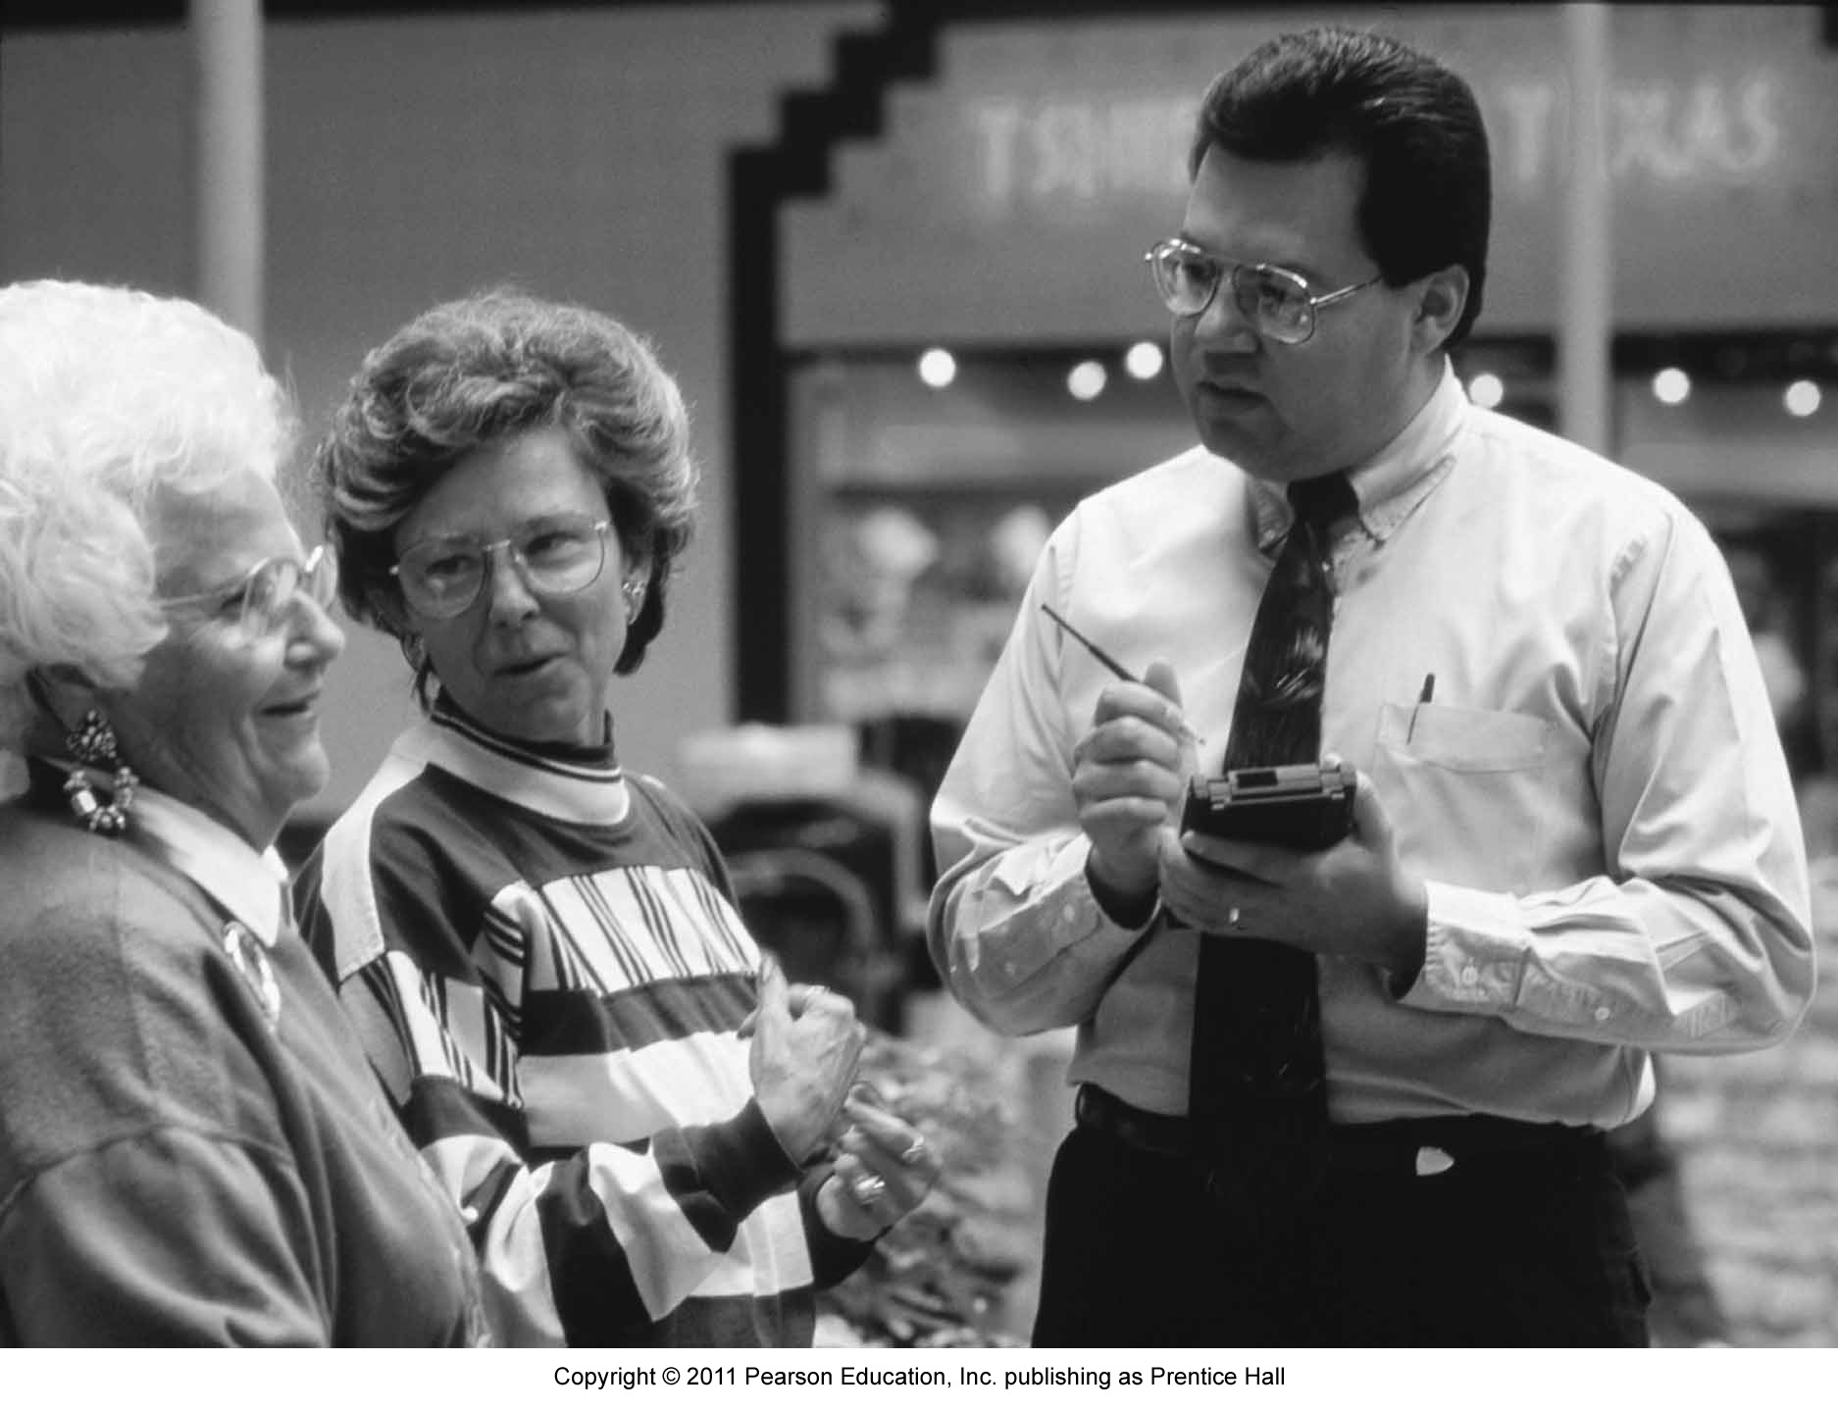
Key Objectives of
Customer Feedback Systems
Assessment and benchmarking of service quality and performance
Customer-driven learning and improvements
Creating a customer-oriented service culture

Slide 18
Customer Feedback Collection Tools
Total market surveys
Post-transaction surveys
Ongoing customer surveys
Customer advisory panels
Employee surveys/panels
Focus groups
Mystery shopping
Complaint analysis

Slide 19
Strengths and Weaknesses of Customer Feedback Collection Tools
LEVEL OF MEASUREMENT
POTENTIAL
FOR
SERVICE
RECOVERY
FIRST
HAND
LEARNING
COST
EFFECTIVENESS
COLLECTION TOOLS
FIRM
TRANSACTION SPECIFIC
REPRESENTATIVE/ RELIABLE
PROCESS
ACTIONABLE
Total Market Survey (Incl. Competitors)
Annual Survey on Overall Satisfaction
Transactional Survey
Service Feedback Cards
Mystery Shopping
Unsolicited Feedback (e.g., complaints)
Focus Group Discussions
Service Reviews

Slide 20
Analysis, Reporting, and Dissemination of Customer Feedback
Relevant feedback tools and collecting customer feedback should be channeled back to the relevant parties to take action
Three common types of performance reports:
  Monthly Service Performance Update
  Quarterly Service Performance Review
  Annual Service Performance Report

Slide 21
Hard Measures of
Service Quality

Slide 22
Hard Measures of Service Quality
Service quality indexes
  Embrace key activities that have an impact on customers
Control charts to monitor a single variable
  Offer a simple method of displaying performance over time against specific quality standards
  Enable easy identification of trends
  Are only good if data on which they are based are accurate
FedEx: One of the first service companies to understand the need for an index of service quality that embraced all the key activities that affect customers

Slide 23
Tools to Analyze and Address Service Quality Problems

Slide 24
Tools to Analyze and Address
Service Quality Problems
Fishbone diagram
  Cause-and-effect diagram to identify potential causes of problems
Pareto Chart
  Separating the trivial from the important. Often, a majority of problems are caused by a minority of causes (i.e., the 80/20 rule)
Blueprinting
  Visualization of service delivery, identifying points where failures are most likely to occur

Slide 25
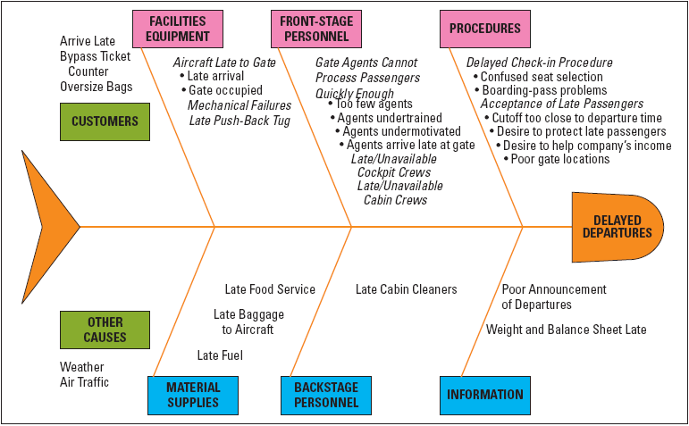
Cause-and-Effect Chart for
Flight Departure Delays

Slide 26
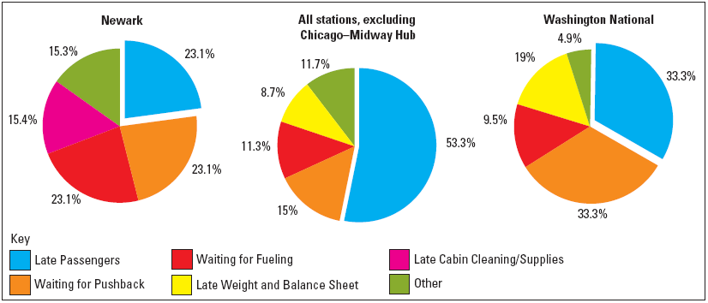
Analysis of Causes of Flight Departure Delays

Slide 27
Blueprinting
Depicts sequence of front-stage interactions experienced by customers plus supporting backstage activities
Used to identify potential fail points
  where failures are most likely to appear
Shows how failures at one point can have a ripple effect
Managers can identify points which need urgent attention
  Important first step in preventing service quality problems

Slide 28
Return On Quality (ROQ)
Assess costs and benefits of quality initiatives
  ROQ approach is based on four assumptions:
    - quality is an investment
    - quality efforts must be financially accountable
    - it’s possible to spend too much on quality
    - not all quality expenditures are equally valid
  Implication: Quality improvement efforts may benefit from being related to productivity improvement programs
  To determine feasibility of new quality improvement efforts, determine costs and then relate to anticipated customer response
Determine optimal level of reliability
  Diminishing returns set in as improvements require higher investments
  Know when improving service reliability becomes uneconomical

Slide 29
When Does Improving Service Reliability Become Uneconomical?
Satisfy Target Customers Through Service Recovery
100%
Optimal Point of Reliability: Cost of Failure = Service Recovery
Service Reliability
Satisfy Target Customers Through Service Delivery as Planned
A
B
C
D
Investment
Small Cost,
Large Improvement
Large Cost,
Small Improvement
Assumption: Customers are equally (or even more) satisfied with the service recovery than with a service that is delivered as planned.

Slide 30
Productivity in a Service Context
Productivity: amount of output produced relative to amount of inputs
  Improvement in productivity means an improvement in the ratio of outputs to inputs.
Intangible nature of service makes it hard to measure productivity of service firms, especially for information-based services
  Both input and output are hard to define
  Relatively simpler in possession-processing services, as compared to information- and people-processing services

Slide 31
Service Efficiency, Productivity, and Effectiveness
Efficiency: involves comparison to a standard, usually time-based (e.g., how long employee takes to perform specific task)
  Focus on inputs rather than outcomes and may ignore variations in service quality/value
Productivity: involves financial valuation of outputs to inputs
  Consistent delivery of outcomes desired by customers should command higher prices
Effectiveness: degree to which firm meets goals
  Cannot divorce productivity from quality and customer satisfaction

Slide 32
Improving Service Productivity

Slide 33
Generic Productivity
Improvement Strategies
Typical strategies to improve service productivity:
  Careful control of costs
  Efforts to reduce wasteful use of materials or labor
  Matching productive capacity to average demand levels
  Replacing workers by automated machines or self-service technologies
  Teaching employees how to work more productively
  Broadening variety of tasks that service worker can perform
  Installing expert systems that allow paraprofessionals to take on work previously performed by professionals
Although improving productivity can be approached incrementally, major gains often require redesigning entire processes

Slide 34
Customer-Driven Strategies to Improve Productivity
Change timing of customer demand
  By shifting demand away from peaks, managers can make better use of firm’s productive assets and provide better service
Involve customers more in production
  Get customers to self-serve
  Encourage customers to obtain information and buy from firm’s corporate websites
Ask customers to use third parties
  Delegate delivery of supplementary service elements to intermediary organizations

Slide 35
Implications of Backstage and Front-Stage Changes for Customers
Backstage changes may impact customers
  Keep track of proposed backstage changes, and prepare customers for them
    e.g., new printing peripherals may affect appearance of bank statements
Front-stage productivity enhancements are especially visible in high contact services
  Some improvements only require passive acceptance, while others require customers to change behavior
  Must consider impact on customers and address customer resistance to changes

Slide 36
A Note of Caution on Mere Cost Reduction Strategies
Without new technology, firms improve service productivity by eliminating waste and reducing labor costs
Multitasking can reduce productivity
Excessive pressure breeds discontent and frustration among customer contact personnel
It is often better to search for service process redesign opportunities that lead to quantum leaps in improvements in productivity and service quality at the same time

Slide 37
Summary
Service quality has five key dimensions: Tangibles, Reliability, Responsiveness, Competence, Courtesy
GAPS model can be used to diagnose and address service quality problems:
Customer feedback systems are used to:
  Assess and benchmark service quality and performance
  Institutionalize customer-driven learning and improvements
  Create a customer-oriented service culture
  Gap 1: The Knowledge Gap
  Gap 2: The Policy Gap
  Gap 3: The Delivery Gap
  Gap 4: The Communications Gap
  Gap 5: The Perceptions Gap
  Gap 6: The Service Quality Gap

Slide 38
Summary
Efficiency, productivity, and effectiveness need to be distinguished when measuring service quality
Customer-driven approaches to improving productivity include
  Changing timing of customer demand
  Involving customers more in production
  Asking customers to use third parties
  Use cost-reduction strategies with caution if they are not driven by new technology or process redesign - they may reduce service quality!

Slide 39
Appendix

Slide 40
SERVQUAL
Survey research instrument based on premise that customers evaluate firm’s service quality by comparing:
  their perceptions of service quality actually received with
  their prior expectations of companies in a particular industry
  Poor Quality: Perceived performance ratings < expectations
  Good Quality: Perceived performance ratings > expectations
Developed primarily in context of face-to-face service encounters
Scale contains 22 items reflecting five dimensions of service quality
Scale may have to be customized to the research context as recent research suggests that it is not generalizable

Slide 41
Tools to Analyze and Address
Service Quality Problems
Total Quality Management (TQM)
ISO 9000
  Comprises requirements, definitions, guidelines, and related standards to provide an independent assessment and certification of a firm’s quality management system
Malcolm Baldrige Model Applied to Services
  To promote best practices in quality management, and recognizing, and publicizing quality achievements among U.S. firms
  Many countries around the world have adapted the Malcolm Baldrige Model
Six Sigma & Lean Six Sigma
  Statistically, only 3.4 defects per million opportunities (1/294,000)
  Has evolved from defect-reduction approach to an overall business-improvement approach

